Slide 1

Better understanding of Contrails And Their Mitigation Options
Prof Christiane Voigt
DLR Institute of Atmospheric Physics
2023/12/13

Slide 2
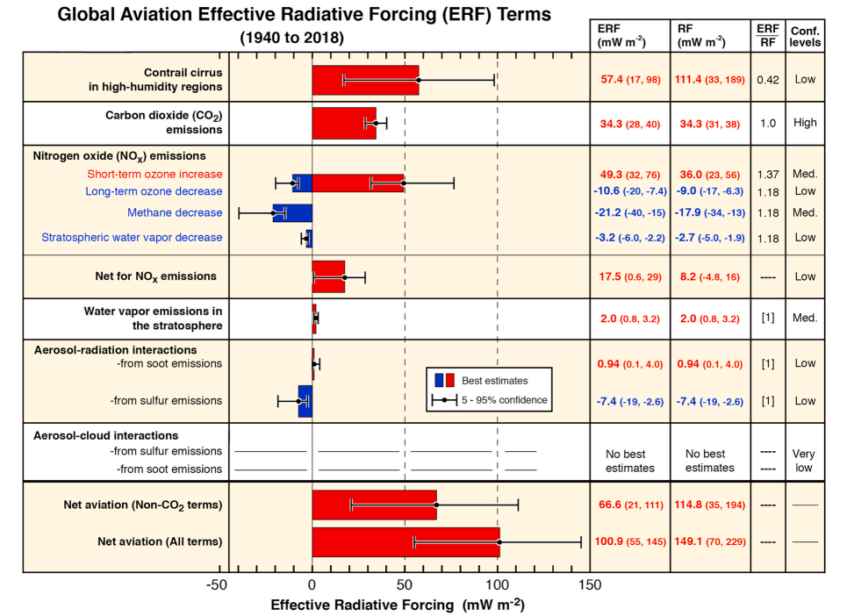
Climate impact from aviation (1940-2018)
Contrails
Carbon dioxide
CO₂
Nitrogen oxides
NO_{x}
Total aviation
Effective Radiative Forcing ERF (mW m⁻²)
Lee et al., Atm Env, 2021

Slide 3
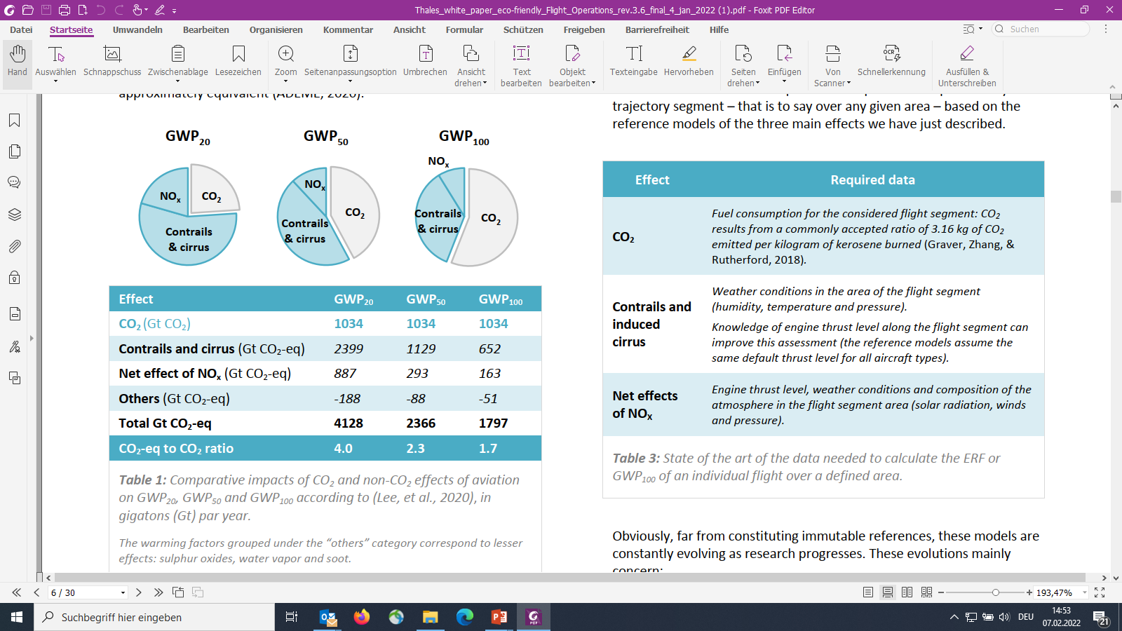
Global Warming Potential of Aviation
years years years
Lee et al., Atm Env, 2021

Slide 4
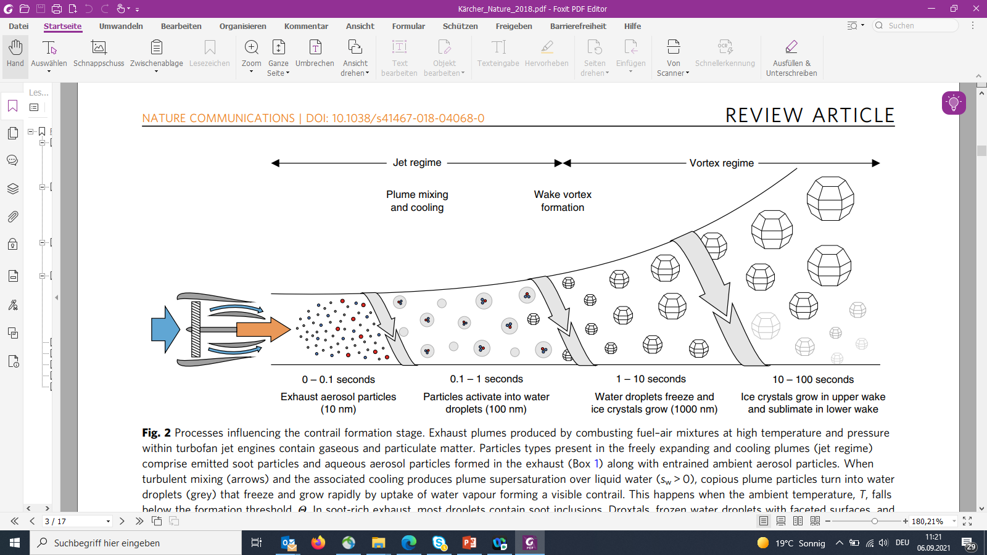
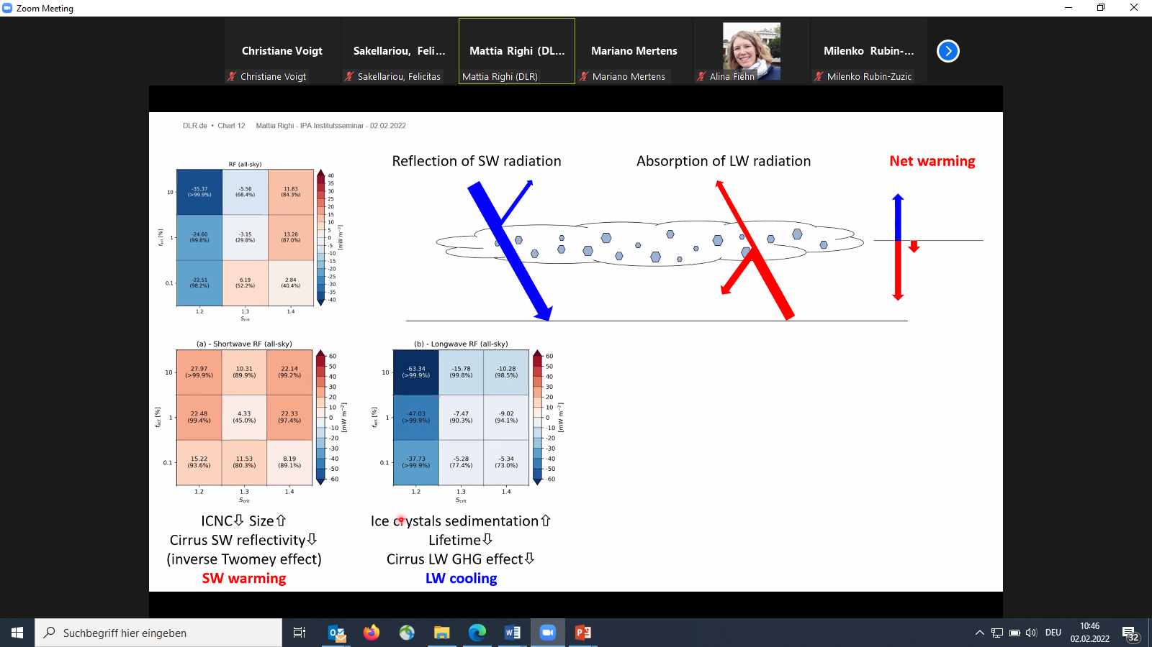
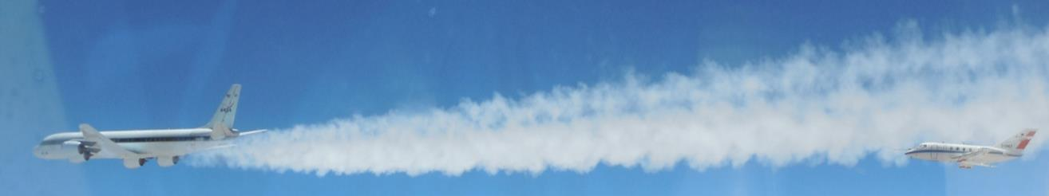
Formation of contrails and climate impact
Trapping of energy from terrestrial LW radiation (greenhouse effect)
Reflection of solar SW radiation
(cooling)
Net Global Mean
Warming contrails
Earth surface
Kärcher, Nature Com., 2018

Slide 5
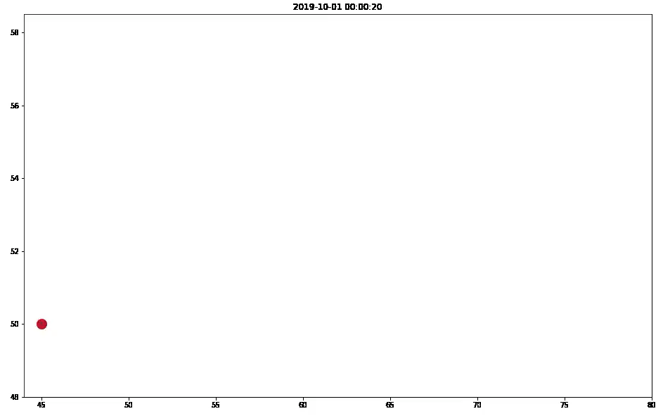
Contrail-Cirrus Prediction Tool (CoCiP) –
Flight segment contrail climate forcing
Flight on 10 Jan 2019 0:00 to 6:00 h
Energy forcing at fligth path segment
Latitude
Radiative forcing during contrail evolution
Longitude
https://py.contrails.org

Slide 6
Climate impact from contrails
Teoh, Engberg, Schumann, Voigt, Rohs, Shapiro, Stettler, egusphere, 2023
https://egusphere.copernicus.org/preprints/2023/egusphere-2023-1859/

Slide 7
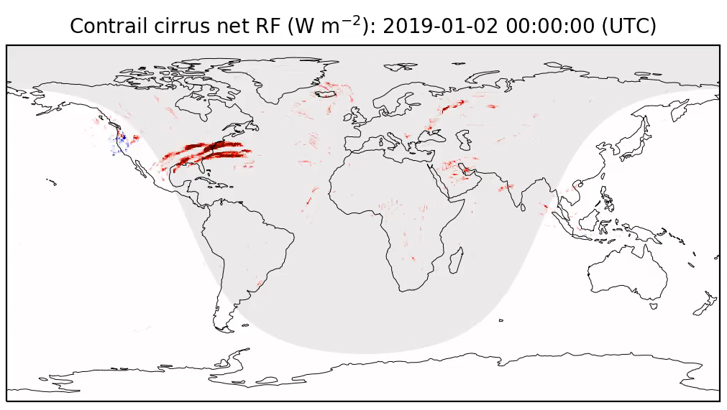
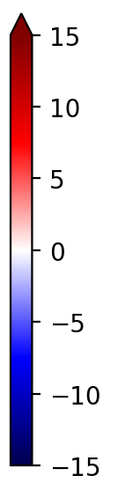
Contrail avoidance by flight routing
open source https://py.contrails.org
Teoh, Stettler, Imperial College, Shapiro, Breakthrough Energies, Schumann, Voigt, DLR

Slide 8
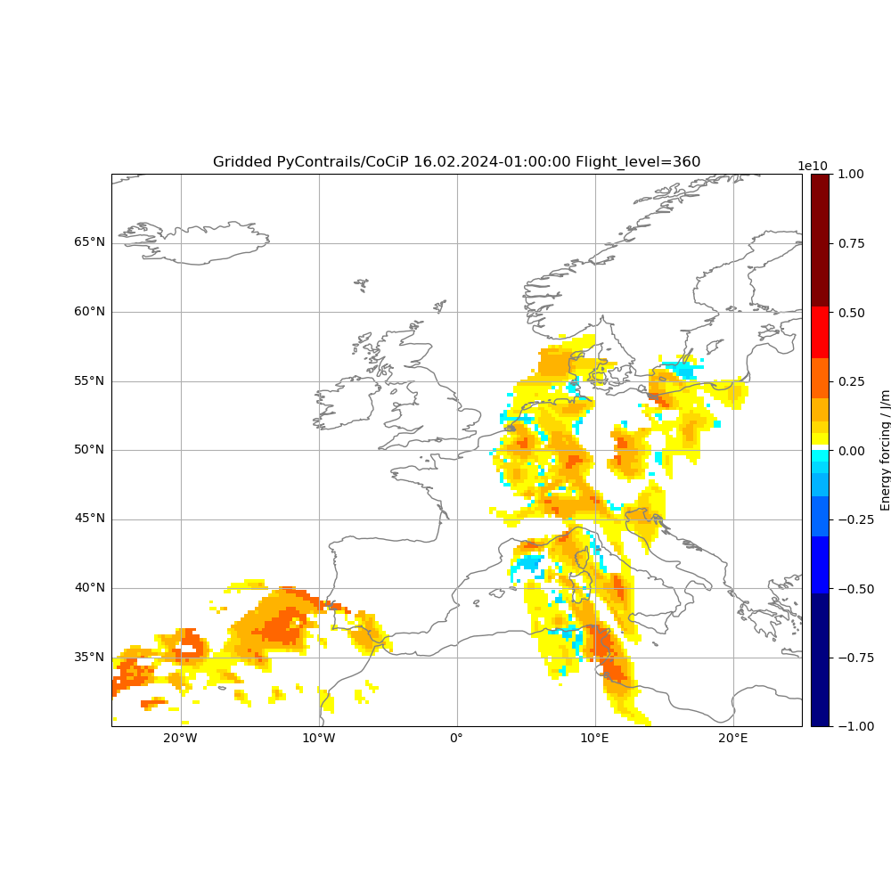
Vorhersage von Regionen mit Kondensstreifen
16.2.2024, Flugfläche 360, stündliche Vorhersage
Kirschler, DLR

Slide 9
Warming and Cooling by Contrails
Hourly net contrail radiative forcing in the Northern Atlantic Flight corridor in 2019
Jan 2019
Cooling
Cirrus
Warming
Warming
Cooling
Dec 2019
Teoh, Stettler, Schumann, Voigt et al., ACP, 2022
https://acp.copernicus.org/articles/22/10919/2022/

