Slide 1


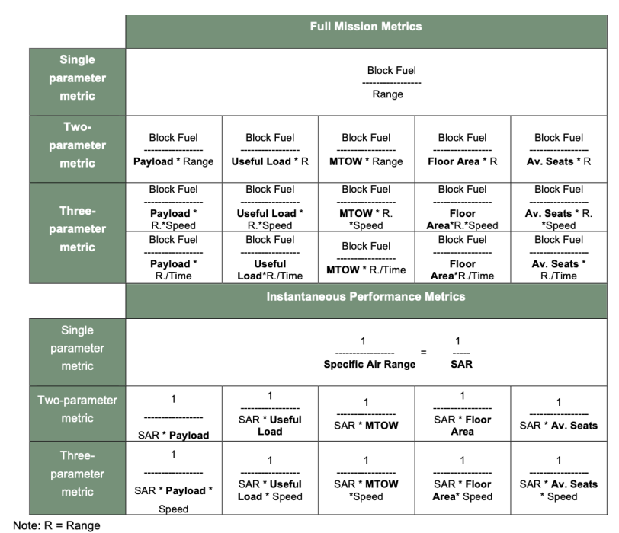
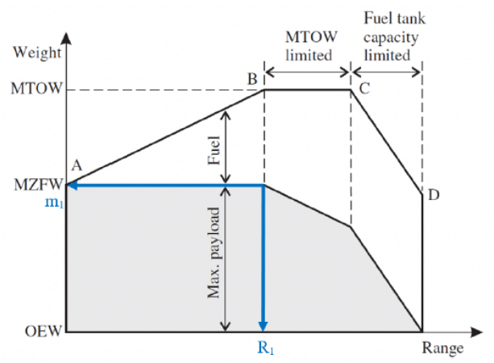






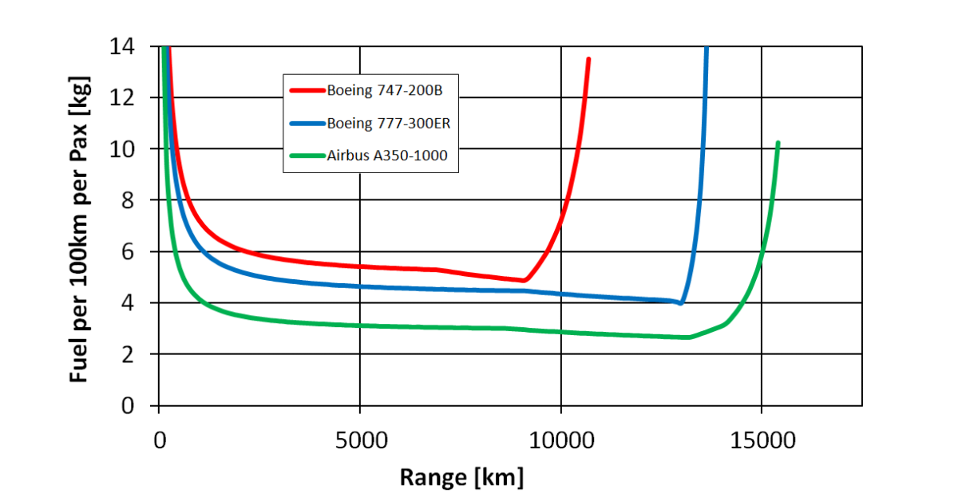


Fuel Consumption
of the 50 Most Used Passenger Aircraft
How to overcome industry's secrecy towards passenger aircraft's fuel consumption?
Get fuel consumption from 4 calculation schemes or extracted from 2 databases or from a literature review. The trick to get it from the ICAO/EASA "metric value" that tries to hide fuel consumption numbers. Applied to 50 aircraft. Results evaluated. But: Precise numbers are difficult to get.
PURPOSE
Fuel consumption of passenger aircraft is certainly known, but towards the public it is considered an industry secret. This project defines fuel consumption for passenger aircraft, shows and evaluates methods and databases for its calculation, and lists the fuel consumption of the 50 most-used passenger aircraft. Input data is only from publicly available documents.
METHODOLOGY
8 ways are considered to determine fuel consumption: Method 1: Specific Air Range (SAR), Method 2: Extended Payload-Range Diagram, Method 3: Bathtub Curve at Harmonic Range, Method 4: EEA Master Emission Calculator, Method 5: BADA, Method 6: Handbook Method, Method 7: Literature Review, Method 8: Metric Value (MV). Method 2 is the simplest method, calculating fuel consumption from the difference of maximum take-off mass (MTOM) and maximum zero-fuel mass (MZFM), which is divided by harmonic range and number of seats in the aircraft. Method 8 calculates fuel consumption from the CO2 Metric Value (MV) defined in ICAO Annex 16, Vol. 3 and EASA CS-CO2.
FINDINGS
Fuel consumption should be defined as kilogram of fuel per kilometer flown, per seat. Each aircraft type has many variants. Different sources give different values for the parameters. This can lead to undetected errors and deviations among the results from different methods beyond their fundamental differences. Method 1 underpredicts, Method 2 overpredicts. Method 4 is a reliable source with apparently good results, but new aircraft types (like A320neo) are presently not in the database. For Method 8, EASA so far publishes only MVs from flight tests with the A330neo. More data will come with new aircraft being certified. With 7 input parameters, an average value can be calculated from Methods 1, 2, and 3. The results give a good first indication of aircraft’s fuel consumption. Fuel consumption depends on range. For an economic range (range at maximum payload, harmonic range) modern aircraft consume between 0,02 kg/km/seat and 0,025 kg/km/seat of kerosine.
Figure 3: Passenger aircraft fuel consumption from various methods. Recommended is to take the
average of the Methods 1, 2, 3. Aircraft sorted by results from the Average Method.
RGF: “For aeroplanes with a single deck determine the area of a surface (expressed in m²) bounded by the maximum width of the fuselage outer mould line (OML) projected to a flat plane parallel with the main deck floor” divided by 1 m² (ICAO Annex 16 2017)
MV is/will be published by EASA.
m₂
Figure 4: Method 8: Calculation of the fuel consumption from the Metric Value (MV) defined by
ICAO Annex 16
R₂
RESEARCH LIMITATIONS
Method 1:
The accuracy of the methods is limited. For this reason, the aircraft with the lowest fuel consumption cannot be named. CO2 emissions can be calculated directly from fuel consumption (3.15 kg CO2 / kg fuel). Otherwise, this project does not go further into emission calculations.
Method 2:
PRACTICAL IMPICATIONS
Figure 1: Left: Possible metrics to define fuel consumption (Bonnefoy 2010) and the one selected
Right: Extended Payload-Range Diagram (Young 2017)
Simple methods to determine the fuel consumption of passenger aircraft are presented.
Method 3: Read the fuel consumption from the bathtub
curve at R1 of the respective aircraft!
SOCIAL IMPICATIONS
Fuel consumption of passenger aircraft can be investigated and can be discussed openly independent of (missing) manufacturer’s data..
ORIGINALITY
So far, no report discusses so many ways to determine fuel consumption of passenger aircraft in such a simple and practical way.
Figure 2: Fuel consumption versus range (Burzlaff 2017) – the so-called bathtub curve
All details in the Bachelor Project of Kühn (2023):
https://nbn-resolving.org/urn:nbn:de:gbv:18302-aero2023-09-11.011
Marius Kühn
Prof. Dr. Dieter Scholz, MSME

