Slide 1
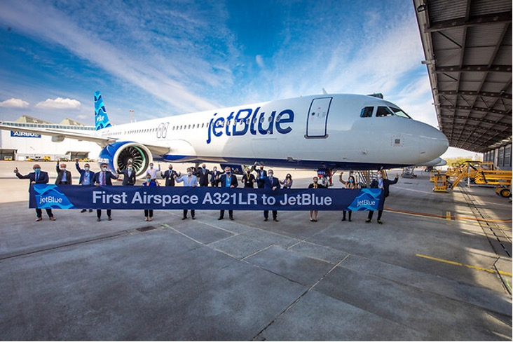
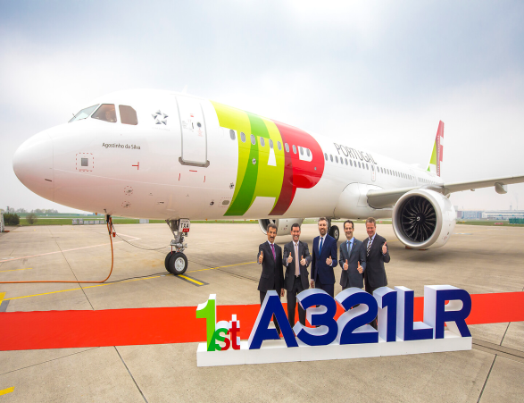
Direct Operating Costs, Fuel Consumption, and Cabin Layout of the Airbus A321LR
Diego Fonseca
Examiner: Prof. Dr.-Ing. Dieter Scholz, MSME
Examiner: Prof. Dr.-Ing. Gordon Konieczny
Presentation of the Bachelor Thesis
Hamburg, 2022-02-17
https://nbn-resolving.org/urn:nbn:de:gbv:18302-aero2021-12-06.014

Slide 2
Abstract
Purpose – Assessment of the Direct Operating Costs (DOC) and fuel consumption of the Airbus A321LR using typical use-cases and comparison with those from similar aircraft. Investigation of the flexibility of the cabin layout using examples from different airlines. Calculation of Ecolabels based on different cabin configurations.
Methodology – All aircraft-related data is retrieved from the Original Equipment Manufacturers’ (OEM) manuals. The DOC assessment uses the Association of European Airlines (AEA) and the TU Berlin method. The fuel consumption is assessed with a tool based on the Breguet Range equation, using successive iterations. The Ecolabel considers resource depletion, global warming, local air quality, and noise pollution, weighted and combined into one overall rating. A cabin study contrast layouts from Airbus with those from operators and also considering ergonomics.
Findings – The A321LR offers improvements in flight range compared to A321CEO and A321NEO. It can operate medium range very efficiently with only minor payload reduction. Very low-density layouts of a few airlines are purely their marketing preferences. Costs per seat and Ecolabel rating vary significantly between low-density and high-density cabin configurations. Predictions for the A321XLR are also very favorable.
Research Limitations – DOC results are not unique numbers but depend on the DOC method applied. Some of the characteristics for the XLR can so far only be estimated, since its entry into service is scheduled for 2023 and, as such, after the submission of this thesis.
Practical Implications – Good reasons for operating the A321LR are elaborated. The Ecolabel allows passengers and operators to openly discuss the ecological implications of different cabin layouts.
Originality – This seems to be the first scientific report that extensively investigates economic and ecologic aspects when operating the A321LR with different cabin layouts.

Slide 3
Direct Operating Costs, Fuel Consumption, and Cabin Layout of the Airbus A321LR
Table of Contents
Introduction
  General Considerations
  Which Missions are Being Flown
  Aircraft and Missions Considered
Fuel Consumption of the Airbus A321LR
  The Breguet Range and Aircraft Weight
  Fuel Consumption – kg/100/PAX
  Comparison of Fuel Consumption (Standard, Low- and High-Density Cabin)
Direct Operating Costs of the Airbus A321LR
  Composition of the DOC
  Two Methods for the Calculation
  Breguet Factor Calculated from the Payload-Range Diagram?
  DOC Comparison between Aircraft
  Seat-Kilometer Cost Comparison between Aircraft

Slide 4
Direct Operating Costs, Fuel Consumption, and Cabin Layout of the Airbus A321LR
Table of Contents
Ecolabel Applied to the Airbus A321LR
  General Considerations and Limitations
  Ecolabels for the A321LR
  Ecolabels for the A321ceo and A321neo
Cabin Layout of the Airbus A321LR
  The Role of the Seat Pitch
  Exemplary Seats (Classes)
  Assessment of A321LR Operators – Seat Pitch / Width
Summary and Conclusions
List of References

Slide 5
Direct Operating Costs, Fuel Consumption, and Cabin Layout of the Airbus A321LR
    Introduction

Slide 6




General Considerations
Facts
Questions/Presumptions
The A321LR was launched in 2018, as an extended-range variant of A321neo and it offers two engine variants: CFM LEAP-1A or PW-1100G
Actual operators : TAP Air Portugal, JetBlue, Air Astana, Air Transat, Aer Lingus, ...
Technology: up to 3 Additional Center Tanks (ACTs) → more fuel → fly longer. An extra-long range (XLR) variant is scheduled for 2023
Structural weight limits with ACTs installation → reduced maximum payload→fewer passengers:
e.g., JetBlue’s A321LR cabin fits 138 seats while most A321neo fit 180-220 passengers! → reflects in the cost per seating passenger → much higher ticket prices
What does Airbus/ airlines say?
What speaks for the LR?
“… with a range of up to 4,000 NM (7,400 km), the A321LR is the unrivalled long-range route opener, featuring true transatlantic capability and premium wide-body comfort in a single-aisle aircraft cabin.” (Airbus 2019a)
“It [A321LR] delivers 30% fuel savings and nearly 50% reduction in noise footprint compared to previous-generation competitor aircraft.” (Airbus 2019a)
Crescent popularity of long-range missions operated with single-aisle aircraft: lower financial risk, strategical decison – e.g., COVID-19 (less demand) and Airbus A380 (expensive, more seats)
Pilots and cabin crew do not need additional training due to commonality along the A320 family (world’s best selling single-aisle aircraft family)

Slide 7
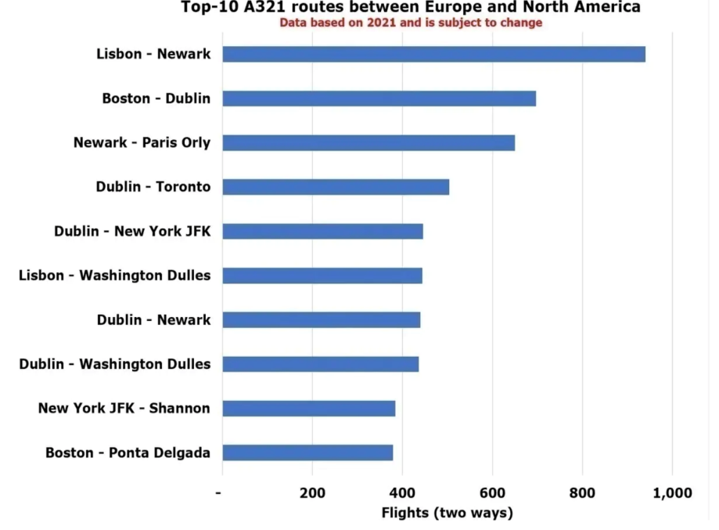
Introduction
Which Missions are Being Flown?
Scheduled long-haul flights operated by A321LR aircraft – winter season 2021/22 (edited from Pearson 2021a)
Top ten A321 routes between Europe and North America in 2021, according to number of flights (Pearson 2021b)

Slide 8
Introduction
Aircraft and Missions Considered
Mission 1 (M1) coincides with the range at maximum payload of the A321LR – 5.600 km
Mission 2 (M2) is equidistant to the ranges of M1 and M2 – 6.500km
Mission 3 (M3) coincides with the range at maximum fuel weight of the A321LR – 7.400 km
(Airbus 2020 and 2021c)
MTOW: Maximum Take-Off Weight
MZFW: Maximum Zero Fuel Weight
OEW: Operating Empty Weight
MFW: Maximum Fuel Weight
The passenger mass considered = 97,0 kg (pax + luggage)

Slide 9

Direct Operating Costs, Fuel Consumption, and Cabin Layout of the Airbus A321LR
    Fuel Consumption
    of the Airbus A321LR

Slide 10
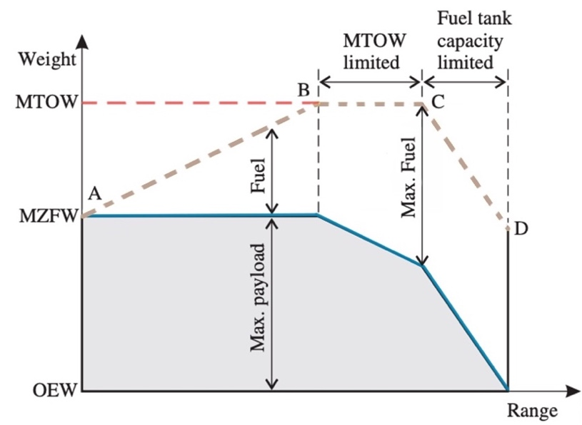
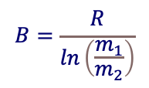

Fuel Consumption of the Airbus A321LR
The Breguet Range and Aircraft Weight
Extended Payload-Range diagram;
based on Young (2017)
$$B=\frac{R}{ln\left(\frac{m_{1}}{m_{2}}\right)}$$
Breguet Factor:
Mission Fuel Mass:
$$m_{fuel}=m_{2}\left(e^{\frac{R}{B}}−1\right)$$
MTOW: Maximum Take-Off Weight
MZFW: Maximum Zero Fuel Weight
OEW: Operating Empty Weight
MFW: Maximum Fuel Weight
Notes:
Specific fuel consumption (kilograms per hundred kilometers and passenger) similar to those of airlines – e.g., 3.6-4,1kg/100km/Pax by Lufthansa Group (2020) in the year 2020

Slide 11
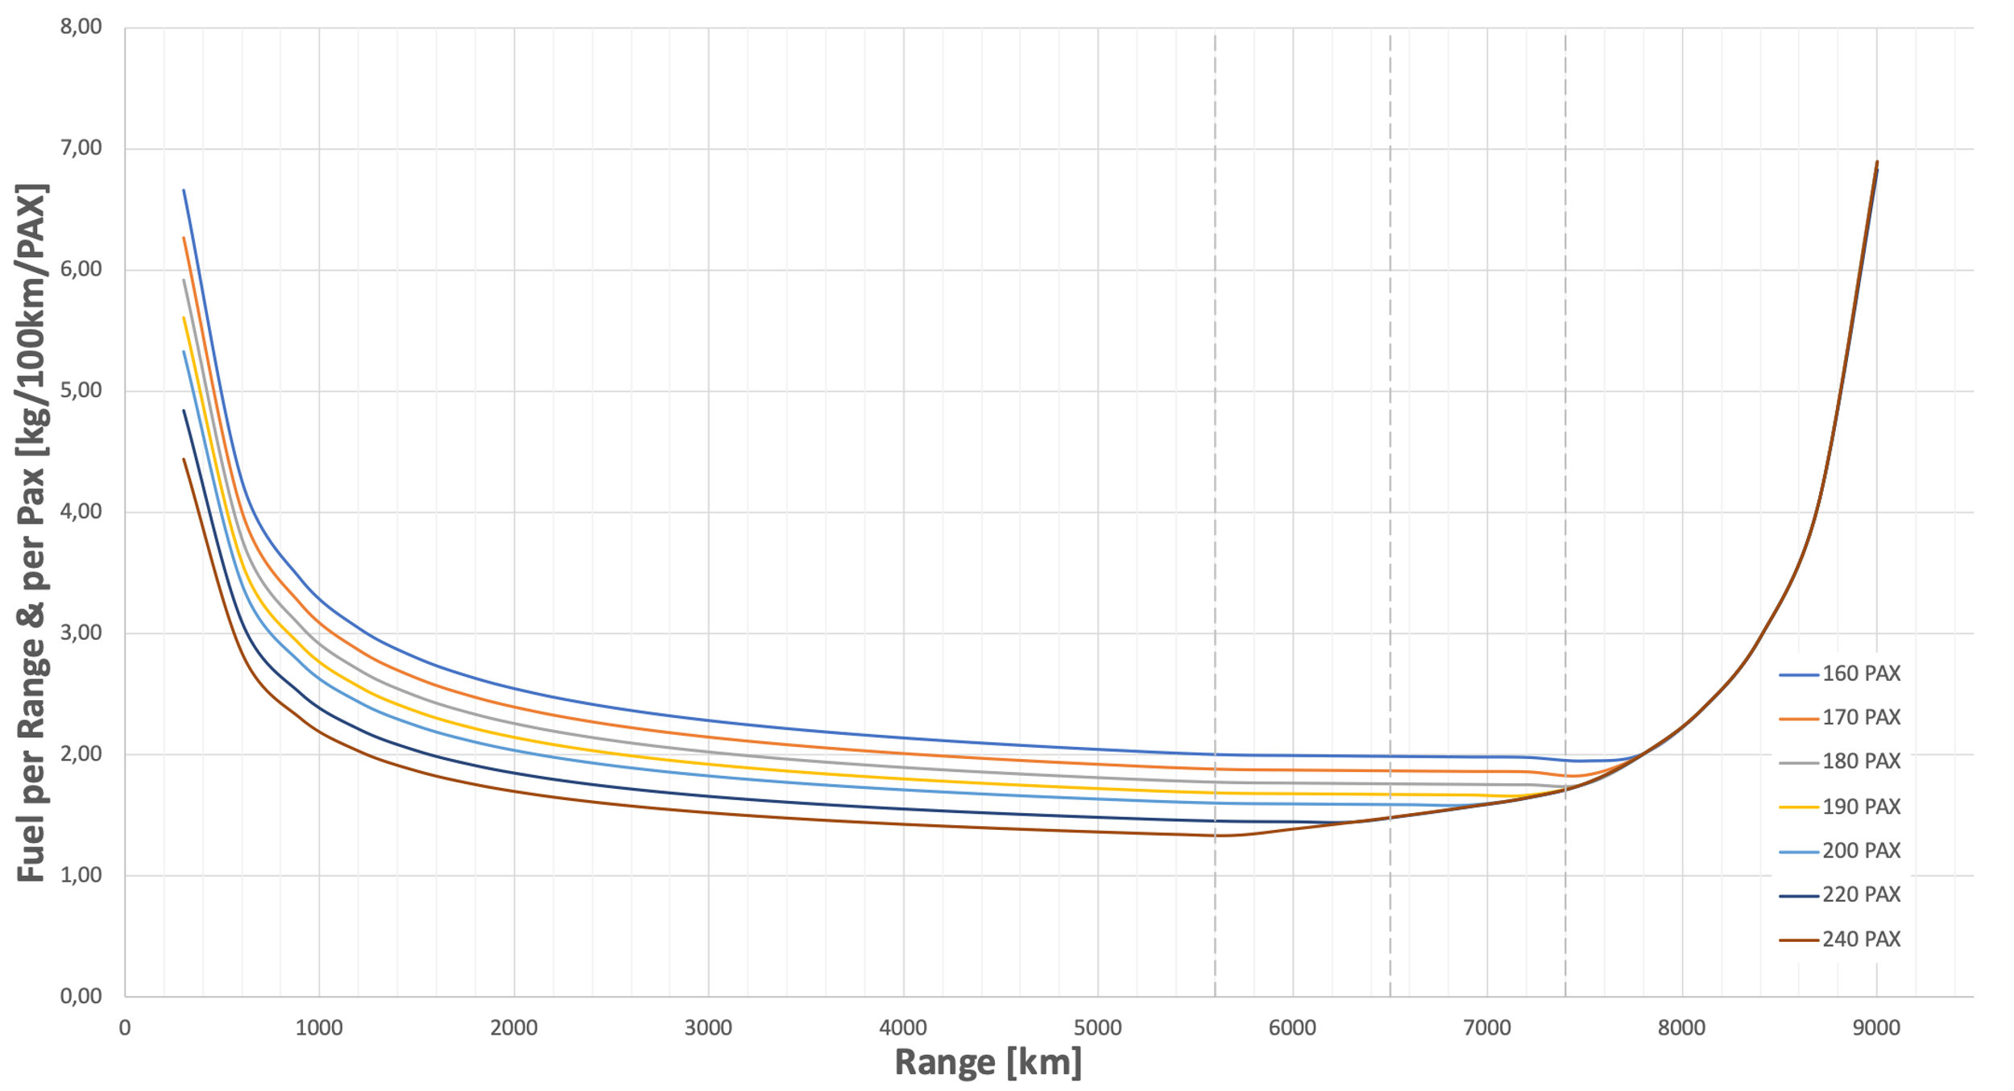
Fuel Consumption of the Airbus A321LR
Fuel Consumption – kg/100km/PAX
Fuel consumption per range and passenger over flown distance for the A321LR
↑ passengers transported, ↓ fuel consumption distributed for each passenger
6,7-1,3 kg/100km/pax from lowest to highest cabin density (Δ=81%). For each add. 10 pax Δ=-11.6%
Fuel consumption at take-off is relatively high. With increasing range, there is better distribution/compensation. E.g., 300-1.000 km Δ=-51%
decreasing trend is maintained until the range at MPL – ~5.600 km. For farther ranges, sensible fuel consumption only possible with reduced maximum capacity (less than 240 pax)
(generated with Scholz 2021a)
Note: from the moment the slope of the curve is inverted, the range is not supported anymore with the corresponding number of pax →
passenger reduction must take place – the fuel is distributed to an (ever) decreasing number of passengers
Notes:
*conventional visualization – kg/100km/PAX – allowing an economical interpretation of the fuel consumed.
It has a characteristic convex curvature.
In a cabin layout with up to 180 pax, the range at MFW of the aircraft (point C, at 7.400 km) can still be flown in a productive manner.
The curvature of every curve starts sooner or later to change. This point represents the point of the trade-off between more range and fewer passengers for the respective curve. In other words, the fuel consumed is then being distributed to a decreasing number of passengers up until it cannot be divided by any passenger anymore (infinity).
The lowest fuel consumption for a 160 pax cabin is reached at 7.800 km with 1.9 kg/100km/pax. With increasing cabin density, the respective fuel consumption decreases, and the minimum occurs at ranges shorter than the one from the 160 pax cabin. For a standard cabin of 200 pax, the lowest fuel consumption is 1,6 kg/100pax/km and occurs before the range of point C at around 6.800 km.

Slide 12
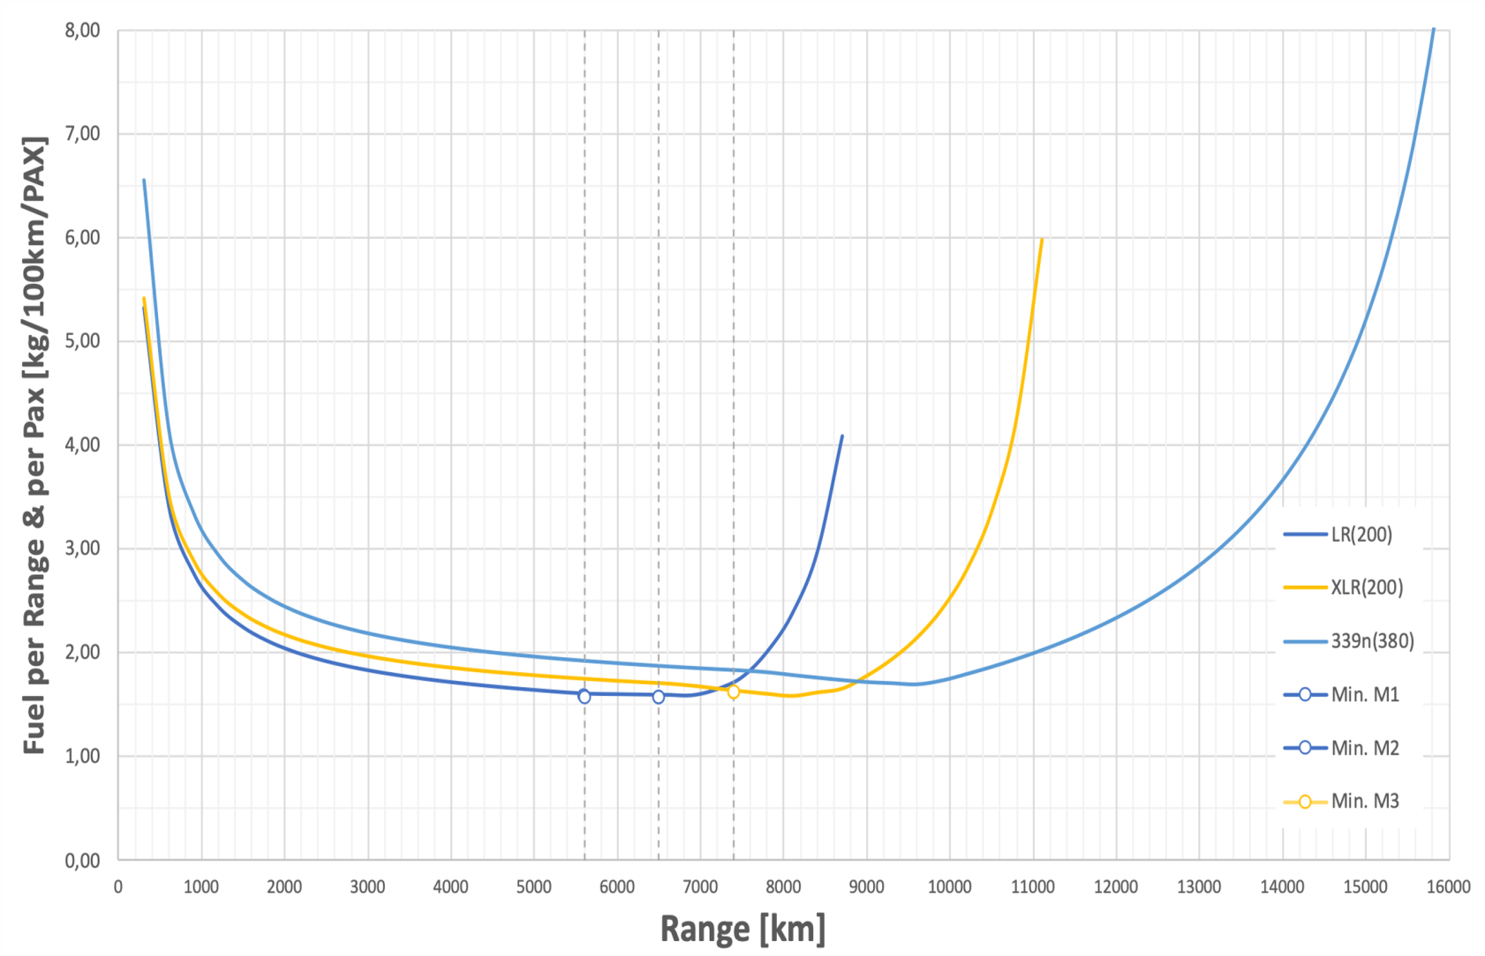
Fuel Consumption of the Airbus A321LR
Fuel Consumption – kg/100km/PAX
Fuel consumption per range and passenger over flown distance: Comparison for
a standard cabin density
(generated with Scholz 2021a)
Notes:
This chart starts to elucidate the use case particularities of each aircraft. The cabin density is, as mentioned, comparatively equal for all aircraft. Nevertheless, the curves clearly differ from one another.
First, it is evident that the aircraft show different operating ranges. Second, the A321LR and the A321XLR reveal similar fuel consumption until a specific range (7400 km), with the curves starting at almost the same level (between 5,3 and 5,4 kg/100km/pax). Between 900 km and 7.200 km, the LR shows slightly lower fuel consumption. After a flight distance of 7.400 km the XLR clearly proves to be more fuel-efficient. For example, at a range of 8.600 km the XLR consumes around 1,65 kg/100km/pax, whilst the LR consumes 4,1 kg/100km/pax (148% more). This happens because this point is far beyond the range of point C of the LR, and thus the payload has already been heavily reduced.
On the other hand, due to the considerably higher MTOW, the fuel consumption of the A330‑900neo is generally higher, and its curve begins (for 300 km) at higher values –around 6,6 kg/100km/pax. This aircraft shows fuel consumption advantages for the current cabin configuration after a flown distance of around 8.700 km, where the XLR starts to exceed its capacities at MFW.
Furthermore, the indicated minima reveal which aircraft is more fuel-efficient at a given range while flying a standard density cabin configuration. For missions up to 5.600 km (M1), the A321LR is the most fuel-efficient aircraft even though the A321XLR shows only minimal disadvantage (less than 9%). For missions up to 6.500 km (M2), the A321LR is still the best-indicated aircraft and conserves around the same advantage towards the XLR. For missions up to 7.400 km (M3), the A321XLR is more advantageous as it is now the most fuel-efficient aircraft with around 1,63 kg/100km/pax. It strikes that the indicated minima for all three missions oscillate slighly, and they are all situated at around 1,60 kg/100km/pax (2,5% variation).

Slide 13
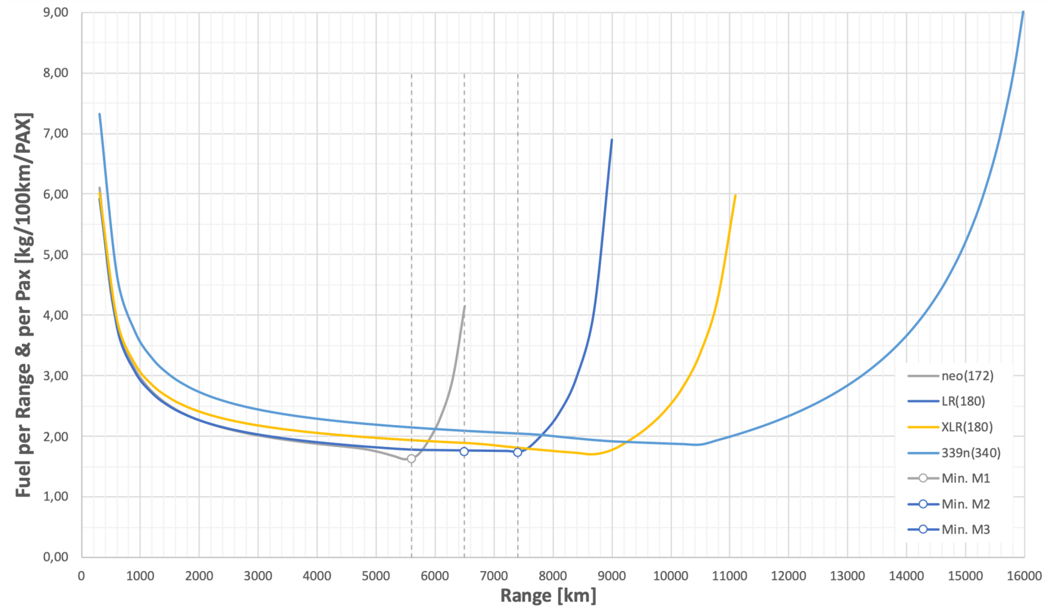
Fuel Consumption of the Airbus A321LR
Fuel Consumption – kg/100km/PAX
Fuel consumption per range and passenger over flown distance: Comparison for
a low-density cabin
(generated with Scholz 2021a)
Notes:
Within the A321 family, the fuel consumption at 300 km is around 6,0 kg/100km/pax. The A321 family once more reveals similar fuel consumption up until a specific range, after which the next recent aircraft is more fuel-efficient. In the case of the A321LR and XLR, a commonality up to a range of 7.400 km is observed. After this point, the A321XLR is again more fuel-efficient. At the range of the previous example, 8.700 km, the A321XLR consumes around 1,7 kg/100km/pax, while the LR consumes 4,1 kg/100km/pax (more 141%).
In the case of the A330-900neo, the relative increase in fuel consumption is considerably higher when compared to the one from a standard cabin – with 40 fewer passengers. The fuel consumption at 300 km is respectively 7,3 and 6,6 kg/100km/pax, representing a variation of plus 10,6%. For the current cabin configuration, this aircraft shows fuel efficiency advantages towards the A321XLR after a flown distance of around 9.200 km – 300 km “later” compared to the standard cabin configuration.
For this configuration, the A321neo is the best indicated for ranges up to 5.400 km in terms of fuel consumption – at around 1,6 kg/100km/pax and 172 maximum passengers. For missions M2 and M3, the most fuel-efficient aircraft is the A321LR, even though the advantage towards the XLR in M3 is minimal (around 2,8%). In both cases, the lowest fuel consumption registered is at around 1,7 kg/100km/pax (LR).

Slide 14
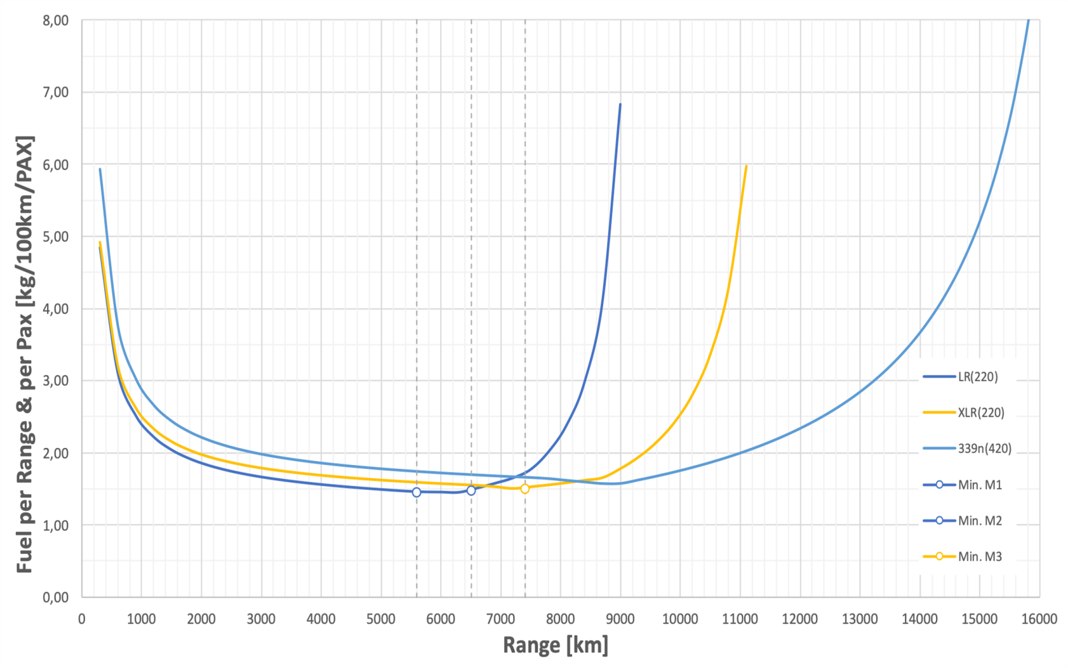
Fuel Consumption of the Airbus A321LR
Fuel Consumption – kg/100km/PAX
Fuel consumption per range and passenger over flown distance: Comparison for
a high-density density
(generated with Scholz 2021a)
Notes:
The fuel consumption of each aircraft is here generally lower than that from the standard density cabin configurations since the consumed fuel is being distributed to more passengers.
For the LR and XLR, the fuel consumption at 300 km is at around 4,9 kg/100km/pax. The commonality between these two aircraft is further maintained, up until 6800 km (the LR shows slightly lower fuel consumption). After this range, the A321XLR becomes more advantageous as its fuel consumption shows lower levels and maintains a slightly decreasing slope until 7.400 km.
In the case of a high-density cabin, at the range of the previous examples (8.700 km), even the A321XLR shows counterproductive fuel consumption as the slope of the curve already has a positive gradient. Here, the A321XLR consumes around 1,7 kg/100km/pax, whilst the LR consumes 4,1 kg/100km/pax (more 148%).
In the case of the A330-900neo, the relative decrease in fuel consumption is higher when compared to the one from a standard cabin – with 40 more passengers. The fuel consumption at 300 km is around 5,9 kg/100km/pax, representing a variation of minus 9,5% towards the standard cabin. For the current cabin configuration, this aircraft shows fuel efficiency advantages after a flown distance of around 8.200 km – 600 km “earlier” compared to the standard cabin.

Slide 15
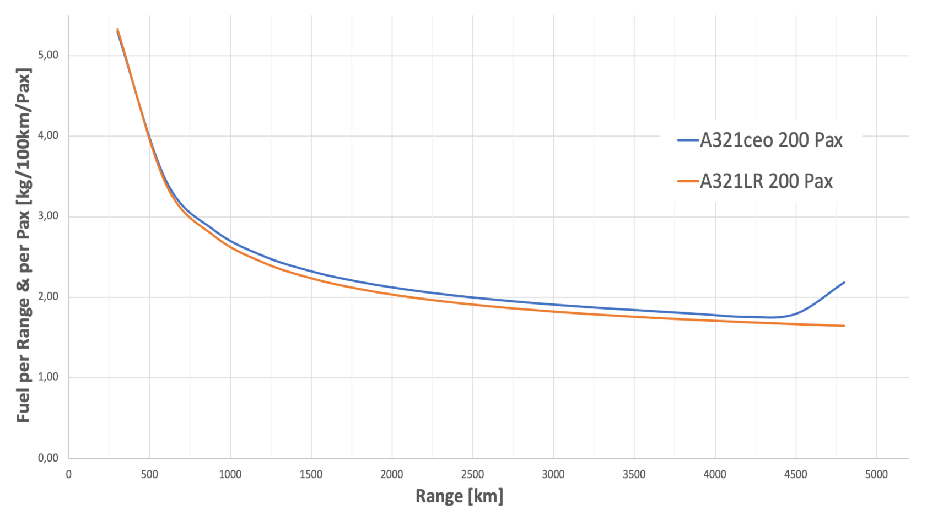
Fuel Consumption of the Airbus A321LR
Fuel Consumption – kg/100km/PAX
Fuel consumption per range and passenger over flown distance: Engine comparison, standard density cabin
Comparison of the fuel consumption A321ceo and the A321LR – 200 pax
(generated with Scholz 2021a)
Notes:
The fuel consumption of each aircraft is here generally lower than that from the standard density cabin configurations since the consumed fuel is being distributed to more passengers.
For the LR and XLR, the fuel consumption at 300 km is at around 4,9 kg/100km/pax. The commonality between these two aircraft is further maintained, up until 6800 km (the LR shows slightly lower fuel consumption). After this range, the A321XLR becomes more advantageous as its fuel consumption shows lower levels and maintains a slightly decreasing slope until 7.400 km.
In the case of a high-density cabin, at the range of the previous examples (8.700 km), even the A321XLR shows counterproductive fuel consumption as the slope of the curve already has a positive gradient. Here, the A321XLR consumes around 1,7 kg/100km/pax, whilst the LR consumes 4,1 kg/100km/pax (more 148%).
In the case of the A330-900neo, the relative decrease in fuel consumption is higher when compared to the one from a standard cabin – with 40 more passengers. The fuel consumption at 300 km is around 5,9 kg/100km/pax, representing a variation of minus 9,5% towards the standard cabin. For the current cabin configuration, this aircraft shows fuel efficiency advantages after a flown distance of around 8.200 km – 600 km “earlier” compared to the standard cabin.

Slide 16

Direct Operating Costs, Fuel Consumption, and Cabin Layout of the Airbus A321LR
    Direct Operating Costs of the Airbus A321LR

Slide 17
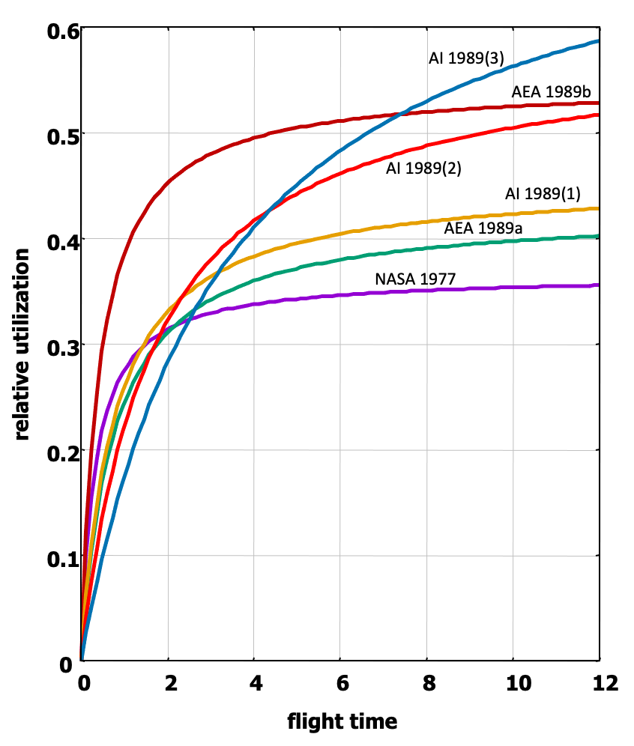

Direct Operating Costs of the Airbus A321LR
General Composition of the DOC
C_{DEP}: Depreciation costs
C_{INT}: Interest costs
C_{INS}: Insurance costs
C_{F}: Fuel costs
C_{M}: Maintenance costs
C_{C}: Crew costs
C_{C}: Fees and charges
$$C_{DOC}=C_{DEP}+C_{INT}+C_{INS}+C_{F}+C_{M}+C_{C}+C_{FEE}$$
Development of the kerosene price from 1980 to 2021 (EIA 2021)
Relative aircraft utilization; edited from Scholz (2015)
→ The longer the flight time the fewer the maximum allowed flight-trips (per day, month or year)

Slide 18
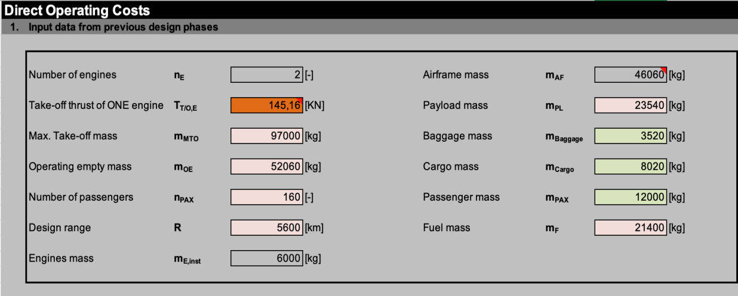
Direct Operating Costs of the Airbus A321LR
Calculation of the DOCs: Two Methods – AEA and TU Berlin
General values for DOC computation of the A321LR with/without cargo – AEA method, M1: 160 pax; Scholz 2021b)
General values for DOC computation of the A321LR with/without cargo – TUB method, M1: 160 pax
AEA Association of European Airlines
TUB Technical University of Berlin

Slide 19
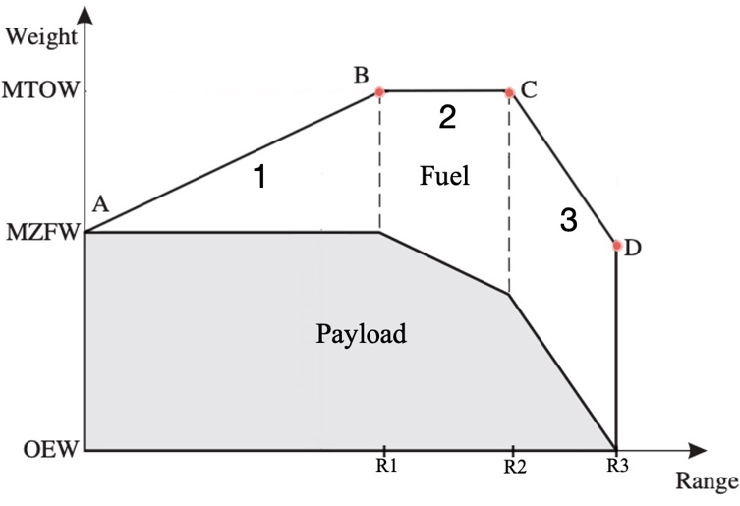


Direct Operating Costs of the Airbus A321LR
Breguet Factor Calculated from the Payload-Range Diagram?
Extended Payload-Range diagram; based on Young (2017)
$$B=\frac{R}{ln\left(\frac{m_{1}}{m_{2}}\right)}=\frac{R}{ln\left(\frac{OEW+PL+MFW}{LW}\right)}=\frac{6500 km}{ln\left(\frac{52060+20795+23595}{52060+20795}\right)\frac{kg}{kg}}=23.168 km$$
or
$$m_{fuel}=m_{2}\left(e^{\frac{R}{B}}−1\right)⟺\frac{R}{B}=\ln\left(\frac{m_{fuel}}{m_{2}}+1\right)⟺B=\frac{R}{\ln\left(\frac{m_{fuel}}{m_{2}}+1\right)}=\frac{6500 km}{\ln\left(\frac{23595}{72855}+1\right)\frac{kg}{kg}}=23.168 km$$

Slide 20
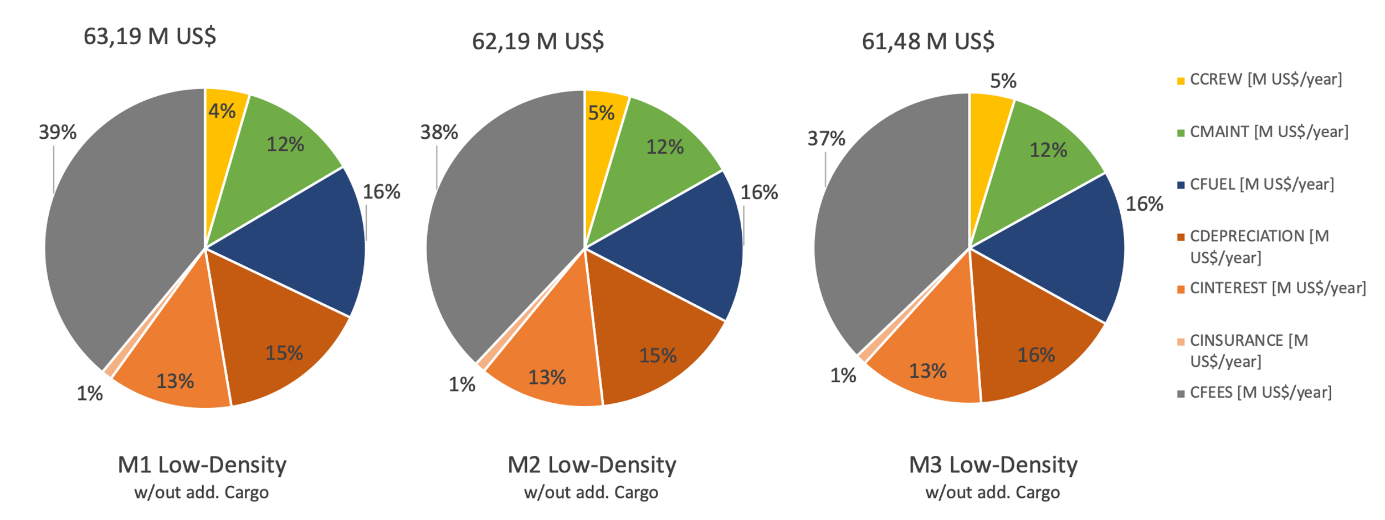
Yearly DOCs with Both Methods
DOC distribution for the A321LR in M1, M2, and M3: low-density cabin configuration, without additional cargo – TUB Method
DOC distribution for the A321LR in M1, M2, and M3: low-density cabin configuration, without additional cargo – AEA Method
Notes:
Figures 7.3 and 7.4 intend to address the differences in cost-shares between the two considered DOC methods. In order to be more realistic, the cases for low-density cabin (180 pax) configurations are presented since the majority of airlines addressed employ a similar configuration or lower. Furthermore, only missions without additional cargo are accounted for in order to avoid extra expenses and thus allow a direct comparison between the missions themselves. The color coding shall abet the interpretation of corresponding cost shares, e.g., capital costs are in shades of orange and navigation costs in shades of gray.
The different methods account for the single cost shares differently. The largest cost share in the TUB method is taken by the fuel costs with a mean of 40% of the total DOCs (13,9 M US$), whereas the AEA method “only” accounts for 16 % of the total costs incurred for fuel (9,9 M US$). The largest cost share in the AEA method is taken by the fee costs (ATC, handling, and landing) with around 38% versus 20% of the TUB method. In nominal values, this translates into 23,66 and 6,97 M US$, respectively. The ratio for the capital costs is similar for both methods. Nevertheless, this represents a nominal difference of 10 M US$. The only costs which can perhaps be relatable for both methods.
Furthermore, because of the larger fuel accounting, the percentage of the C_{FUEL} increases with increasing flight range in the TUB method. In the AEA method, this trend is not observed. On the other hand, the AEA method clearly reflects the effect of reducing flight‑cycles in the C_{FEES}.

Slide 21
DOC Comparison between Aircraft
- different accounting for the nr. of flight trip contributes to distinguished variations along the missions and methods
DOC comparison: standard density cabin: TUB Method
DOC comparison: high-density cabin: TUB Method
DOC comparison: low-density cabin: TUB Method
DOC comparison: low-density cabin: AEA Method
Notes:
Figures 7.5 to 7.8 show, for all considered cabin densities, the DOC comparison between the different (applicable) aircraft considered. The first three charts contain the results obtained with the TUB method, and for comparison, Figure 7.8 shows the results for a low-density cabin configuration using the AEA method.
With this cabin configuration, the DOCs for the XLR are always minimally higher than those of the LR by a mean of +3% or +1 M US$ per year. This can be justified by the added costs incurred due to the higher MTOW and higher fuel demand, which translate into around 1.400, 1.485, and 1.754 US$/flight respectively, for M1, M2, and M3 – around 3% percent of the trip costs. Especially for airlines who haven’t yet invested in any of the LR and XLR so far, this may be an interesting finding, which could be taken into account while deciding to acquire one or the other variant.
The yearly DOCs of the A339neo sum up to more than double the mean costs incurred for the LR due to the significantly higher MTOW and fuel demand – at least +35 M US$. The A321neo can only be employed in M1, being the yearly DOCs around 1,3 or 2,2 M US$ lower than in the LR, depending on the method.
The yearly DOCs generally increase with increasing cabin density. Furthermore, with the TUB method, the DOCs also increase with increasing flight range, while the opposite happens with the AEA method ­– as seen before.

Slide 22
Seat-Kilometer Cost Comparison between Aircraft
SKC comparison: standard density cabin: TUB Method
SKC comparison: high-density cabin: TUB Method
SKC comparison: low-density cabin: TUB Method
SKC comparison: low-density cabin: AEA Method
Notes:
Further, the corresponding seat-kilometer costs (SKC) to the previous figures are presented in the same manner in Figures 7.9 to 7.12.
It strikes that, as long as the range is supported with a given cabin configuration (payload-range-diagram), the SKC show falling costs from shortest to largest mission. In other words, the SKCs for M3 are lower than those of M2, which are lower than those in M1. If the given mission and range imply that a payload limitation has to take place, the costs are off course, divided to less pax, e.g., M3 is not possible anymore for the LR using a 200 pax cabin. Instead, only 186 pax are transported.
In this case, even the SKCs for the A339 reach similar or even lower levels to those of the A321 variants due to the longer range and payload capacities. Otherwise, the SKC are generally always higher (1-3 cents), despite accomodating more than double the passengers.
In the year 2020 the average SKCs appointed by the American low-cost carrier Southwest were around 0,0185 US$/km per seat (11,48 cents per available seat-mile), whereas the corresponding values for American Airlines were 0,0244 US$/km per seat in 2018 (Hayes 2021). These values are in all cases lower than those calculated with both methods, which may be justified that the airlines do not include all operating expenses in the SKCs calculation (particular IOCs). However, the TU Berlin appears to be more realistic since the values are closer to those appointed by the airlines.

Slide 23

Direct Operating Costs, Fuel Consumption, and Cabin Layout of the Airbus A321LR
    Ecolabel
    Applied to the Airbus A321LR

Slide 24
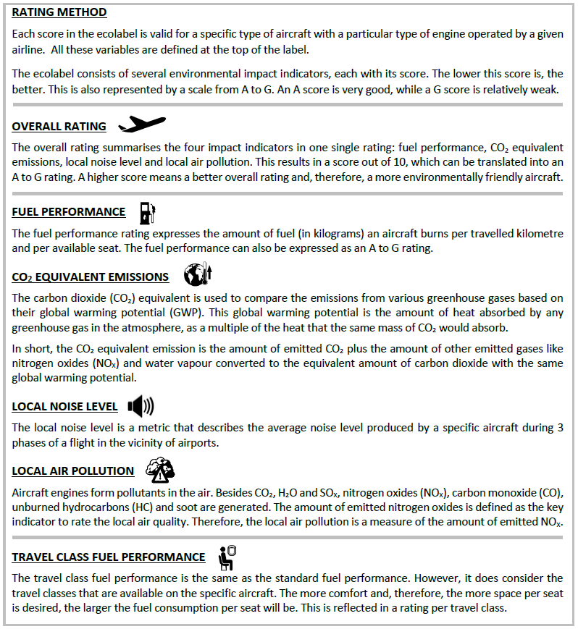
Ecolabel Applied to the Airbus A321LR
General Considerations and Limitations
Flyer explaining the Ecolabel to the general public or passengers (Hurtecant 2021)
Exemplary layout of the Ecolabel (Hurtecant 2021)
Notes:
In the context of the Hamburg Aerospace Lecture Series, Scholz summarized the concept developed so far in the presentation “Ecolabel for Aircraft – Definition, and Application” (Scholz 2020). Here, a sequence of measures is stated, which would reduce the environmental burden of flying, according to their priority:
avoid traveling,
for each trip, select the best mode of transportation (aircraft, train, bus);
select the shortest route;
select the best aircraft-airline-combination (based on Ecolabel);
select an economy seat;
compensate.
One can say that the developed method is capable of reproducing the nuances between different configurations and translating them into logical results in an expected way. Furthermore, the units in which the different categories of the Ecolabel are expressed were chosen very cleverly. For example, by normalizing the fuel consumption and CO₂ emissions (units kg) in kilometers (range) and seats (number of passengers), it is possible to compare aircraft with distinguished ranges and cabin configurations. The units and values can therefore be universally employed between aircraft and are therefore suitable for direct comparisons. The same applies to the local noise level and for the local air pollution (allows to compare engines based on their output thrust).
Before all else, a clear conclusion from the environmental assessment is that the overall rating of the Ecolabel is directly proportional to the total number of seats, i.e., the number of passengers in the aircraft cabin. In other words, this means that the more the passengers transported in a single flight, the better the distribution of the ecological impact. For this matter, this observation gives a leading edge to low-cost carriers in terms of ecological rating since these operators tend to employ very dense cabin configuration in opposition to legacy carriers, who prioritize comfort and thus fewer seats.
Furthermore, it is possible to conclude that the fuel consumption rate – expressed in kilograms of fuel per flown kilometer and per seat – generally worsens with the improvement of the seating class. This happens because the B/C offers fewer seats, more seat pitch, and more seat width than the Y/C. The same applies to the F/C, which performs even worse. Because of this, it can be affirmed that the higher seating classes influence the fuel consumption distribution negatively, and a Y/C seat should be therefore prioritized. This implementation of this measure alone would contribute to a better overall Ecolabel rating for a given airline and aircraft.
The air pollution rating is based on the Emission Index of NOx (EI_{NOx}) expressed in grams of NOx per kilograms of fuel and corresponding values for each specific aircraft can be retrieved from the official European Environment Agency emission calculator (EEA 2020) – without distinction of engines types. The Ecolabel itself, uses another method for this calculation – the Boeing Fuel Flow Method (Hurtecant 2021, pp. 69) – which after a closer look, reveals generally higher values for the NOx emissions. This method and its corresponding database have the advantage of posessing a more detailed databank.
Furthermore, despite aircraft mostly having two optional engines, these engines also vary in design so that, in the end, it is not easily ascertainable, which specific variant an airline employs. As expected, the different variants also show nuances in terms of emissions (NOx), amongst others. The Ecolabel tries to solve this discrepancy by building an average throughout the engine variants, which has its disadvantages to a certain extent. However, this may be the best solution since, for most cases, it is unlikely to know the exact denomination of the employed engine.
As an example, Table 7.3 shows for the A321ceo, the EI_{NOx} calculated with values from the EEA table at stage length of 1000 NM or 1.850 km and from the Ecolabel. The considered engine type was the CFM56-5B1/2P, where a variation of around 20% was found!
On the other hand,the comparison between different (engine) generations, e.g., neo versus ceo, shows how this reflects in the Ecolabel’s overall performance. When compared to the engines of the A321ceo (EIS in 1997), the A321neo’s engines (EIS in 2020) are built bigger and are capable of greater thrust. For this matter, these engines consume more fuel than the previous generation, which reflects in the fuel consumption (kg/100km/seat) and in the CO₂ equivalent emissions (kg/km/seat) – see A339 as well. On the other side, by employing more recent and consequently better technologies the neo engines are more efficient and contribute to lower noise levels (EPNdB/EPNdB) and air pollution (NO_{x}/Thrust) in the vicinity of airports.
Furthermore, the comparison between different engines from the “same” generation, e.g., PW‑1100G and CFM LEAP-1A32, reveals that the PW-1100G is less air pollutant (in relation to the output thrust) but slightly more noise pollutant in the vicinity of airports. Nevertheless, if transporting the same number of passengers, these two engines show the same values for the fuel consumption and CO₂ emission – this was not clear at first sight. Overall it is safe to affirm that the Pratt &Whittney engines are overall the better option since the discrepancy in local air pollution is more significant – A-Rating vs. C-Rating of the LEAP 1A32. For the record, the thrust of the two engines is very similar, being 147,28 kN and 143,1 kN for the Pratt &Whittney and for the CFM engines, respectively.

Slide 25
Ecolabel Applied to the Airbus A321LR
General Considerations and Limitations
Ecolabel: exemplary distribution of the impact categories – weighted (Hurtecant 2021)
Ecolabel: exemplary distribution of the impact categories – unweighted (Hurtecant 2021)
Comparison of EI_{NOx} between the EEA emission calculator and the Ecolabel
Notes:
In the context of the Hamburg Aerospace Lecture Series, Scholz summarized the concept developed so far in the presentation “Ecolabel for Aircraft – Definition, and Application” (Scholz 2020). Here, a sequence of measures is stated, which would reduce the environmental burden of flying, according to their priority:
avoid traveling,
for each trip, select the best mode of transportation (aircraft, train, bus);
select the shortest route;
select the best aircraft-airline-combination (based on Ecolabel);
select an economy seat;
compensate.
One can say that the developed method is capable of reproducing the nuances between different configurations and translating them into logical results in an expected way. Furthermore, the units in which the different categories of the Ecolabel are expressed were chosen very cleverly. For example, by normalizing the fuel consumption and CO₂ emissions (units kg) in kilometers (range) and seats (number of passengers), it is possible to compare aircraft with distinguished ranges and cabin configurations. The units and values can therefore be universally employed between aircraft and are therefore suitable for direct comparisons. The same applies to the local noise level and for the local air pollution (allows to compare engines based on their output thrust).
Before all else, a clear conclusion from the environmental assessment is that the overall rating of the Ecolabel is directly proportional to the total number of seats, i.e., the number of passengers in the aircraft cabin. In other words, this means that the more the passengers transported in a single flight, the better the distribution of the ecological impact. For this matter, this observation gives a leading edge to low-cost carriers in terms of ecological rating since these operators tend to employ very dense cabin configuration in opposition to legacy carriers, who prioritize comfort and thus fewer seats.
Furthermore, it is possible to conclude that the fuel consumption rate – expressed in kilograms of fuel per flown kilometer and per seat – generally worsens with the improvement of the seating class. This happens because the B/C offers fewer seats, more seat pitch, and more seat width than the Y/C. The same applies to the F/C, which performs even worse. Because of this, it can be affirmed that the higher seating classes influence the fuel consumption distribution negatively, and a Y/C seat should be therefore prioritized. This implementation of this measure alone would contribute to a better overall Ecolabel rating for a given airline and aircraft.
The air pollution rating is based on the Emission Index of NOx (EI_{NOx}) expressed in grams of NOx per kilograms of fuel and corresponding values for each specific aircraft can be retrieved from the official European Environment Agency emission calculator (EEA 2020) – without distinction of engines types. The Ecolabel itself, uses another method for this calculation – the Boeing Fuel Flow Method (Hurtecant 2021, pp. 69) – which after a closer look, reveals generally higher values for the NOx emissions. This method and its corresponding database have the advantage of posessing a more detailed databank.
Furthermore, despite aircraft mostly having two optional engines, these engines also vary in design so that, in the end, it is not easily ascertainable, which specific variant an airline employs. As expected, the different variants also show nuances in terms of emissions (NOx), amongst others. The Ecolabel tries to solve this discrepancy by building an average throughout the engine variants, which has its disadvantages to a certain extent. However, this may be the best solution since, for most cases, it is unlikely to know the exact denomination of the employed engine.
As an example, Table 7.3 shows for the A321ceo, the EI_{NOx} calculated with values from the EEA table at stage length of 1000 NM or 1.850 km and from the Ecolabel. The considered engine type was the CFM56-5B1/2P, where a variation of around 20% was found!
On the other hand,the comparison between different (engine) generations, e.g., neo versus ceo, shows how this reflects in the Ecolabel’s overall performance. When compared to the engines of the A321ceo (EIS in 1997), the A321neo’s engines (EIS in 2020) are built bigger and are capable of greater thrust. For this matter, these engines consume more fuel than the previous generation, which reflects in the fuel consumption (kg/100km/seat) and in the CO₂ equivalent emissions (kg/km/seat) – see A339 as well. On the other side, by employing more recent and consequently better technologies the neo engines are more efficient and contribute to lower noise levels (EPNdB/EPNdB) and air pollution (NO_{x}/Thrust) in the vicinity of airports.
Furthermore, the comparison between different engines from the “same” generation, e.g., PW‑1100G and CFM LEAP-1A32, reveals that the PW-1100G is less air pollutant (in relation to the output thrust) but slightly more noise pollutant in the vicinity of airports. Nevertheless, if transporting the same number of passengers, these two engines show the same values for the fuel consumption and CO₂ emission – this was not clear at first sight. Overall it is safe to affirm that the Pratt &Whittney engines are overall the better option since the discrepancy in local air pollution is more significant – A-Rating vs. C-Rating of the LEAP 1A32. For the record, the thrust of the two engines is very similar, being 147,28 kN and 143,1 kN for the Pratt &Whittney and for the CFM engines, respectively.

Slide 26
Ecolabel Applied to the Airbus A321LR
Ecolabels: A321LR
generated with Hurtecant (2021)
Ecolabel for the Airbus A321LR: Airbus standard configuration
Ecolabel for the Airbus A321LR: Air Transat
Ecolabel for the Airbus A321LR: TAP Air Portugal
202 passengers in Y/C
187 passengers in Y/C
12 passengers in B/C
113 passengers in Y/C
42 passengers in premium Y/C
16 passengers in B/C
* Y/C: Economy Class; B/C: Business Class; F/C: First Class

Slide 27
Ecolabel Applied to the Airbus A321LR
Ecolabels: A321LR, A321ceo, and A321neo
generated with Hurtecant (2021)
Ecolabel for the Airbus A321LR: JetBlue
Ecolabel for the A321ceo:
Airbus std. configuration
Ecolabel for the A321neo:
Airbus std. configuration
90 passengers in Y/C
24 passengers in premium Y/C
22 passengers in B/C
2 passengers in F/C
220 passengers in Y/C
202 passengers in Y/C
* Y/C: Economy Class; B/C: Business Class; F/C: First Class

Slide 28

Direct Operating Costs, Fuel Consumption, and Cabin Layout of the Airbus A321LR
    Cabin Layout
    of the Airbus A321LR

Slide 29
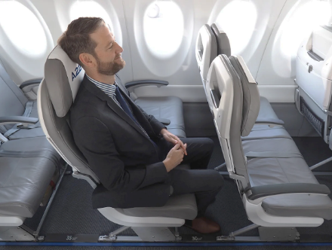
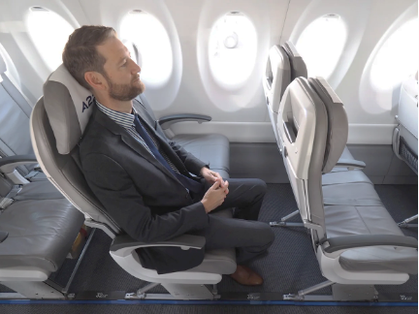
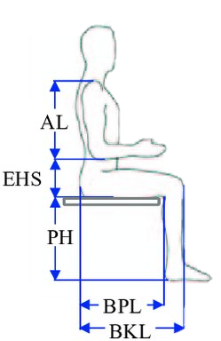
Cabin Layout of the A321LR: The Role of the Seat Pitch
- Uncomfortable/ unnatural knee angle
- Limited legroom and body freedom
+ More seat rows
→Low-cost airlines /economy class
+ More comfortable
- Less seat rows
→ Legacy airlines /Starting from B/C
Seat pitch 31” (Honig 2018)
Seat pitch 34” (Honig 2018)
Conditioned by:
Demography (body height, weight) – e.g., population of the USA vs. Japan
Gender
Market strategy – low-cost vs. legacy airlines
Table 6.1 Legroom for considered percentiles at a 29” and 34” seat pitch (SeatMaestro 2021a and Ergocenter NCSU 2006)
-
Clearance (at knee height) = Legroom - BKL
(edited from Gosende 2017)
Notes:
Anthropometric measurements while seating (edited from Gosende 2017)
It has been made clear that the A321LR offers great cabin flexibility, which opens up plenty of possibilities to its operators. This is only possible because of the engineering technologies implemented, which allow a rapid replacement of seats, even during the turnaround time.
The figures in Chapter 6 showcase obvious differences between a narrower and a larger seat pitch, which can be basically described as a paradigm between offering more legroom to the passengers or fitting more seat rows in the aircraft cabin. Each one of the aircraft’s operators hast to face this decision, which lastly depends on their market strategy.
Moreover, demographic implications like the height and overall body measurements of the aimed population also have an influence. Generally speaking, the population of countries like the USA, Germany, or Sweden is generally taller than that of Japan, Vietnam, or Thailand. In other words, a cabin configuration exclusively designed to operate in Vietnam would be expected to feel extremely narrow to an average-sized American tourist or traveler. This constatation sure does not apply to every single citizen from both countries, but for the demographic majority, it should be true. Furthermore, a trend regarding the two different genders (male and female) is showcased and should apply independently of the demography – men are generally taller than women.
The background of the considerations made above are ergonomic implications, which were addressed in Table 6.1 – the buttock-knee-length (BKL) is the main measurement to take into account while assessing the seat pitch. This dimension directly influences the clearance (space) at knee height towards the next seat. If too narrow, passengers will for sure experience discomfort, especially on long flights. For this matter, it was ascertained that the male percentile should be the one considered for the definition of the seat pitch since female passengers will, in most cases, always have more legroom available.
Considering the most common seat pitches in the economy class appointed by SeatMaestro (2021a), 29” has proven to be insufficient (no clearance for the 95% American male) and 34” to be perhaps somehow excessive, at least in the eyes of low-cost airlines. A seat pitch between 31” and 33” in economy class for the American population should be more reasonable, depending on the airline market strategy – low-cost or a legacy carrier. In any case, the conglomeration of all the factors discussed so far leads to the conclusion that some compromises have to be made when choosing the best seat pitch since there is not a perfect configuration applicable to every single market, mission, and demography.
On the other hand, it is a fact that airlines normally “grant” more space (seat pitch) to passengers in the B/C and F/C while simultaneously equipping those seats with better, dedicated, in-flight entertainment (IFE). Overall, these sorts of seats portray a certain aspect of luxury and represent an upgrade to the passenger in terms of comfort, servicing, as well as for psychological satisfaction. Furthermore, another characteristic of the differentiation between seating classes is the difference in seat widths. It was shown that B/C and F/C seats are also generally wider than those of the Y/C (Figures 6.12 to 6.14), aside from beneficiating from dedicated galleys and toilets (Figures 6.9 to 6.11).
The symbiosis of these two aspects, seat pitch and seat width, can be observed in the case of JetBlue (American airline). This airline shows for all seating classes larger seat pitch and seat width than all the European and Asian airlines taken into account, culminating in a significantly reduced total number of seats in the LR’s cabin – less 30% than the airline with the most seats and less 17% than the airline with the second least seats.
The following closing considerations could be extracted from the cabin layout assessment:
the longer the flight, the more important the seat pitch gets;
the seat pitch and seat pitch (should) take ergonomic aspects into account;
low-cost carriers prioritize more seating rows – more seats, at a lower price;
legacy carriers prioritize offering more comfort and better in-flight service at a corresponding (higher) price – fewer seats, at a higher price;
the total number of seats has a major influence on the DOC, fuel consumption, and Ecolabel of the mission.

Slide 30
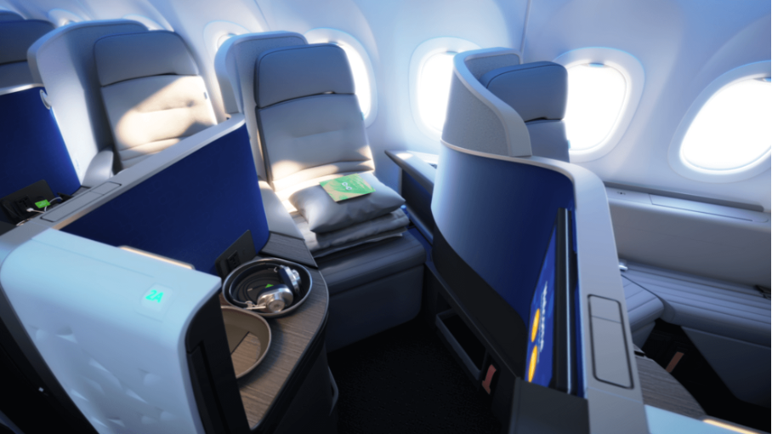
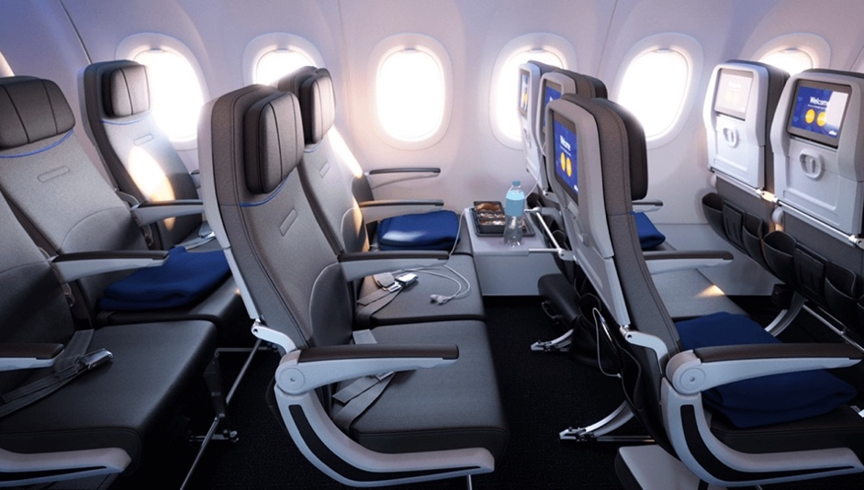
Cabin Layout of the Airbus A321LR
Exemplary Seats (Classes)
JetBlue Mint Studio – business class (JetBlue 2021b)
JetBlue coach seats – economy class (JetBlue 2021b)

Slide 31
Cabin Layout of the Airbus A321LR
Assessment of A321LR Operators – Seat Pitch / Width
Table 6.2 Cabin configurations for different airlines (measurements in inch)
(Airbus 2020; SeatGuru 2021a, 2021d, 2021b; Air Astana 2021 and JetBlue 2021b)

Slide 32
Direct Operating Costs, Fuel Consumption, and Cabin Layout of the Airbus A321LR
    Summary and Conclusions

Slide 33
Summary
„Ideal“ Fuel Consumption for Specific Airlines
Overall fuel consumption evaluation regarding the cabin configurations of the A321LR by different airlines
Notes:
The fuel consumption assessment elucidates the aspect of the operating ranges relative to the design points (B, C, and D) for a given aircraft and assists in the process of discussing the statements made by the OEM and the operators. Through the different visualization, it is possible to indicate which ranges at a given cabin configuration can (still) be operated productively as well as comparing the results to those of other aircraft generations (previous and upcoming). First, these considerations are made disassociated from any sort of cost, ecological, or passenger-related impact.
One starting consideration is the fact that, according to its PRD, the A321neo is capable of an MPL of 25.000 kg, which would translate into a maximum of 257 passengers at 97 kg each, if not for the cabin seating limitations. This means that the design of the A321neo already had considerable reserves, which is somehow unusual, considering the ranges that it usually operates. In other words, this means that the A321neo is generally employed “far” beyond its maximum capabilities if not fully loaded with additional cargo. This consideration solidifies the motivation to extend the range of the aircraft in a variant with additional fuel tanks (ACTs and RCTs) instead of additional cargo.
Regarding the previously mentioned operators of the A321LR (Chapter 6), Figure 7.1 synthesizes the maximum ranges possible at the given cabin configuration without (further) payload reduction. Furthermore, this table displays the corresponding fuel consumption calculated in kg/100km/pax (approximated values). The color-coding indicates whether and to which extent the value is rated as positive or detrimental in relation to the fuel consumption.
First of all, it strikes that in any given case, the previously established M2 (6.500 km) can be operated within a productive and “sensible” fuel consumption per 100 km and pax. Air Transat, the operator with the highest cabin density (199 pax), can operate this range and even surpass it for an extra 300 km without having to block (further) seats. This range is already 13,3% greater than the farthest, by the LR regularly operated route, given in Chapter 2.6 – Lisbon (PT) to Belém (BR) with 6.000 km. By saying this, it is also clearly obvious that the range of the design point B of the LR – 5600km – can also be productively operated, even with maximum seating capacity (240 pax). This is the reason why all ranges are coded with shades of green.
The considered M3, which coincides with the range at MFW of the LR at 7.400 km, is reachable up until a cabin configuration of around 180 pax – in compliance with the structural load limitations. In other words, airlines that employ the LR with a similar cabin configuration (number of pax) to Aer Lingus or lower are also able to operate this range – see Figure 7.1.
Considering that the LR’s cabin can theoretically accommodate 240 pax, it is safe to affirm that most airlines could fly longer missions (than the actual) and still within a productive frame of fuel consumption. In other words, most airlines could either fly further or fit more seats. Furthermore, it strikes that the cabin configuration of JetBlue is very disadvantageous to healthy fuel consumption.
In terms of the fuel consumption per 100 km and passenger, the comparison with other aircraft reveals that the XLR will potentially surpass the LR only after a specific range. Since the aircraft share the same fuselage and engines (i.e., similar efficiency), the advantages of the XLR are only noticeable starting from the point that the LR cannot operate the given mission effectively due to range limitations (not payload). According to the findings in Chapter 3, these ranges are 7600 km, 7200 km, or 6800 km corresponding to low-, standard-, and high-density cabin configuration, respectively. In any mission shorter than these ranges, the LR will generally show lower consumption at a given cabin configuration due to the lower MTOW. Nevertheless, the implementation of ACTs and RCTs has proven itself yet again, as the XLR definitively extends the range without excessively limiting the payload – see Fehler! Verweisquelle konnte nicht gefunden werden..
The favorable implementation of this technology can be traced back until the Airbus A321neo.
Nevertheless, the A321LR will only be more advantageous than the A321neo igiven two scenarios:
in a cabin configuration with more than 170 pax, at a reasonable range – common flight distance, e.g., 2.000 - 4.000 km;
after a range of around 5.800 km, independent of the cabin configuration. After this range the neo is heavily limited in terms of payload, not even reaching the usual 180 pax for a low-density cabin configuration.
In conclusion, it is only suitable to say that the LR is more fuel-efficient than the neo if the proper context is given, i.e., starting from a range of around 5.800 km or with a standard to high-density cabin configuration already at ranges shorter than 5.800 km. Until reaching its range at MPL, the neo should show slightly lower fuel consumption because of the lower MTOW.
As long as the A321 variants are still within their design ranges, the A330-900neo will always show a higher fuel consumption for all ranges and cabin configurations. Only starting from a range of around 8.700 km, the A339 is capable of lower fuel consumption than the XLR – the LR is not operational anymore at this point.

Slide 34
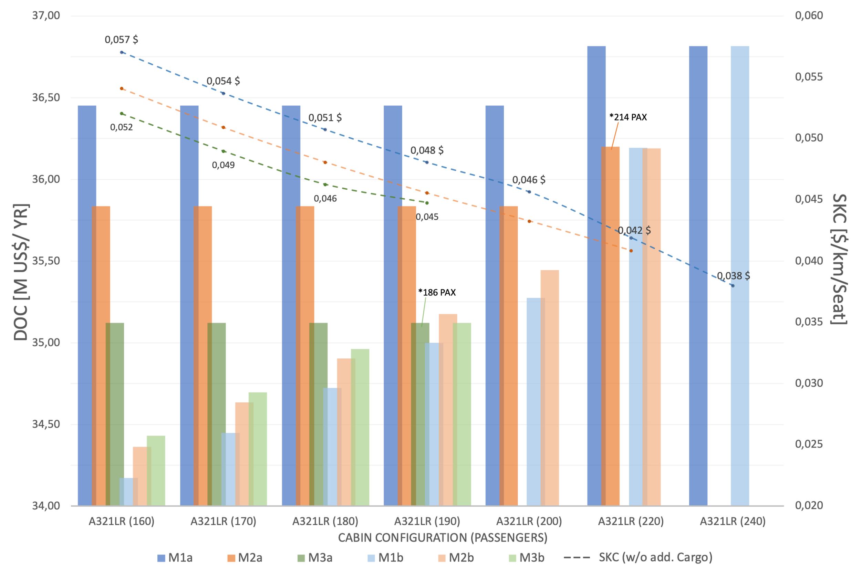
Overview of the DOCs and SKC for the A321LR – Chart, TUB Method
Yearly DOCs and SKCs of the A321LR with the TUB Method: all missions and cabin configurations; a: with cargo; b: without cargo
Notes:
The DOC assessment represents the financial approach to the operation of the A321LR and was performed extensively in Chapter 4. The most relevant findings were combined in charts, which intend to optimize the interpretation of the results in order to discuss them and draw conclusions. As already mentioned, the use of two different DOC methods makes it possible to analyze the different distribution of the single cost shares, apart from comparing different aircraft and missions.
For a better follow up, the ranges of the predefined missions are once again listed:
Mission 1 (M1) coincides with the range at MPL of the LR – 5.600 km;
Mission 2 (M2) is equidistant to the ranges of M1 and M2 – 6.500km;
Mission 3 (M3) coincides with the range at MFW of the LR – 7.400 km.
Figure 7.2 shows for all considered missions, with additional cargo (a) until the MPL and without additional cargo (b), the resulting yearly DOCs and Seat-Kilometer Costs (SKC) of the A321LR calculated with the TUB method. For the sake of simplicity, the results with the AEA were omitted. Nevertheless, they can be roughly estimated using a factor of 1,78 (+89%) for the DOCs and 2,52 (+126%) for the SKC.
Note: The axis for the DOCs starts at 34,0 M US$ and the one for the SKCs at 0,020 US$ (2 cents).
First, it strikes that, especially at lower-density cabin configurations, the gap between the DOCs of missions with and without cargo is bigger, and this gap decreases with increasing cabin density and missions range. As a consequence, airlines should only fill the remaining margin until MPL consistently with cargo if the outcome is financially positive, i.e., if the revenue generated covers the expenses. If not so, carrying more pax should be more viable instead. For example, in M1a, a total of 8.000 kg of cargo, i.e., more than 50% of the m_{pax}, has to be added in order to reach the MPL! For this reason, the only cost differential between missions with additional cargo remains the number of cabin crews aboard the aircraft, which only depends on the number of passengers.
Furthermore, the SKC will always decrease with an increasing number of passengers and is lower in longer missions, as long as the missions can be productively operated (fuel consumption). Nevertheless, with a cabin configuration of at least 220 pax, SKCs of 0,042 U$ with M1 are possible with M1, being then lower than the lowest possible with M3 – at 0,045 US$ and 190 pax. The lowest seat-kilometer costs are possible exclusively with M1 – at 0,038 US$ and 240 pax – in a combination in which even M2 is not possible anymore.
The highest yearly DOCs, 36,82 M US$, are incurred for M1a in a 220 pax cabin and also in a 240 pax cabin configuration, independently of carrying additional cargo or not – the MPL is reached. The lowest yearly DOCs, 34,17 M US$, are registered with M1 in a 160 pax cabin configuration and the exemption of transporting additional cargo.
In terms of the ratio DOC/flexibility (without cargo), it seems reasonable to operate the LR with a cabin configuration of around 190 pax since there is only an insignificant difference between the DOCs (and SKCs) of the contemplated missions. In other words, airlines would have the most flexibility while choosing the routes and with a minimal DOC difference :
35,00 M US$/yr with 713 flight‑cycles à 5.600 km;
35,17 M US$/yr with 673 flight‑cycles à 6.500 km;
35,12 M US$/yr with 570 flight‑cycles à 7.400 km.
This happens because the effects of flight‑cycles and flight distance, which are inversely proportional, neutralize each other in this particular case. These effects are responsible for the variation of C_{FEES} and C_{FUEL}, respectively – see Chapter 4. In order to assess the most profitable option, airlines should consider the difference between ticket prices, i.e., medium-haul versus long-haul, and multiply it by the number of FCs. As an example, should the ticket prices for the flight New York-São Paulo, Brazil (7.400 km) be at least 0,3% higher than in the flight New York-London (5.600 km), the model of M3 will be most profitable – this is mostly the case.

Slide 35
Summary
DOC Observations
In terms of the ratio DOC/flexibility (without cargo), it seems reasonable to operate the LR with a cabin configuration of around 190 pax since there is only an insignificant difference between the DOCs (and SKCs) of the contemplated missions → airlines have the most flexibility while choosing routes and with minimal DOC difference :
35,00 M US$/yr with 713 flight cycles à 5.600 km;
35,17 M US$/yr with 673 flight cycles à 6.500 km;
35,12 M US$/yr with 570 flight cycles à 7.400 km.
Reason: effects of flight cycles and flight distance (inversely proportional) neutralize each other in this particular case: C_{FEES} vs. C_{FUEL}, respectively
→ Most profitable option depends on ticket prices, i.e., medium-haul versus long-haul, and multiply it by the number of flight cycles.

Slide 36
Final conclusions
Deeper insight into the Airbus A321LR: better understanding of operational aspects
Theoretical DOC methods will deliver different costs than those from airlines. The assessment allowed to rank operating costs and clarify the relationship between flight cycles, flight time, and total costs.
Better understanding the implementation of the ACTs (to the A321neo) in order to fly larger ranges → The accommodation of ACTs does not have significant impact on the maximum possible payload in the LR for the given missions. Geometrical/cabin limitations already limit the number of seating passengers in the neo(despite higher MPL)
The neo engines ( A321neo, LR, XLR) have showed clear advantage towards the ceo (emissions and fuel consumption) – 20 years gap between both engines
An update from the neo to the LR is not justifiable if only (very) low-density cabin configurations are employed. In all other cases the LR is the best choice.
The XLR can accommodate 20,3% more fuel, due to a +4,3% MTOW and -5,2% MPL but is only sensible after a range of 7.400 km compared to the LR
A higher density cabin is ecologically always the best choice. Advantage for low-cost carriers!
The seat pitch and market strategy dictate the cabin layout and influence the passenger comfort. This happens in contradiction to the ecological best choice

Slide 37
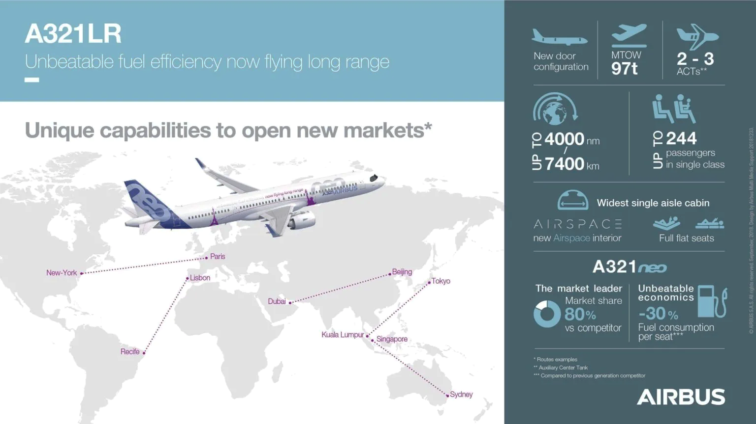
Infographic and possible routes for the Airbus A321LR (Lothar 2021)

Slide 38

Direct Operating Costs, Fuel Consumption, and Cabin Layout of the Airbus A321LR
Contact
info@ProfScholz.de
http://library.ProfScholz.de
Quote this document:
Fonseca, Diego, 2021. Direct Operating Costs, Fuel Consumption, and Cabin Layout of the Airbus A321LR.
Presentation of the Bachelor Thesis. Aircraft Design and Systems Group (AERO), HAW Hamburg, 2022-02-17.
Available from: https://nbn-resolving.org/urn:nbn:de:gbv:18302-aero2021-12-06.014
© Copyright by Author, CC BY-NC-SA, https://creativecommons.org/licenses/by-nc-sa/4.0

Slide 39
List of References
AIRBUS, 2019a. TAP Air Portugal takes delivery of its first A321LR. Airbus.
Available from: https://bit.ly/3p51Lxv
Archived at: https://perma.cc/ZBH9-9CB5
AIRBUS, 2020. A321. Aircraft Characteristics. Airport and Maintenance Planning. Airbus.
Available from: https://bit.ly/3Gd4HPy
Archived at: https://perma.cc/3HL8-86BT
AIRBUS, 2021a. JetBlue takes delivery of A321LR with the first airspace interior. Airbus.
Available from: https://bit.ly/3I2rFL2
Archived at: https://perma.cc/57WA-7TRG
AIRBUS, 2021c. A330. Aircraft Characteristics. Airport and Maintenance Ülanning. Airbus.
Available from: https://bit.ly/3Gd4HPy
Archived at: https://perma.cc/X9QJ-HGH5
EIA, 2021. U.S. Gulf Goast Kerosene-Type Jet Fuel Spot Price FOB. U.S Energy Information Administration.
Available from: https://bit.ly/3BWUBAE
Archived at: https://perma.cc/VVC2-45FM
ERGOCENTER NCSU, 2006. Antropometric Data. The Ergonomics Center. North Carolina State University
Available from: https://bit.ly/3n3b1kP
Archived at: https://perma.cc/3QXN-GDBD

Slide 40
List of References
GOSENDE, Pablo, 2017. Anthropometry-based approach for side-mounted desktop chairs design evaluation for university students in ecuador. Guayaquil, Engineering Faculty, Salesian Polytechnic University. ResearchGate.
Available from:https://bit.ly/3lQBxyp
Archived at: https://doi.org/10.1109/ETCM.2017.8247516
HURTECANT, Daan, 2021. Launch of an Ecolabel for Passenger Aircraft. Master Thesis. Hamburg: Hochschule für Angewandte Wissenschaften Hamburg.
Available from: https://bit.ly/3jcOhxy
Archived at: https://doi.org/10.7910/DVN/LU5VAZ
LOTHAR, 2021. Zweistrahler im Portrait: der Airbus A321. Meilen Optimieren.
Available from: https://bit.ly/31i0Bqv
Archived at: https://perma.cc/E6ST-96F9
PEARSON, James, 2021a. Revealed: the Longest Airbus A321neo Routes This Winter. Simple Flying.
Available from: https://simpleflying.com/longest-a321neo-routes-winter-2021/
Archived at: https://perma.cc/MBZ4-TXR9
PEARSON, James, 2021b. The Incredible Rise of Transatlantic A321LR Narrowbody Flights. Simple Flying.
Available from: https://simpleflying.com/transatlantic-a321lr-narrobody-flights/
Archived at: https://perma.cc/2KAP-GKBA
SCHOLZ, Dieter, 2015. Aircraft Design. Lecture Series. Hamburg, Germany: Hamburg Open Online University (HOOU).
Available from: https://www.fzt.haw-hamburg.de/pers/Scholz/HOOU/

Slide 41
List of References
SCHOLZ, Dieter, 2021a. Aircraft Fuel Consumption – Estimation and Visualization. FuelCalculation_SLZ [Excel File]. Hamburg, Germany: Hochschule für Angewandte Wissenschaften Hamburg.
Available from:https://doi.org/10.7910/DVN/2HMEHB (Excel file)
SCHOLZ, Dieter, 2021b. PreSTo – Aircraft Preliminary Sizing Tool: PreSTo-DOC. PreSTo‑DOC_1.0 [Excel File]. Hamburg, Germany: Hochschule für Angewandte Wissenschaften Hamburg.
Available from: https://www.fzt.haw-hamburg.de/pers/Scholz/PreSTo.html (Excel file)
SEATMAESTRO, 2021a. On Legroom and Airplane Seat pitch.
Available from: https://www.seatmaestro.com/legroom-airplane-seat-pitch/
Archived at: https://perma.cc/E4UX-LVM4
YOUNG, Trevor M., 2017. Performance of the Jet Transport Airplane: Analysis Methods, Flight Operations, and Regulations. New Jersey, John Wiley & Sons.
Available from: https://doi.org/10.1002/9781118534786

