Slide 1
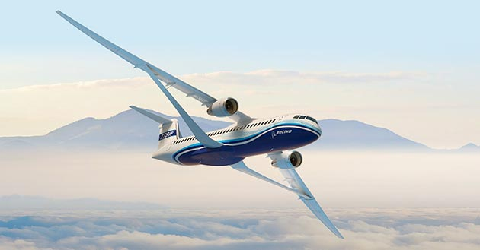
Wing Design Regarding Mass and Drag
Dieter Scholz Hamburg University of Applied Sciences
Based on the Master Thesis of Houssein Mahfouz
SAWE 83rd International Conference on Mass Properties Engineering
Online, 20-22 May 2024
Paper 3801
https://doi.org/10.48441/4427.1587

Slide 2
Abstract
Purpose – To optimize the parameters of the wing of a jet transport aircraft with equations from the aircraft design on wing mass and drag in a spreadsheet (Excel) and with its optimizer (Solver).
Methodology – The wing mass is calculated using Torenbeek's equation (with and without wing strut) and alternatively using an equation from the Luftfahrttechnischen Handbuch (LTH). Drag is divided into zero-lift drag, induced drag, and wave drag. The respective methods for calculating these drag elements are taken from Scholz's lecture notes. The aircraft design is mapped in a simplified way without the many hierarchically structured iterations. Instead, this simple wing design uses only one iteration. Procedures with snowball effect (Mass Growth Factor), with the 1st law of aircraft design and with both procedures combined are examined. On the one hand, the drag (fuel consumption) is minimized and, on the other hand, the take-off mass, which can be seen as a proxy for Direct Operating Costs (DOC).
Findings – The simple approach to Multidisciplinary Design Optimization (MDO) is provided as a spreadsheet "Wing-MDO". In comparison with the complete aircraft design and optimization program "Optimization in Preliminary Aircraft Design" (OPerA), the results from the simpler "Wing-MDO" could be confirmed or calibrated to it. A further comparison resulted from the literature review. For an aircraft with parameters like the Airbus A320, an optimal wingspan is obtained by minimizing the drag of 42.52 m (-23.94 %) without a wing brace and 53.09 m (-24.50 %) using a wing brace and minimizing the take-off mass an optimal wingspan of 36.65 m (-8.76 %) or 44.20 m (-13.31 %). The resulting changes in drag or take-off mass are given in parentheses.

Slide 3
Abstract
Practical Implications – "Wing-MDO" is offered to the community as a simple and user-friendly tool in Excel for optimizing basic wing parameters.
Social Implications – The optimization of an aircraft traditionally starts with the wing. This can currently also be seen in the new Boeing X-66A project. The present thesis serves to classify such proposals and shows that wings with a high span (and aspect ratio) can significantly reduce fuel consumption and thus CO2 emissions and environmental impact. Presented simple calculations make public discourse possible.
Originality – Disciplines have presented the impact of their investigations at aircraft level, without considering the iterations (snowball effects) of aircraft design. Using the example of the wing, it could be shown how individual effects on mass and drag can be transferred simply but correctly to the aircraft level.

Slide 4
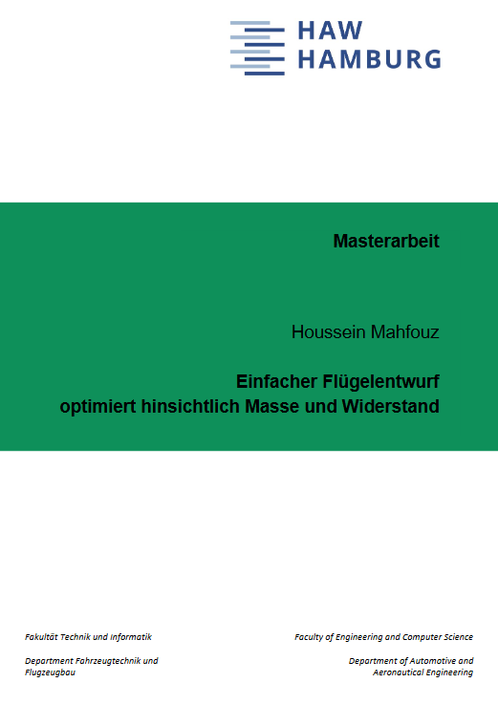
Acknowledgment
Wing Design Regarding Mass and Drag
Houssein Mahfouz prepared a Master Thesis:
"Einfacher Flügelentwurf optimiert hinsichtlich Masse und Widerstand"
(Simple Wing Design Optimized for Mass and Drag)
at
Hamburg University of Applied Sciences,
Aircraft Design and Systems Group (AERO).
http://library.ProfScholz.de
https://nbn-resolving.org/urn:nbn:de:gbv:18302-aero2023-10-16.018

Slide 5
Wing Design Regarding Mass and Drag
Motivation
Wing optimization is the classic first choice for optimization in classic aircraft design.
Wing optimization has two closely related disciplines: aerodynamics and structures.
The economics are always of most importance in commercial aviation
=> integration of economics as a third discipline.
In order to integrate these disciplines, the method of Multidisciplinary Design Optimization (MDO) is used. Traditionally, numerical methods such as Computational Fluid Dynamics (CFD) and Finite Element Method (FEM) have been used for this purpose.
This thesis investigates a simpler approach:
=> handbook equations are used for wing drag and wing mass
=> objective function is the take-off mass, which can be used as a proxy for the Direct Operating Costs (DOC).
How to integrate take-off mass into the optimization without the whole Aircraft Design loop, but instead using – much simpler – the mass growth factor?

Slide 6
Wing Design Regarding Mass and Drag
Table of Contents
Introduction Wing Design Optimized with Wing-MDO Wing Design Optimized in Aircraft Design with OPerA Comparison of the Results of Wing-MDO and OPerA Comparison of the Results of Wing-MDO and the Literature Review Efficient Wing with Large Wingspan for the Next Generation of Aircraft Conclusions and Outlook Contact List of References

Slide 7
Wing Design Regarding Mass and Drag
Introduction

Slide 8
Introduction
Objectives and Research Questions
Development of a sound understanding of simple Multidisciplinary Design Optimization (MDO) in aircraft design. Consideration of equations from aircraft design (zero lift drag, wave drag, induced drag and wing mass) to model wing MDO in Excel.
Research questions:
Is it possible to obtain practical, optimized wing parameters if, instead of the numerical methods (CFD and FEM), only equations from the aircraft design are used and aircraft design iterations are only taken into account by a Mass Growth Factor?
Optimization only with Excel's Solver and determination of relevant objective function for results (maximum take-off mass).
Comparison of the Wing-MDO tool to be created with the existing aircraft design optimizer OPerA (from PhD program).
Performing a literature review to support the comparison!

Slide 9
Wing Design Regarding Mass and Drag
Wing Design
Optimized with Wing-MDO

Slide 10
Wing Design Optimized with Wing-MDO
Description of Wing-MDO
Multidisciplinary Design Optimization (MDO) Program
User-friendly Excel file
Calculation of wing mass, drag coefficients (zero-lift drag, wave drag, induced drag), and drag
Two separate mass estimation methods:
=>Torenbeek Method => LTH Method
Set up with 20 Iteration Steps for Wing Mass Determination
Using the Excel Solver as a powerful optimization tool

Slide 11
Wing Design Optimized with Wing-MDO
Description of Wing-MDO
Parameter variation:
Investigation of classic compromises in wing design,
Variation of parameters: wingspan, relative thickness, taper, sweep, wing loading, Mach number and flight altitude,
The user sets the range in which parameters are changed.
Two program versions:
Wing-MDO-1: Focus on minimization of drag,
Wing-MDO-2: Overcoming the challenges of minimizing take-off mass.

Slide 12
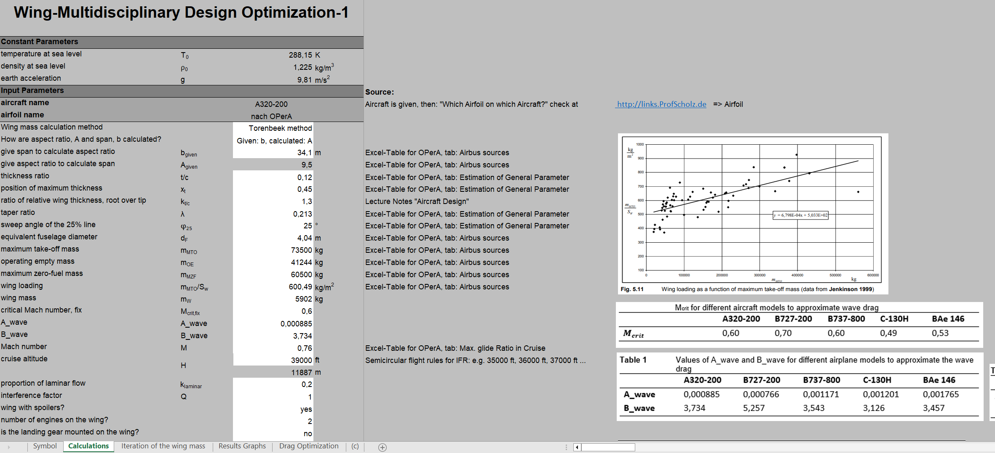
Wing Design Optimized with Wing-MDO
Description of Wing-MDO
Wing-MDO-1 Layout (Screenshot):
Similarity in user interface and table structure of Wing-MDO-1 and Wing-MDO-2

Slide 13
Wing Design Optimized with Wing-MDO
Wing-MDO-1
Use of the Snowball Factor $k_{MG,i}$ to calculate the change in wing mass between iteration steps:
$$k_{MG,i}=\frac{m_{MTO,i}}{m_{MPL}}$$
Calculation of the new take-off mass from one iteration steps to the other:
$$m_{MTO,i+1}=m_{MTO,i}+k_{MG,i}∙\left(−m_{W}+m_{W,i}\right)$$
(1)
(2)

Slide 14
Wing Design Optimized with Wing-MDO
Wing-MDO-2
Main goal: Solving the problem of take-off mass minimization experienced in Wing-MDO-1
Identified problems with Wing-MDO-1:
Wingspan tends towards zero
Significant increase in relative thickness
Cause: Failure to take fuel mass into account in the take-off mass calculation equation of Wing-MDO-1
Calculation of the take-off mass in Wing-MDO-2 using the "1st law of the aircraft design":
$$m_{MTO}=m_{MPL}/(1−m_{F}/m_{MTO}−m_{OE}/m_{MTO})$$
Calculation of the new operating empty mass:
$$m_{OE,i+1}=m_{OE,i}+k_{MG,i}∙\left(−m_{W}+m_{W,i}\right)$$
Results show that both $k_{MG}$in (4) together with (3) overestimate the change in wing mass.
=> Introduction of a reduction factor $k_{k,MG}$ in (4):
$$m_{OE,i+1}=m_{OE,i}+k_{k,MG}∙k_{MG,i}∙\left(−m_{W}+m_{W,i}\right)$$
(3)
(4)
(5)

Slide 15
Wing Design Optimized with Wing-MDO
Wing-MDO-2
Identification of $k_{k,MG}$, so that Wing-MDO-2 and OPerA achieve the same wingspan for a cantilever wing while minimizing take-off mass
=> $k_{k,MG}=0.855$
Introduction of a damping factor $k_{damping}$ in (3) to cope with diverging iteration:
$$m_{MTO,i+1}=m_{MTO,i}+\left(\frac{m_{MPL}}{1−{\left(\frac{m_{F}}{m_{MTO}}\right)}_{i}−{\left(\frac{m_{OE}}{m_{MTO}}\right)}_{i}}−m_{MTO,i}\right) ∙k_{damping}$$
=> $k_{damping}$ = 0.69 is a good value.
(6)

Slide 16
Wing Design Optimized with Wing-MDO
Optimization Results
Concrete example:
Optimization for cantilever and braced wing based on the standard configuration of the A320-200
Application of the LTH method:
Aspect ratio out of range in this example
=> no meaningful results
=> LTH method not anymore taken into account
Torenbeek method chosen to continue optimization

Slide 17
Wing Design Optimized with Wing-MDO
Optimization Results (Wing-MDO-1)
Results of drag minimization of a cantilever wing
 | b_{given} [m] | t/c [-] | λ [-] | ϕ₂₅ [°] | M [-] | H [m] | A [-] | m_{MTO} [kg] | S_{W} [m²] | m_{W} [kg] | D_{min} [N] | % difference in drag after optimization
f (b) | 50,20 | - | - | - | - | - | 15,57 | 97214 | 161,89 | 11903 | 28702 | -11,54
f (t/c) | - | 0,190 | - | - | - | - | 9,51 | 73400 | 122,23 | 5876 | 31236 | -3,73
f (λ) | - | - | 0 | - | - | - | 9,30 | 75110 | 125,08 | 6323 | 31317 | -3,48
f (ϕ₂₅) | - | - | - | 12,50 | - | - | 9,26 | 75385 | 125,54 | 6395 | 31731 | -2,20
f (M) | - | - | - | - | 0,73 | - | 9,07 | 77008 | 128,24 | 6818 | 31392 | -3,25
f (H) | - | - | - | - | - | 6858 | 9,07 | 77008 | 128,24 | 6818 | 25224 | -22,26
f (b, t/c) | 51,11 | 0,186 | - | - | - | - | 17,13 | 91545 | 152,45 | 10516 | 27320 | -15,80
f (b, λ) | 50,70 | - | 0 | - | - | - | 16,34 | 94457 | 157,30 | 11233 | 27399 | -15,55
f (b, ϕ₂₅) | 51,17 | - | - | 9,92 | - | - | 16,64 | 94522 | 157,41 | 11249 | 27603 | -14,93
f (b, M) | 50,85 | - | - | - | 0,71 | - | 15,82 | 98170 | 163,48 | 12134 | 27316 | -15,81
f (b, H) | 38,98 | - | - | - | - | 7571 | 11,06 | 82537 | 137,45 | 8245 | 25022 | -22,88
f (t/c, ϕ₂₅) | - | 0,186 | - | 12,09 | - | - | 9,68 | 72134 | 120,12 | 5544 | 30720 | -5,32
f (b, t/c, ϕ₂₅) | 52,38 | 0,180 | - | 10,66 | - | - | 18,29 | 90090 | 150,03 | 10155 | 26515 | -18,28
f (b, ϕ₂₅, M) | 52,91 | - | - | 9,26 | 0,71 | - | 17,38 | 96738 | 161,09 | 11788 | 26005 | -19,85
f (t/c, ϕ₂₅, M) | - | 0,189 | - | 11,33 | 0,72 | - | 9,70 | 71980 | 119,87 | 5503 | 29502 | -9,07
f (t/c, ϕ₂₅, H) | - | 0,138 | - | 21,54 | - | 7076 | 9,28 | 75240 | 125,30 | 6357 | 25130 | -22,55
f (b, t/c, ϕ₂₅, M) | 54,74 | 0,185 | - | 9,84 | 0,70 | - | 19,50 | 92255 | 153,63 | 10691 | 24789 | -23,60
f (b, t/c, ϕ₂₅, H) | 42,52 | 0,149 | - | 14,45 | - | 8570 | 13,22 | 82157 | 136,82 | 8148 | 24677 | -23,94

Slide 18
Wing Design Optimized with Wing-MDO
Optimization Results (Wing-MDO-2)
Results for minimizing the take-off mass of a cantilever wing
 | b_{given} [m] | ϕ₂₅ [°] | M [-] | A [-] | S_{W} [m²] | m_{W} [kg] | m_{MTO,min} [kg] | % difference in take-off mass after optimization
f (b) | 35,20 | - | - | 10,90 | 113,63 | 7130 | 68236 | -7,16
f (ϕ₂₅) | - | 27,50 | - | 10,16 | 114,38 | 6957 | 68687 | -6,55
f (M) | - | - | 0,74 | 10,21 | 113,82 | 6817 | 68353 | -7,00
f (b, ϕ₂₅, M) | 36,65 | 6,95 | 0,73 | 12,03 | 111,68 | 6986 | 67065 | -8,76

Slide 19
Wing Design Regarding Mass and Drag
Wing Design
Optimized in
Aircraft Design
with OPerA

Slide 20
Wing Design Optimized in Aircraft Design with OPerA
Description of OPerA
Development of OPerA (Optimization in Preliminary Aircraft Design) as part of Mihaela Nita's PhD Thesis, supervision: Prof. Scholz (Nita 2013). Main objective: Set up optimization for preliminary and conceptual aircraft design. OPerA includes various modules such as Parameter Estimation, Preliminary Sizing, Area Estimation, Interference Factors, Resistance Estimation, Mass Calculation, Fuel Consumption Calculation, Direct Operating Cost Calculation and more. Two types of optimization with genetic algorithm (differential evolution):
a) Built-in VBA algorithms or
b) Interface with Optimus. User can set control parameters, free parameters, and objective functions (e.g., cost minimization or fuel mass reduction) to determine optimal aircraft parameters according to mission requirements.

Slide 21
Wing Design Optimized in Aircraft Design with OPerA
Optimization of a Cantilever Wing Based on the A320-200
Results to minimize fuel mass
Results to minimize take-off mass
Results to minimize DOC
 | A [-] | ϕ₂₅ [°] | M [-] | b [m] | m_{MTO} [kg] | S_{W} [m²] | m_{W} [kg] | m_{F, min} [kg] | % difference in fuel mass after optimization
f(A) | 18,56 | - | - | 50,24 | 81669 | 136,01 | 11417 | 13466 | -16,18
f(ϕ₂₅) | - | 21,23 | - | 34,48 | 77296 | 125,15 | 6659 | 16045 | -0,13
f(M) | - | - | 0,72 | 34,68 | 76025 | 126,60 | 6238 | 15774 | -1,82
f (A, ϕ₂₅, M) | 19,88 | 20,09 | 0,68 | 49,62 | 77056 | 123,83 | 9920 | 12674 | -21,12
 | A [-] | ϕ₂₅ [°] | M [-] | b [m] | S_{W} [m²] | m_{W} [kg] | m_{MTO, min} [kg] | % difference in take-off mass after optimization
f (A, ϕ₂₅, M) | 12,01 | 7,04 | 0,65 | 36,65 | 111,92 | 6077 | 73594 | -5,29
 | A [-] | ϕ₂₅ [°] | M [-] | b [m] | m_{MTO} [kg] | S_{W} [m²] | m_{W} [kg] | C_{DOC,min} [€/NM/t] | % difference in DOC after optimization
f (A, ϕ₂₅, M) | 13,22 | 13,22 | 0,69 | 39,35 | 75507 | 117,06 | 7650 | 1,16 | -1,98

Slide 22
Wing Design Regarding Mass and Drag
Comparison of
the Results of Wing-MDO and OPerA

Slide 23
Comparison of the Results of Wing-MDO and OPerA
Wing-MDO vs. OPerA
Results to minimize drag, fuel mass, take-off mass, and DOC of a cantilever wing based on the A320-200
Comparable results of Wing-MDO and OPerA
Selection of tool depending on the specific objective function:
Drag minimization: Wing-MDO-1 due to faster calculation.
Minimization of take-off mass (proxy for DOC): Wing-MDO-2 is suitable (not Wing-MDO-1).
Complete aircraft design with many parameters and DOC calculation: Use OPerA.
 | Objective functions with % difference after optimization |  | b [m] | ϕ₂₅ [°] | M [-] | A [-] | m_{MTO} [kg] | S_{W} [m²] | m_{W} [kg]
f (b, ϕ₂₅, M),_{Wing-MDO-1} | D_{min} | (-19,85) | 52,91 | 9,26 | 0,71 | 17,38 | 96738 | 161,10 | 11788
f (A, ϕ₂₅, M),_{OPerA} | m_{F,min} | (-21,12 ) | 49,62 | 20,09 | 0,68 | 19,88 | 77056 | 123,83 | 9920
f (b, ϕ₂₅, M),_{Wing-MDO-2} | m_{MTO,min} | (-8,76) | 36,65 | 6,95 | 0,73 | 12,03 | 67065 | 111,68 | 6986
f (A, ϕ₂₅, M),_{OPerA} | m_{MTO,min} | (-5,29 ) | 36,65 | 7,04 | 0,65 | 12,01 | 73594 | 111,92 | 6077
f (A, ϕ₂₅, M),_{OPerA} | C_{DOC,min} | (-1,98) | 39,35 | 13,22 | 0,69 | 13,22 | 75507 | 117,06 | 7650

Slide 24
Wing Design Regarding Mass and Drag
Comparison of
the Results of Wing-MDO and a Literature Review

Slide 25
Comparison of the Results of Wing-MDO and a Literature Review
Master Thesis of Hoogervorst 2015 (TU Delft)
Titel:
Wing Aerostructural Optimization Using the Individual Discipline Feasible Architecture.
Objective: Minimizing drag by optimizing the wing geometry of the Airbus A320.
Approach used: Applying the Individual Discipline Feasible (IDF) architecture to solve a gradient-based multidisciplinary design optimization problem.
Advantage of IDF architecture: Does not require coupled sensitivity analysis for gradient-based optimization, allowing for greater flexibility in choosing software for disciplinary analysis and reducing overall computational costs.
Software tools used:
Aerodynamics: SU2 software for deformation of surface and volume lattices, calculation of flow properties and derivation of sensitivities.
Structure: FEMWET software to model the static aeroelastic deformation and aeroelastic axis of the wing.

Slide 26
Comparison of the Results of Wing-MDO and a Literature Review
Wing-MDO-1 Compared to Hoogervorst 2015
Results of drag minimization of a cantilever wing achieved by Wing-MDO-1 and Hoogervorst 2015
Comparable results despite different optimization approaches.
Optimization with Wing-MDO-1 is faster than the optimization carried out in the study by Hoogervorst 2015.
 | b/2 [m] | ϕ₂₅ [°] | A [-] | m_{MTO} [kg] | S_{W} [m²] | m_{W} [kg] | C_{D} [-]
Wing-MDO-1 | 21,26 | 14,4 | 13,22 | 82157 | 68,40 | 8148 | 0,0136
Hoogervorst 2015 | 19,57 | 20,2 | 11,55 | 70948 | 66,32 | 8270 | 0,0142
% Difference | 8,64 | 28,71 | 14,46 | 15,80 | 3,14 | 1,48 | 4,23

Slide 27
Wing Design Regarding Mass and Drag
Efficient
Large Span Wing
for the
Next Generation
of Aircraft

Slide 28
Efficient Large Span Wing for the Next Generation of Aircraft
Efficient Wing
Drag: Optimization vs. Standard A320-200 for Cantilevered and Braced Wing
A braced wing is more efficient than a cantilever wing.
Recommended span: 36 m to 52 m (ICAO code D).

Slide 29
Efficient Large Span Wing for the Next Generation of Aircraft
Boeing's Innovative Aircraft Project (Boeing X-66A)
Boeing is working on a successor for the B737 Max in cooperation with NASA. This project, called the "Sustainable Flight Demonstrator", uses the innovative "Transonic Truss-Braced Wing" concept, known as the X-66A. (Bardan 2023, Ebner 2023, Sebayang 2023). Boeing X-66A is to be equipped with a folding braced wing with a high aspect ratio and
wingspan of approximately 52 m. (Boeing 2019) Goal: Reduction of drag and integration of more efficient components (e.g. propulsion systems)
Boeing X-66A (Boeing 2019)

Slide 30
Wing Design Regarding Mass and Drag
Conclusions
and
Outlook

Slide 31
Wing Design Regarding Mass and Drag
Conclusions and Outlook
The master thesis helps to understand wing optimization in aircraft design and shows that practical and optimum wing parameters can be found by using only handbook equations from aircraft design instead of numerical methods. The aircraft design iteration is taken into account by a snowball factor (mass growth factor) and optimization with the Solver in Excel.
Ideas for future research:
Identifying different values for the reduction factor $k_{k,MG}$ to achieve specific objectives:
To achieve comparable results in drag minimization between Wing-MDO-1 and Wing-MDO-2 (instead of Wing-MDO-2 and OPerA).
Ensuring comparable results between Wing-MDO-2 and OPerA for different aircraft types and a wide range of parameters, not only for taking into account wingspan.
Investigation of efficient engines integrated into braced wings using OPerA and its practical aircraft design approach.

Slide 32
Wing Design Regarding Mass and Drag
Contact
info@ProfScholz.de
http://mass.ProfScholz.de and http://library.ProfScholz.de
Quote this document:
SCHOLZ, Dieter, 2024. Wing Design Regarding Mass and Drag. In: Society of Allied Weight Engineers (SAWE), 83rd
International Conference on Mass Properties Engineering. Online, 20-22 May 2024.
Available from: https://doi.org/10.48441/4427.1587
Quote the thesis:
MAHFOUZ, Houssein, 2023. Einfacher Flügelentwurf optimiert hinsichtlich Masse und Widerstand.
Masterarbeit. Aircraft Design and Systems Group (AERO), HAW Hamburg, 2023-10-30.
Available from: https://nbn-resolving.org/urn:nbn:de:gbv:18302-aero2023-10-16.018
© Copyright by Author, CC BY-NC-SA, https://creativecommons.org/licenses/by-nc-sa/4.0

Slide 33
Wing Design Regarding Mass and Drag
List of References
BARDAN, Roxana, 2023. NASA Issues Award for Greener, More Fuel-Efficient Airliner of Future. NASA
Available from: | https://go.nasa.gov/3QiFStn
Archived at: | https://perma.cc/YMC7-QTNP
BOEING, 2019. Spreading our wings: Boeing unveils new Transonic Truss-Braced Wing.
Available from: | https://bit.ly/3qXKqeP
Archived at: | https://perma.cc/5KA2-7HG9
EBNER, Ulrike, 2023. Transonic Truss-Braced Wing heißt nun X-66A. In: Flugrevue, 2023-06-13.
Available from: | https://bit.ly/3RXVVxR
Archived at: | https://perma.cc/BP9N-A8Z2
NITA, Mihaela Florentina, 2013. Contributions to Aircraft Preliminary Design and Optimization. Dissertation. München: Verlag Dr. Hut.
Available from: | https://purl.org/aero/NITA_DISS_2013
SEBAYANG, Andreas, 2023. Boeing und Nasa wollen "Sustainable Flight Demonstrator" bis 2030 in die Luft bringen. Airliners.de.
Available from: | https://bit.ly/48Wf09H
Archived at: | https://perma.cc/2LJX-UL8G

