Slide 1
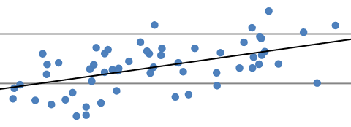
Methods for Operating Empty Mass Estimation in Aircraft Design
Dieter Scholz Hamburg University of Applied Sciences
Based on the Project of Jan Lehnert
R in NM
SAWE 83rd International Conference on Mass Properties Engineering
Online, 20-22 May 2024
Paper 3804
https://doi.org/10.48441/4427.1585

Slide 2
Abstract
Purpose – Calculation methods from Torenbeek, Raymer, Marckwardt, and Loftin are examined and compared. The question is whether there is a more precise method for passenger aircraft to determine the operating empty mass fraction based on new statistics.
Methodology – Equations for estimating the operating empty mass fraction are determined from parameters including thrust-to-weight ratio, wing loading, design range, payload, and number of engines (on the wing). Only aircraft parameters are used, which are already known in preliminary sizing and for which a physical connection exist to the operating empty mass fraction.
Findings – New methods surpass the accuracy of the classic calculation methods. This is achieved by using more and other design parameters and their optimal mathematical combination.
Practical implications – The risk of incorrect mass estimation in preliminary sizing is reduced.

Slide 3
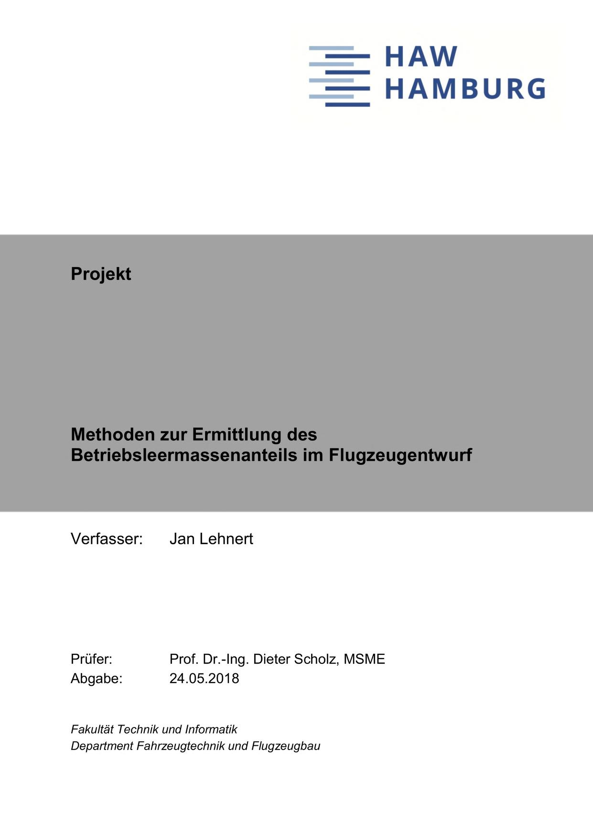
Acknowledgment
Methods for Operating Empty Mass Estimation in Aircraft Design
Jan Lehnert prepared a project:
"Methoden zur Ermittlung des Betriebsleermassenanteils im Flugzeugentwurf"
(Methods to Determine the Operating Empty Mass in Aircraft Design)
at
Hamburg University of Applied Sciences,
Aircraft Design and Systems Group (AERO).
http://library.ProfScholz.de
https://nbn-resolving.org/urn:nbn:de:gbv:18302-aero2018-05-24.014
His work is referenced here as: Lehnert 2018

Slide 4
Methods for Operating Empty Mass Estimation in Aircraft Design
Table of Contents
Equations and Numbers from Textbooks New Equations Contact

Slide 5
Methods for Operating Empty Mass Estimation in Aircraft Design
Equations and Numbers
from Textbooks

Slide 6
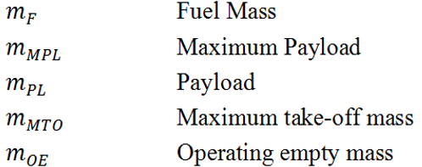
Equations and Numbers from Textbooks
"First Law of Aircraft Design" and Operating Empty Mass Ratio
$m_{MTO}=$ $m_{OE}+m_{F}+m_{MPL}$
Basic mass summation
$1=$ $\frac{m_{OE}}{m_{MTO}}+\frac{m_{F}}{m_{MTO}}+\frac{m_{MPL}}{m_{MTO}}$
Unity Equation (according to Torenbeek)
First Law of Aircraft Design (Scholz 2015)
$$\frac{m_{OE}}{m_{MTO}}$$
Operating Empty Mass ratio

Slide 7
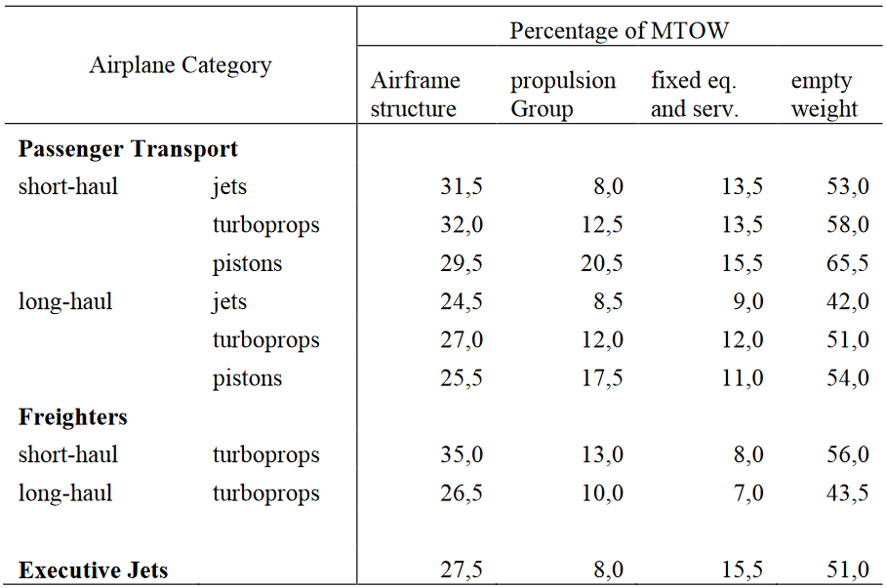
Equations and Numbers from Textbooks
Some Numbers from Torenbeek
Operating Empty Mass ratio
Torenbeek 1982
fromTU Delft.

Slide 8
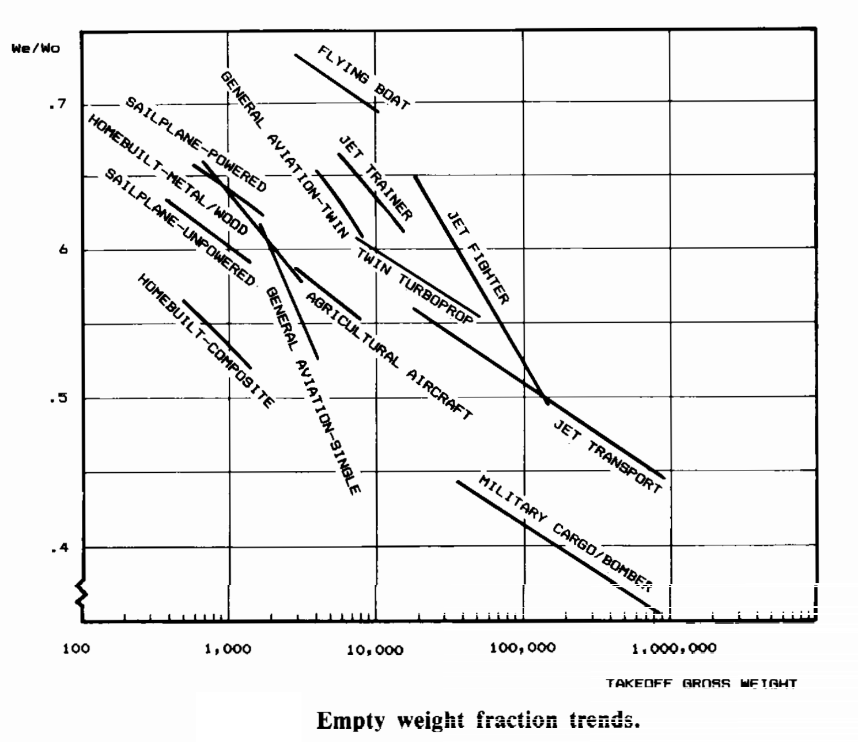
Equations and Numbers from Textbooks
Some Numbers from Raymer
Operating Empty Mass ratio
Apparent reduction with aircraft size. Physically, the reduction is due to range.
There is a correlation between aircraft size and range. This explains the reduction of Operating Empty Mass ratio with size.
Raymer 1992. His book published with AIAA.

Slide 9
Equations and Numbers from Textbooks
Equation from Marckwardt
Operating Empty Mass ratio
According to Marckwardt (HAW Hamburg), OEM ratio reduces with range, R and number of engines, n_{E} on the wing. MTOM rather increases OEM ratio, but very little. This can all be seen from the exponents in the first equation. MTOM is initially unknown. This leads to an iteration with OEM ratio set to 0.5 initially. The iteration converges after only three steps, because MTOM has very little influence.
Please see my Aircraft Design lecture notes (Scholz 2015) for details.

Slide 10
Equations and Numbers from Textbooks
Equation from Loftin
Operating Empty Mass ratio
Loftin 1980 (NASA) calculates OEM ratio from what is know after the matching chart is drawn in aircraft preliminary sizing. The simple equation is based on aircraft data from 1980. It still works well.
Please see my Aircraft Design lecture notes (Scholz 2015) for details.

Slide 11
Methods for Operating Empty Mass Estimation in Aircraft Design
New Equations

Slide 12
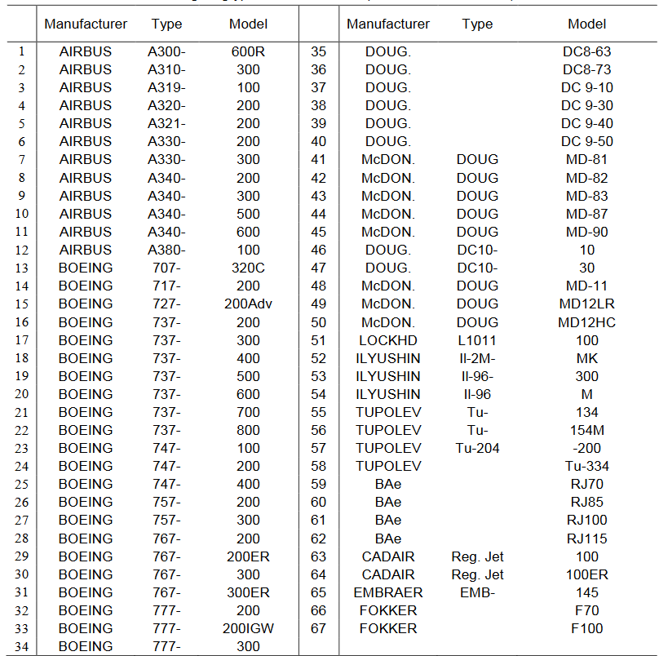
New Equations
Database from Jenkinson Used for the New Equations
Data of 67
Passenger
Jet Aircraft
Produced by Lloyd Jenkinson, Loughborough University with students.
His book: Jenkinson 1999.
https://booksite.elsevier.com/9780340741528/appendices/data-a/default.htm, archive at: https://web.archive.org/web/20230402100910/https://booksite.elsevier.com/9780340741528/appendices/data-a/default.htm

Slide 13
New Equations
Reevaluating the Equation from Loftin
old (1980):
new (2018):
After 38 years the equation results pretty much unchanged from regression.
Lehnert 2018

Slide 14
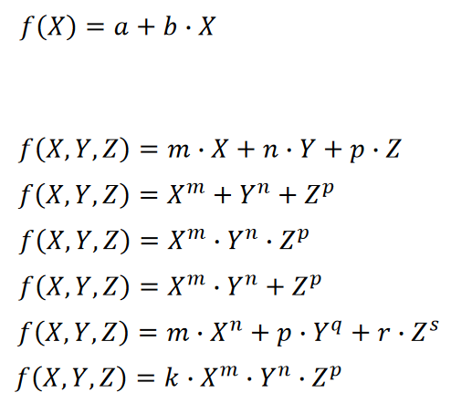
New Equations
Possible Structure of New Equations
Linear Regression:
Multiple Regression:
Nonlinear Regression:
The best:
Lehnert 2018

Slide 15
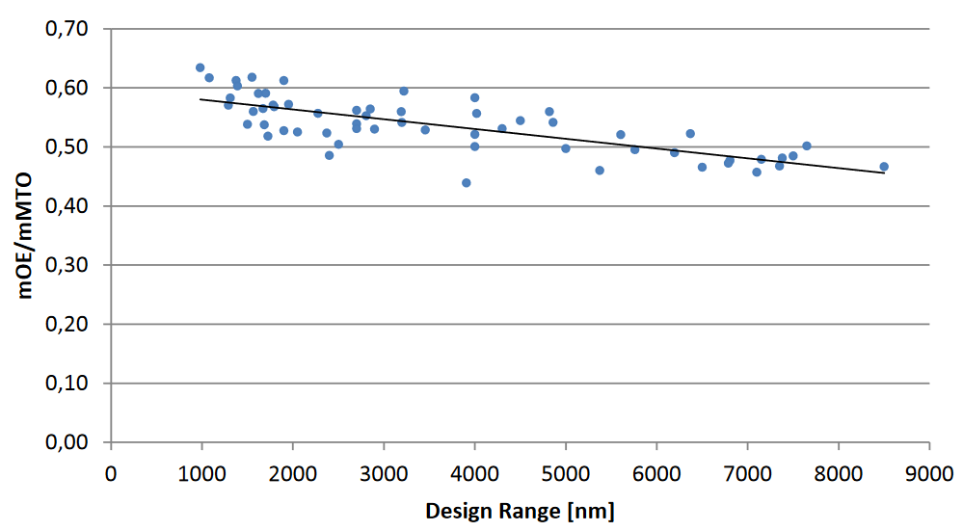
New Equations
Equation from Design Range, Plotting the Data
Long-range aircraft need to be efficient to make money. This is why OEM ratio is decreasing with range.
Lehnert 2018

Slide 16
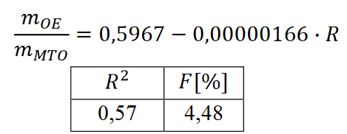
New Equations
Equation from Design Range (R in NM)
Regression coefficient, R ² and average relative error, F are used to determine the accuracy of the equation.
R ² > 0.5 is useful
R ² > 0.7 is a good accuracy
Lehnert 2018

Slide 17
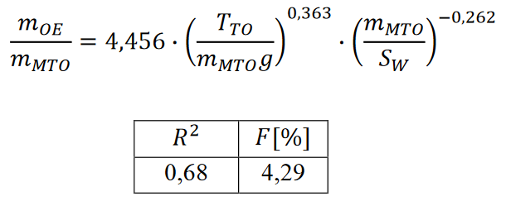
New Equations
Equation from Thrust-to-Weight Ratio and Wing Loading
The matching chart in jet aircraft preliminary sizing plots thrust-to-weight ratio versus wing loading. This makes these two parameters natural candidates for an equation. The equation is an extension of Loftin's equation.
Lehnert 2018

Slide 18
New Equations
Equation from Thrust-to-Weight Ratio, Wing Loading, Range,
Payload, and Number of Engines on the Wing
Now we add more parameters readily available in preliminary sizing. The more, the better. Range, R has proven its usefulness already, engines on the wing reduce wing root bending moment, but number of engines, n_{E} has little influence. The same is true for payload (exponent close to zero).
Lehnert 2018

Slide 19
New Equations
Equation from Thrust-to-Weight Ratio, Wing Loading, and Range
The Winner !
Omitting unnecessary parameters keeps the accuracy almost the same as in the previous equation but simplifies its application.
Lehnert 2018

Slide 20
Methods for Operating Empty Mass Estimation in Aircraft Design
Contact
info@ProfScholz.de
http://mass.ProfScholz.de and http://library.ProfScholz.de
Quote this document:
SCHOLZ, Dieter, 2024. Methods for Operating Empty Mass Estimation in Aircraft Design.
In: Society of Allied Weight Engineers (SAWE), 83rd International Conference on Mass Properties Engineering.
Online, 20-22 May 2024.
Available from: https://doi.org/10.48441/4427.1585
© Copyright by Author, CC BY-NC-SA, https://creativecommons.org/licenses/by-nc-sa/4.0

Slide 21
Methods for Operating Empty Mass Estimation in Aircraft Design
List of References
JENKINSON, Lloyd, SIMPKIN, Paul, RHODES, Darren, 1999. Civil Jet Aircraft Design. Oxford, UK: Butterworth-Heinemann. Archived at: https://perma.cc/ZLV5-A5Y8.
LOFTIN, L. K. Jr., 1980. Subsonic Aircraft: Evolution and the Matching of Size to Performance. NASA-RP-1060. Available from: https://ntrs.nasa.gov/citations/19800020744.
MARCKWARDT: Please see lecture notes: SCHOLZ 2015.
RAYMER, Daniel P., 1992. Aircraft Design – A Conceptual Approach. Washington, DC, USA: American Institute of Aeronautics and Astronautics (AIAA). Archived at: https://perma.cc/U478-X52U.
SCHOLZ, Dieter, 2015. Aircraft Design. Lecture Notes. Hamburg University of Applied Sciences.
Available from: http://LectureNotes.AircraftDesign.org.
TORENBEEK, Egbert, 1982. Synthesis of Subsonic Airplane Design. Delft : Delft University Press. Archived at: https://perma.cc/K8A2-M7MT.

