Slide 1
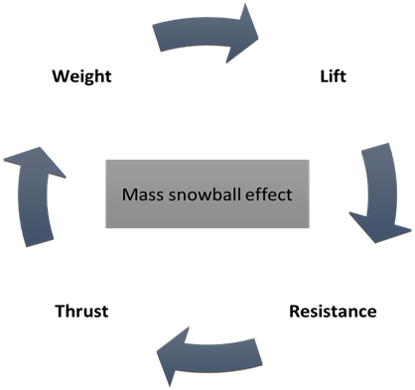
The Aircraft Mass Growth and Reduction Factor
Dieter Scholz Hamburg University of Applied Sciences
Based on https://doi.org/10.5281/zenodo.4159259
SAWE 83rd International Conference on Mass Properties Engineering
Online, 20-22 May 2024
Paper 3802
https://doi.org/10.48441/4427.1588

Slide 2
Abstract
The Aircraft Mass Growth and Reduction Factor
Purpose – This project work shows a literature survey, clearly defines the mass growth factor, shows a mass growth iteration, and derives an equation for a direct calculation of the factor (without iteration). Definite values of the factor seem to be missing in literature. To change this, mass growth factors are being calculated for as many of the prominent passenger aircraft as to cover 90% of the passenger aircraft flying today. The dependence of the mass growth factor on requirements and technology is examined and the relation to Direct Operating Costs (DOC) is pointed out.
Methodology – Calculations start from first principles. Publically available data is used to calculate a list of mass growth factors for many passenger aircraft. Using equations and the resulting relationships, new knowledge and dependencies are gained.
Findings – The mass growth factor is larger for aircraft with larger operating empty mass ratio, smaller payload ratio, larger specific fuel consumption (SFC), and smaller glide ratio. The mass growth factor increases much with increasing range. The factor depends on an increase in the fixed mass, so this is the same for the payload and empty mass. The mass growth factor for subsonic passenger aircraft is on average 4.2, for narrow body aircraft 3.9 and for wide body aircraft (that tend to fly longer distance) 4.9. In contrast supersonic passenger aircraft show a factor of about 14.
Practical implications – The mass growth factor has been revisited in order to fully embrace the concept of mass growth and may lead to a better general understanding of aircraft design.
Social implications – A detailed discussion of aircraft costs as well as aircraft development requires detailed knowledge of the aircraft. By understanding the mass growth factor, consumers can have this discussion with industry at eye level.
Originality/value – The derivation of the equation for the direct calculation of the mass growth factor and the determination of the factor using the method for 90% of current passenger aircraft was not shown.

Slide 3
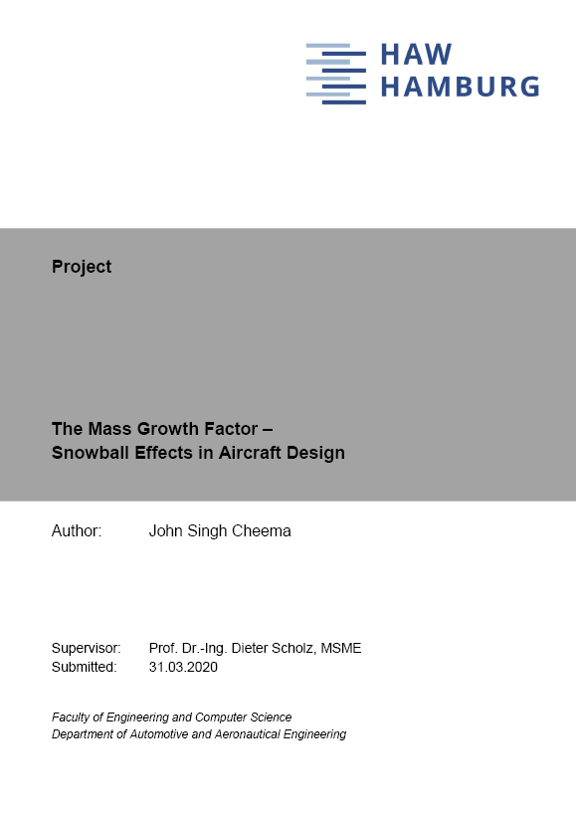
Acknowledgment
The Aircraft Mass Growth and Reduction Factor
This presentation is based on the project of
John Singh Cheema
prepared at
Hamburg University of Applied Sciences
Aircraft Design and Systems Group (AERO)
Download from:
http://library.ProfScholz.de
https://nbn-resolving.org/urn:nbn:de:gbv:18302-aero2020-03-31.011
Referenced here as:
Cheema 2020

Slide 4
Table of Contents
The Aircraft Mass Growth and Reduction Factor
Background
Literature Review (Overview)
Definition & Overall Picture
Iteration of the Mass Growth Factor
Mass Growth Factor – Considering 90% of Passenger Aircraft
Mass Growth Factor
Obtained from Payload Fraction
Obtained from Technology and Range
Linked to Direct Operating Costs (DOC)
Summary

Slide 5
Background
The aircraft mass growth factor is fundamental to aircraft preliminary design. Due to the fact that mass during some aircraft design phases seems rather to increase than to decrease compared to initial estimates, the factor is called mass growth factor.
However, a mass reduction factor is mathematically the same. The mass reduction factor can lead to even substantial mass reduction and is as such the secret to efficient aircraft design. For simplicity and tradition we may just talk about mass growth.
It is usually defined as the ratio of an increase in the total mass (take-off mass) due to an arbitrary increase in local mass (empty mass) determined after a full iteration in aircraft design to achieve the original performance requirements (payload and range).
The aircraft design iteration sees after each loop another increment in the take-off mass, so that an initial (local) mass increase aggravates the situation like a snow ball transforming into an avalanche. Hence the pseudonym snowball factor.
The concept of the mass growth factor is probably as old as aviation. It has been discussed heavily from the 1950th to the 1970th and has continued to be mentioned until today. Nevertheless, it seems not to be well enough understood today. Maybe its importance has declined due to modern computing power providing quite accurate mass estimates in each design phase, but detaching the engineer from the feel for the numbers.

Slide 6
Avalanche – Snow Ball Effect
Avalanche (Dahu1, wikimedia.org, CC BY-SA)

Slide 7
Literature Review (Overview)
}
Ballhaus 1954 (SAWE Paper)
Saelman 1973 (SAWE Paper)
Fürst 1999 (LTH, Germany)
Sinke 2019 (Lecture Notes, TU Delft)
SAWE 2019 (SAWE Book)
Aircraft Design Books
Torenbeek 1976
Roskam 1989
Jenkinson 1999
Howe 2000
Müller 2003
For details: Cheema 2020.
elaborate the principle
}
talk about design aspects
SAWE: Society of Allied Weight Engineers
LTH: Luftfahrttechnisches Handbuch

Slide 8
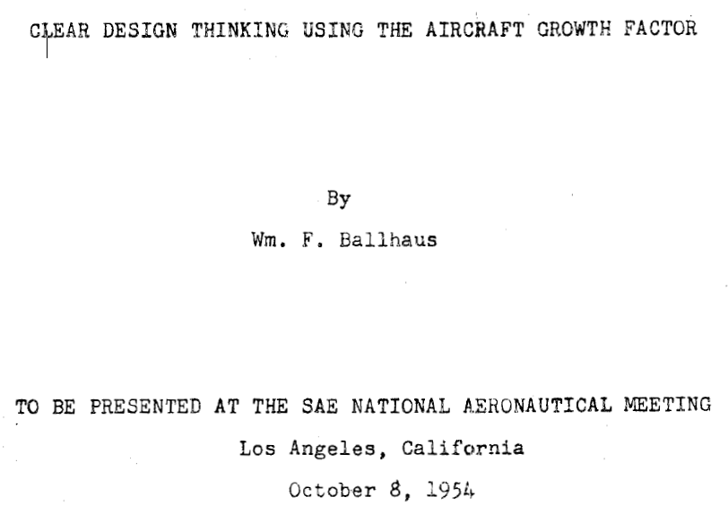
Literature Review (Overview)

Slide 9
Definition
Ballhaus 1954

Slide 10
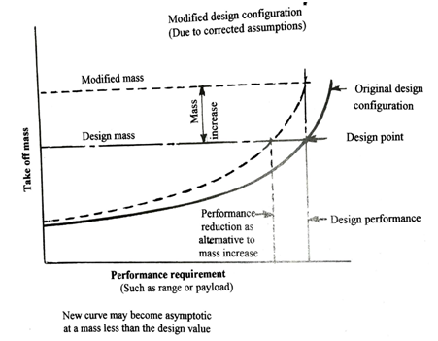
Aircraft Design Mass Growth (Overall Picture)
Howe 2000

Slide 11
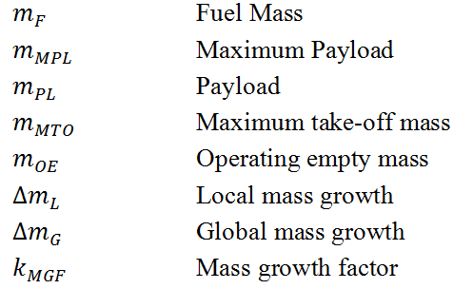
Iteration of the Mass Growth Factor (Equations)
. . .

Slide 12
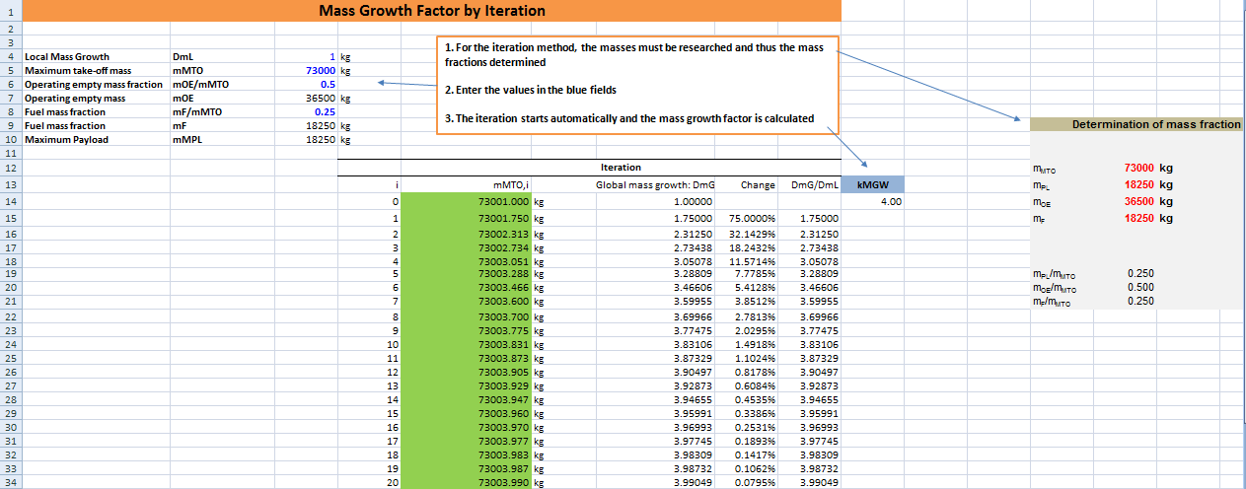
Iteration of the Mass Growth Factor (Excel Table)
. . .
Data and tools uploaded to Harvard Dataverse: https://doi.org/10.7910/DVN/6NHDDP

Slide 13
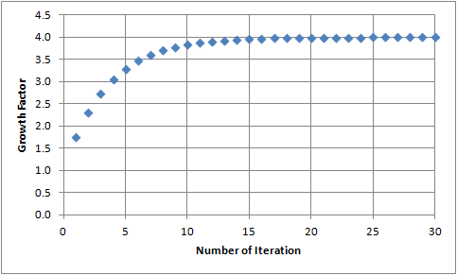
Iteration of the Mass Growth Factor (Convergence)
Convergence of the mass growth factor using the example of the Boeing 767-300

Slide 14
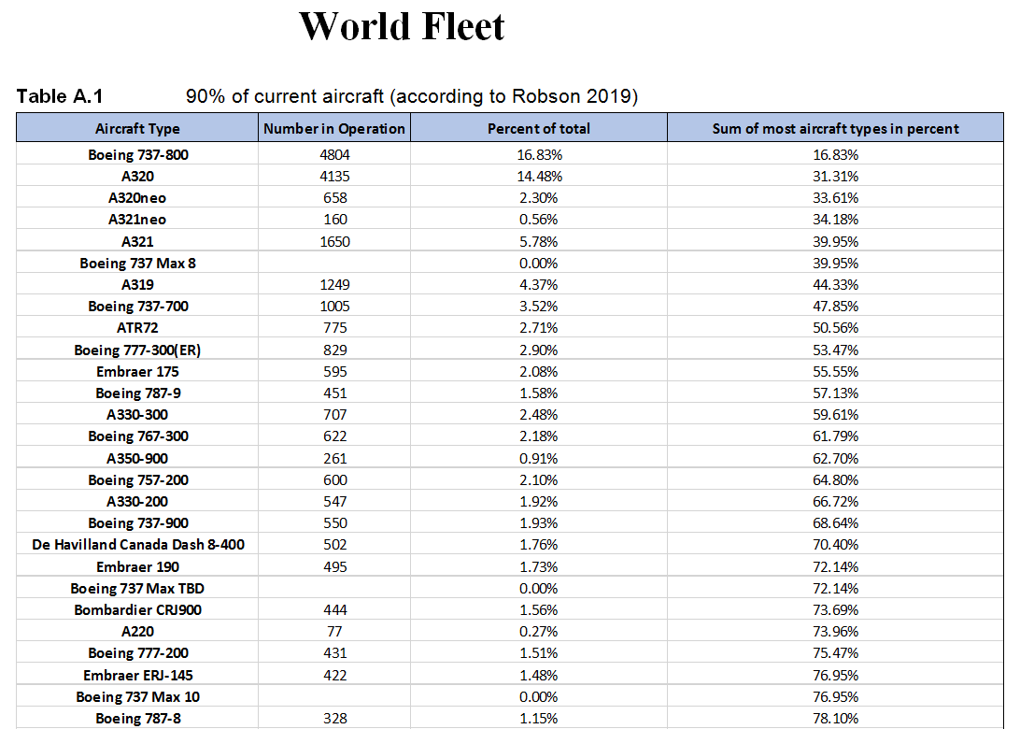
Considering 90% of Passenger Aircraft
. . .
e.g. 27 aircraft,
78.1% of fleet

Slide 15
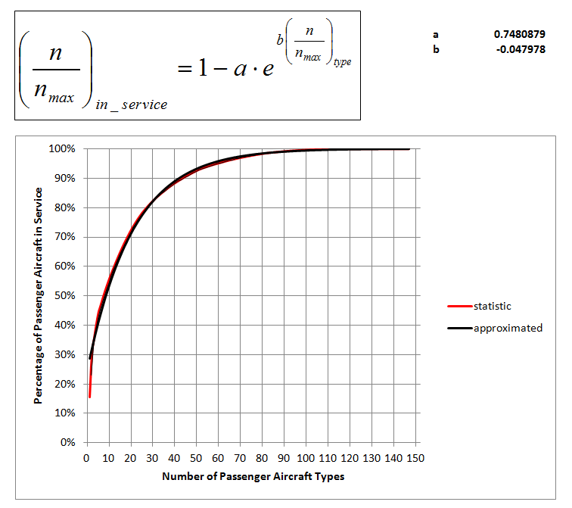
Considering 90% of Passenger Aircraft
with data from Flight 2016

Slide 16
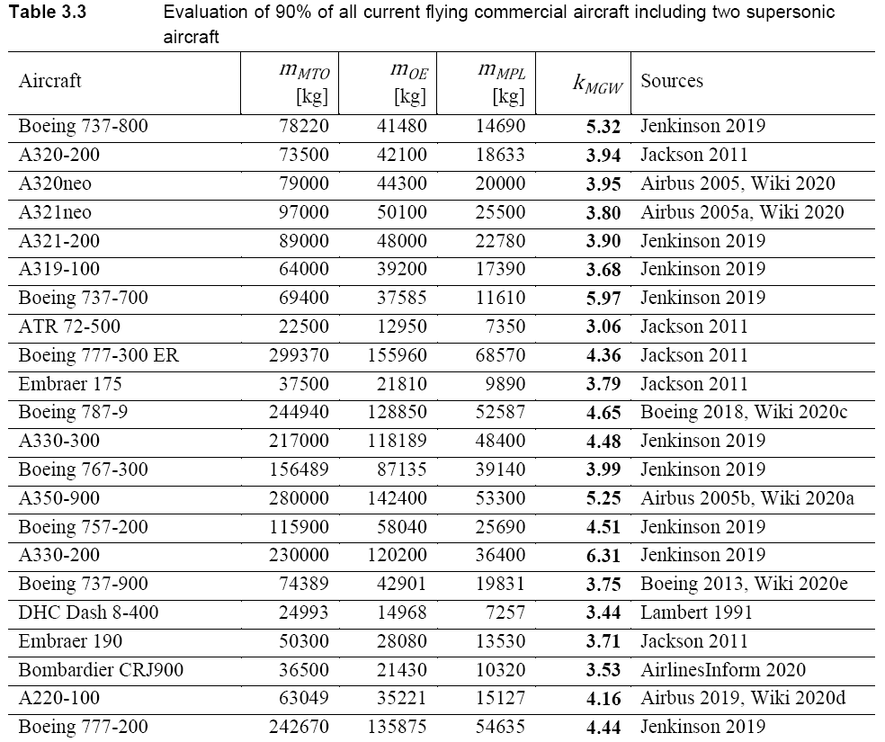
Mass Growth Factor – Considering 90% of Passenger Aircraft
90% of aircraft considered globally with more than 19 seats by looking at 44 aircraft types.
ATR 72:
propeller aircraft,
short range
. . .
Cheema 2020

Slide 17
Wisdom Gained
1.) Larger aircraft do not necessarily have a higher mass growth factor.
2.) It does not matter how large the local mass growth is;
the mass growth factor remains unaffected.*
3.) It does not matter whether there is one kg more operating empty mass or
one kg more payload on board. The mass growth factor for a growth in the
operating empty mass is therefore the same factor as for a growth in the
payload.
4.) Old long-range aircraft are more sensitive to local mass growth
than new short-range aircraft.
* This as long as the local mass growth is much smaller than the fixed mass.
The position of the local mass growth does not matter, if the wing is not yet fixed and is
positioned according to the new weight and balance situation.

Slide 18
Mass Growth Factor – Aircraft Categories
}

Slide 19
Mass Growth Factor – Obtained from Payload Fraction
After a longer derivation (Cheema 2020), we find a simple equation:

Slide 20
Mass Growth Factor – Can Go to Infinity
As soon as
approaches 1.0 the mass growth factor, k_{MG} goes towards infinity!
This means the design task has no solution!

Slide 21
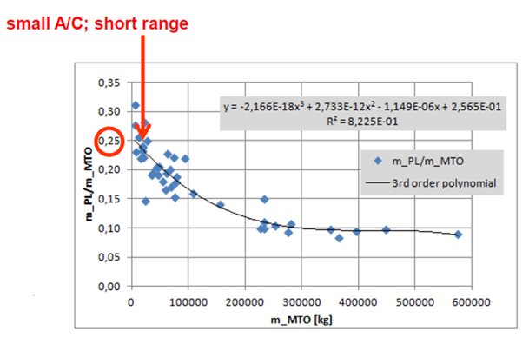
Mass Growth Factor – Payload Fraction from Statistics
Scholz 2018

Slide 22
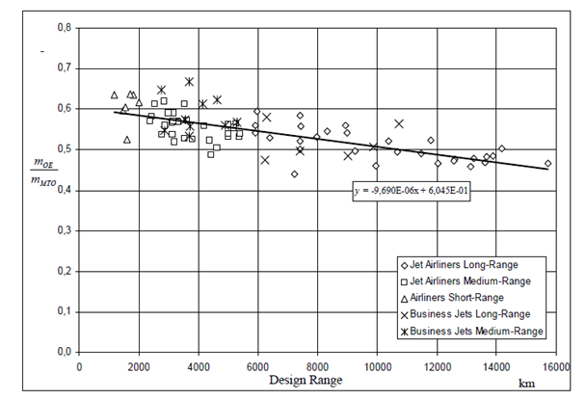
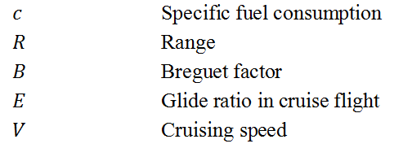
Mass Growth Factor – Obtained from Technology and Range
Scholz 2015
Lehnert 2018

Slide 23
Mass Growth Factor – Linked to Direct Operating Costs (DOC)
Seat-Mile-Costs:
depends on cruise speed (given)
range (given)
payload (given, constant)
fuel costs
depreciation, maintenance costs

Slide 24
Summary
The mass growth (and reduction) factor is well known, but not well understood:
Derivation missing => added
Numerical values missing => added
Average value for subsonic passenger aircraft: 4.2
range from 3.1 (ATR-72) via 6.2 (A380) and 6.5 (B747-400) to 15.6 (Concorde)
The mass growth factor important for the design phase (snow ball effect)
and also a good indicator to quickly understand the aircraft's economy.
The mass growth factor can be estimated from basic parameters:
range, R; E = L/D; c = SFC; cruise speed, V :

Slide 25
The Aircraft Mass Growth and Reduction Factor
Contact
info@ProfScholz.de
http://mass.ProfScholz.de and http://library.ProfScholz.de
Quote this document:
SCHOLZ, Dieter, 2024. The Aircraft Mass Growth and Reduction Factor. In: Society of Allied Weight Engineers (SAWE), 83rd International Conference on Mass Properties Engineering. Online, 20-22 May 2024.
Available from: https://doi.org/10.48441/4427.1588
© Copyright by Author, CC BY-NC-SA, https://creativecommons.org/licenses/by-nc-sa/4.0

Slide 26
Understanding the Aircraft Mass Growth and Reduction Factor
List of References

