Slide 1


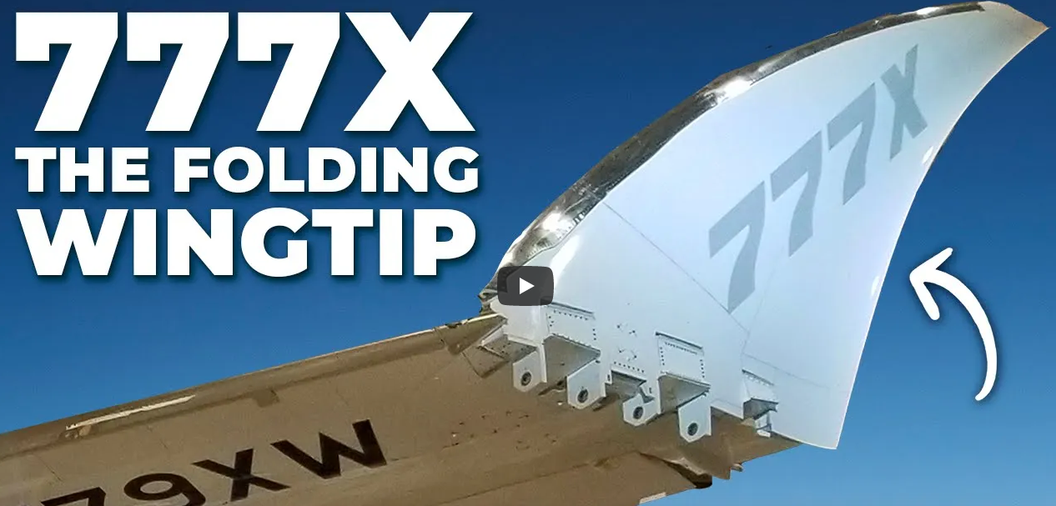
Mass Estimation of Folding Wings
Dieter Scholz Hamburg University of Applied Sciences
Vladimir Zhuravlev Moscow Aviation Institute
Based on the Master Thesis of Houssein Mahfouz
Douglas Skyraider (Public Domain)
SAWE 83rd International Conference on Mass Properties Engineering
Online, 20-22 May 2024
Paper 3803
https://doi.org/10.48441/4427.1586
https://youtu.be/W99w0h4oeyY

Slide 2
Abstract
    Purpose – Review of mass increase of folding wings applied to passenger aircraft.
    Methodology – Data is obtained from literature (Yarygina and Popov). Data is reworked to build new, simple equations.
    Findings – Wing folds on passenger aircraft are intended to reduce wingspan at the gate. This keeps new, more efficient large-span aircraft in the original wingspan category according to the ICAO Aerodrome Reference Code. A wing fold cuts off part of the wing. The structural loads in the cut are larger if the cut is further inboard. A wing fold at the tip (is basically no fold and) adds no mass. The additional mass of a wing fold increases in good approximation linearly from tip to root. A wing fold at half-span position increases wing mass by about 33%. A one-sided fold is possible. A one-sided fold e.g. 20% from the tip has the same wing mass increase as a fold on both sides 10% from the tip (resulting in the same remaining span after folding). Stowage of an unsymmetrical aircraft with a one-sided fold is more complicated but one such fold may be mechanically simpler than two.
    Research Limitations – Calculating a fold more inboard than 32% of half span is extrapolating given data.
    Practical Implications – Approximating wing mass increase due to a fold can be estimated easily. The equations can be used in a spreadsheet for aircraft design optimization.

Slide 3
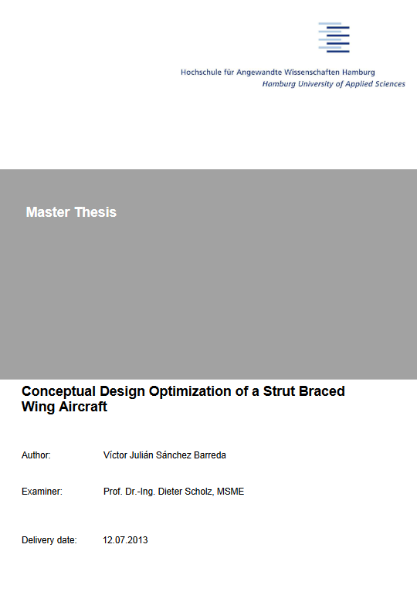
Acknowledgment (1/3)
Mass Estimation of Folding Wings
    This presentation is based on the work of the PhD student (at that time)
    Maria Viktorovna Yarygina and her supervisor Prof. Dr. Yuri Ivanovich Popov,
    both are from Moscow Aviation Institute (MAI). Their research is from 2011 and 2012.
    Their publications are listed on the next page.
    Prof. Dr. Vladimir Zhuravlev, Moscow Aviation Institute (MAI) is coauthor
    of this presentation. Through all the years he helped greatly as a dear friend
    to find Russian publications and to translate essential parts of them.
    Víctor Julián Sánchez Barreda prepared a Master Thesis:
    "Conceptual Design Optimization of a Strut Braced Wing Aircraft" at
    Hamburg University of Applied Sciences, Aircraft Design and Systems Group (AERO).
    Chapter 3.4.3 "Folding Wing Technology" takes up the work of Ms Yarygina and
    sets the equations up for use in an Excel table. Download from:
    http://library.ProfScholz.de
    https://nbn-resolving.org/urn:nbn:de:gbv:18302-aero2013-07-12.019
    His work is referenced here as: Sanchez 2013

Slide 4
Acknowledgment (2/3)
Mass Estimation of Folding Wings
    Publications of Maria Viktorovna Yarygina and Prof. Dr. Yuri Ivanovich Popov
    Yarygina M.V., 2011. The Effect of Wing Folding on Airplane Performance (Влияние складывания крыла на характеристики самолёта). Abstract of a presentation at the 10th International Conference “Aviation and Space – 2011”, Moscow, MAI. 8-10 November 2011, pp. 44-45.
    Available from: https://mai.ru/upload/iblock/cb8/cb875c083d5050ac0d975fc2eb365107.pdf
    Archived at: https://perma.cc/33RZ-MXQ9
    Popov Yu.I., Yarygina M.V., 2011. Methods for Weight Analysis of a Folding Wing of a Deck-Based Airplane. (Методика весового анализа складного крыла самолета палубного базирования.) In: Online journal "Proceedings of MAI" (Электронный журнал «Труды МАИ»), vol. 2011, no. 43 (Выпуск № 43), 23 pages.
    Available from: https://mai.ru/publications/index.php?ID=24860
    Archived at: https://perma.cc/HH5T-Q7M2
    Yarygina M.V., Popov Yu.I., 2012a. Development of the Weight Formula for a Folding Wing (Формирование весовой формулы складного крыла). In: Aviation Engineering News of Universities (Авиационная техника. Известия высших учебных заведений), vol. 2012. no 2, pp. 8-12.
    Available from: https://old.kai.ru/aviatech/archive/2.12.cr.htm
    Archived at: https://perma.cc/S8S8-TTQQ

Slide 5
Acknowledgment (3/3)
Mass Estimation of Folding Wings
    Publications of Maria Viktorovna Yarygina and Prof. Dr. Yuri Ivanovich Popov
    English version of Yarygina 2012a:
    Yarygina, M.V., Popov, Y.I., 2012b. Development of the Weight Formula for a Folding Wing. In: Russian Aeronautics (Iz VUZ), vol. 55, pp. 120–126.
    Available from: https://doi.org/10.3103/S106879981202002X
    Archived at: https://perma.cc/NVW3-YTB3
    Yarygina M.V., 2012c. Design and Weight Analysis of Structures of Folding Wing (Проектирование и весовой анализ конструкций складного крыла.) In: Online journal "Proceedings of MAI" (Электронный журнал «Труды МАИ»), vol. 2012. no. 51 (Выпуск № 51), 24 pages.
    Available from: https://mai.ru/publications/index.php?ID=29226
    Archived at: https://perma.cc/SDA6-MGSR
    Yarygina, Maria Viktorovna. The Method of the Folding Wing’s Design and Mass Optimization for the Naval Aircraft. In: 4th European Conference for Aerospace Sciences (Saint Petersburg, Russia, July 4 to 8, 2011). Belgian: EUCASS. 9 pages.
    Available from: https://www.eucass.eu/component/docindexer/?task=download&id=4337
    Archived at: https://perma.cc/ZN4A-MAYB

Slide 6
Mass Estimation of Folding Wings
Motivation
Wing optimization results in large wingspan. However, span is limited at airports.
Possible solutions are:
=> Winglets
=> Box Wing Aircraft
=> large-span wings in flight and folding wings at the gate!
Winglets, the Box Wing Aircraft, any nonplanar wing systems have aerodynamic and structural disadvantages.
The folding wing allows aerodynamically uncompromised, planar large wingspan.
A wing fold adds mass. How much additional mass?
Only aircraft design can give the final answer, if a wing fold has advantages. See presentation "Wing Design Regarding Mass and Drag" for a simple approach.

Slide 7
Mass Estimation of Folding Wings
Table of Contents
Wingspan Limits at Airports
Types of Wing Folds
Calculating Additional Mass for a Wing Fold
One-Sided Wing Fold
The Way Forward?
Contact

Slide 8
Mass Estimation of Folding Wings
    Wingspan Limits at Airports

Slide 9
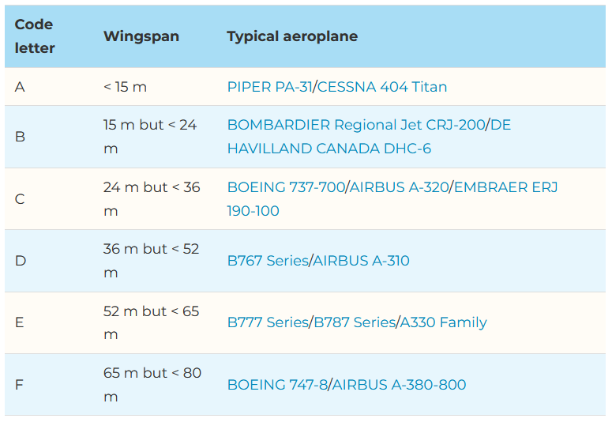
Wingspan Limits at Airports
ICAO Aerodrome Reference Code
https://skybrary.aero/articles/icao-aerodrome-reference-code

Slide 10
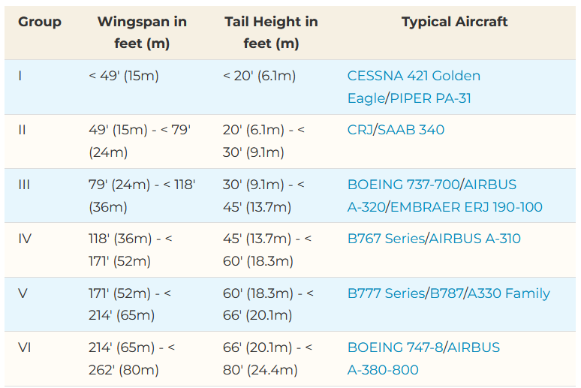
Wingspan Limits at Airports
Airplane Design Group (ADG) by FAA
These groups are defined in FAA Advisory Circular 150/5300-13. It is sometimes used in place of the ICAO Aerodrome Reference Code. Boundaries for wingspan are identical.
https://skybrary.aero/articles/airplane-design-group-adg

Slide 11
Mass Estimation of Folding Wings
    Types of Wing Folds

Slide 12
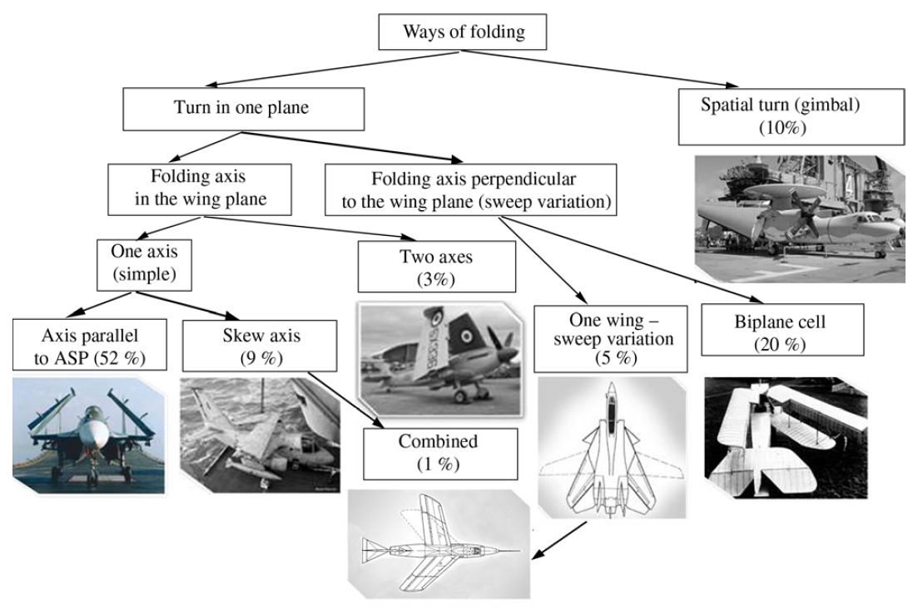
Types of Wing Folds
Classification of Wing Folds
Yarygina 2012b
ASP: Airplane Symmetry Plane

Slide 13
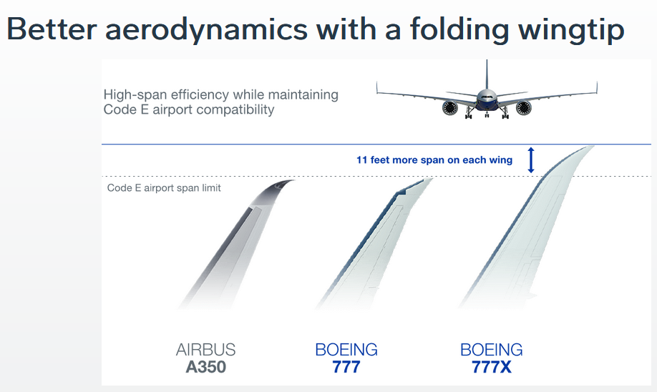
Types of Wing Folds
Boeing B777X
Code E: < 65 m.
B777X wingspan:
235 ft = 71.6 m
Wing tip:
11 ft = 3.3 m
Two times:
22 ft = 6.6 m
B777X at gate:
213 ft = 65 m https://www.boeing.com/commercial/777x/by-design
A wing extension is by roughly a factor 3 better than a winglet!
See: D. Scholz, https://doi.org/10.13111/2066-8201.2018.10.1.12

Slide 14
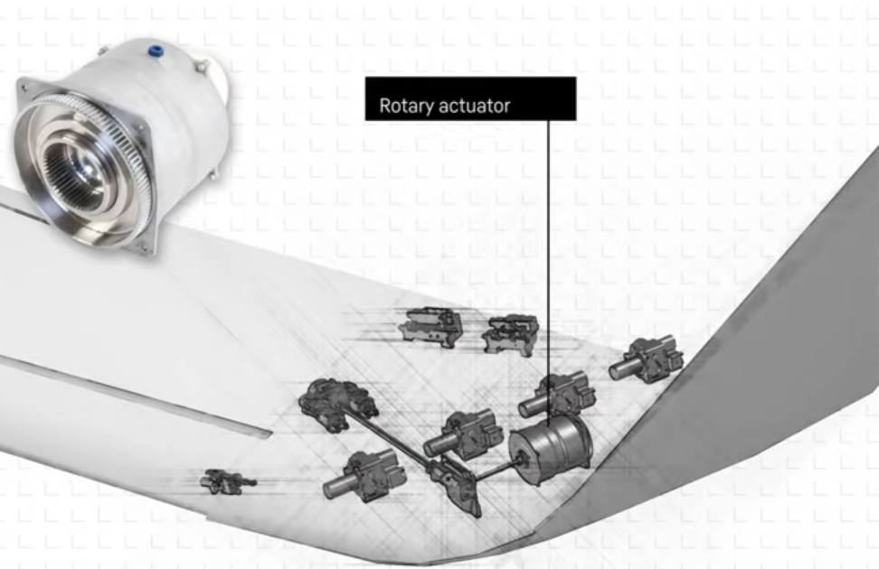
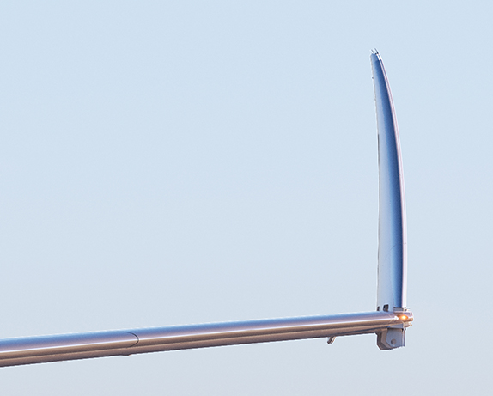
Types of Wing Folds
Boeing B777X – Actuation
Actuation mechanism by Liebherr Aerospace
https://youtu.be/y_9gUT2Tk8o
"Folding wingtip enables high-span efficiency while maintaining taxiway and gate compatibility."
(Boeing)

Slide 15
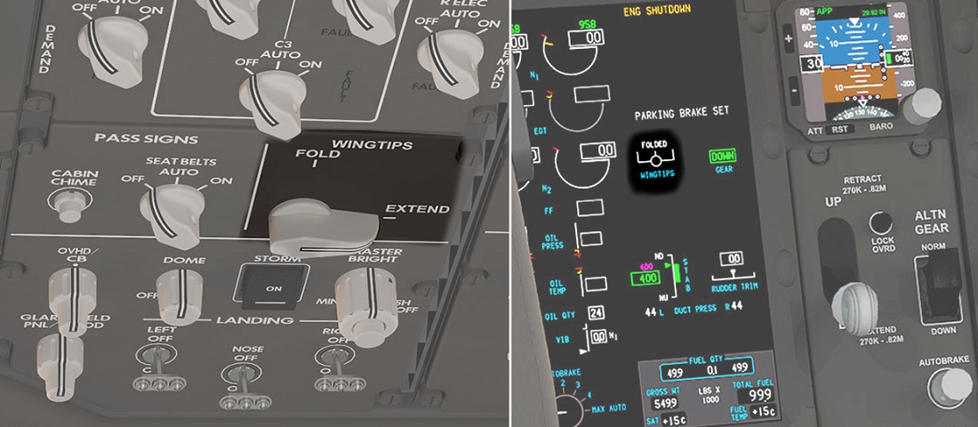
Types of Wing Folds
Boeing B777X – Cockpit
Folding wing tip
on the B777X Overhead Panel and on the EICAS (Engine Indicating and Crew Alerting System)
Flight Global 2017 (https://perma.cc/5GEE-K59Z)

Slide 16
Mass Estimation of Folding Wings
    Calculating
    Additional Mass
    for a Wing Fold

Slide 17
    Calculating Additional Mass for a Wing Fold
Assumptions
Yarygina and Popov looked at carrier-based airplanes with folding wings. They got hold of mass statistics (no details published with their) and produced statistical equations to resemble these mass findings.
Statistics of carrier-based airplanes may not lead to optimum results for passenger aircraft. However, there is no such data on passenger aircraft (with the exception of the B777X, but not in reach for me), so the data of carrier-based airplanes must be sufficient also for passenger aircraft.
The most widespread folding type is the axis parallel to the Airplane Symmetry Plane (ASP). A turn is performed around the axis located on the upper wing surface along its chord. The given folding type is the most manufactured. It is safe in terms of structural design and results in the smallest mass increase.
The axis of the fold is usually in the rib plane of a swept wing.
The statistic is for the simple butt joint (one piece of wing positioned against the other).
Often, it is necessary to change not only the wing structure, but also the wing high-lift devices (or other parts of the wing). The equations here are limited to the direct wing fold mass increase.

Slide 18
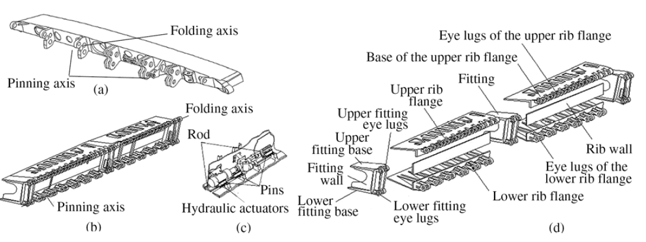
    Calculating Additional Mass for a Wing Fold
Elements of Wing Folds (1/2)
(6)
The wing bending moment is taken up by panels. The fold is designed with eye-lugs. They merge within each other like two combs. The upper eye-lugs are the folding axis, the lower eye-lugs are the pinning axis. a) MIG-29K, b) Su-33, c) actuator in the folding mechanism. (Yarygina 2012b)

Slide 19
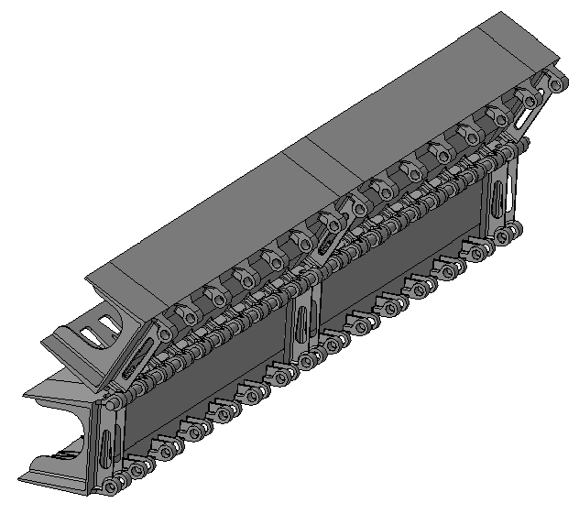
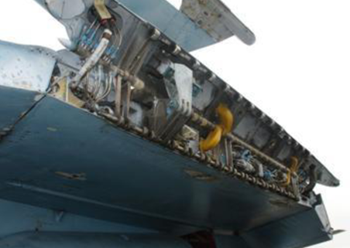
    Calculating Additional Mass for a Wing Fold
Elements of Wing Folds (2/2)
The folding wing of the Su-33. The upper eye-lugs are the folding axis, the lower eye-lugs are the pinning axis. An actuation arm is visible. Hydraulics and electrics are routed through the fold to supply the outer part of the wing. Left: Popov 2011. Right: Yarygina 2012c.

Slide 20
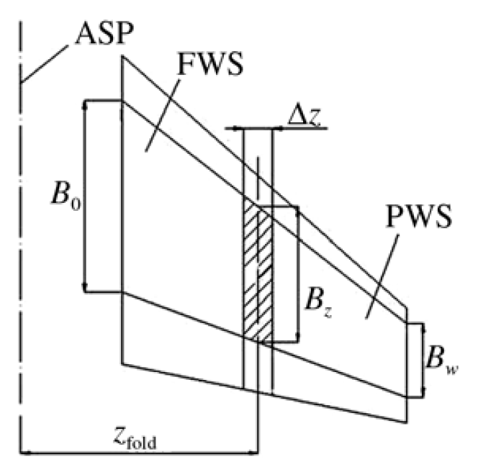
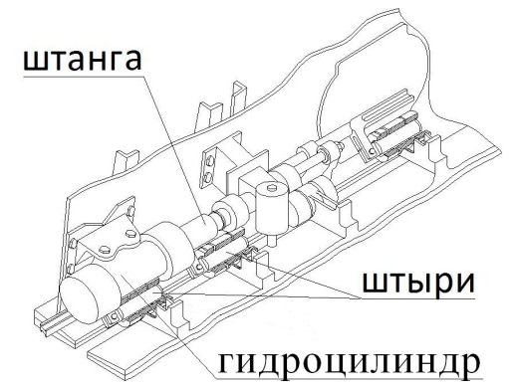
    Calculating Additional Mass for a Wing Fold
Mass Contributions of Wing Folds
The wing with a fold at position z_{fold} consists of a Fixed Wing Section (FWS) and a Pivoting Wing Section (PWS). ASP is the Airplane Symmetry Plane. At the fold a structural section Δz is structurally reinforced. This is the load-carrying insert structure between FWS and PWS, with additional mass, m_{ins}.
Furthermore, there is additional mass of the folding mechanism, m_{mech,fold} and
additional mass of the pinning mechanism, m_{mech,pin} .
The additional mass of the actuation system (below) is included in the additional mass of the pinning mechanism.
Yarygina 2012b and 2012c

Slide 21

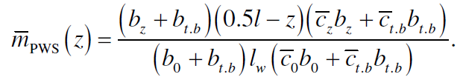
    Calculating Additional Mass for a Wing Fold
Critique (1/2)
Yarygina builds equations from statistics from three know points of relative span position z or y/(b/2) at 0.32, 0.48, and 0.64. Results are polynomials of this form
The equations have one independent parameter. It is not the relative span position y/(b/2), but the relative size of the cross section of the torsion box at the wing fold position
Using the size of the torsion box may be a good idea, but statistical data is given and evaluated towards (1) based on relative span, z and not m_{PWS}(z).
y is the absolute distance to the side (in span direction), b is wingspan, b/2 is half-span.
(1)
Yarygina 2012b

Slide 22
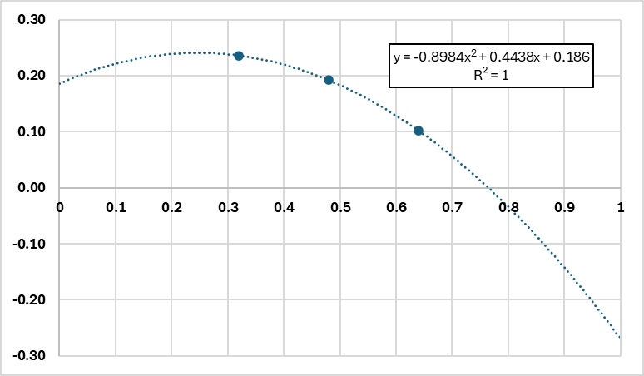
    Calculating Additional Mass for a Wing Fold
Critique (2/2)
Yarygina builds mass equations from statistics from three known points of relative span position, z or y/(b/2) at 0.32, 0.48, and 0.64. Results are polynomials of this form
Mass increase at three points is given. The equation obtained from this polynomial fit is only valid in between the three point (in the range of relative span from 0.32 and 0.64).
Especially fold positions near the tip are relevant for passenger aircraft but cannot be calculated with (1).
Note: Given plot is for the whole wing (left and right). (1) may calculate only the mass increase of one wing side.
Evaluation of mass data: https://doi.org/10.7910/DVN/T56NM9
(1)

Slide 23
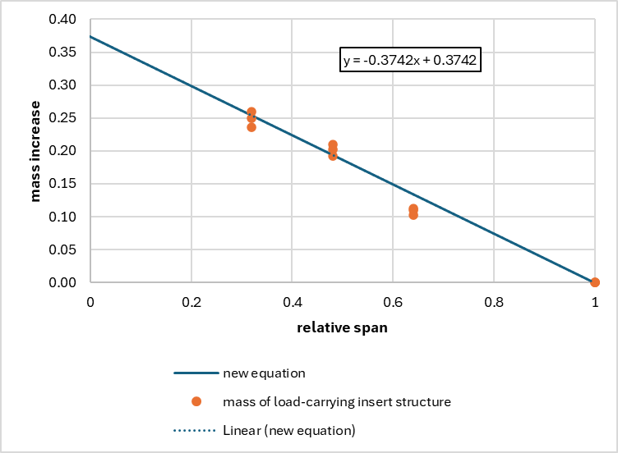
    Calculating Additional Mass for a Wing Fold
New Equation for m_{ins} Based on Given Data
Data points (Yarygina 2012b) and new equation for relative additional mass of the load-carrying insert structure.
m_{ins} = -0.374 y/(b/2) + 0.374

Slide 24
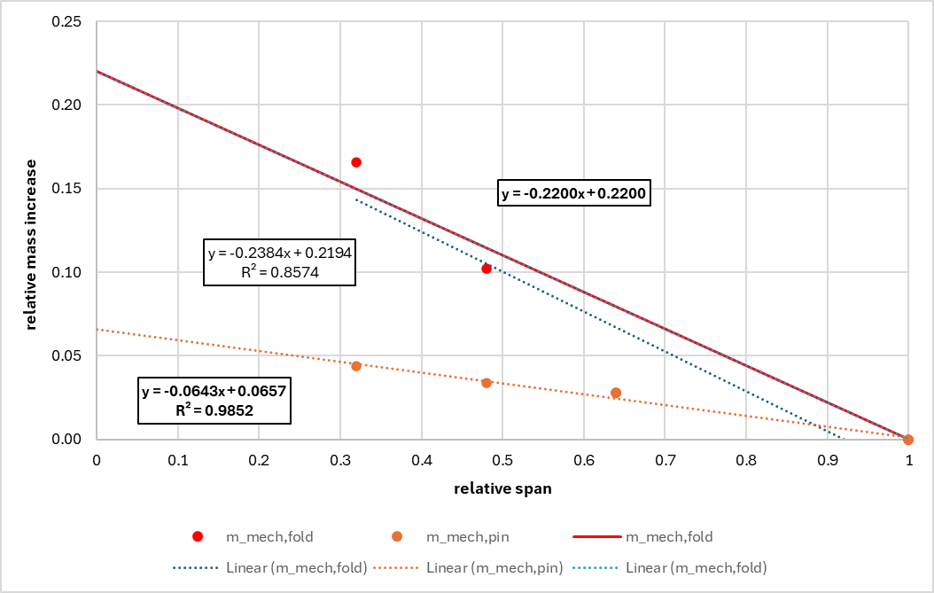
    Calculating Additional Mass for a Wing Fold
New Equation for m_{mech,fold} and m_{mech,pin} Based on Given Data
Data points (Yarygina 2012b) and new equation for relative additional mass of folding mechanism and pinning mechanism in a way to achieve zero additional mass at wing tip.
m_{mech,fold} =
-0.220 y/(b/2) + 0.220
m_{mech,pin} =
-0.065 y/(b/2) + 0.065

Slide 25
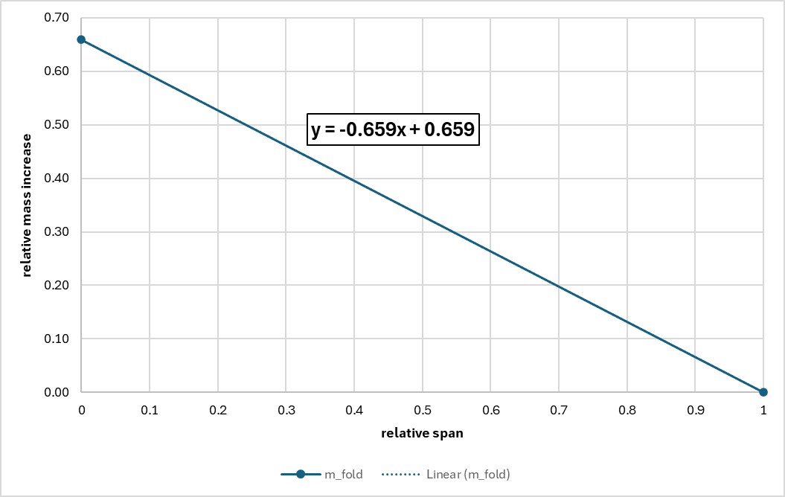
    Calculating Additional Mass for a Wing Fold
Summing Up: New Equation for m_{fold}
A new and simple equation considering all or most effects of relative additional mass of folding wings
as a function of the relative span position of the wing fold.
m_{fold} =
m_{ins} + m_{mech,fold} + m_{mech,pin} =
-0.659 y/(b/2) + 0.659
Note: Equations are based on data of fighters. Passenger aircraft experience smaller load factors. Accordingly, the mass increase of a wing fold of a passenger aircraft may be lower than given here.

Slide 26
Mass Estimation of Folding Wings
    One-Sided
    Wing Fold

Slide 27
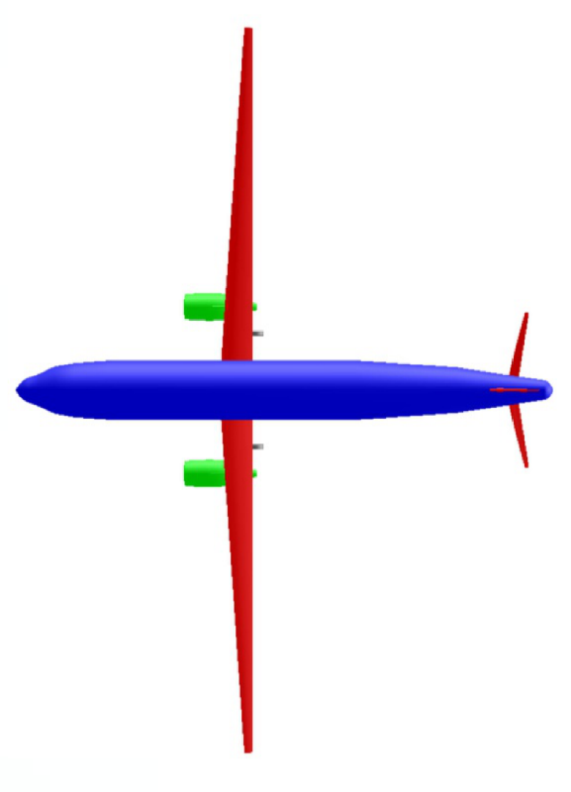
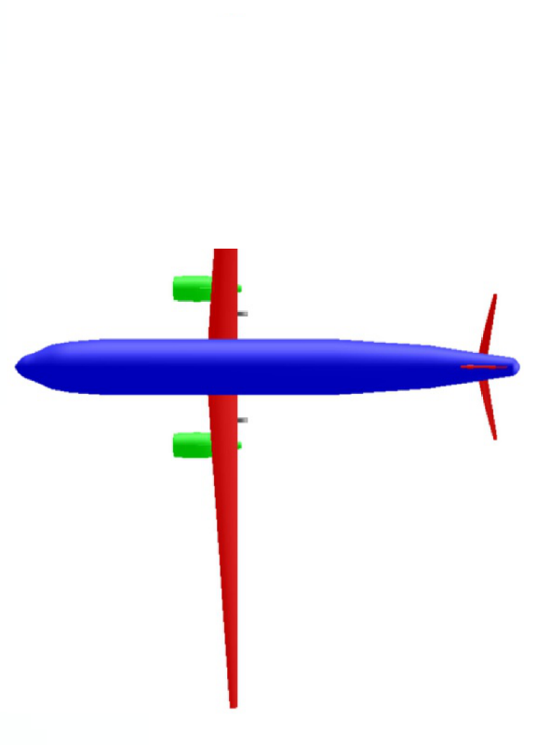
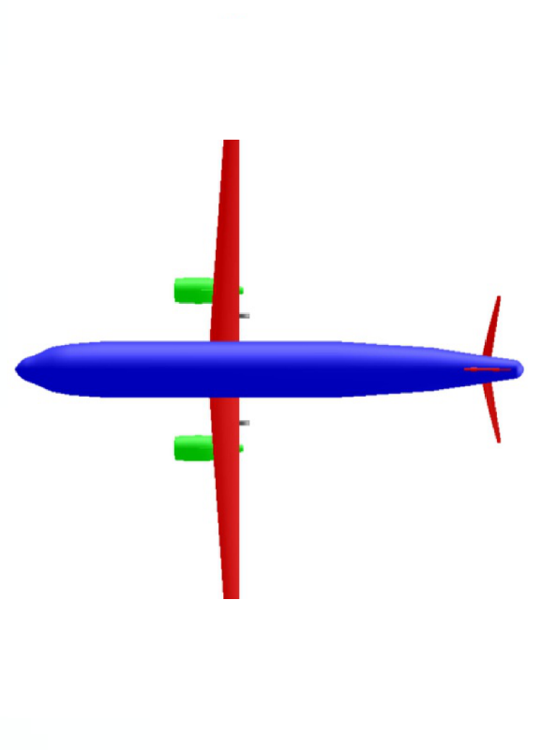
    One-Sided Wing Fold
Considering a One-Sided Wing Fold
A one-sided fold is possible. A one-sided fold e.g. 20% from the tip has the same wing mass increase as a fold on both sides 10% from the tip (resulting in the same remaining span after folding). Stowage of an unsymmetrical aircraft with a one-sided fold is more complicated but one such fold may be mechanically simpler than two folds.
one-sided fold two-sided fold
same span on ground

Slide 28
Mass Estimation of Folding Wings
    Airport
    Considerations

Slide 29
    Airport Considerations
Implications of Larger Wingspan (Code Letter) at Airports
Considering folding wings at airports?
Or just going for a larger Code Letter (moving e.g. from C to D)?
Implications for gates:
Gates are built according to the wingspan (code letter) of the aircraft. This determines the distance between gates along the terminal building. If (old) code C aircraft are designed with larger wingspan to yield code D aircraft, they would need to use other gates available only in smaller numbers. Eventually the airport terminal buildings would need to be reconstructed to serve demand for larger code letters.
Landing fees are determined from maximum take-off mass (MTOM). Aircraft with larger span and more demand for space are initially not charged more but benefit from lower fuel burn in cruise. Landing fees may be calculated from MTOM and wingspan in the future, if airports get major problems due to space demands from large wingspan.
Implications for taxiways:
Taxiways exist that are large enough for two code C aircraft to pass each other in a two-way operation. The same taxiway may allow only one-way operation for code D aircraft or larger. Larger span aircraft can lead to handling restriction at the airport.

Slide 30
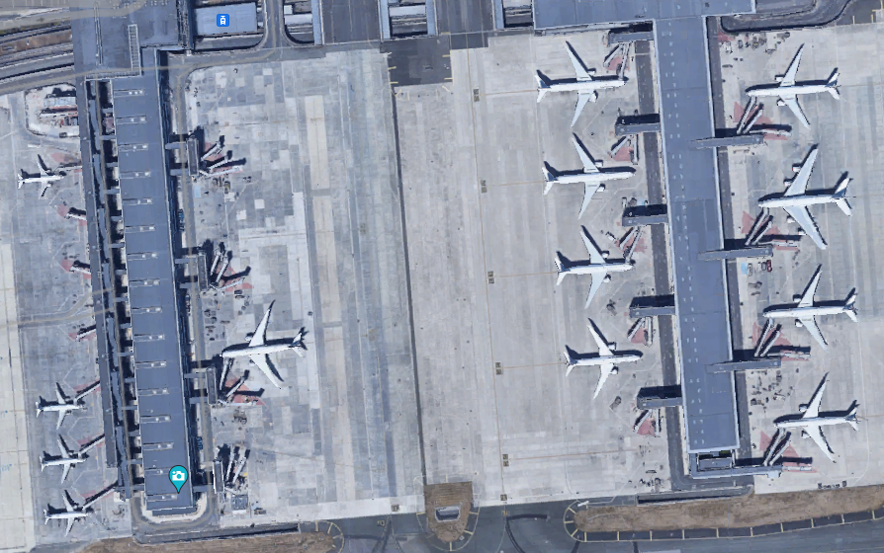
    Airport Considerations
Different Gates at Airports for Different Code Letters
Airports offer gates for aircraft with different size (wingspan and code letter) according to demand.
Airport Charles de Gaulle, Terminal 2, Paris (Google Maps, https://maps.app.goo.gl/m7iAjuBuob71wi6j9)

Slide 31
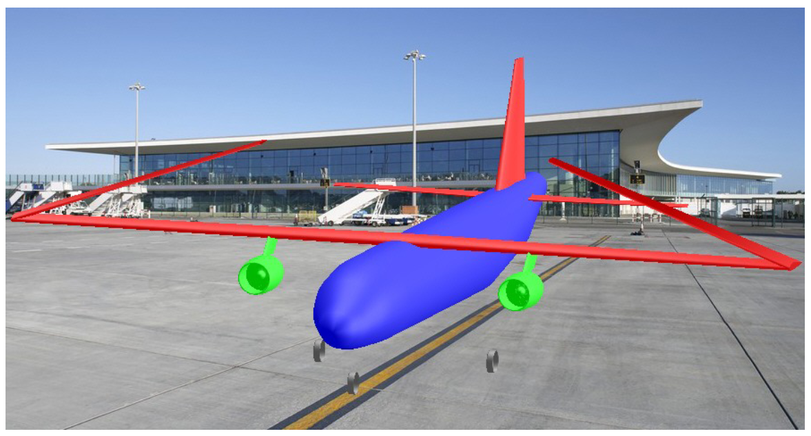
    Airport Considerations
Folding Wing at Airport
Impression of aircraft with folding wing at airport (Scholz)

Slide 32

Mass Estimation of Folding Wings
Contact
info@ProfScholz.de
http://mass.ProfScholz.de and http://library.ProfScholz.de
Quote this document:
SCHOLZ, Dieter, 2024. Mass Estimation of Folding Wings. In: Society of Allied Weight Engineers (SAWE), 83rd
International Conference on Mass Properties Engineering. Online, 20-22 May 2024.
Available from: https://doi.org/10.48441/4427.1586
Evaluation of mass data from Yarygina 2012b: https://doi.org/10.7910/DVN/T56NM9 (Excel file)
© Copyright by Author, CC BY-NC-SA, https://creativecommons.org/licenses/by-nc-sa/4.0

