Slide 1
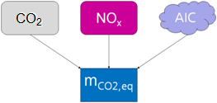
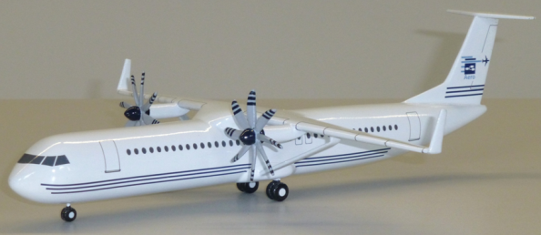
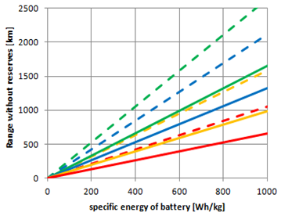
Passenger Aircraft Design towards
Lower Emissions with SAF, LH2, and Batteries
(Pros & Cons)
Dieter Scholz Hamburg University of Applied Sciences
RAeS Conference: Alternative Propulsion Systems –
The Challenges and Opportunities for Aircraft Design
London, UK / Hybrid, 01.–02.12.2021
https://doi.org/10.5281/zenodo.5904292

Slide 2
Contents
Passenger Aircraft Design towards Lower Emissions with SAF, LH2, and Batteries
    Introduction
    Aircraft Design Basics
    Urban Aviation / Short / Medium / Long Range
    Environmental Evaluation
    New Energies, Propulsion, and Aircraft
    Summary
    Contact / Quote this Document
    Bibliography / Literature

Slide 3
Passenger Aircraft Design towards Lower Emissions with SAF, LH2, and Batteries
Abstract
We consider that use of SAF is mainly a question of its availability and price. For engineers, it is a matter of sourcing primary energy involved in producing SAF – not to forget that SAF is only sustainable, if the CO2 is really taken out of the atmosphere in fuel production, which is intended to be put back into the atmosphere during flight. LH2 requires new (or modified) aircraft that are less efficient than conventional aircraft. Calculations show about 40% more fuel consumption (by energy) for LH2. This adds to the demand of LH2 for sourcing more primary energy. Batteries for electric flights suffer from their weight (as we already know). In addition, there are interesting aircraft design questions arising from issues such as: higher number of propellers and propeller integration into the airframe. It is explained, why hybrid electric or turbo electric solutions have clear disadvantages. There are also the non-CO2 effects. Here we shall consider flying lower with LH2 and also kerosene/SAF aircraft.
The video to this presentation: https://youtu.be/bHTpsDqtPqI

Slide 4
    Introduction

Slide 5
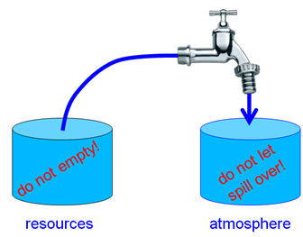
Introduction
Resources or Atmosphere – What is the Problem?
Two barrels symbolize:
left: the finite fossil energy reserves and
right: the finite capacity of the atmosphere to absorb.
It does not work to open the tap more each year.
It also does not work to set the tap at constant flow. It needs to be closed!

Slide 6
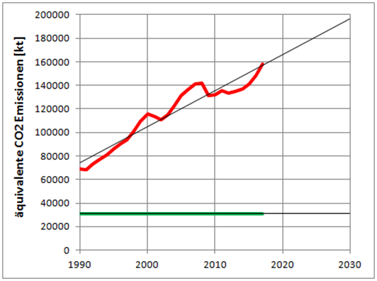
Introduction
"Green Deal" (2050) and "Fit for 55" (2030)
The equivalent CO2 emissions (in 1000 tonnes or kt) of international aviation in the EU are rising continuously (red line). According to the "Green Deal" of the EU, they have to go to 45% of the 1990 value (by 2030) (green line). Diagram created with data from. EEA 2019 (https://perma.cc/2EZ6-DQBN)
80% of humans on earth never flew and will probably never fly.
Global warming from aviation is a "rich world's problem"!

Slide 7
Introduction
Two "Schools" Marching towards Zero Emission
1.) The traditional school: "We have to increase efficiency."
Critique: "You will never make it to zero emission!"
2.) The new school: "We have to apply new fuels and do not care about their overall inefficiency, because all energy will be renewable energy, which is without harm."
Critique: "You will run out of energy resources!"

Slide 8
Introduction
The Way towards Zero Emission
Zero Emission can be achieved by a combination of these principles:
apply new technologies to increase efficiency, and:
apply new fuels and with new means of propulsion/flying with no or less emissions, and:
apply the carbon (CO2) cycle with biofuels or SAF from PtL, and:
compensate remaining emissions.

Slide 9
Introduction
The Problems with Zero Emission Measures
Efficiency: Mathematical fact: Adding measures with improved efficiency on top of each other does not lead to zero emissions. Example: If you take an aircraft that burns only 50% of the fuel on a magic ATM system that reduces the distance by 50% you do not get zero emission, but 25% emission of the reference.
Experience: The rebound effect teaches us that in the long run increased efficiency leads to a lower price, which leads to more demand, which leads to more emissions.
Fuels: It is not so easy. Electricity does not just come from the socket. The energy production needs to be considered with a Life Cycle Analyses (LCA). Hydrogen combustion does not produce CO2, but has non-CO2 effects. Details later.
CO2 Cycle: A biofuel carbon cycle is not 100% efficient. It reduces CO2 by about 50%.
Compensate: Compensating emissions may not be sustainable. A new forest that is cut after 30 years is not a long term carbon sink. Compensation comes with philosophical questions. No one likes to pay for compensation.

Slide 10
    Aircraft Design Basics

Slide 11
Aircraft Design Basics
First Law of Aircraft Design
Maximum Take-Off mass is a combination of PayLoad and Fuel mass
(to reach maximum useful load) plus the Operating Empty mass of the aircraft:
In case of electric propulsion fuel mass is meant to be battery mass.
Maximum Take-Off mass is a surrogate parameter for cost !

Slide 12
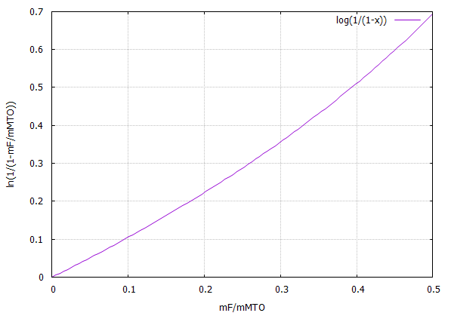
Aircraft Design Basics
Breguet Range Equation (for Jets)
Note: The Thrust Specific Fuel Consumption, c = SFC_{T} is not constant,
rather a function of speed. Very roughly, we can write it as a linear function:
≈
Is speed increasing range? No!
≈
≈
≈

Slide 13
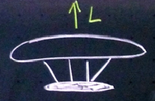

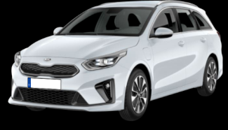

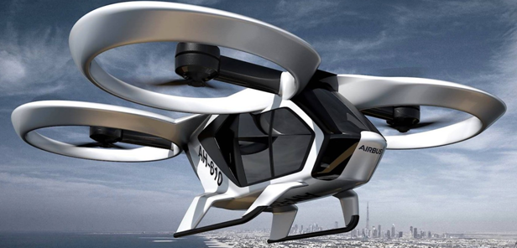
Force along the Way due to Lift or Weight: Induced Drag, D_{i}
Airship
D_{i} = L / ∞ = 0
D = D₀ + D_{i}
Force to push vehicle
through the air
L
Train
D_{i}
D_{i} = L / 700
Vehicle shows less resistence / drag
Aircraft
D_{i} = L / 40
D_{i} = L / 70: Car on tarmac
D_{i} = L / 20: Car on sand
L = T
Airtaxi Helicopter
D_{i} = induced Drag
L = Lift = Weight
T = Thrust
D_{i} = T = L / 1

Slide 14
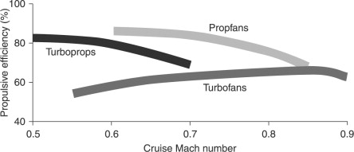
Aircraft Design Basics
Propulsive Efficiency
Wheel (≈ 100%)
(≈ 90%) Problems with Certification
(≈ 85%)
(≈ 70%)
https://www.sciencedirect.com/topics/engineering/propulsive-efficiency

Slide 15
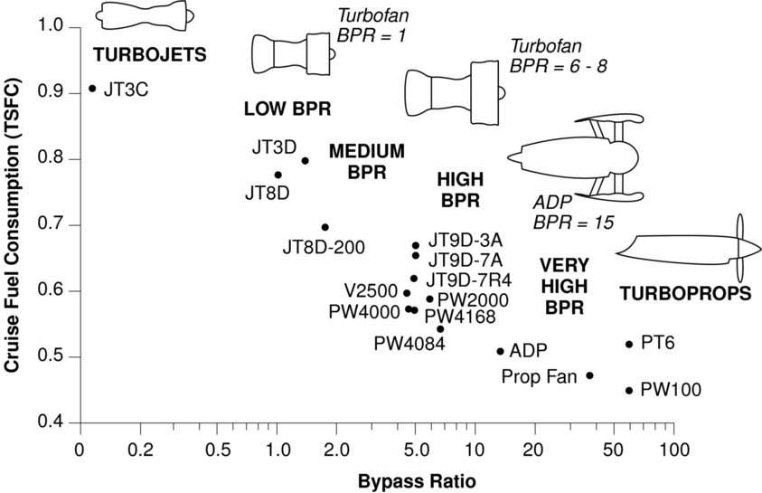
Specific Fuel Consumption
x
2015
GTF
x
x
(e.g. ATR 72)
x*
PISTONPROP
1950:
Wright R-3350
(Super Constellation)
* Bypass Ratio not defined
https://web.mit.edu/16.unified/www/FALL/thermodynamics/notes/node84.html

Slide 16
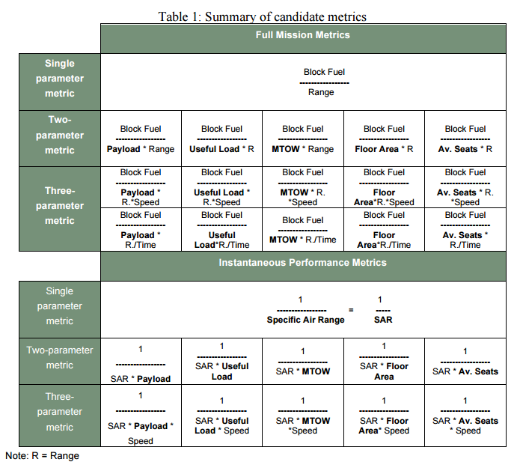

Desperately Needed: A Definition of the Aircraft's Fuel Consumption
Selecting a Fuel Metric:
1/(SAR . n_{seat} )
Specific Air Range; 1/SAR=fuel consumption
can be measured in flight or calculated
from basic aircraft parameters:
aircraft mass, m
aerodynamic efficiency, L/D
specific fuel consumption, SFC
aircraft speed, V
or extracted from published
Payload Range Diagrams
http://partner.mit.edu/projects/metrics-aviation-co2-standard

Slide 17
From Energy to Approximate Emission Comparison
Type of Comparison Kerosene Electricity / Battery
Energy (wrong)
Max. Exergy (not good)
Exergy (ok)
Primary Energy (better)
CO2 (without altitude effect)
Equivalent CO2 (good, simple)
ESSER 2016, Table 73
ESSER 2016, Table 15
ESSER, Anke, SENSFUSS, Frank, 2016. Evaluation of Primary Energy Factor Calculation Options for Electricity. Karlsruhe: Fraunhofer-Institut für System- und Innovationsforschung (ISI). Available from: https://ec.europa.eu/energy/sites/ener/files/documents/final_report_pef_eed.pdf
Archived at: https://perma.cc/WMY7-QER4

Slide 18

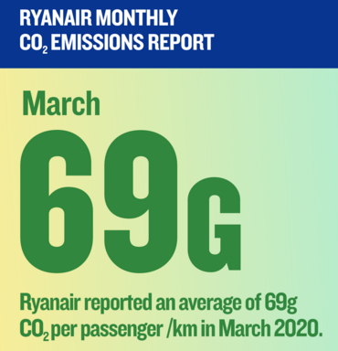

Pro & Con Low Cost Airline – Who Is Right?
Advertising Standards Athority, UK
Ryanair Ltd said the metric they used to measure CO2 emissions was grams of CO2 per passenger-kilometre. Five key efficiency drivers: aircraft model, seating density, load factor, freight share and distance.
https://www.asa.org.uk/rulings/ryanair-ltd-cas-571089-p1w6b2.html

Slide 19

Many Possible Energy Paths for Aviation
fossile fuel => jet engine no future solution
bio fuel (algae, ...) => jet engine not sustainable
regenerative electricity => aerial contact line => electric engine not for aviation => train!
regenerative electricity => battery => electric engine electric: very short range
regenerative electricity => LH2 => jet engine new infrastructure & planes
but 2.7 times better efficiency than PtL
regenerative electricity => LH2 => fuel cell => electric engine see 5.; heavy
regenerative electricity => PtL (drop in fuel) => jet engine same infrastructure & planes
regenerative electricity => PtL => GT/Gen. => electric engine hybrid electric, heavy
regenerative electricity => PtL => GT/Pump => hydraulic motor hybrid hydraulic , heavy
PtL: Power to Liquid GT: Gasturbine; Gen.: Generator
Additional conversions & major aircraft parts: Solutions 6 (one more component) and 8/9 (two more comp.)

Slide 20
Validation of Transport Options – Are We Doing the Right Thing?
Physics favor trains over aircraft (low drag due to weight) => less energy, less CO2. Regenerative energy via aerial contact line efficiently fed into vehicle.
PtL for jet/prop engines: Regenerative energy into aircraft NOW! But: Much primary energy needed!
LH2 for jet/prop engines: Less efficient aircraft (40% more consumption), new or modified aircraft needed. New infrasturcture needed. Not as much primary energy needed for fuel production (2.7 times less than for PtL).
Hybrid-electric propulsion has NO advantages for passenger aircraft.
Unpredictable political environment for short range flights => high risk investment .
Aircraft are the only means of transportation over oceans long range.
Ships are too slow and hence no regular service, bridges and tunnels are limited in length.
Trains beat aircraft on short range (less access time to station, less waiting time in station, ...).
Trains beat aircraft to connect adjacent megacities over land up to medium range with high volume.
A380 is too small and unfit, because designed for long range.
Aircraft over land, if ...
  long range,
  short range and no train available due to low volume traffic
    aircraft need less investment into infrastructure than (high speed) trains.
    Construction costs for high speed trains: 5 M€/km to 70 M€/km (2005, Campos 2009)
    alternative: rail replacement bus service
  over remote areas, if no train is available (mountains, desserts, polar regions).

Slide 21
    Urban Aviation
    Short / Medium / Long
    Range

Slide 22
    Urban Aviation

Slide 23
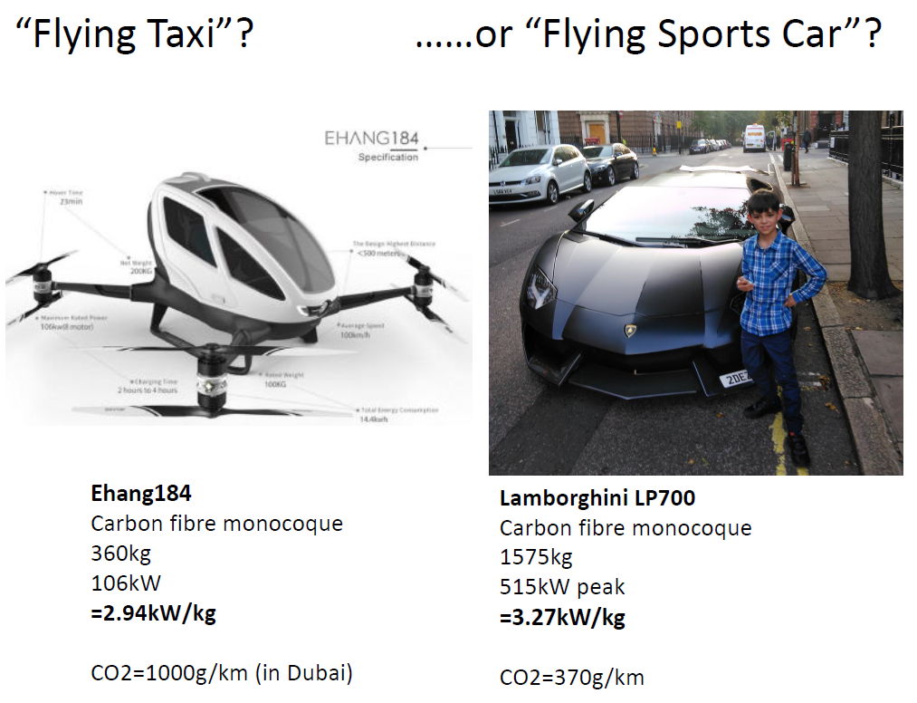
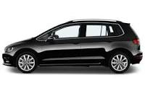
Airtaxi Is Not the Solution to Save the Environment
based on Caldwell 2018
Aircraft (Ryanair):
CO2 = 69 g/km/person
1 kg fuel = 3.15 kg CO2
VW Golf TDI
4.2 l/100 km
1440 kg
118 kW
= 0.082 kW/kg
= 0.29 kW/kg = 0.33 kW/kg
CO2:
CO2 = 106 g/km

Slide 24


Airtaxi: 200 $ for 24 km (7 €/km) – Taxi Hamburg: 1,80 €/km
It won't get cheaper if batteries and electric motors are used!

Slide 25
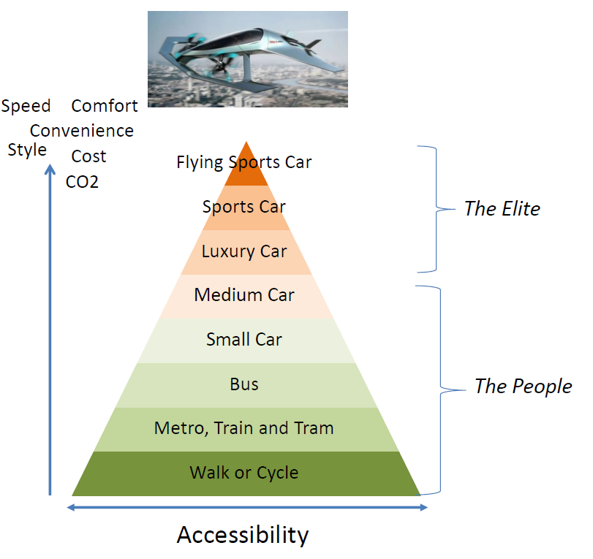
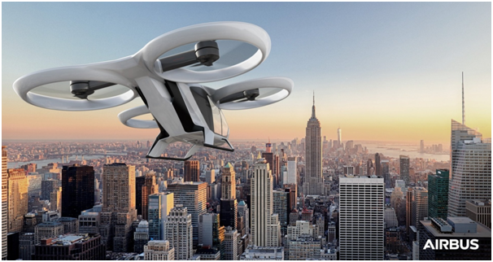
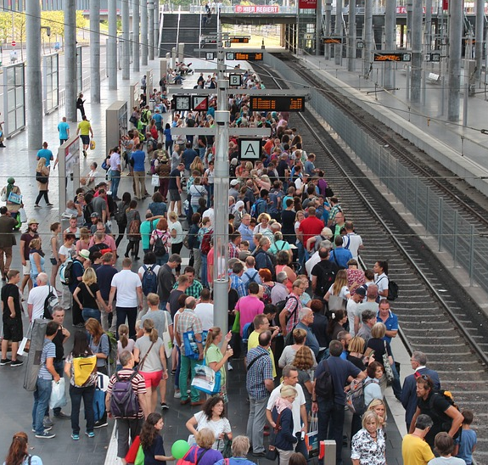
Airtaxi for the Elite – Not for Mass Transportation
City Airbus, 4 Passengers, max: 15 min.
Airtaxi: Not a technical solution!
Waiting for the City Airbus?
Max Pixel, CC0
Airtaxi: No solution to solve a traffic problem!
Caldwell 2018

Slide 26
    Short Range

Slide 27
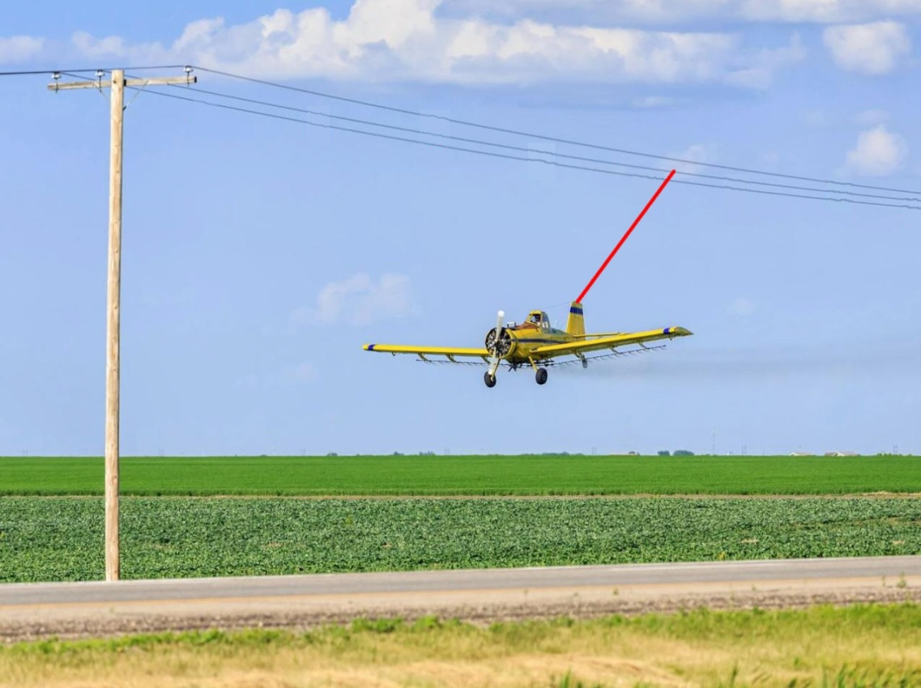
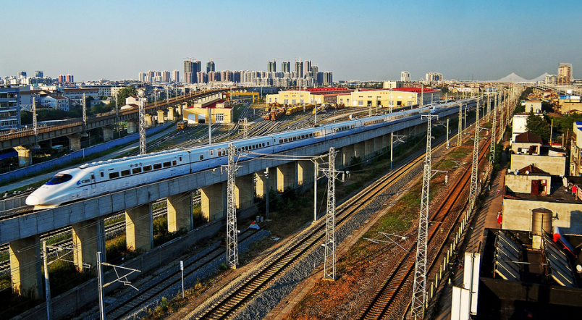

For Short Range We Take the Train!
Elektro mobility needs to be supplied from the grid. This is already invented: The train!
Put the aircraft on tracks!
This replaces the Induced Drag, D_{i} by Rolling Friction
Aircraft: Induced drag is drag due to Lift = Weight. Train: Rolling Friction is also drag due to Weight.
Aircraft: For minimum drag, induced drag is 50% of total drag.
For the same weight, rolling friction of a train is 5% of the induced drag of an aircraft!
This means: For the same weight, drag of an aircraft is reduced by ≈ 47.5% if put on rails!

Slide 28
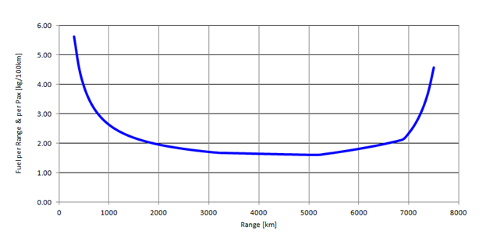
Short Range
Aircraft Fuel
Consumption –
Short Range
Not Efficient
Use the Train!
Airbus A320neo
Train is about 3 times more energy-efficient (certainly on short range)
Train uses 50% Eco Electricity Mix (factor 2)
Aircraft Factor 3, because in addition non-CO2 effects from:
  NOX and
  H2O (AIC)
3*2*3: aircraft is 18 times worse on global warming!
Simple Calculation of Aircraft Fuel Consumption with Public Data:
See details: https://bit.ly/3mWHo6c
Fuel Consumption = (MTOW – MZFW) / (R . Seats) . 100
R: Range at maximum payload, from payload range diagram (Document for Airport Planning).
Example calculation with Airbus A320neo:
2.2 kg per 100 km per seat =
(73500 kg – 62800 kg) / (3180 km . 150) . 100

Slide 29
    Medium Range

Slide 30
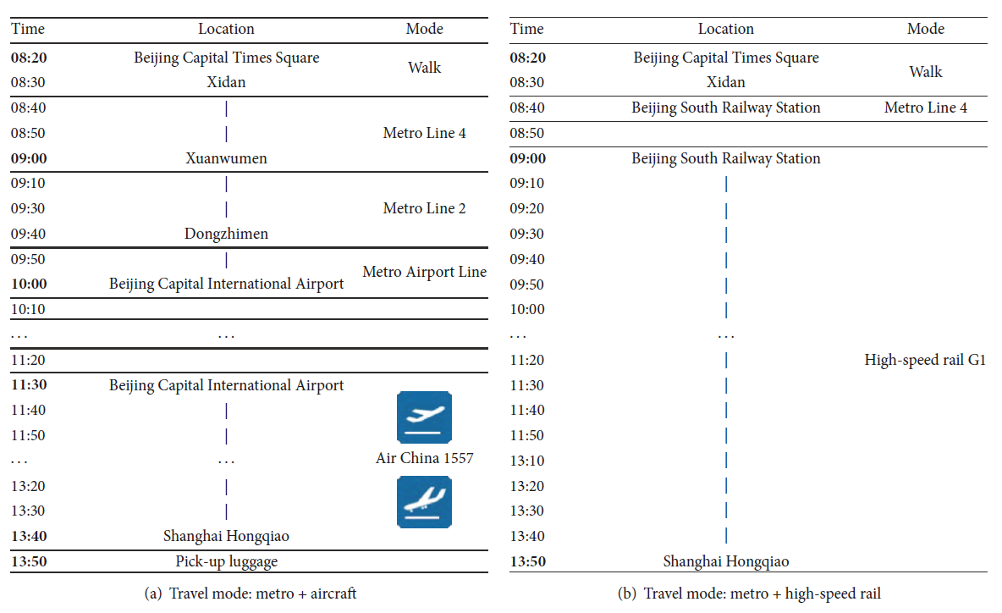
Medium Range between Megacities: We Take the Train!
Example: Two Megacities – Beijing & Shanghai – Comparison Aircraft versus Train
China High Speed Rail (CHR)
Beijing to Shanghai:
1200 passengers per train
1200 km distance
350 km/h
≈ every 20 min. (an A380 every 10 min.)
usually fully booked
88000 passengers per day (both directions)
Example: Train number G1
Train
Aircraft
new: 13:28
Sun 2017
Comparison air transportation versus high-speed rail
for a trip from Beijing Capital Times Square to Shanghai Hongqiao in China.
Despite the large spatial distance of more than 1200 km,
passengers using either mode arrive approximately at the same time. Probability of delays is less on the train.

Slide 31
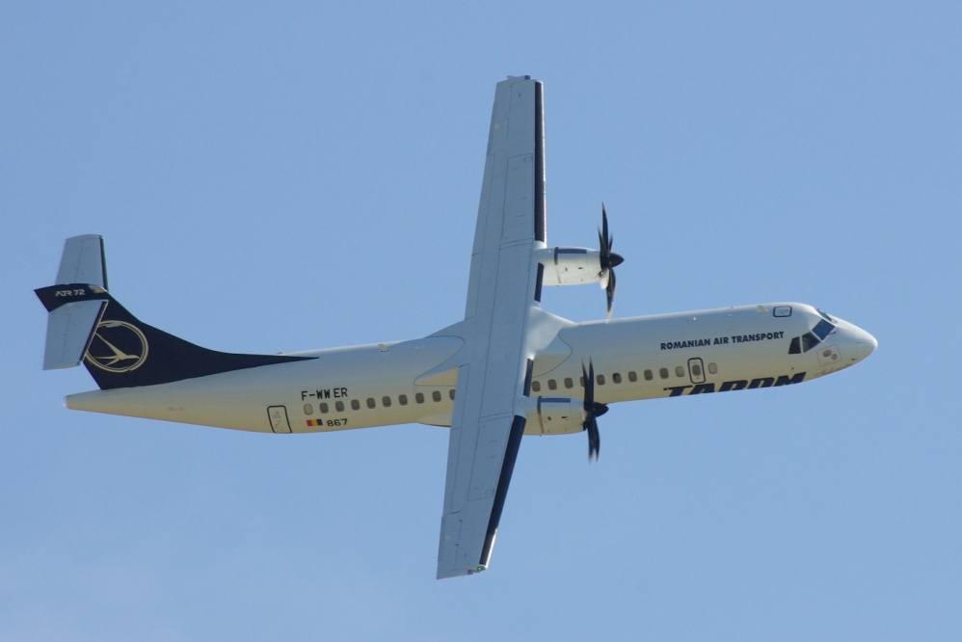
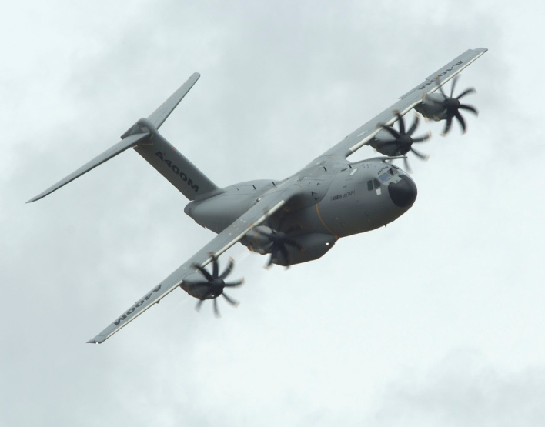
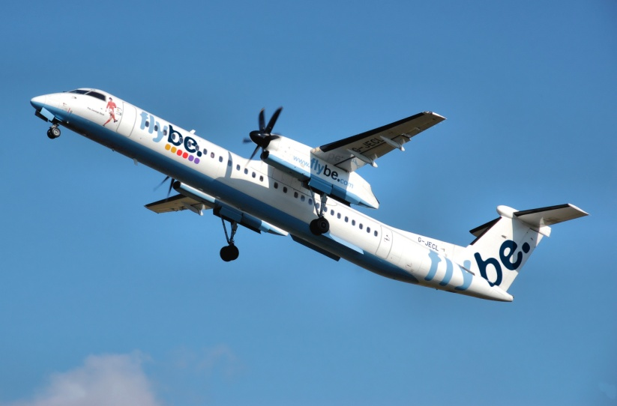
A Propeller Driven Aircraft for 180 Passengers with Two Engines of the A400M ?
… saves lots of fuel!
Airbus A400M
ATR 72
"Smart Turboprop", Design see next pages!
Q400

Slide 32
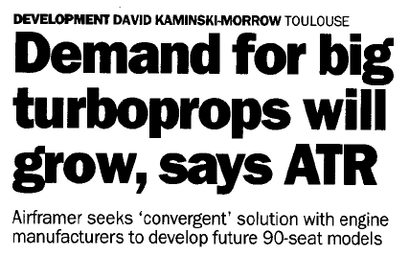
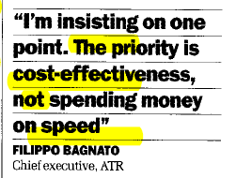
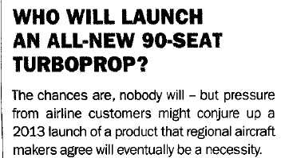
A Larger Propeller Aircraft Is Discussed for 10 Years!
05/2011:
01/2013:
01/2013:
01/2013:
01/2011:

Slide 33
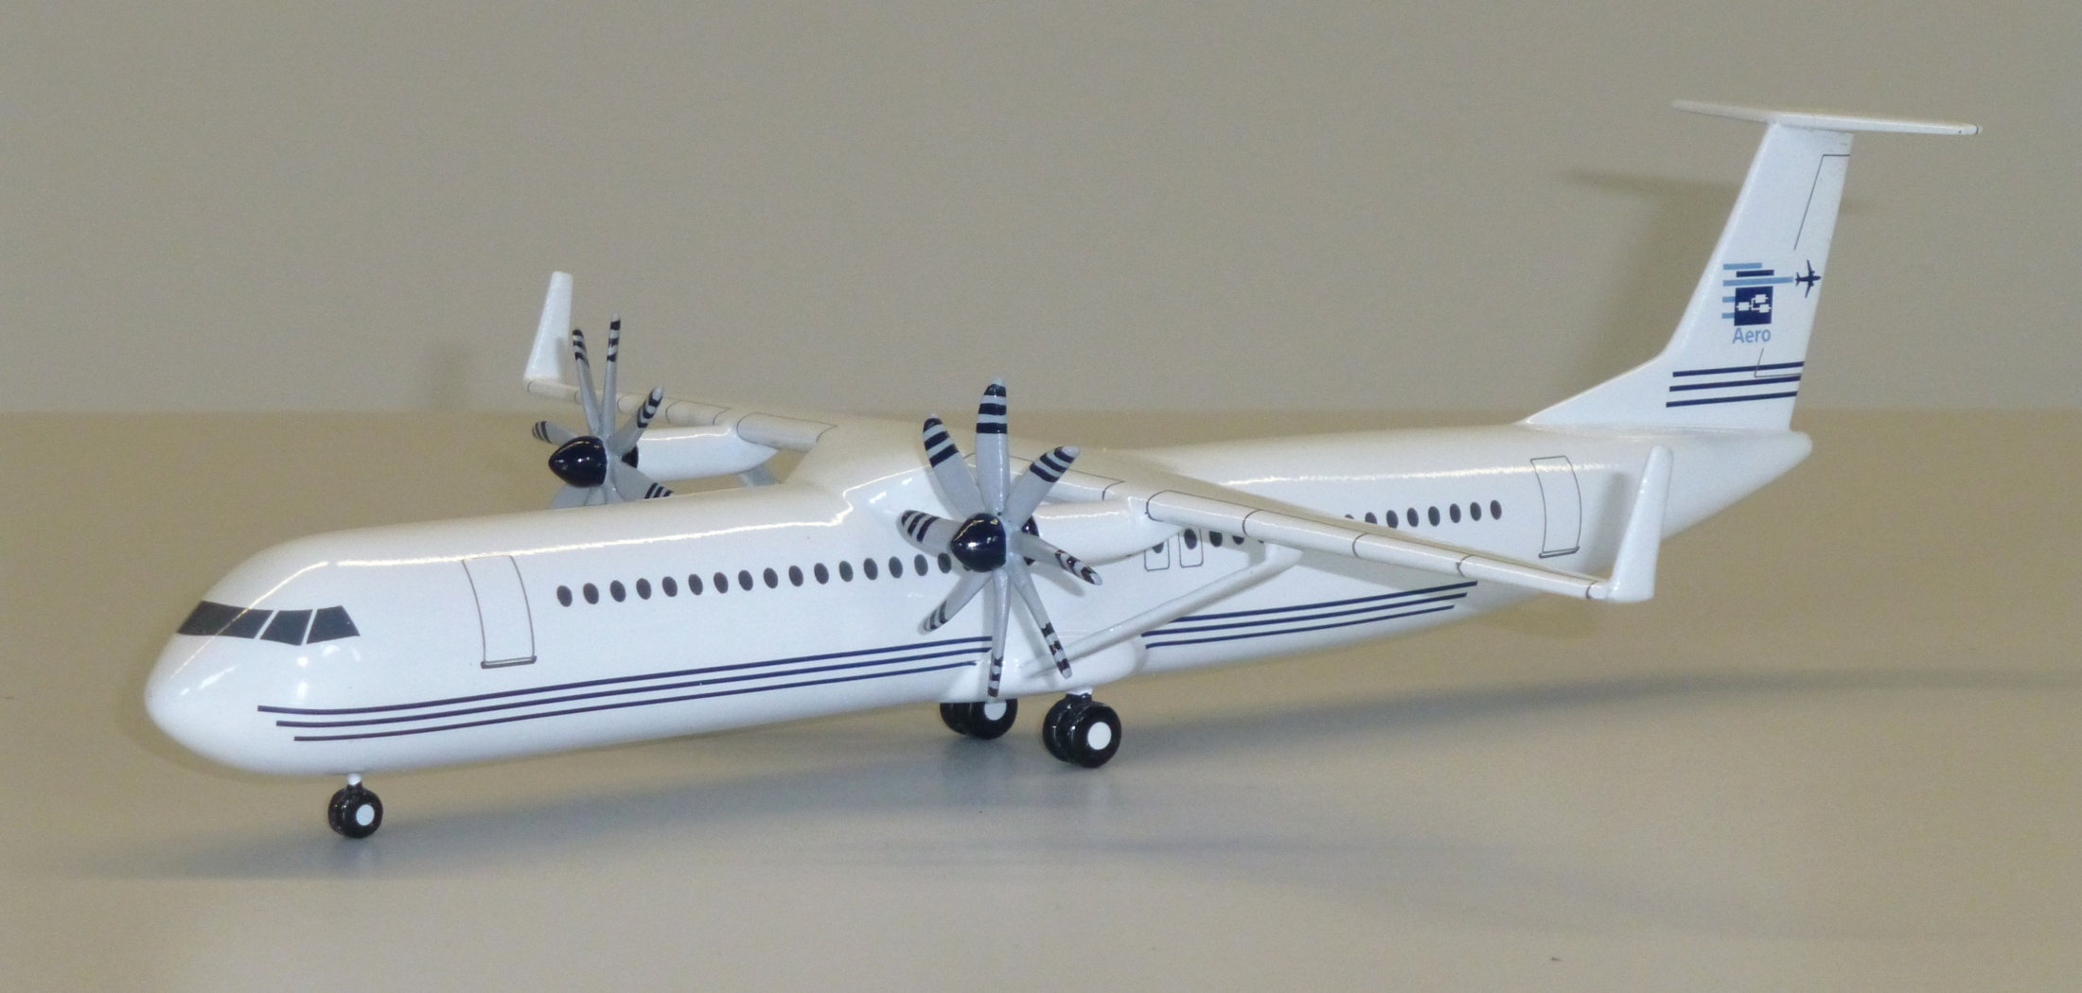
"Smart Turboprop": Large Propellers, Braced Wing, Partial Laminar Flow
http://Airport2030.ProfScholz.de

Slide 34
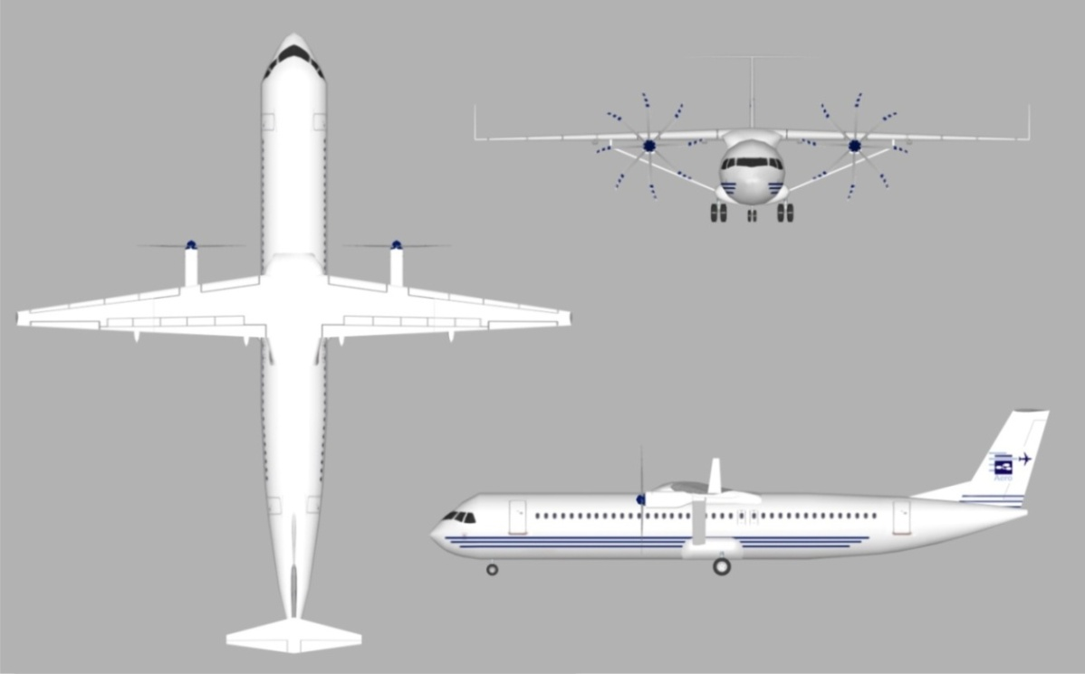
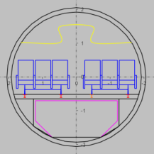
"Smart Turboprop": Fly Slow and Low for Reduced Global Warming!
Natural Laminar Flow (NLF)
Power to Mass Ratio kW/t
36 % less fuel
In 23000 ft altitude: no
radiative forcing due to
Aviation Induced Cloudiness
(AIC)
Payload Mass [t]

Slide 35
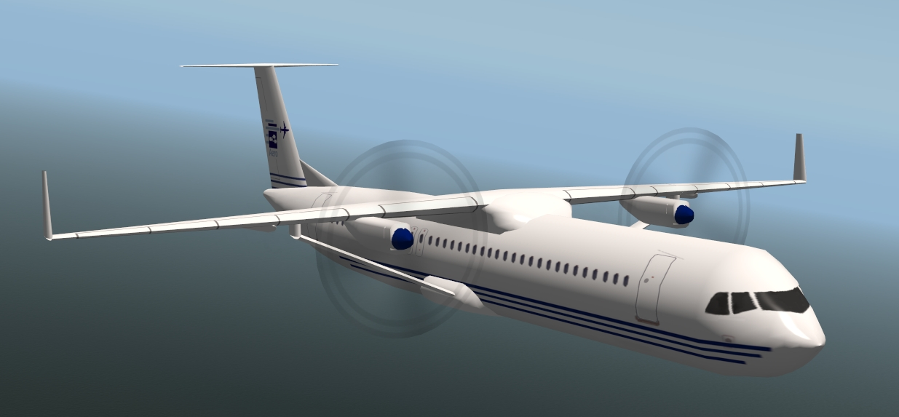
"Smart Turboprop": 17% Less Operating Costs!

Slide 36
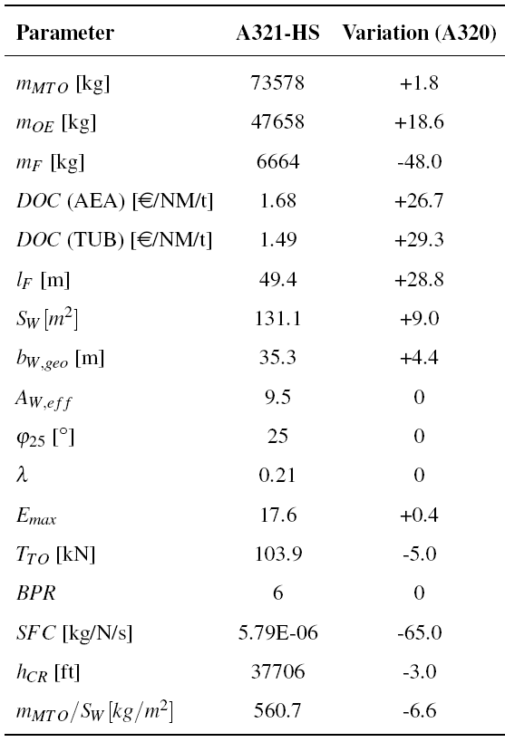
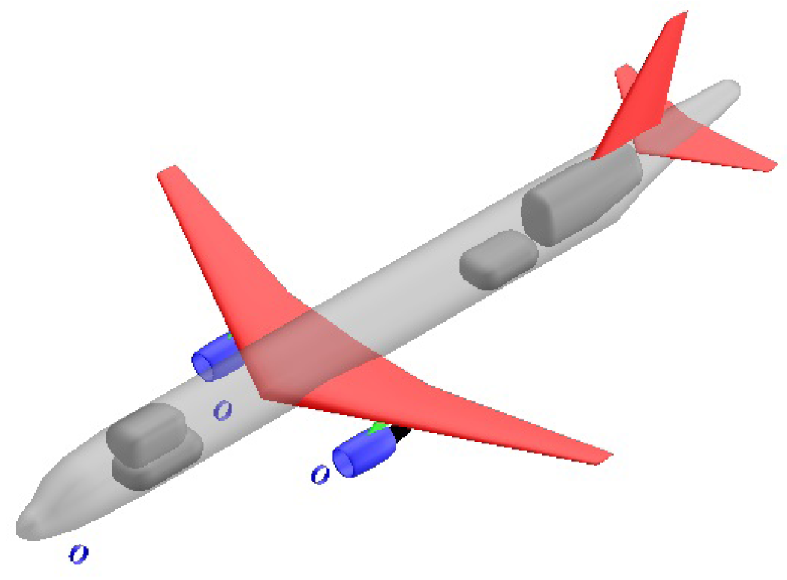
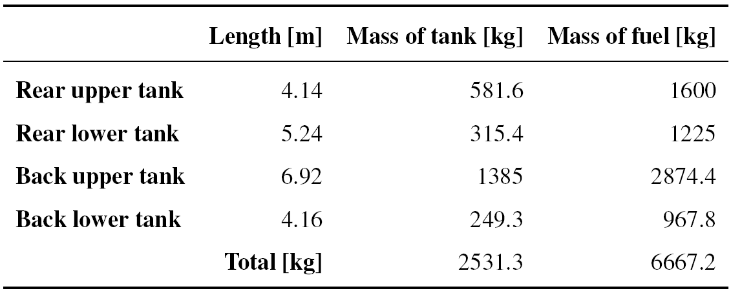
A320 Converted to Hydrogen
Comparison A321-HS with A320-200
S = Stretch
https://doi.org/10.5281/zenodo.4073172
energy up 46 %
A321: l_{F} = 44.5 m
Delta fuselage
length: 4.9 m.
Further stretch
or A319 cabin
required.
To do:
"Smart Turboprop"
with LH2 to
combine best of
both solutions.
Details of the tanks for the A321-HS

Slide 37
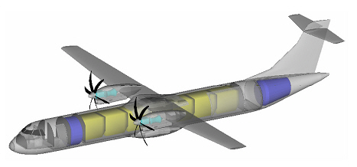
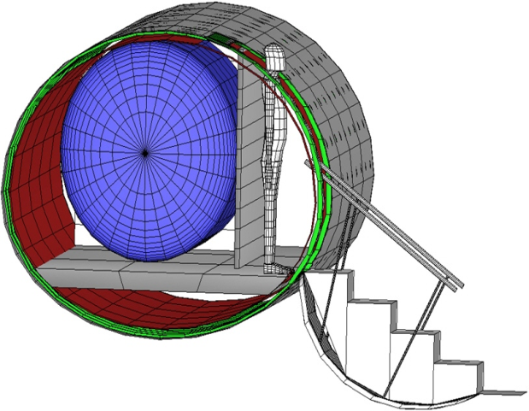
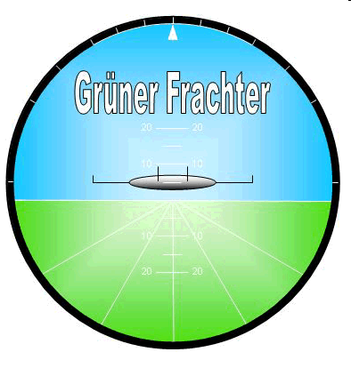
Example: Freighter for
Medium Range with Hydrogen (LH2): ATR 72
Project "Green Freighter"
http://GF.ProfScholz.de

Slide 38
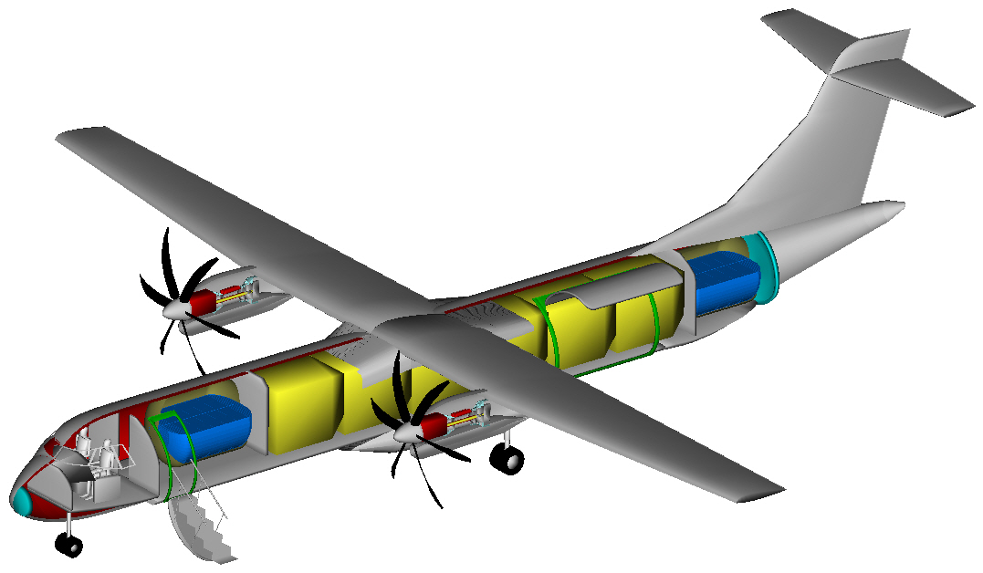
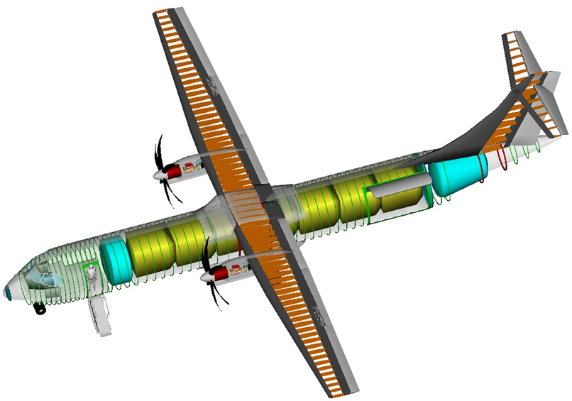
Example: Freighter for
Medium Range with Hydrogen (LH2):
ATR 72
HEINZE, TU Braunschweig, 2009
see http://GF.ProfScholz.de

Slide 39
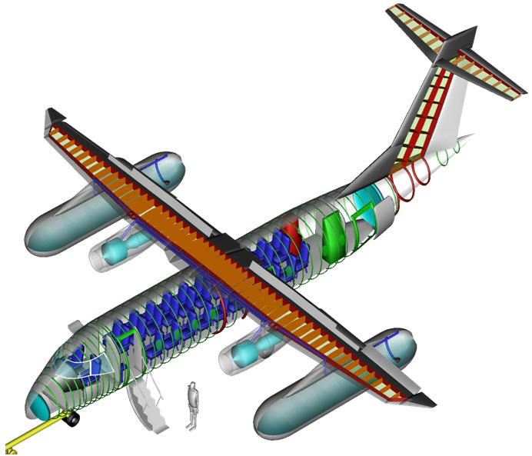
Example: Passenger Airplane for Medium Range with Hydrogen (LH2)
Project "Green Freighter"
HEINZE, TU Braunschweig, 2009
see http://GF.ProfScholz.de

Slide 40
    Long Range

Slide 41
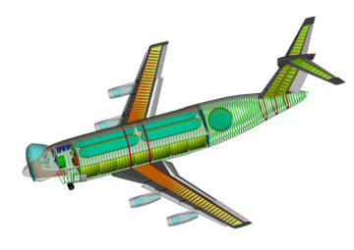
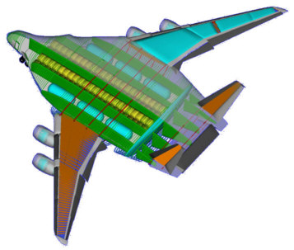
Example: Freighter for Long Range with Hydrogen (LH2)
Project "Green Freighter"
HEINZE, TU Braunschweig, 2009
see http://GF.ProfScholz.de

Slide 42
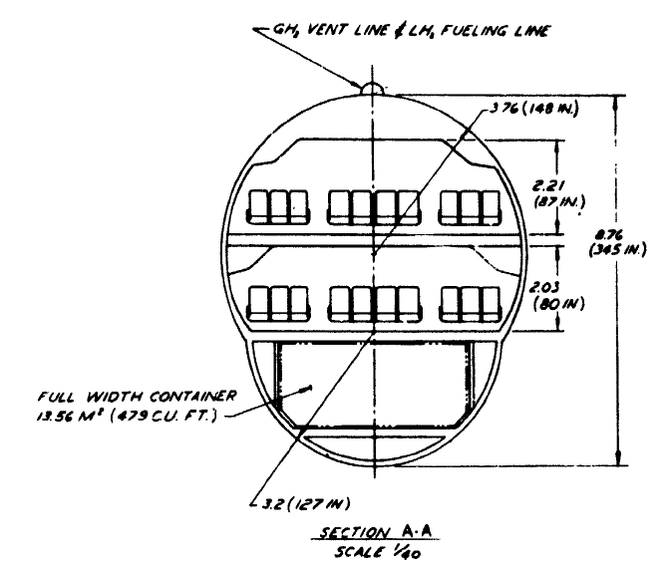

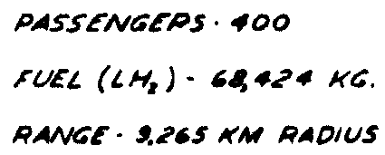
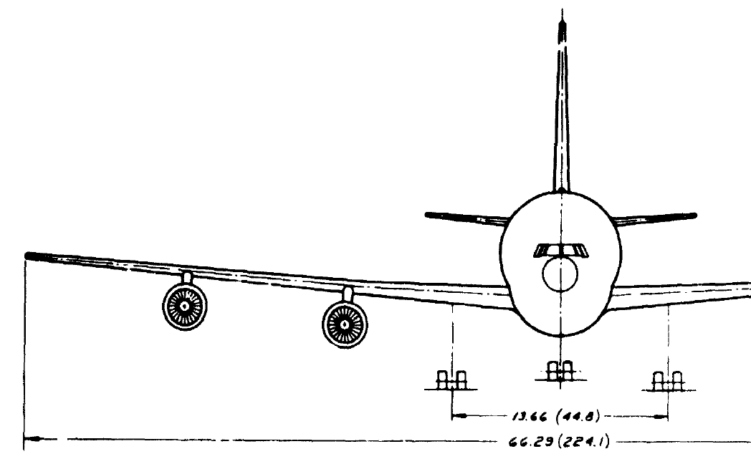

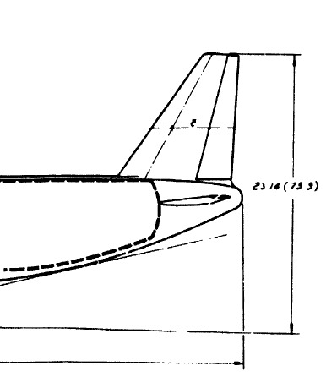
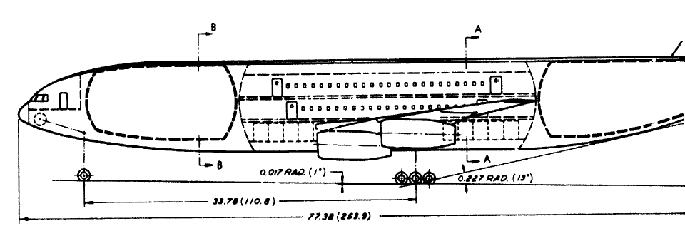
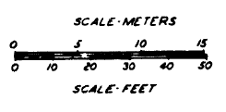
Large Passenger Aircraft for LH2 and Extreme Long Range
Lockheed 1976
Range: 18530 km = 10000 NM
BREWER, G.D., MORRIS, R.E., 1976. Study of LH2 Fueled Subsonic Passenger Transport Aircraft. Lockheed, NASA CR-144935. Available from: https://ntrs.nasa.gov/citations/19760012056

Slide 43
    Environmental Evaluation

Slide 44
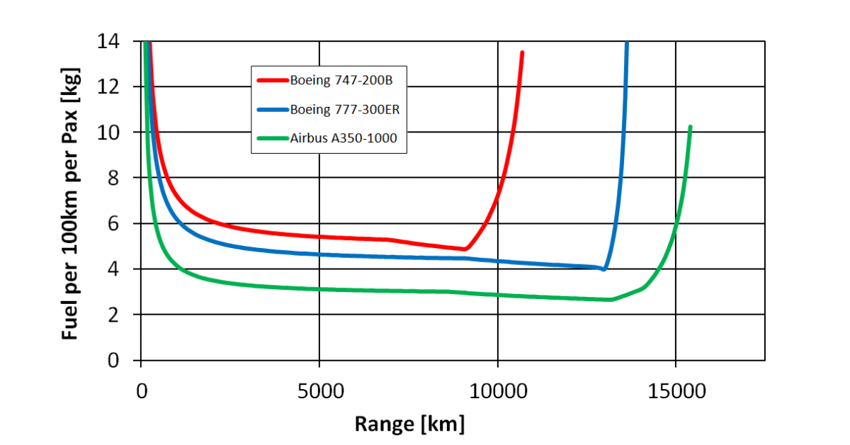
Fuel Consumption per 100 km and Person Depends on Flight Distance!
BURZLAFF, Marcus, 2017. Aircraft Fuel Consumption - Estimation and Visualization. Project. Hamburg University of Applied Sciences, Aircraft Design and Systems Group (AERO). Available from: https://nbn-resolving.org/urn:nbn:de:gbv:18302-aero2017-12-13.019

Slide 45
Equivalent CO2
CO₂
NO_{x}
AIC
m_{CO2,eq}
CAERS, Brecht, SCHOLZ, Dieter, 2020. Conditions for Passenger Aircraft Minimum Fuel Consumption, Direct Operating Costs and Environmental Impact. German Aerospace Congress 2020 (DLRK 2020), Online, 01.-03.09.2020.
Available from: https://doi.org/10.5281/zenodo.4068135
Notes:
AIC = Aircraft Induced Cloudiness
No Radiative forcing used: Only total emissions of all aircraft during a period of time

Slide 46

Emissions, Change in Atmosphere, Climate Forcing
CO2: Long term influence
Non-CO2: Short term influence (immediate mitigation is possible)
RAPP, Markus, 2019. Perspektive: Wasserstoff & Hybride. Meeting: "Emissionsfreies Fliegen-wie weit ist der Weg?", Berlin, 13.11.2019

Slide 47

Altitude-Dependent Equivalent CO2 Mass
Sustained Global Temperature Potential, SGTP (similar to GWP):
Species | Emission Index, EI (kg/kg fuel)
CO₂ | 3,15
H₂O | 1,23
SO₂ | 2,00 ∙ 10⁻⁴
Soot | 4,00 ∙ 10⁻⁵
Species | SGTP_{i,100}
CO₂ (K/kg CO₂) | 3,58 ∙ 10⁻¹⁴
Short O₃ (K/kg NO_{x}) | 7,97 ∙ 10⁻¹²
Long O₃ (K/NO_{x}) | -9,14 ∙ 10⁻¹³
CH₄ (K/kg NO_{x}) | -3,90 ∙ 10⁻¹²
Contrails (K/NM) | 2,54 ∙ 10⁻¹³
Contrails (K/km) Cirrus (K/NM) Cirrus (K/km) | 1,37 ∙ 10⁻¹³ 7,63 ∙ 10⁻¹³ 4,12 ∙ 10⁻¹³
EI emission index
f_{NM} fuel consumption
per NM or km
R_{NM} range in NM or km
CF characterization factor
Cirrus/Contrails = 3.0
water vapor not considered
AIC aviation-induced
cloudiness

Slide 48

Altitude-Dependent Equivalent CO2 Mass
E.g.:
Forcing Factor s = f(h)
The curves go along with the ICAO Standard Atmosphere (ISA) applicable for average lattitudes. With a first approximation, the curves could be adapted to other lattitudes by stretching and shrinking them proportionally to the altitude of the tropopause.
The curves from SVENSSON 2004 (Fig. 1) show similar shapes. However, the importance of AIC is not yet as distinct.
SVENSSON, Fredrik, HASSELROT, Anders, MOLDANOVA, Jana, 2004. Reduced Environmental Impact by Lowered Cruise Altitude for Liquid Hydrogen-Fuelled Aircraft. In: Aerospace Science and Technology, Vol. 8 (2004), Nr. 4, pp. 307–320. Available from: https://doi.org/10.1016/j.ast.2004.02.004
Schwartz 2009 and 2011
Notes:
Sustained Global Temperature Potential. Forcing factor = altitude dependency

Slide 49

Altitude-Dependent Equivalent CO2 Mass
units only
SCHWARTZ, Emily, KROO, Ilan M., 2009. Aircraft Design: Trading Cost and Climate Impact.
47th AIAA Aerospace Sciences Meeting including The New Horizons Forum and Aerospace Exposition,
05.01.-08.01.2009, Orlando, Florida, AIAA 2009, No.1261. Available from: https://doi.org/10.2514/6.2009-1261
JOHANNING, Andreas, SCHOLZ, Dieter, 2014. Adapting Life Cycle Impact Assessment Methods for Application in Aircraft Design.
German Aerospace Congress 2014 (DLRK 2014), Augsburg, 16.-18.09.2014.
Available from: https://nbn-resolving.org/urn:nbn:de:101:1-201507202456. Download: http://Airport2030.ProfScholz.de
Notes:
Equations by Emily Dallara Schwarz
Emission indices and characterization factors
CF of CO2 is 1: no altitude dependency

Slide 50

Altitude-Dependent Equivalent CO2 Mass
Forcing Factor s = f(h)
Forcing factors (lines) with 66% likelihood ranges (shaded areas). Altitudes with forcing factors based on raditiative forcing data with independent probability distributions. (SCHWARTZ 2011)
Based on KÖHLER 2008 and RÄDEL 2008.
SCHWARTZ DALLARA, Emily, 2011. Aircraft Design for Reduced Climate Impact. Dissertation. Stanford University.
Available from: http://purl.stanford.edu/yf499mg3300
KÖHLER, Marcus O., RÄDEL, Gaby, DESSENS, Olivier, SHINE, Keith P., ROGERS, Helen L., WILD, Oliver, PYLE, John A., 2008. Impact of Perturbations to Nitrogen Oxide Emissions From Global Aviation. In: Journal of Geophysical Research, 113. Available from: https://doi.org/10.1029/2007JD009140
RÄDEL, Gaby, SHINE, Keith P., 2008. Radiative Forcing by Persistent Contrails and Its Dependence on Cruise Altitudes. In: Journal of Geophysical Research, 113. Available from: https://doi.org/10.1029/2007JD009117
Notes:
Sustained Global Temperature Potential. Forcing factor = altitude dependency

Slide 51


Aviation-Induced Cloudiness: Contrail Cirrus & Persistent Contrails
Cirrus/Contrails = 4.0
(b) Aviation forcing components, of which aviation-induced cloudiness (AIC) account for more than half.
(c) Breakdown of AIC radiative forcing into contrail cirrus and persistent contrails.
KÄRCHER, Bernd, 2018. Formation and Radiative Forcing of Contrail Cirrus. In: Nature Communications, Vol. 9, Article Number: 1824. Available from: https://doi.org/10.1038/s41467-018-04068-0

Slide 52
Life Cycle Assessment (LCA)
Midpoint categories
Climate:
From
Inventory via
Midpoint Categories and
Endpoint Categories to a
Singel Score
OpenLCA
http://www.openlca.org
Inventory
analysis
results
Endpoint categories
ReCiPe
http://www.lcia-recipe.net
Energy:
Johanning 2014, 2016, 2017
ReCiPe Method: https://www.leidenuniv.nl/cml/ssp/publications/recipe_characterisation.pdf

Slide 53

Positive Effect for the Environment: Fly Lower!
“Neutral” mix of 50 – 50 resource depletion and engine emissions
Clear altitude boundary from $m_{CO2,eq}$ visible
Fuel consumption shape visible
Fly low and slow
Units: normalized value between 0 and 1
Notes:
Explain normalized values and weighting factors

Slide 54
Positive Effect for the Environment: Fly Lower!
Changing the regular cruise altitude of an Airbus A320-200 of about 11500 m to an altitude of 6500 m at a constant Mach 0.78 would result in:
a decrease of equivalent CO2 mass of 78 % and
an increase of fuel consumption of 5.6 %.
  The increase of fuel consumption is mostly influenced by
  an increase of TSFC of 6.0 % and
  a decrease of the aerodynamic efficiency of 5.4 %.
Combining equivalent CO2 mass and resource depletion (fuel consumption) into the environmental impact would result in a decrease of 70 % in environmental impact.
As the Mach number is kept constant, DOC are only effected by fuel consumption and increase by only 0.6%.
However, for the atmosphere this is an exchange of considerable less short term non-CO2 warming potential versus a little more CO2 long term warming potential. This exchange can be questioned, because it is not good for future generations.

Slide 55

From Life Cycle Assessment to Ecolabel
    Each Aircraft of an Airline
    gets an Ecolabel
    Comparison among all Passenger Aircraft
    (A to G)
http://ecolabel.ProfScholz.de
SCHOLZ, Dieter, 2017. An Ecolabel for Aircraft. German Aerospace Congress 2017 (DLRK 2017), Munich, Germany, 05.-07.09.2017. Available from: https://doi.org/10.5281/zenodo.4072826
Fuel consumed is allocated according to used cabin floor area for each class.

Slide 56
    New Energies, Propulsion,
    and Aircraft

Slide 57
    Hydrogen (LH2)

Slide 58

Airbus: "Zero-Emission" Hybrid – Hydrogen Passenger Aircraft
  "At Airbus, we have the ambition to develop the world’s first zero-emission commercial aircraft by 2035."
  Statement from 2020-09-21.
Beware! "Zero-emission" is never possible; not for aircraft, not for animals/humans (CO2, CH4).
For details: SCHOLZ, Dieter, 2020. Design of Hydrogen Passenger Aircraft – How much 'Zero-Emission' is Possible?

Slide 59

How Many Passengers Go into this Airplane (Intended for 200 Pax)?
Answer:
If you assume its the largest type door (Type A): max. 110 Pax are allowed.
If you look at the proportions of the aircraft: ≈ 20 Pax !?

Slide 60

Kerosene and LH2 Combustion
EI_{NOx}
m_{F}
not included in
LH2 combustion
EMEP/EEA Guidebook
https://www.eea.europa.eu
Own Fuel Calculation

Slide 61



Comparing the Emissions of Kerosene and Hydrogen Aircraft
Here secondary effects are applied on top of the primary effect for contrails due to larger ice crystals (factor 0.77) and for visible contrails (factor 0.77 assumed) leading all together to a reduction factor of 0.77² = 0.6. The same factor is assumed for cirrus clouds. For NOx a factor of 0.35 is assumed due to lean combustion and low flame temperature. With that equivalent CO2 mass is now in the order of that for kerosene propulsion. See Excel table:
https://doi.org/10.7910/DVN/DLJUUK
LH2 versus kerosene aircraft as function of altitude. LH2 aircraft benefit at high or low altitudes compared to kerosene aircraft.

Slide 62


Airbus – Past Technology Timeline for Hydrogen
1995-08-30
https://perma.cc/RF4R-LS8R
... but nothing happend!

Slide 63

Airbus – Future Technology Timeline for Hydrogen
Airbus' EU Briefing, 2021-02-09
https://perma.cc/2G6J-76DA

Slide 64
    Hydrogen (LH2) and SAF

Slide 65




EU-Study, May 2020
Emissions
≠ 0%
Energy / Primary Energy
primary
energy
factor
1.7
4.6
PtL needs
2.7 times
more
energy
than LH2!
https://doi.org/10.2843/471510
Archived at: https://perma.cc/BJJ6-5L74
and many others

Slide 66

Refueling One A350 Once per Day:
52 of the Larges Wind Power Plants (4.6 MW each) Are Needed!

Slide 67

EU-Study, May 2020: Aviation's Energy Demand – Too Much
( )
https://doi.org/10.2843/471510, Archived at: https://perma.cc/BJJ6-5L74
Footnote 38: Total generation capacity of renewable energy: 2351 GW (2018)
Globally, total renewable energy generation capacity reached 2,351 GW at the end of last year – about a third of total installed electricity capacity. Hydropower accounts for the largest share with an installed capacity of 1,172 GW – about half of the total. Wind and solar energy account for most of the remainder, with capacities of 564 GW and 480 GW, respectively. Other renewables included 121 GW of bioenergy, 13 GW of geothermal energy and 500 MW of marine energy (tide, wave and ocean energy).
https://www.hydroreview.com/2019/04/03/irena-reports-renewable-energy-now-accounts-for-a-third-of-global-power-capacity
Archived at: https://perma.cc/YLY4-CG2R
Aviation's energy demand today is too high: Minium needed all wind or solar energy available today!
First we need to reduce the amount of air travel.
Then we may have a chance to power aviation with renewable energy.

Slide 68

Best Use Renewable Energy to Replace Coal Power Plants (PtL)
http://ptl.ProfScholz.de
1.) 1 kWh of renewable energy ...
2.) ... can replace 2.5 kWh lignite in coal-fired power plants (efficiency 40%);
3.) This corresponds to 0.9 kg of CO2 (0.36 kg of CO2 for 1 kWh of energy from lignite *).
4.) ... converted into Sustainable Aviation Fuel (SAF) only 0.22 kWh remain (efficiency: 70% electrolysis, 32% Fischer-Tropsch), 99% transport; https://perma.cc/BJJ6-5L74
5.) which save only 0.057 kg of CO2 (0.26 kg of CO2 for 1 kWh of kerosene *).
* UBA, 2016: CO2 Emission Factors for Fossil Fuels. https://bit.ly/3r8avD1

Slide 69

Best Use Renewable Energy to Replace Coal Power Plants (LH2)
http://ptl.ProfScholz.de
1.) 1 kWh of renewable energy ...
2.) ... can substitute 2,5 kWh of coal (lignite, brown coal) in a coal power plant (efficiency of a coal power plant: 40%) this is
3.) ... equivalent to 0.9 kg CO2 (0.36 kg CO2 for 1 kWh of energy burning lignite*)
4.) ... but if used in an aircraft it generates LH2 with energy of 0.6 kWh (efficiencies: 70% electrolysis, 83% liquefaction & transport)
5.) LH2 aircraft consume (say) 10% more energy (higher operating empty mass, more wetted area); so a kerosene aircraft needs ...
6.) only 0.55 kWh, which can be substituted. This is equivalent to 0.14 kg CO2 (0.26 kg CO2 for 1 kWh of energy burning kerosene*).
7.) Note: Not considered is that hydrogen aircraft may come with higher non-CO2 effects than kerosene aircraft.
* UBA, 2016. CO2 Emission Factors for Fossil Fuels. Available from: https://bit.ly/3r8avD1

Slide 70

External Emissions: CO2, NOX, AIC
The Carbon Cycle
SAF need DAC (Direct Air Capure) to compensate for CO2 ("cabon cycle")
In addition: SAF and BioFuel need more DAC to compensate for the global warming effect due to
  NOX and
  H2O (AIC)
Production of synthetic kerosene (e-fuel) with power-to-liquid (PtL). Taking CO2 from the air (Direct Air Capture, DAC) enables a carbon cycle.

Slide 71
    Electric Flight ?

Slide 72

Calculating Maximum Range
for Battery–Electric Flight
: realistic parameters

Slide 73

Airbus / Rolls-Royce: E-Fan X: Hybrid–Electric Flight
?
ROLLCE-ROYCE, 2017. We’ve Teamed up with Airbus and Siemens to Fly a Hybrid-Electric Aircraft by 2020. Twitter, 2017-11-28. Available from: https://twitter.com/RollsRoyce/status/935443638137622528
Archived at: https://perma.cc/C26X-PLCR
*
* Siemens eAircraft Unit
sold to Rolls-Royce in 2019
Electric engines have at best the same mass as an aviation gas turbine.
The new propulsion system (gas turbine, generator, electric motor) has
at least 3 times the mass of the original propulsion system, which could do with only the gas turbine.

Slide 74


Airbus / Rolls-Royce: E-Fan X: Hybrid – Electric Flight
???
Project cancelled: 2020-04-24
https://www.airbus.com/innovation/zero-emission/electric-flight.html
Archived at: https://perma.cc/9ZPP-ULRS
https://www.airbus.com/newsroom/stories/our-decarbonisation-journey-continues.html
Archived at: https://perma.cc/CPS5-RB94
For more on hybrid-electric flight see Bibliography:
SCHOLZ 2018, https://doi.org/10.15488/3986
SCHOLZ 2019, https://doi.org/10.5281/zenodo.3265212
SCHOLZ 2019, https://doi.org/10.5281/zenodo.4072283
???
Airbus 2018

Slide 75

Electric Flight
Savings due to a Large Number of (Electric) Engines? – Climb OEI: sin γ
sin γ
It depends on the required climb gradient, sin γ.
It is not defined today, how a One-Engine-Inoperative (OEI) climb is treated by CS-25 with respect to sin γ.
Many engines could also lead to increased thrust requirements!?
sin γ increased beyond 3% by 0,3%-points per engine
assumed:
E = L/D = 20
sin γ kept constant at 3% for larger number of engines

Slide 76

Electric Flight
Savings due to a Large Number of (Electric) Engines? – One Engine Inop or More?
general thrust factor:
For a design with very many engines n_{E}, EASA / FAA could re-define the thrust factor.
The number of engines assumed inoperative n_{E,inop} could be increased:
n_{E,inop} >1, for larger n_{E}
4 engines with 1 failed need a thrust factor of 1.33. 20 engines with 4 failed need a thrust factor of 1.25 – only slightly less. However, probability for 4 engines failed from 20 is very low.
Applied, this could reduce the advantage of many engines.

Slide 77

Electric Flight
An Infinite Number of Engines Reduces the Propeller Area to Zero!
The more propellers are put on the wing the smaller their diameter. As the number of propellers goes to infinity the propeller area is only a line on the wing and the propeller area goes to zero.
To maximize the total propeller area, an optimum number of propellers may be 4.
Rolls-Royce (NAS 2016)

Slide 78
    Flying Less !

Slide 79

Google translation
of French webpage.
https://www.lemonde.fr/idees/article/2020/05/29/aeronautique-la-transition-ecologique-impose-une-profonde-transformation-de-notre-industrie_6041127_3232.html
Archived at: https://perma.cc/5L84-G4QN

Slide 80




Largest Reduction of Emissions in
Aviation History from the Corona–Pandemic
Traffic reduction is more efficient than technology
https://stay-grounded.org
Ikreis, CC BY-SA, https://bit.ly/2Jn11T0

Slide 81

Saving the World Starts in Our Mind: Video "The Bill"
Watch "The Bill", a short video (4:21).
The video may make you think about how we live and what (how much flying) we really need.
https://youtu.be/EmirohM3hac (German)
https://youtu.be/rWfb0VMCQHE (English Subtitles)

Slide 82
    Summary

Slide 83
Summary
Urban Air Mobility is for the rich. No benefit to the environment. No reduction of congestion.
Short Range is for the train.
Medium Range between Megacities is for the train.
For other Medium Range operation: Propeller aircraft with smart design. Hydrogen could be used.
Long Range: Drop-in fuel from renewable energy (SAF, E-Fuel), but: high primary energy needs. Hydrogen possible, but inefficient aircraft design.
Published fuel consumption and an ecolabel for all aircraft would be beneficial.
Decisions should be based on a Life Cycle Analysis (LCA).
Aviation has a water problem (AIC). Less so a CO2 problem.
But: CO2 dominates in the long run.
Flying lower has substancial environmental benefits. Similar other options exist.
Battery-electric flight only works on short range (where it is generally not needed).
Hybrid-electric flight has no advantages for passenger aircraft.
Burning hydrogen has the same radiative forcing like kerosene, but avoids the accumulation of CO2.
Aviation to the extend as today (2019) may face problems to be supplied with renewable energy. Aviation must not use renewable energy already allocated for other use (e.g. the substitution of coal power plants).
Flying less needs to be considered.

Slide 84

Contact
RAeS Conference: Alternative Propulsion Systems – The Challenges and Opportunities for Aircraft Design
info@ProfScholz.de
http://www.ProfScholz.de
http://AERO.ProfScholz.de
How to quote this document:
SCHOLZ, Dieter, 2020. Passenger Aircraft Design towards Lower Emissions with SAF, LH2, and Batteries
(Pros & Cons). RAeS Conference: Alternative Propulsion Systems – The Challenges and Opportunities for Aircraft Design. London, UK / Hybrid, 01.–02.12.2021. – Available from: https://doi.org/10.5281/zenodo.5904292
© Copyright by Author, CC BY-NC-SA, https://creativecommons.org/licenses/by-nc-sa/4.0

Slide 85
RAeS Conference: Alternative Propulsion Systems – The Challenges and Opportunities for Aircraft Design
Bibliography / Literature
Cryoplane: Reports, Licentiate, Paper
WESTENBERGER, Andreas, 2003: Liquid Hydrogen Fuelled Aircraft – System Analysis, CRYOPLANE. Final Technical Report.
Available from: http://purl.org/AeroLectures/2004-02-26 (PDF)
SCHOLZ, Dieter; SEECKT, Kolja, 2010: Schlussbericht - FH3-Projekt "Grüner Frachter". HAW Hamburg, Department F&F, AERO. Berichts-Nr.: GF_WT0.1_AB. Download: http://GF.ProfScholz.de
EU, 2020. Hydrogen-Powered Aviation. Available from: https://doi.org/10.2843/471510. Archived at: https://perma.cc/BJJ6-5L74
SEECKT, Kolja, 2010. Conceptual Design and Investigation of Hydrogen-Fueled Regional Freighter Aircraft. Stockholm, KTH, Licentiate Thesis in Cooperation with HAW Hamburg. Download: http://GF.ProfScholz.de
SEECKT, Kolja, HEINZE, Wolfgang, SCHOLZ, Dieter, 2008. The Green Freighter Project – Objectives and First Results. In: CD Proceedings: ICAS 2008 - 26th Congress of the International Council of the Aeronautical Sciences including the 8th AIAA Aviation Technoloy, Integration, and Operations (ATIO) Conference (Anchorage, Alaska, USA, 14.-19.09.2008). Edinburgh, UK: Optimage Ltd. Paper: ICAS 2008-4.10.3. Download: http://GF.ProfScholz.de
SEECKT, Kolja, SCHOLZ, Dieter, 2009. Jet versus Prop, Hydrogen versus Kerosene for a Regional Freighter Aircraft. In: DGLR: Deutscher Luft- und Raumfahrtkongress 2009 : Tagungsband - Ausgewählte Manuskripte (DLRK, Aachen, 08.-10.09.2009). Download: http://GF.ProfScholz.de
HEINZE, W., HANSEN, L.-U., WERNER-SPATZ, C., HORST, P., 2009. Gesamtentwurfsuntersuchungen zu BWB-Frachtflugzeugen mit alternativen Treibstoffen (Deutscher Luft- und Raumfahrtkongress, Aachen, 08.-10.09.2009). Download: http://GF.ProfScholz.de
SEECKT, Kolja, SCHOLZ, Dieter, 2010. Application of the Aircraft Preliminary Sizing Tool PreSTo to Kerosene and Liquid Hydrogen Fueled Regional Freighter Aircraft. In: DGLR: Deutscher Luft- und Raumfahrtkongress 2010: Tagungsband - Ausgewählte Manuskripte (DLRK, Hamburg, 31.08.-02.09.2010). Download: http://GF.ProfScholz.de

Slide 86
SCHOLZ, Dieter, DIB, Leon, 2015. Hydrogen as Future Fuel Used in Minimum Change Derivatives of the Airbus A321. German Aerospace Congress 2015 (DLRK 2015), Rostock, Germany, 22.-24.09.2015. Available from: https://doi.org/10.5281/zenodo.4073172
DIB, Leon, 2015. The Aviation Fuel and the Passenger Aircraft for the Future – Hydrogen. Master Thesis. HAW Hamburg. Available from: http://Library.ProfScholz.de
SCHOLZ, Dieter, 2020. Design of Hydrogen Passenger Aircraft – How much 'Zero-Emission' is Possible? Hamburg Aerospace Lecture Series, HAW Hamburg (online), 19.11.2020. Available from: https://doi.org/10.5281/zenodo.4301104
Green Aviation and Aviation Ethics
SCHOLZ, Dieter, 2012. Eco-Efficiency in Aviation – Flying Off Course? German Aerospace Congress 2012 (DLRK 2012), Berlin, Germany, 10.-12.09.2012. Available from: https://doi.org/10.5281/zenodo.4067014
SCHOLZ, Dieter, 2020. Airbus' Cabin Air Explanations during the Corona Pandemic – Presented, Analyzed, and Criticized. Available from: http://purl.org/corona/M2020-06-19 (PDF)
SCHOLZ, Dieter, 2020. Review of CO2 Reduction Promises and Visions for 2020 in Aviation. German Aerospace Congress 2020 (DLRK 2020), Online, 01.-03.09.2020. Available from: https://doi.org/10.5281/zenodo.4066959
SCHOLZ, Dieter, 2020. Aviation Ethics – Growth, Gain, Greed, and Guilt. German Aerospace Congress 2020
(DLRK 2020), Online, 01.-03.09.2020. Available from: https://doi.org/10.5281/zenodo.4068009
Evaluation of Aircraft Configurations
SCHOLZ, Dieter, 2006. Die Blended Wing Body Flugzeugkonfiguration. Hamburg Aerospace Lecture Series, 2006-09-28. Available from: https://bit.ly/3leyyMr (PDF)
JOHANNING, Andreas, SCHOLZ, Dieter, 2012. Novel Low-Flying Propeller-Driven Aircraft Concept For Reduced Direct Operating Costs And Emissions. In: CD Proceedings: ICAS 2012 - 28th Congress of the International Council of the Aeronautical Sciences (ICAS, Brisbane, 23.-28.09.2012). Edinburgh, UK: Optimage Ltd, 2012. Paper: ICAS2012-1.10.5. Download: http://Airport2030.ProfScholz.de

Slide 87
SCHOLZ, Dieter, JOHANNING, Andreas, 2014. Smart Turboprop – A Possible A320 Successor. 4th Symposium on Collaboration in Aircraft Design (25.-27.11.2014, Toulouse, France). Presentation. Download: http://Airport2030.ProfScholz.de
JOHANNING, Andreas, SCHOLZ, Dieter, 2014. Airport2030, AP4.1: Evolutionäre Flugzeugkonfigurationen - Schlussbericht. HAW Hamburg, Department F&F, AERO. Berichts-Nr.: Airport2030_AB_Schlussbericht. Download: http://Airport2030.ProfScholz.de
Hybrid-Electric Aircraft
SCHOLZ, Dieter, 2018. Evaluating Aircraft with Electric and Hybrid Propulsion. In: UKIP Media & Events: Conference Proceedings : Electric & Hybrid Aerospace Symposium 2018 (Cologne, 08.-09.11.2018). Available from: https://doi.org/10.15488/3986. Available from: http://EHA2018.ProfScholz.de (PDF)
SCHOLZ, Dieter, 2019. Electric and Hybrid Aviation – From Media Hype to Flight Physics. Hamburg Aerospace Lecture Series, 2019-04-25. Available from: https://doi.org/10.5281/zenodo.3265212
SCHOLZ, Dieter, 2019. Limits to Principles of Electric Flight. German Aerospace Congress 2019 (DLRK 2019), Darmstadt, 30.09.-02.10.2019. Available from:https://doi.org/10.5281/zenodo.4072283
Life Cycle Analysis (LCA): Dissertation, Paper
JOHANNING, Andreas, 2017. Methodik zur Ökobilanzierung im Flugzeugvorentwurf. München: Verlag Dr. Hut. Dissertation. ISBN 978-3-8439-3179-3. Download: http://Airport2030.ProfScholz.de
JOHANNING, Andreas, 2016: Life Cycle Assessment in Conceptual Aircraft Design – Excel Tool LCA-AD. Available from: http://doi.org/10.13140/RG.2.1.1531.0485
JOHANNING, Andreas, SCHOLZ, Dieter, 2013. A First Step Towards the Integration of Life Cycle Assessment into Conceptual Aircraft Design. German Aerospace Congress 2013 (DLRK 2013), Stuttgart, 10.-12.09.2013.
Available from: https://nbn-resolving.org/urn:nbn:de:101:1-201407183813. Download: http://Airport2030.ProfScholz.de
JOHANNING, Andreas; SCHOLZ, Dieter, 2014. Conceptual Aircraft Design Based on Lifecycle Assessment. In: ICAS 2014 - 29th Congress of the International Council of the Aeronautical Sciences (St. Petersburg, 07.-12.09.2014). Paper: ICAS2014-9.10.1. Download: http://Airport2030.ProfScholz.de

Slide 88
JOHANNING, Andreas, SCHOLZ, Dieter, 2014. Adapting Life Cycle Impact Assessment Methods for Application in Aircraft Design.
German Aerospace Congress 2014 (DLRK 2014), Augsburg, 16.-18.09.2014. Available from: https://nbn-resolving.org/urn:nbn:de:101:1-201507202456. Download: http://Airport2030.ProfScholz.de
JOHANNING, Andreas, SCHOLZ, Dieter, 2015. Comparison of the Potential Environmental Impact Improvements of Future Aircraft Concepts Using Life Cycle Assessment. In: CEAS: 5th CEAS Air&Space Conference: Proceedings (CEAS2015, Delft, 07.-11.09.2015). DocumentID: 80. Download: http://Airport2030.ProfScholz.de
Environmental Impact
SCHWARTZ, Emily, KROO, Ilan M., 2009. Aircraft Design: Trading Cost and Climate Impact. 47th AIAA Aerospace Sciences Meeting including The New Horizons Forum and Aerospace Exposition, 05.01.-08.01.2009, Orlando, Florida, AIAA 2009, No.1261. Available from: https://doi.org/10.2514/6.2009-1261
SCHWARTZ DALLARA, Emily, 2011. Aircraft Design for Reduced Climate Impact. Dissertation. Stanford University. Available from: http://purl.stanford.edu/yf499mg3300 – Forcing Factor s(h) based on: KÖHLER 2008 and RÄDEL 2008.
KÖHLER, Marcus O., RÄDEL, Gaby, DESSENS, Olivier, SHINE, Keith P., ROGERS, Helen L., WILD, Oliver, PYLE, John A., 2008. Impact of Perturbations to Nitrogen Oxide Emissions From Global Aviation. In: Journal of Geophysical Research, 113. Available from: https://doi.org/10.1029/2007JD009140
RÄDEL, Gaby, SHINE, Keith P., 2008. Radiative Forcing by Persistent Contrails and Its Dependence on Cruise Altitudes. In: Journal of Geophysical Research, 113. Available from: https://doi.org/10.1029/2007JD009117
CAERS, Brecht, SCHOLZ, Dieter, 2020. Conditions for Passenger Aircraft Minimum Fuel Consumption, Direct Operating Costs and Environmental Impact. German Aerospace Congress 2020 (DLRK 2020), Online, 01.-03.09.2020.
Available from: https://doi.org/10.5281/zenodo.4068135
SCHOLZ, Dieter, 2020. Calculation of the Emission Characteristics of Aircraft Kerosene and Hydrogen Propulsion. Excel table. Available from: https://doi.org/10.7910/DVN/DLJUUK

Slide 89
Aircraft Design
SCHOLZ, Dieter, 2015: Aircraft Design, 2015. Lecture notes and more as part of "Hamburg Open Online University (HOOU)". Webpage: http://HOOU.ProfScholz.de
DOC
SCHOLZ, Dieter, THORBECK, Jürgen, 2013. TU Berlin DOC Method. 3rd SCAD - Symposium on Collaboration in Aircraft Design, (Linköping University, 19.-20.09.2013). Hamburg: AERO, 2013. – Download: http://reports-at-aero.ProfScholz.de,
http://www.fzt.haw-hamburg.de/pers/Scholz/Aero/TU-Berlin_DOC-Method_with_remarks_13-09-19.pdf
Further References
CALDWELL, Niall, 2018. Digital Displacement: Hydraulic Power for the Digital Age. In: UKIP Media & Events: Conference Proceedings : Electric & Hybrid Aerospace Symposium 2018 (Cologne, 08.-09. November 2018)
CANNON, Frank, 2016. Aircraft Cabin Air Contamination and Aerotoxic Syndrome – A Review of the Evidence. In: Collegium Basilea: Nanotechnology Perceptions, Vol. 12 (2016), pp. 73-99. Available from: https://doi.org/10.4024/N08CA16A.ntp.12.02. Download: URL: http://skybrary.aero/bookshelf/books/3594.pdf
SUN, X., ZHANG, Y., WANDELT, S., 2017. Air Transport versus High-Speed Rail – An Overview and Research Agenda. In: Journal of Advanced Transportation, Vol. 2017, Article ID 8426926. Available form: https://doi.org/10.1155/2017/8426926

