Slide 1
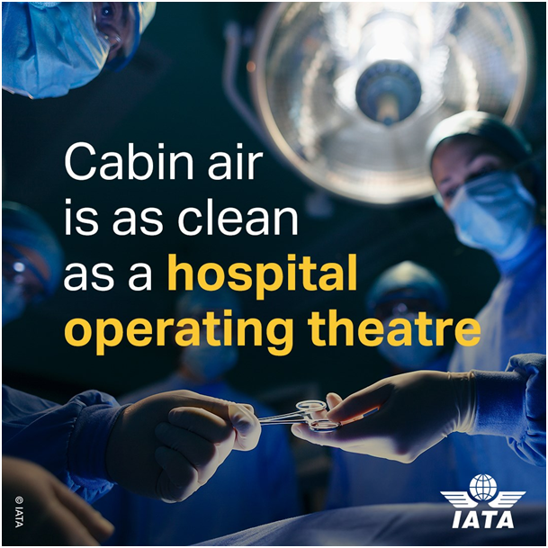
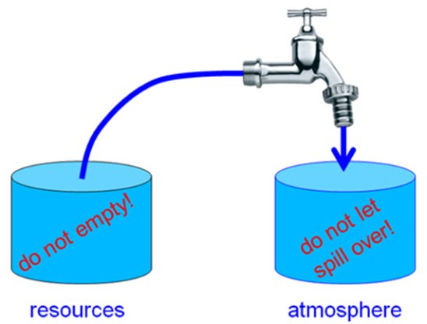
Zero Emission – The New Credo in Civil Aviation Internal: Cabin Ventilation Against the Corona Virus External: CO2, NOX, AIC
Dieter Scholz Hamburg University of Applied Sciences
German Aerospace Congress 2021 (DLRK 2021)
Online, 01 September 2021
https://doi.org/10.5281/zenodo.5919013

Slide 2
Abstract
Purpose – Reach awareness about the strategy of the aviation industry (manufacturers, airlines, organizations) when faced with restrictions from government. Internal emissions (corona virus) and external emissions (CO2, NOX, AIC) are the threats today.
Approach – Industry published information during the corona pandemic as well as related to aviation and climate change is collected from the Internet and set against scientific evidence.
Findings – Internal emissions: HEPA filters in aircraft do not produce cabin air "as clean as in a hospital operating theater". External emissions: The goal "zero emission" is proclaimed, but it becomes evident already now that measures are not sufficient and dates will not be met to come even close to set goals. Sustainable aviation fuel (SAF) is very energy intensive. Non-CO2 effects from aircraft burning hydrogen in jet engines must not be ignored. SAF will only make aircraft climate neutral when about 3 times more CO2 is captured with Direct Air Capture (DAC) then emitted. This is necessary to account for the non-CO2 effects.
Research limitations – The presentation is based on examples.
Practical implications – The public gets ill informed. Therefore, it is important so set the record straight. In addition, the strategy used by the aviation industry is exposed.
Social implications – The discussion opens up the topic beyond aviation expert circles.
Originality – Not much comparable information is given by other authors.

Slide 3
Zero Emission – The New Credo in Civil Aviation
Table of Content
Internal Emissions: Cabin Ventilation Against the Corona Virus
Legend or Truth?
Summary
External Emissions: CO2, NOX, AIC*
Zero Emission Initiatives/Reports
Technology (LH2, SAF, Efficiency Chains)
Strategy and Belief
Summary
Dichotomy and Similarity of Internal and External Emissions
Contact, Further Reading, References
* AIC: Aviation-Induced Cloudiness (contrails & contrail cirrus)

Slide 4
Zero Emission – The New Credo in Civil Aviation
Internal Emissions:
Cabin Ventilation
Against the Corona Virus
These slides summarize and extend a lecture from the DGLR local branch Hamburg. For a few more details see:
https://doi.org/10.5281/zenodo.5356568

Slide 5
Internal: Cabin Ventilation Against the Corona Virus
Simple Basic Thoughts Help to Structure the Problem
Problem 1: A fast and global spread of the virus (SARS-CoV-2) by aircraft!
Fact: The virus spread very quickly from Wuhan over continents in all parts of the world – not by ship, not by train, but by airplane. No one denies this.
As such, world wide mobility is boon and bane (German: Segen und Fluch)
Pandemics happened before, but this one resulted in a necessary (partial) shut-down of aviation.
Governments (to some extend) and passengers made the shut-down a reality.
Organizations of the aviation industry worked with all their power against the shut-down.
Understandable? Yes.
Responsible? No!
Mitigation possibilities: Screening, testing, quarantine, ... vaccination
Problem 1 is NOT the topic of this lecture, because
=> we know this is a problem,
=> this lecture has a technical focus.

Slide 6
Internal: Cabin Ventilation Against the Corona Virus
Simple Basic Thoughts Help to Structure the Problem
Problem 2: Infections with a virus on board of passenger aircraft!
Compared with Problem 1, this is the minor problem of the two, because not every healthy passenger flying together with an ill person will get infected.
Certainly, every additional ill person arriving at a flight destination is a threat to the region.
Furthermore, it is not only about those who might get infected on board, but also about a further spread of the virus to family, friends, and the community. An infection on board can be the start of an exponential growth.
We know about a high risk of infection when ...
1.) many people are together yes, the case on passenger aircraft!
2.) people are close to each other yes, the case on passenger aircraft!
3.) people are together for a long time yes, the case on long-range flights!
4.) people are inside (rather than outside) yes, the case on passenger aircraft!
5.) the room is badly ventilated This will be investigated in this presentation!
Do not be misguided:
If it would turn out that the aircraft cabin is well ventilated, infection risks 1.) to 4.) remain a cause of concern for passengers flying.

Slide 7
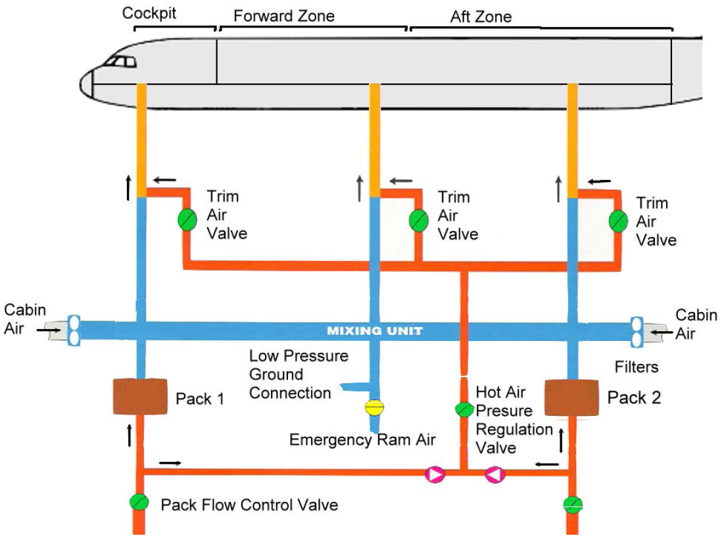
Internal: Cabin Ventilation Against the Corona Virus
Overview
50% of air via outflow valve
100%
50%
50%
Recirculation
Recirculation
HEPA Filter
HEPA Filter
Airbus A320
engine bleed air
50%
engine bleed air

Slide 8
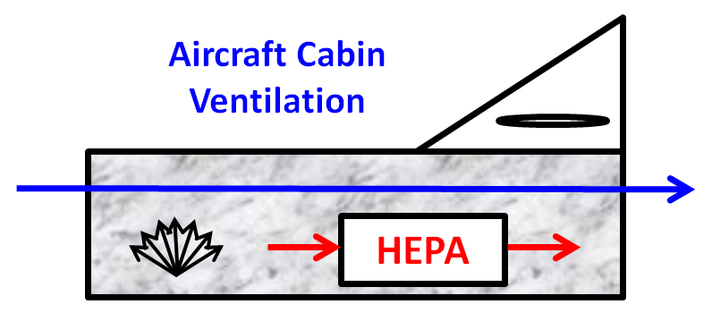
Internal: Cabin Ventilation Against the Corona Virus
Overview – Simplified Version
outside air
recirculation
source
filter

Slide 9
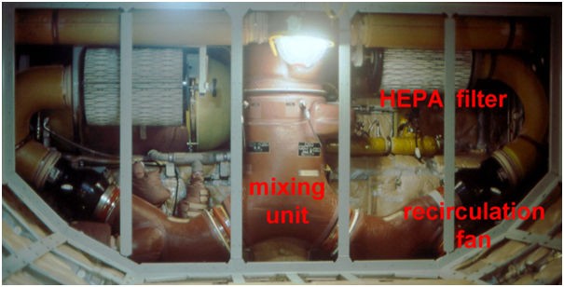
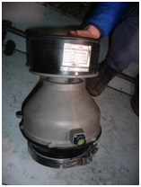
Internal: Cabin Ventilation Against the Corona Virus
Mixing Unit, HEPA Filters, Recirculation Fan
recirculation fan
Airbus A320

Slide 10
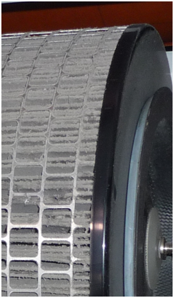
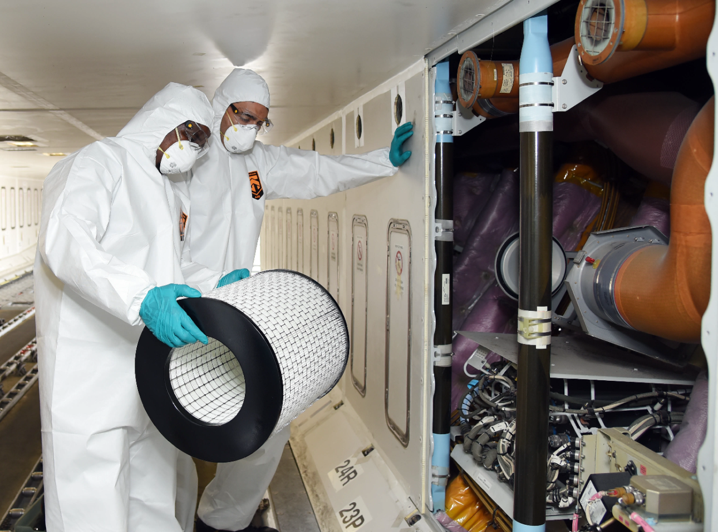
Internal: Cabin Ventilation Against the Corona Virus
HEPA Filter
Airbus A320, old HEPA filter
Airbus A380, Emirates. Installing a new HEPA filter. High risk operation?

Slide 11
Dieter Scholz:
Aircraft Cabin Ventilation Theory,
Memo, 2020-06-27.
https://doi.org/10.31224/osf.io/ac6p8
See this document for a List of References
mentioned in this section.
Internal: Cabin Ventilation Against the Corona Virus
Ventilation Equation
C_{out(side)} Q_{e}
C
Q_{e}
S

Slide 12
Internal: Cabin Ventilation Against the Corona Virus
Solving the Ventilation Equation for Steady State

Slide 13
Internal: Cabin Ventilation Against the Corona Virus
Air Change Rate and Time for One Air Change

Slide 14
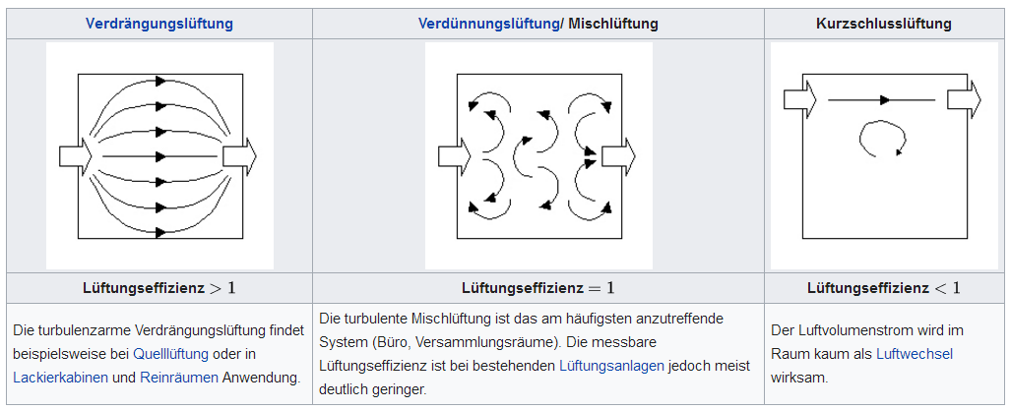
Internal: Cabin Ventilation Against the Corona Virus
Types of Ventilation and Ventilation Efficiency, η
Displacement Ventilation Mixed Ventilation Short Circuit Ventilation
η >1
η = 0.25 ... 1
η → 0
https://de.wikipedia.org/wiki/Lüftungseffizienz

Slide 15
Internal: Cabin Ventilation Against the Corona Virus
Effective Air Flow and Ventilation Efficiency, η

Slide 16
Internal: Cabin Ventilation Against the Corona Virus
The Simplified Ventilation Equation for the Unsteady Case
Time Constant (next page)

Slide 17
Internal: Cabin Ventilation Against the Corona Virus
The Time Constant, T for Unsteady Ventilation

Slide 18
Internal: Cabin Ventilation Against the Corona Virus
Solving the Unsteady Ventilation Equation
T

Slide 19
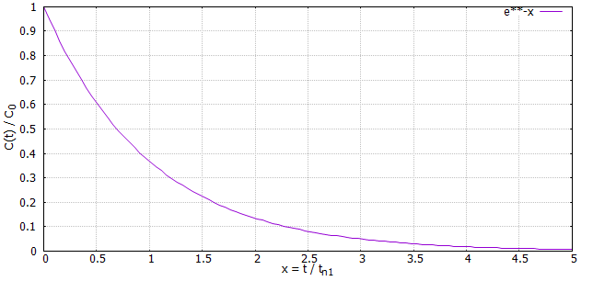
Internal: Cabin Ventilation Against the Corona Virus
Visualizing the Unsteady Ventilation Equation
T
Relative remaining concentration for a ventilation efficiency of η = 1 versus relative time.
Hence, rinsing is an asymptotic process. A relative concentration will only reach the value 0%
of the initial amount after an infinitely long time.

Slide 20
Internal: Cabin Ventilation Against the Corona Virus
More from the Unsteady Ventilation Equation

Slide 21
Internal: Cabin Ventilation Against the Corona Virus
More from the Unsteady Ventilation Equation

Slide 22
Internal: Cabin Ventilation Against the Corona Virus
Time to "Fully Renew" (1%, ISO 14644-3) the Air in a Room

Slide 23
Internal: Cabin Ventilation Against the Corona Virus
Legend or Truth?

Slide 24
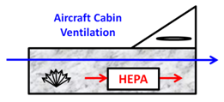
Legend or Truth?
Industry Claim 1:
The air in the aircraft "as clean as in a hospital operating theatre" (due to HEPA filters)
Wrong logic applied: Even if the HEPA filters would filter out 100% of the viruses in the SUPPLIED air, the AIR IN THE CABIN is still NOT virus free, because the viruses are in the cabin in the first place.
50% reduction to (unknown) reference: What is possible is this. The virus concentration in the cabin can be halved (with 50% recirculation) if, in addition, recirculation with a 100% effective HEPA filter is used. C = S / Q .
HEPA filters may not exist or not work: There are no binding requirements for the existence (some smaller aircraft do not have them) or the maintenance of HEPA filters in aircraft. Therefore, no information can be given about their quality in practice. But: Filtration efficiency may even improve, when filters are old and dirty.
IATA:
https://perma.cc/686X-X9AZ?type=image

Slide 25
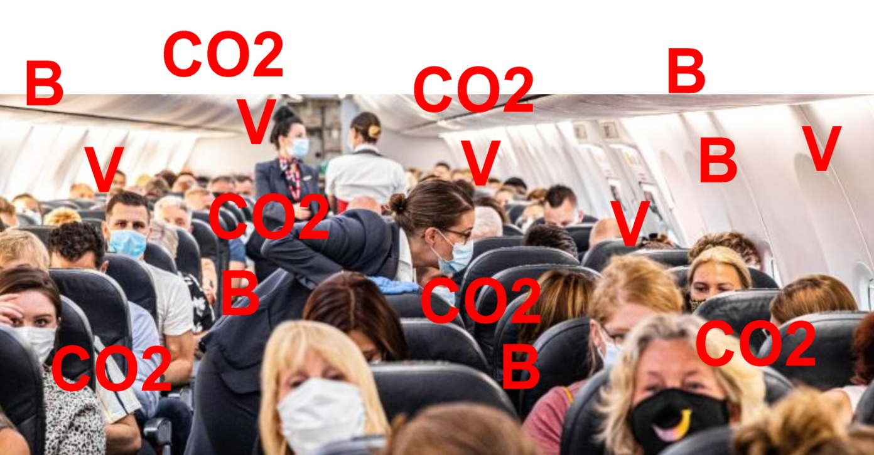
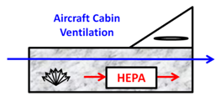
Legend or Truth?
Industry Claim 1:
The air in the aircraft "as clean as in a hospital operating theatre" (due to HEPA filters)
True comparison: The air is as clean as in a hospital operating theatre, if ≈ 200 people are watching.
o Hospitals filter incoming air – aircraft filter recirculated air.
o Incoming air is NOT filtered on passenger aircraft. This can lead to cabin air contamination.

Slide 26
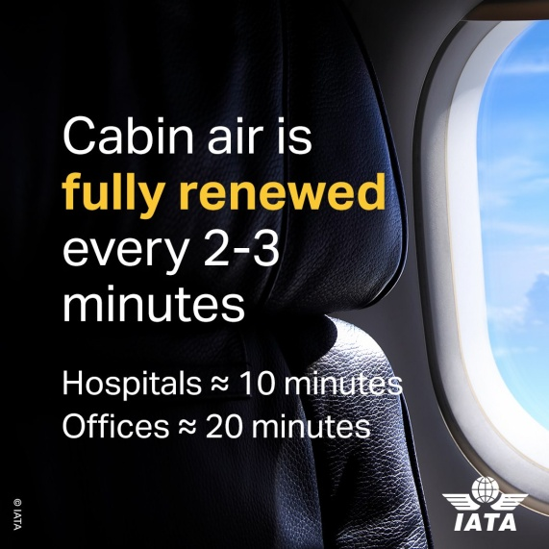
Legend or Truth?
Industry Claim 2:
The air in the aircraft is " FULLY renewed every 2 to 3 minutes"
Statement is irrelevant: The air change rate is only important for dynamic processes (not relevant here!). C = S / Q .
Unfit parameter for comparison: The air change rate, n in the aircraft is only so high because the volume V per passenger (about 2 m³ on an airplane) is so small. This makes the air change rate, n unfit as a parameter for comparison with rooms where people have more volume each (office, cathedral, ...).
One air change in 3 minutes is wrong: For 0.25 kg of air per minute and person and 2 m³ per person, a cabin volume of fresh air must flow into the cabin at least every 6.7 minutes. Aircraft better than required? Manufacturers seem to use the "cabin volume" (volume above cabin floor) instead the "volume in the pressure seals" to calculate one theoretical air change in about 3 minutes.
Statement "fully" is wrong: With optimal mixed ventilation (which is never the case in practice), the concentration of a substance is reduced to 37% of the original value after one air change. Only after 5 air changes does the concentration drop below 1% (assuming a ventilation efficiency of η = 1).
IATA:
https://perma.cc/686X-X9AZ?type=image

Slide 27
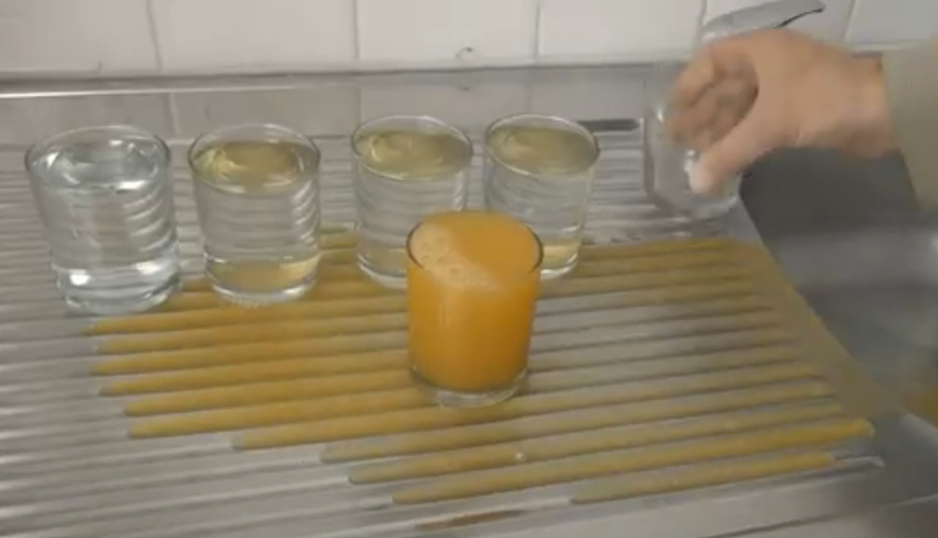
Legend or Truth?
Industry Claim 2:
The air in the aircraft is " FULLY renewed every 2 to 3 minutes"
No, see video: 5 air exchanges are necessary!
Video: https://youtu.be/QYP255V03BY?t=544

Slide 28
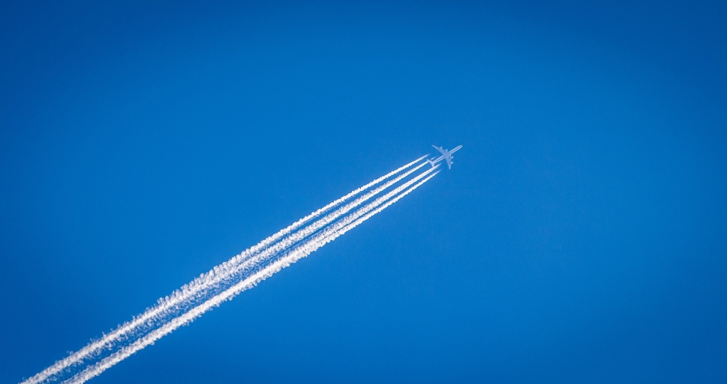
Legend or Truth?
Industry Claim 2:
The air in the aircraft is " FULLY renewed every 2 to 3 minutes"
Ventilation Comparison
Aircraft versus Home
Ventilation rate: Q = 18 m³/h (0.25 kg/min) Q = 90 m³/h relevant value
Volume per person: V = 2 m³ V = 36 m² . 2.5 m = 90 m³
Air change rate: n = Q / V = 18/2/h = 9/h n = Q/V = 90/90/h = 1/h
One air change in: t = 6.7 min t = 1 h = 60 min irrelevant value
Ventilation rate in the (my) home is 5-times that of the aircraft!
Video: https://youtu.be/QYP255V03BY?t=375

Slide 29
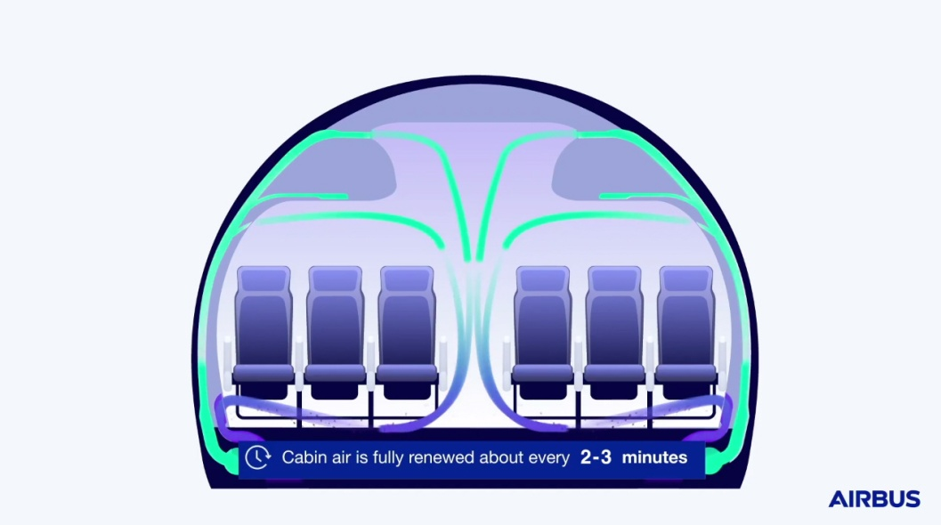
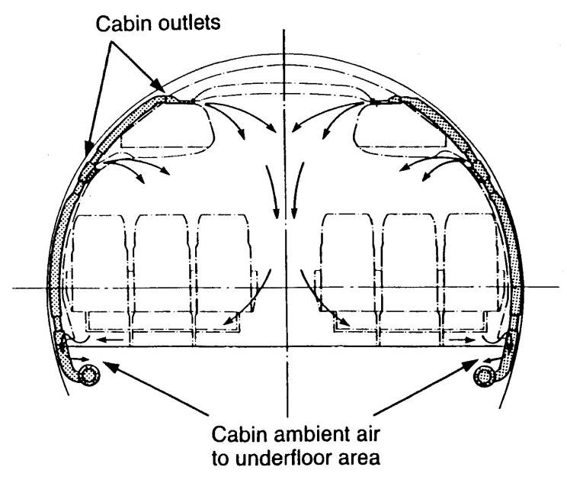
Legend or Truth?
Industry Claim 3:
The air flow in the aircraft cabin "only from top to bottom"
or "no horizontal flow" (not sideways, not forward or aft)
Air flow from one passenger to the other
Shown for more than 30 years to everyone
on A320
GEN FAM
courses taught by Airbus:
Airbus: Video: https://youtu.be/tVkf2ogGG_Y?t=45
In the cross-section of the cabin, the ventilation causes vortices, which mix the air within several rows of seats.
Turbulence and diffusion also mix the air along the cabin (forwards and backwards).
Air flow only overhead the passengers?

Slide 30
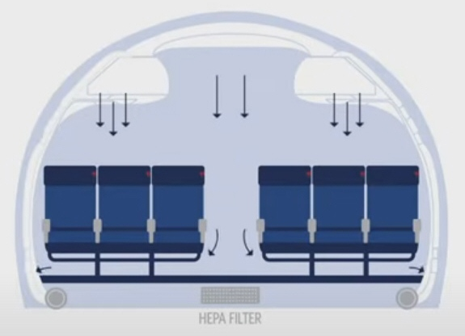
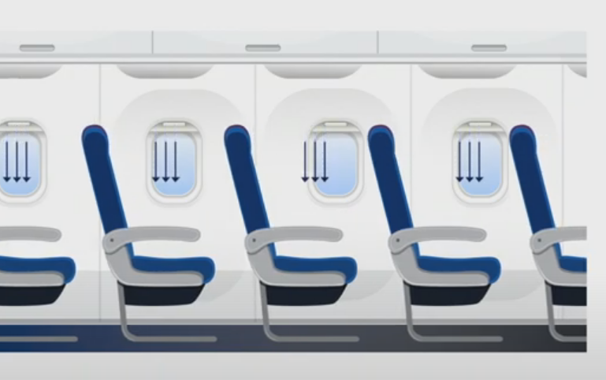
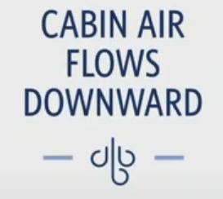
Legend or Truth?
Industry Claim 3:
The air flow in the aircraft cabin "only from top to bottom"
or "no horizontal flow" (not sideways, not forward or aft)
Delta: Video: https://youtu.be/ll-4LUfcr_s?t=67
Delta: Video: https://youtu.be/ll-4LUfcr_s?t=33
Air flow only from top to bottom?
Cabin air ventilation out of the overhead bins?

Slide 31
Legend or Truth?
Industry Claim 3:
The air flow in the aircraft cabin "only from top to bottom"
or "no horizontal flow" (not sideways, not forward or aft)
Jean-Brice Dumont, Airbus ("guru"):
It [the air] flows from top to bottom at one meter per second, and is subsequently removed through the floor. This airflow is optimized to prevent longitudinal movement, so there is no spread between adjacent seat rows.
Facebook, 29.05.2020
Dieter Scholz:
Airbus' Cabin Air Explanations during the
Corona Pandemic – Presented, Analyzed,
and Criticized, Memo, 2020-06-19.
https://doi.org/10.31224/osf.io/b9dkp
https://www.facebook.com/watch/?v=582384906021127
Video: https://youtu.be/LV00dLUdK0k
https://perma.cc/YA6L-JEJ6

Slide 32
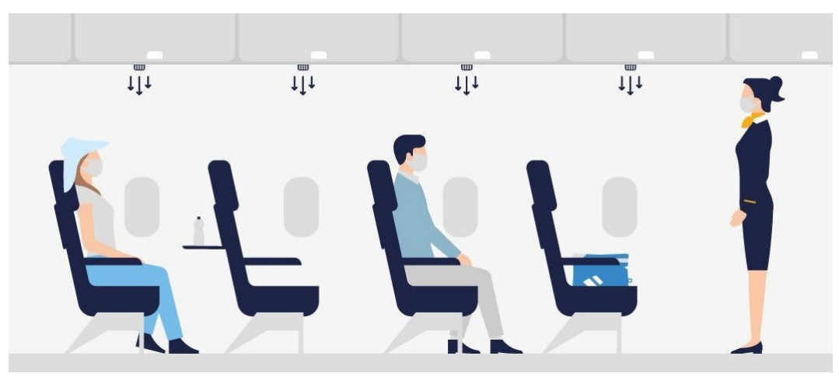
Legend or Truth?
Industry Claim 3:
The air flow in the aircraft cabin "only from top to bottom"
Lufthansa under the heading "#WeCare – damit Sie unbesorgt fliegen" (https://perma.cc/UQ59-AZ3F).
Air flows from the air jets. This is in contrast to the EASA recommendations.
(https://perma.cc/MR7X-Y73R). Turbulence shoud be avoided in the cabin.
Turbulence is also caused by walking through the aisle.

Slide 33
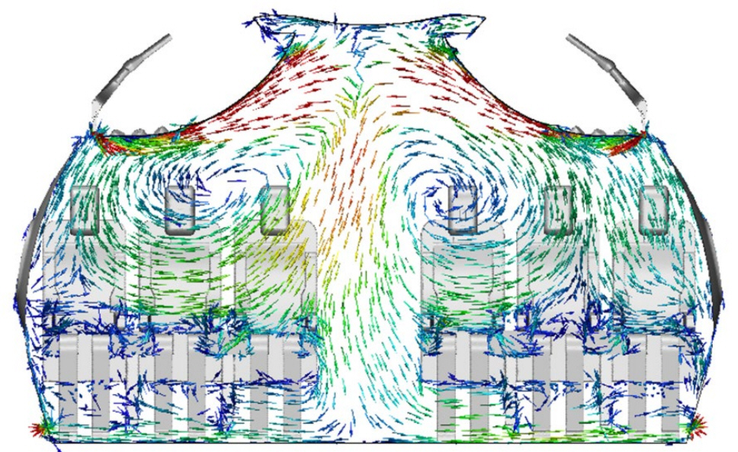
Legend or Truth?
Industry Claim 3:
The air flow in the aircraft cabin "only from top to bottom"
Flow direction indicated by the arrows show flow from one passenger to the other and as such the exchange of breathing air.
Nevertheless,
Boeing concludes:
"the risk of contracting COVID-19 while flying is low. Engineering controls on modern aircraft that employ high air flow from ceiling to floor, HEPA filtration, and set design / positioning that minimize air flow between rows, and play an important role in the control of particle fate in the cabin."
Source:
https://perma.cc/S5VV-UNS2
Boeing: CFD simulation of flow in a B737 cabin cross section. Snapshot of a dynamic situation.

Slide 34
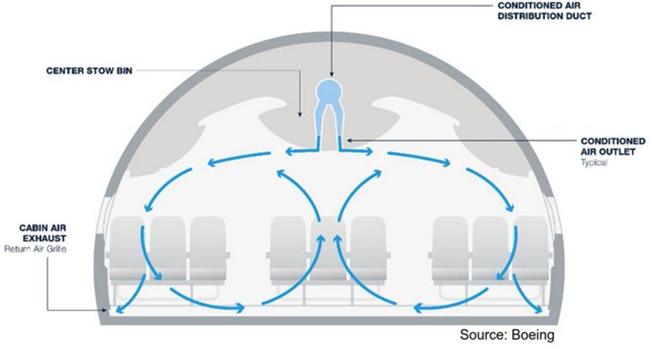
Legend or Truth?
Industry Claim 3:
The air flow in the aircraft cabin "only from top to bottom"
Boeing shows its special (unfavorable) case of the B767 with central ventilation from the top initially sideways (to avoid drafts on passengers in the center bench). Visible are the rotors typical for every cabin ventilation to ensure full rinsing and mixing.

Slide 35
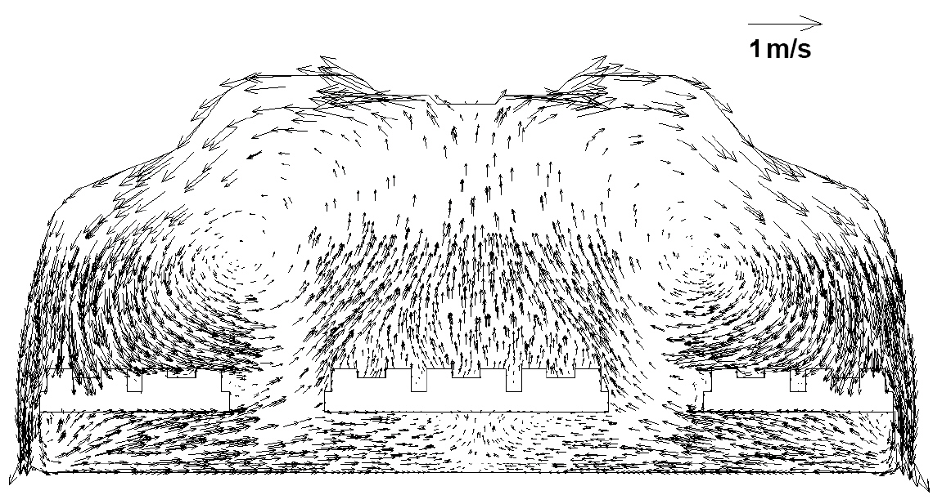
Legend or Truth?
Industry Claim 3:
The air flow in the aircraft cabin "only from top to bottom"
Explanations given by science:
The special (unfavorable) case of the B767 was studied by Prof. Chen, Purdue University.
Gupta, J., Lin, C.-H., and Chen, Q, 2011. Transport of Expiratory Droplets in an Aircraft Cabin. In:
Indoor Air, 21(1), 3-11. Archived at: https://perma.cc/QD3Z-YTVA

Slide 36
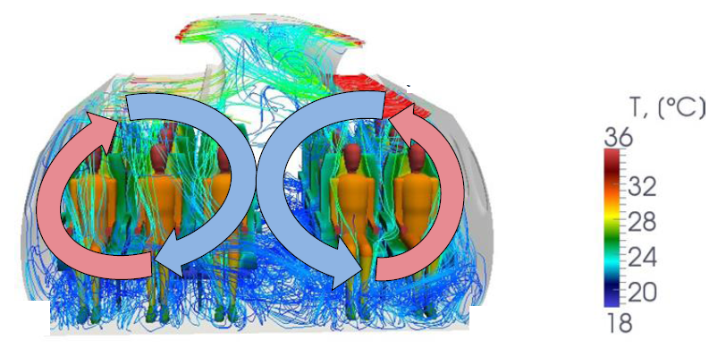
Legend or Truth?
Industry Claim 3:
The air flow in the aircraft cabin "only from top to bottom"
Explanations given by science (DLR, Göttingen):
The aircraft cross section is ventilated with "rotors" on either side of the aisle.
The cabin is cooled with cold air from above. Warm air rises up near the windows.
By courtesy of DLR.

Slide 37
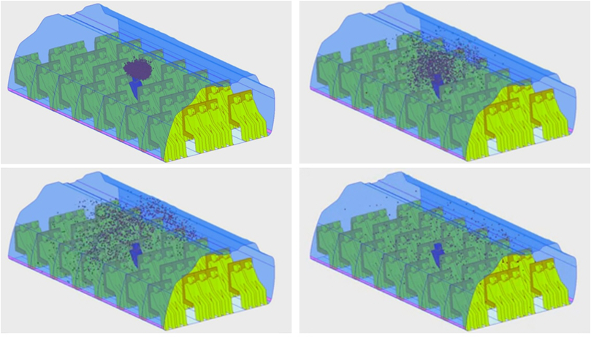
Legend or Truth?
Industry Claim 3:
The air flow in the aircraft cabin "only from top to bottom"
Explanations given by science:
The special (unfavorable) case of the B767 was studied by Prof. Chen, Purdue University.
Video: https://engineering.purdue.edu/~yanchen/infection.html

Slide 38
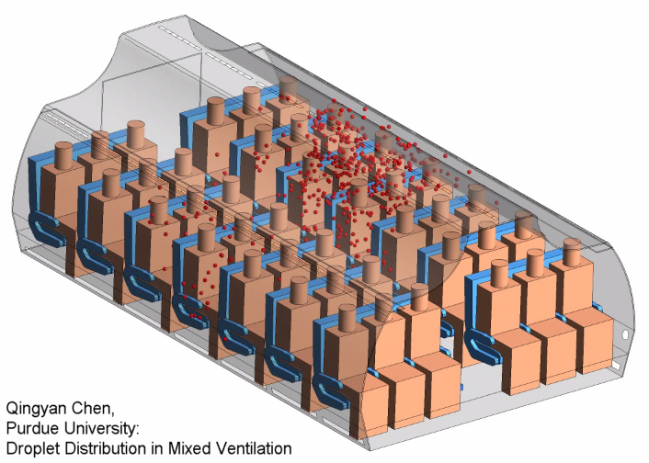
Legend or Truth?
Industry Claim 3:
The air flow in the aircraft cabin "only from top to bottom"
Explanations given by science:
Video: https://youtu.be/t2QV5aqo_bI

Slide 39
Legend or Truth?
Industry Claim 3:
The air flow in the aircraft cabin "only from top to bottom"
Explanations given by science (DLR, Göttingen):
A person in the central aisle seat of the 5 abreast Do 728 is the source of aerosole particles.
Numerical simulation of these aerosol particles in (normal) mixed ventilation. After 90 s, most particles (65%)
are still floating (red). Only few particles have left the cabin (20%), or have settled on a surface (16%) (blue).
Three rows are shown in the simulation that are most covered in aerosoles.
Aerosoles also travel to adjacent other rows further fore and aft. There the concentration is less.
SCHMELING, D., WAGNER, C.,et al., 2021, Aerosolausbreitung in der Do-728-Passagierkabine.
In: DGLR, Luft- & Raumfahrt, No. 2, 2021, pp. 20-23. Available from: https://www.dglr.de

Slide 40
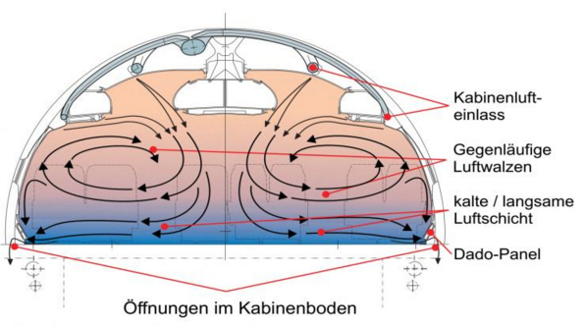
Legend or Truth?
Industry Claim 3:
The air flow in the aircraft cabin "only from top to bottom"
Explanations given by science:
Flow in the cabin of an Airbus A340. Here, the cabin temperature is increased with warm air from the outlets. Rotors are present on either side of the center line. The flow (see arrows) transports breathing air from one passenger to the other.
KNIGGE, Henning, 2014: Modellierung des dynamischen Verhaltens der zonalen Kabinentemperatur und anderer Komfortparameter in Flugzeugkabinen. Dissertation, Technische Universität Hamburg-Harburg. Göttingen: Cuvillier.

Slide 41
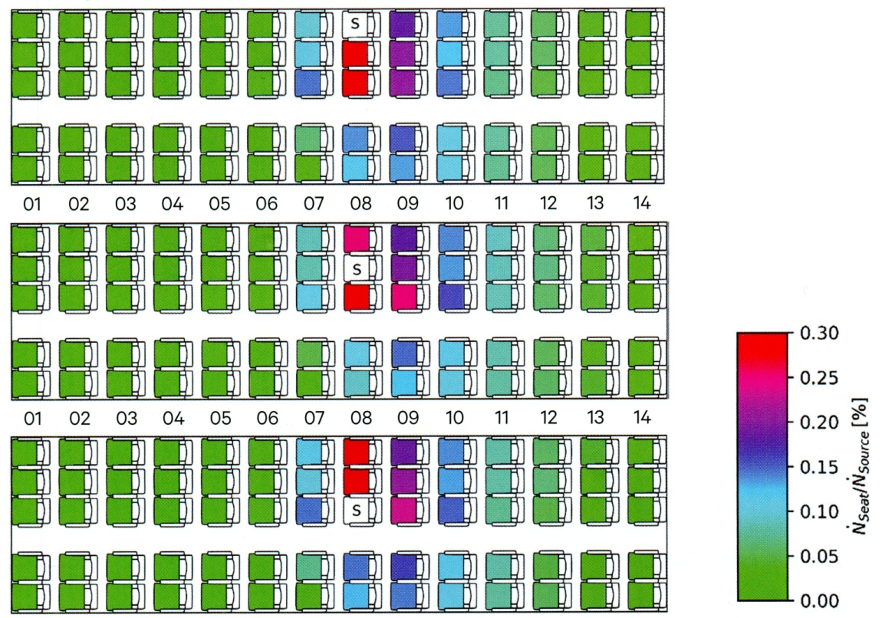
Legend or Truth?
Industry Claims 4:
The seats provide a barrier for transmission to the front and rear of the cabin.
Refuted: Also simulations (slides above) show droplets pass seat rows easily.
Further explanations given by science (DLR Göttingen):
A person (S) sits in different seats on a Do 728 and is the source of aerosole particles. Measurements of these aerosol particles in (normal) mixed ventilation. Once the "dynamics approach a steady state" [?], concentrations are measured and averaged over a period of 5 min. Without medical details it is impossible to say, if another person can get infected or not. Just based on concentrations and colors it can be determined. Aerosoles migrate to the other side of the aisle. One row to the front and two rows to the back seem to see elevated aerosole concentrations.
SCHMELING, D., WAGNER, C.,et al., 2021, Aerosolausbreitung in der Do-728-Passagierkabine.
In: DGLR, Luft- & Raumfahrt, No. 2, 2021, pp. 20-23. Available from: https://www.dglr.de

Slide 42
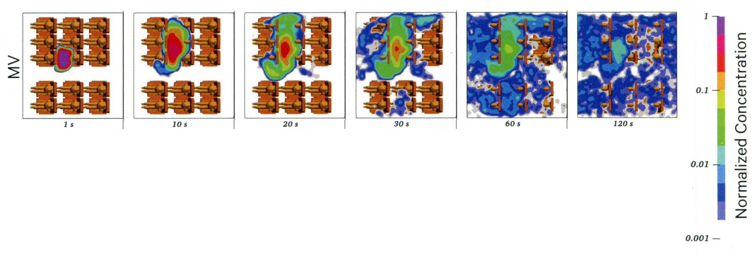
Legend or Truth?
Industry Claims 4:
The seats provide a barrier for transmission to the front and rear of the cabin.
Further explanations given by science (DLR Göttingen):
A person sits in the center aisle seats on a Do 728 and is the source of aerosole particles. Numerical simulation of these aerosol particles in (normal) mixed ventilation. The situation is shown after the instantaneous particle release in a clean cabin. The concentration is given relative to the initial concentration in front of the source. Just based on concentrations and colors it can be determined: Aerosoles migrate to the other side of the aisle. After only 120 s the aerosoles are almost evenly distributed within the three rows under investigation. It can be assumed that by this time also more rows to the front and back see some concentration of aerosoles. It is known from slides above that after 90 s or 120 s only a small percentage of particles has left the cabin. It must be kept in mind that the simulated situation does not represent reality well. In reality the cabin is in a quasi steady state situation with incoming and outgoing particles in equilibrium. Within the duration of a flight some of the aerosoles will have the chance to travel anywhere in the cabin.
SCHMELING, D., WAGNER, C.,et al., 2021, Aerosolausbreitung in der Do-728-Passagierkabine. In: DGLR, Luft- & Raumfahrt, No. 2, 2021, pp. 20-23. Available from: https://www.dglr.de

Slide 43
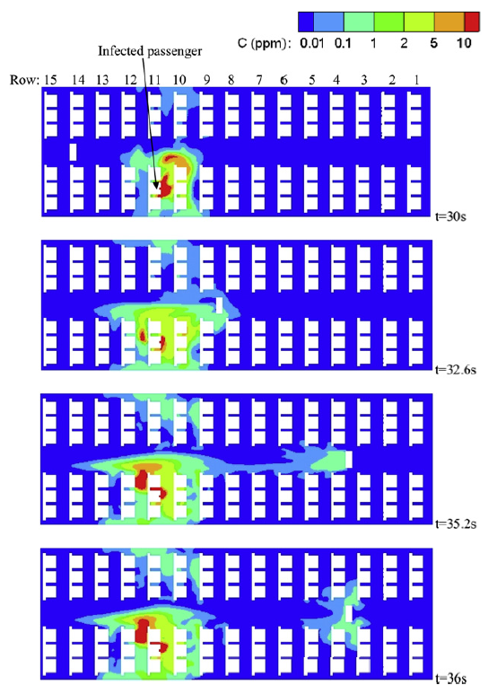
Legend or Truth?
Industry Claims 4:
The seats provide a barrier for transmission to the front and rear of the cabin.
People moving through the aisle transport emissions from sitting passengers!
Contaminant transport process at breathing level due to the body moving at 1.75 m/s along the aisle for a pulsed contaminant release from the infected passenger.
MAZUMDAR, Sagnik, CHEN, Qingyan, et al., 2011. Impact of Scaling and Body Movement on Contaminant Transport in Airliner Cabins. Atmospheric Environment, 2011, 45. Jg., Nr. 33, S. 6019-6028.

Slide 44
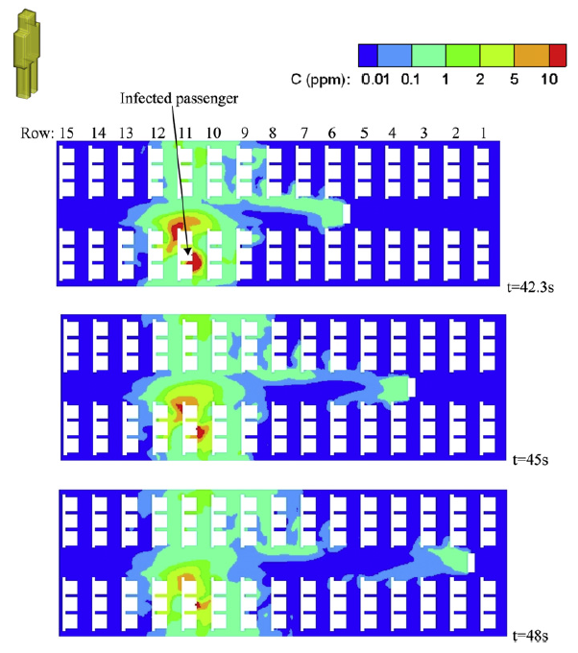
Legend or Truth?
Industry Claims 4:
The seats provide a barrier for transmission to the front and rear of the cabin.
People moving through the aisle transport emissions from sitting passengers!
Contaminant concentrations at breathing level for instances when the body stopped movement at rows 2, 4, & 6 respectively along the aisle for a pulsed release of the contaminant from the infected passenger.
MAZUMDAR, Sagnik, CHEN, Qingyan, et al., 2011. Impact of Scaling and Body Movement on Contaminant Transport in Airliner Cabins. Atmospheric Environment, 2011, 45. Jg., Nr. 33, S. 6019-6028.

Slide 45
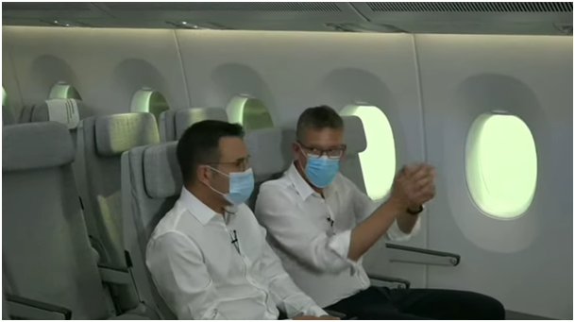
Legend or Truth?
Industry Claims 5:
The passengers look forward and have little facial contact.
Dieter Scholz:
Airbus' Cabin Air Explanations during the
Corona Pandemic – Presented, Analyzed,
and Criticized, Memo, 2020-06-19.
https://doi.org/10.31224/osf.io/b9dkp
Jean-Brice Dumont, Airbus, explains on Facebook that all viruses will move forward, even when looking to your neighbor – as in this picture. Video: https://youtu.be/LV00dLUdK0k
Missing logic. The picture speaks for itself.

Slide 46
Legend or Truth?
Industry Claim 6:
6 feet physical distancing minimum without a mask (CDC recommendation) is equivalent to 1 foot distance onboard the aircraft with a mask.
Scientific facts:
No airflow that separates passengers.
No masks are worn during extended periods (meals) during flight (especially in first class).
https://perma.cc/NE83-9GS9

Slide 47
Legend or Truth?
Industry Claim 7:
"But with just 44 published cases of potential inflight COVID-19 transmission among 1.2 billion travelers, the risk of contracting the virus on board appears to be in the same category as being struck by lightning," said Alexandre de Juniac, IATA’s Director General and CEO up to 2020. (https://perma.cc/S29W-VDNM)
However, 44 cases is just based on 13 studies (IATA: https://perma.cc/Y2VV-ZJEM), but this number divided by all passengers in 2020 is ... 'Bad math' says Dr. David Freedman, a U.S. infectious diseases specialist.
https://perma.cc/8SWH-2BKD

Slide 48
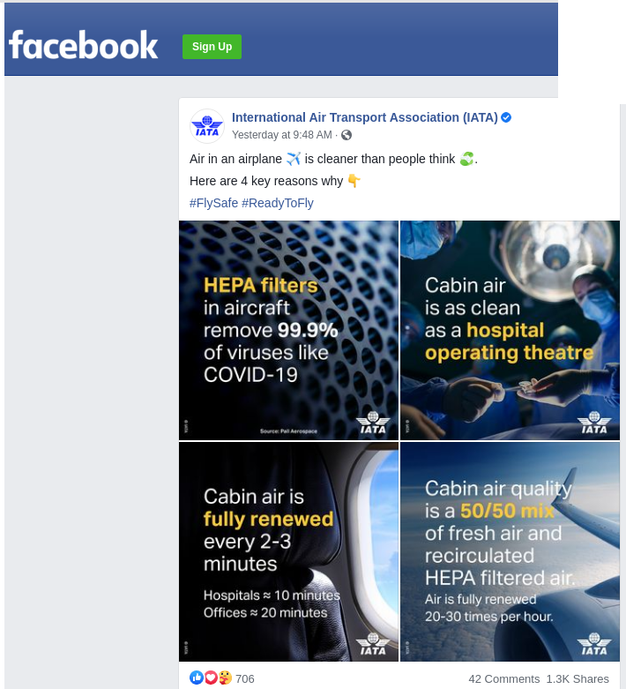
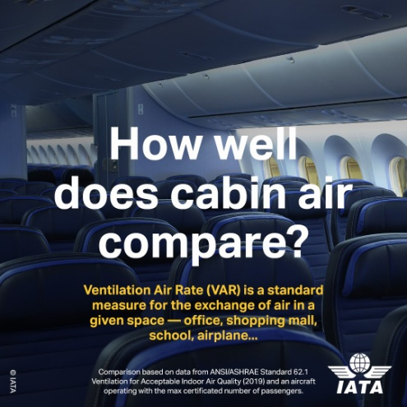
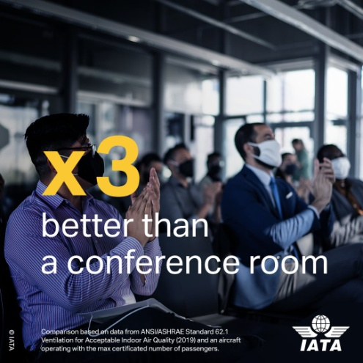
Legend or Truth?
IATA Active on Facebook
Facebook
21 September 2020
https://perma.cc/686X-X9AZ?type=image

Slide 49
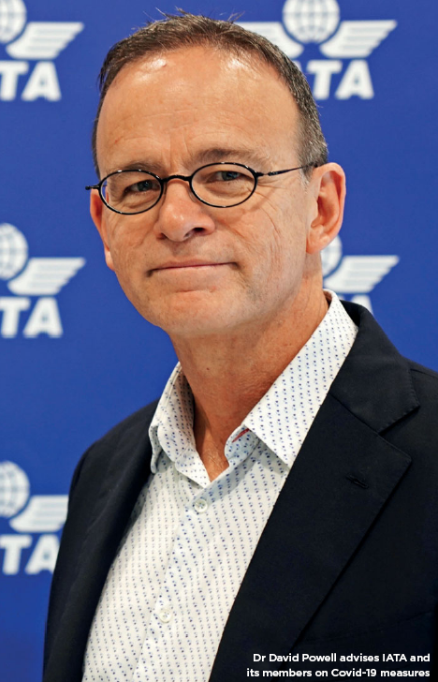
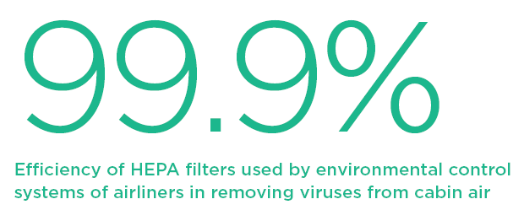
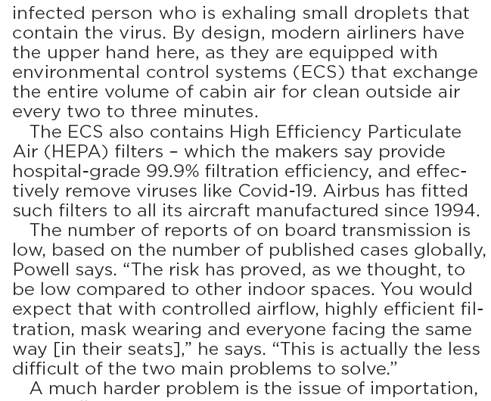
Legend or Truth?
IATA Does Not Give Up on the Topic
Flight International
September 2021
https://perma.cc/64N4-JVEE

Slide 50
Internal: Cabin Ventilation Against the Corona Virus
Summary: Internal Emissions
In the pandemic, aviation poses two dangers: 1.) The rapid, global spread of the virus and 2.) the mutual contamination of the densely packed passengers in the aircraft cabin, whose ventilation system cannot rule out infection.
Since Corona, the ventilation technology of aircraft cabins has become a political issue.
For financial reasons, flying is considered safe by the aviation industry even in Corona times.
Reason is (as claimed) the aircraft cabin ventilation – better than anything else.
The ventilation in passenger aircraft is explained incorrectly by industry!
Here, the ventilation technology is explained: Requirements, basics, related aircraft systems, and ventilation theory.
Right or wrong does matter!
We need to adhere to moral principles.
See also: "Aviation Ethics – Growth, Gain, Greed, and Guilt", https://doi.org/10.5281/zenodo.4068008

Slide 51
Zero Emission – The New Credo in Civil Aviation
External Emissions:
CO2, NOX, AIC
This is part draws from the HAW Report "Umweltschutz in der Luftfahrt" (Environmental Protection in Aviation). For many more details see:
https://nbn-resolving.org/urn:nbn:de:gbv:18302-aero2021-07-03.015

Slide 52
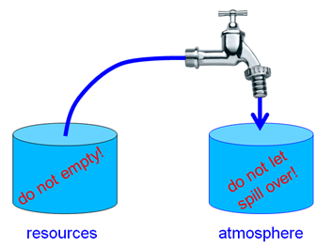
External Emissions: CO2, NOX, AIC
Resources or Atmosphere – What is the Problem?
Two barrels symbolize:
left: the finite fossil energy reserves and
right: the finite capacity of the atmosphere to absorb.
It does not work to open the tap more each year.
It also does not work to set the tap at constant flow. It needs to be closed!

Slide 53
External Emissions: CO2, NOX, AIC
The Climate Disaster Will Come First – Climate Action Now!
In pre-industrial times, the CO2 concentration was 280 ppm, in 2021 it was 420 ppm.
With current CO2 emissions, the CO2 concentration increases by ≈ 3 ppm every year.
By doubling from 280 ppm to 560 ppm, the average temperature will increase by ≈ 3 °C.
Paris Agreement of 2015: Temperature rise should ideally be limited to 1.5 °C.
That would then be 420 ppm - so already in 2021!
So, we would have to reduce CO2 emissions to zero today.
At the 2-degree limit, we could get to 467 ppm and there would be another 15 years with today's CO2 emissions.
In practice, emissions could be reduced linearly from 100% today to 0% in 30 years (around 2050).
However, if we were to use up all fossil energy reserves (coal will last for several hundred years), the CO2 content of the atmosphere would rise to around 1600 ppm, which, according to simple calculations, would mean a temperature increase of 14 °C.
This consideration makes it clear that an overflow of the right barrel (previous figure) will occur first and is therefore more critical.
The climate disaster comes before the end of fossil fuels.

Slide 54
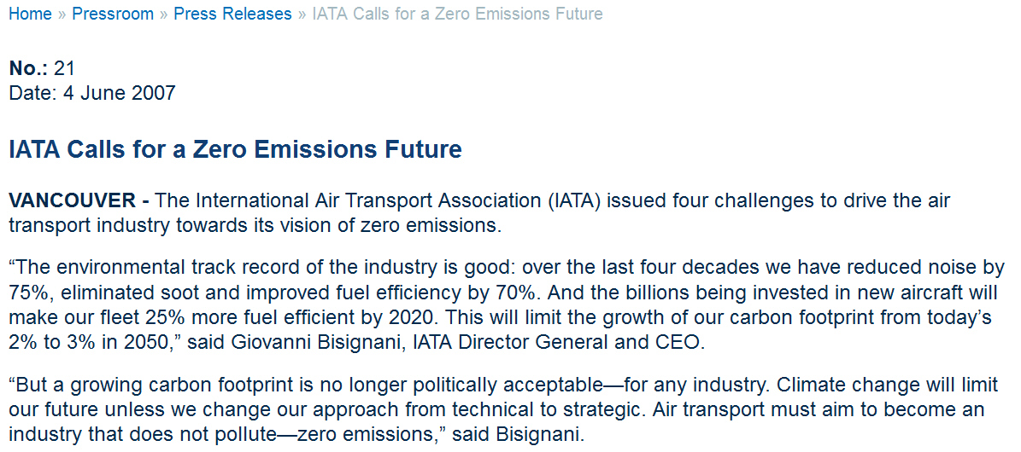
External Emissions: CO2, NOX, AIC
History of "Zero Emissions":
IATA 2007: First in Proclaiming "Zero Emissions" (Goals Not Active Anymore)
Archived at: https://perma.cc/JSR2-JC79

Slide 55
External Emissions: CO2, NOX, AIC
Zero Emission Initiatives / Reports
EASA, EEA, and EUROCONTROL published the "European Aviation Environmental Report" (2019) on 2019-05-13. The report does not set a zero emission target, but is noteworthy in this respect.
https://www.easa.europa.eu/eaer
https://doi.org/10.2822/309946
CS3PG Stakeholder Group is the commission‘s strategic planning group to deliver in a timely, open and transparent manner an aligned position from the European aviation stakeholders related to "Clean Aviation". For a 2050 horizon the goal is climate neutral aviation. A draft report "Clean Aviation" was published on 2020-06-25.
https://www.clean-aviation.eu
https://ec.europa.eu/info/sites/info/files/research_and_innovation/funding/documents/ec_rtd_he-partnerships-clean-aviation.pdf
Archived at: https://perma.cc/C3BF-79MU

Slide 56
External Emissions: CO2, NOX, AIC
Zero Emission Initiatives / Reports
EASA, EEA, and EUROCONTROL published the "European Aviation Environmental Report" (2019) on 2019-05-13. The report does not set a zero emission target, but is noteworthy in this respect.
https://www.easa.europa.eu/eaer
https://doi.org/10.2822/309946
CS3PG Stakeholder Group is the commission‘s strategic planning group to deliver in a timely, open and transparent manner an aligned position from the European aviation stakeholders related to "Clean Aviation". For a 2050 horizon the goal is climate neutral aviation. A draft report "Clean Aviation" was published on 2020-06-25.
https://www.clean-aviation.eu
https://ec.europa.eu/info/sites/info/files/research_and_innovation/funding/documents/ec_rtd_he-partnerships-clean-aviation.pdf
Archived at: https://perma.cc/C3BF-79MU

Slide 57
External Emissions: CO2, NOX, AIC
Zero Emission Initiatives / Reports
Airbus announced on 2020-09-21 a new "Zero-Emission" hybrid-hydrogen passenger aircraft with estimated entry into service by 2035. Essentially, the idea is to burn liquid hydrogen in jet engines. This will avoid long-living CO2 emission, but will produce more water in the exhaust. Airbus has not produced a report, but provides much information to the media.
https://www.airbus.com/innovation/zero-emission/hydrogen/zeroe.html
Archived at: https://perma.cc/HJ6L-3HUB
DLR and BDLI in Germany delivered on 2020-10-14 the report "Zero Emission Aviation – Emissionsfreie Luftfahrt: White Paper der deutschen Luftfahrtforschung" (2020).
https://www.dlr.de/content/de/artikel/news/2020/04/20201014_deutschland-auf-kurs-zum-klimaneutralen-fliegen https://www.bdli.de/meldungen/deutschland-auf-kurs-zum-klimaneutralen-fliegen-dlr-und-bdli-uebergeben-white-paper-zero
PDF archived at: https://perma.cc/M5VN-HG3Z

Slide 58
External Emissions: CO2, NOX, AIC
Zero Emission Initiatives / Reports
Research institutions from 13 countries have joined forces on 2020-11-24 to form the 'Zero Emission Aviation' (ZEMA) Group. A four-page document includes this statement: "As researchers, we aim for an aviation system which is free of negative impacts. We will do our utmost to protect our planet and communicate this to the public in order to achieve not only acceptance but strong support for aviation."
https://www.dlr.de/content/en/articles/news/2020/04/20201124_research-initiative-pioneers-sustainable-flight.html
https://www.dlr.de/content/en/downloads/2020/statement-zero-emission-aviation.pdf
Archive at: https://perma.cc/54LM-JGKX
Destination 2050: Europe’s airlines, airports, aerospace manufacturers and air navigation service providers (A4E, ACI Europe, ASD, CANSO, ERA) have laid out a joint long-term vision of reaching net zero CO2 emissions. The report is called "Destination 2050 – A Route to Net Zero European Aviation" (2021).
https://www.destination2050.eu
Full report archived at: https://perma.cc/7JBX-69RZ

Slide 59
External Emissions: CO2, NOX, AIC
The Way towards Zero Emission
Based on some of the above documents, Zero Emission can be achieved only by a combination of these principles:
applying new technologies to increase efficiency, and:
applying new fuels and new means of propulsion/flying with no or less emissions, and:
applying the carbon cycle with biofuels or SAF, and:
compensating remaining emissions.

Slide 60
External Emissions: CO2, NOX, AIC
Problems with Zero Emission Measures
related to 1.: Mathematical fact: Adding measures with improved efficiency on top of each other does not lead to zero emissions. Example: If you take an aircraft that burns only 50% of the fuel on a magic ATM system that reduces the distance by 50% you do not get zero emission, but 25% emission of the reference.
Experience: The rebound effect teaches us that in the long run increased efficiency leads to a lower price, which leads to more demand, which leads to more emissions.
related to 2.: It is not so easy. Electricity does not just come from the socket. The energy production needs to be considered with a Life Cycle Analyses (LCA). Hydrogen combustion does not produce CO2, but has non-CO2 effects. Details next page.
related to 3.: A biofuel carbon cycle is not 100% efficient. It reduces CO2 by about 50%.
related to 4.: Compensating emissions may not be sustainable. A new forest that is cut after 30 years is not a long term carbon sink. Compensation comes with philosophical questions. In addition, no one likes to pay for compensation.

Slide 61
External Emissions: CO2, NOX, AIC
Hydrogen Aircraft Emissions
Hydrogen combustion has no CO2 emissions.
Hydrogen combustion has 2.58 times more water emissions than kerosene.
This means, hydrogen combustion leads to contrails forming already at lower altitudes and hence contrails will be seen more often. A factor 1.2 is assumed.
The method from Schwartz 2009 (next page) was applied and adapted.
With the mentioned primary effects, aviation-induced cloudiness (AIC) with its line-shaped contrails and cirrus clouds would lead to an equivalent CO2 mass 50% higher than for kerosene. Secondary effects also included reduce equivalent CO2 mass by 50%.
Hydrogen flame temperature is higher (without applying special technologies) and as such NOx emissions would be higher. However, lean combustion leads to less NOx.
AIC can be reduced due to larger ice crystals because of absence of soot.
Results are calculated with an Excel table: https://doi.org/10.7910/DVN/DLJUUK . See next three pages.
More background in presentation:
"Design of Hydrogen Passenger Aircraft - How much "Zero-Emission" is Possible?"
Available from: https://doi.org/10.5281/zenodo.4301103

Slide 62
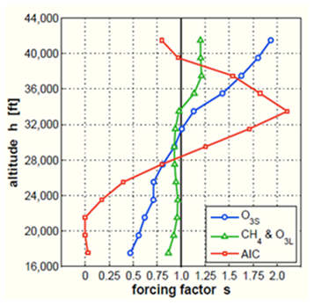
External Emissions: CO2, NOX, AIC
Hydrogen Aircraft Emissions
Forcing factors according to Schwartz 2009 and 2011
(see References on last page).

Slide 63
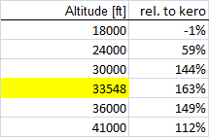
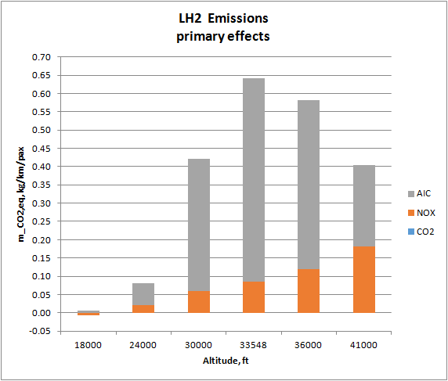
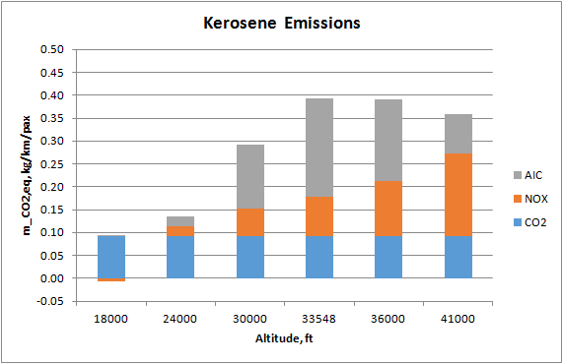
External Emissions: CO2, NOX, AIC
Hydrogen Aircraft Emissions – Primary Effects
https://doi.org/10.7910/DVN/DLJUUK
Equivalent CO2 mass calculated from a simple climate model adapted to hydrogen combustion. Only primary effects are considered (factor: 2.58). Hydrogen emissions are about 50% higher than kerosene emissions in normal cruise altitude and medium latitude.

Slide 64
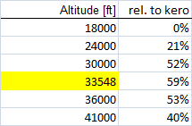
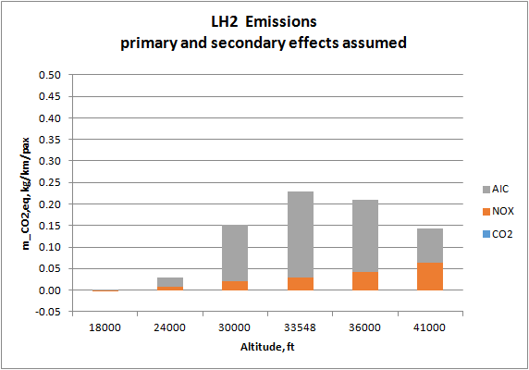
External Emissions: CO2, NOX, AIC
Hydrogen Aircraft Emissions – Secondary Effects
https://doi.org/10.7910/DVN/DLJUUK
Equivalent CO2 mass calculated from a simple climate model adapted to hydrogen combustion. Beneficial secondary effects (sphere model) are considered (factor: 0.929). Hydrogen emissions may be 50% lower than kerosene emissions in normal cruise altitude and medium latitude.

Slide 65
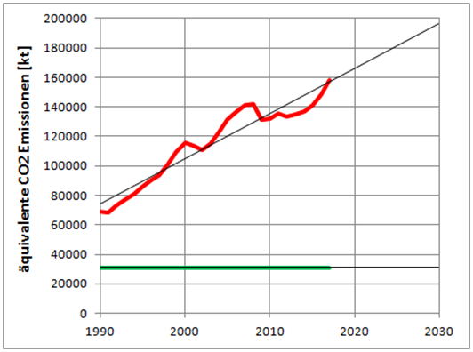
External Emissions: CO2, NOX, AIC
"Green Deal" (2050) and "Fit for 55" (2030)
The equivalent CO2 emissions (in 1000 tonnes or kt) of international aviation in the EU are rising continuously (red line). According to the "Green Deal" of the EU, the to 45% of the 1990 value (by 2030) (green line). Diagram created with data from. EEA 2019 (https://perma.cc/2EZ6-DQBN)

Slide 66
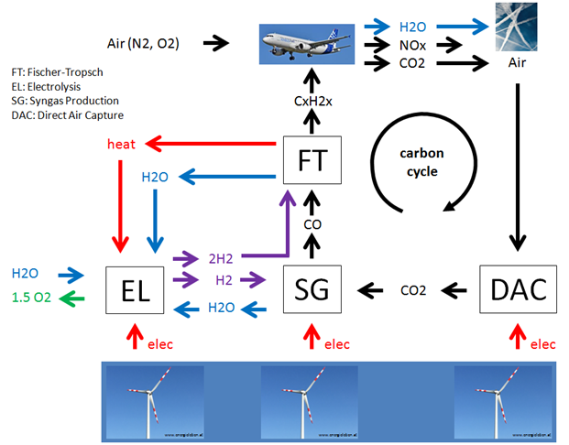
External Emissions: CO2, NOX, AIC
The Carbon Cycle
SAF need DAC (Direct Air Capure) to compensate for CO2 ("cabon cycle")
In addition: SAF and BioFuel need more DAC to compensate for the global warming effect due to
NOX and
H2O (AIC)
Production of synthetic kerosene (e-fuel) with power-to-liquid (PtL). Taking CO2 from the air (Direct Air Capture, DAC) enables a carbon cycle.

Slide 67
External Emissions: CO2, NOX, AIC
Best Use Renewable Energy to Replace Coal Power Plants
http://ptl.ProfScholz.de
1.) 1 kWh of renewable energy ...
2.) ... can replace 2.5 kWh lignite in coal-fired power plants (efficiency 40%);
3.) This corresponds to 0.9 kg of CO2 (0.36 kg of CO2 for 1 kWh of energy from lignite *).
4.) ... converted into Sustainable Aviation Fuel (SAF) only 0.22 kWh remain (efficiency: 70% electrolysis, 32% Fischer-Tropsch), 99% transport; https://perma.cc/BJJ6-5L74
5.) which save only 0.057 kg of CO2 (0.26 kg of CO2 for 1 kWh of kerosene *).
* UBA, 2016: CO2 Emission Factors for Fossil Fuels. https://bit.ly/3r8avD1

Slide 68
External Emissions: CO2, NOX, AIC
Best Use Renewable Energy to Replace Coal Power Plants
http://ptl.ProfScholz.de
1.) 1 kWh of renewable energy ...
2.) ... can substitute 2,5 kWh of coal (lignite, brown coal) in a coal power plant (efficiency of a coal power plant: 40%) this is
3.) ... equivalent to 0.9 kg CO2 (0.36 kg CO2 for 1 kWh of energy burning lignite*)
4.) ... but if used in an aircraft it generates LH2 with energy of 0.6 kWh (efficiencies: 70% electrolysis, 83% liquefaction & transport)
5.) LH2 aircraft consume (say) 10% more energy (higher operating empty mass, more wetted area); so a kerosene aircraft needs ...
6.) only 0.55 kWh, which can be substituted. This is equivalent to 0.14 kg CO2 (0.26 kg CO2 for 1 kWh of energy burning kerosene*).
7.) Note: Not considered is that hydrogen aircraft may come with higher non-CO2 effects than kerosene aircraft.
* UBA, 2016. CO2 Emission Factors for Fossil Fuels. Available from: https://bit.ly/3r8avD1

Slide 69
External Emissions: CO2, NOX, AIC
Aircraft Fuel
Consumption –
Short Range
Not Efficient
Use the Train!
Airbus A320neo
Train is about 3 times more energy-efficient (certainly on short range)
Train uses 50% Eco Electricity Mix (factor 2)
Aircraft Factor 3, because in addition non-CO2 effects from:
NOX and
H2O (AIC)
3*2*3: aircraft is 18 times worse
Simple Calculation of Aircraft Fuel Consumption with Public Data:
See details: https://bit.ly/3mWHo6c
Fuel Consumption = (MTOW – MZFW) / (R . Seats) . 100
R: Range at maximum payload, from payload range diagram (Document for Airport Planning).
Example calculation with Airbus A320neo:
2.2 kg per 100 km per seat =
(73500 kg – 62800 kg) / (3180 km . 150) . 100

Slide 70
External Emissions: CO2, NOX, AIC
Industry Strategy – Presented by InfluenceMap, 2021, June
https://perma.cc/82VC-KEBR

Slide 71
External Emissions: CO2, NOX, AIC
Airbus – Past Technology Timeline
1995-08-30
https://perma.cc/RF4R-LS8R
... but nothing happend!

Slide 72
External Emissions: CO2, NOX, AIC
Technology Timeline – Airbus' EU Briefing, 2021-02-09
A hydrogen replacement of the A320 will NOT come before 2050!
https://perma.cc/2G6J-76DA

Slide 73
External Emissions: CO2, NOX, AIC
The New Credo: "Nirvana of Zero Emission"
In Indian religions (Buddhism, Hinduism, Jainism, and Sikhism) "Nirvana" it the state of perfect quietude, freedom, highest happiness as well as the liberation from attachment and worldy suffering. (Wikipedia)
2021-05-24
https://perma.cc/E2YR-HBNW

Slide 74
External Emissions: CO2, NOX, AIC
Growth in Aviation Has to Stop! – The Earth Is Finite
Let us trust in a change in values ​​in society. It is already underway. More locality, more modesty and deceleration. The automatic consequence: Flying less. There will be pioneers and also people standing on the brake, but the rethinking will come with increasing evidence of climate change, its consequences and causalities. Sweden made the start and the younger generation with Fridays for Future. The term "flight shame" has established itself. The change in values ​​will, however, be borne more by a self-confident understanding of the circumstances than by our conscience, which generates a feeling of shame. Traveling to distant countries will no longer automatically elicit recognition, explains Prof. Nawrocki (2021, https://perma.cc/7S7A-HVP2), lecturer in "Regenerative Energy Systems" and "Post-Growth Economics". "A lot of CO2 - a lot of honor" was yesterday. Instead, it will soon be good behavior to include a brief explanation of the need to travel and the efforts to minimize CO2 in a travel report. It is to be hoped that politics and public authorities will contribute to the dissemination of objective information on the subject of flying. Notes such as those from Transport Minister Andreas Scheuer: "I also warn against promoting flight shame" (FAZ 2019, https://perma.cc/TS4W-MNRA) are not very helpful and only serve the interests of the profit oriented aviation industry.

Slide 75
External Emissions: CO2, NOX, AIC
Summary: External Emissions
The climate disaster will come before resource depletion.
For this reason we saw (at least) 6 Zero Emission Initiatives / Reports in two years.
The way towards Zero Emission has 4 principles: technology, fuels, carbon cycle, and compensation, but there are problems with these Zero Emission measures; neither one works on its own.
So far aviation growth more than compensated any technological and operational efforts to save CO2.
Burning hydrogen, continues to produce emissions.
Burning SAF is no different (tank to wake) from kerosene fuel. The difference comes from the carbon cycle and that depends on Direct Air Capture (DAC). CO2 must not be shifted from one sector to the other (using point sources).
In addition, also the non-CO2 effects from SAF and LH2 need to be compensated by extra captured CO2. If this is not done, aviation will continue to contribute to global warming.

Slide 76
External Emissions: CO2, NOX, AIC
Summary: External Emissions
Goals are good, but they also need to be looked at realistically:
It seems too late to reach the 1.5 °C limit
"Fit for 55" is necessary, but aviation with its enormous growth since 1990 has no chance to come anywhere close to this goal.
The earth is limited. Hence also renewable energy is limited. Aircraft fed with SAF need 3 to 5 times the amount of energy due to the upstream chain of inefficiencies.
Saving CO2 in a limited world needs to get rid of coal power plants first.
Therefore, aviation needs to be responsible itself for its energy supply (e.g. from Africa)
Aircraft fly efficiently over an average range (average related to their design range).
Aircraft consume per passenger and distance twice or more on short range.
Trains use up to 50% renewable energy over the grid (in Germany), aircraft do not.
Aircraft face a factor of about three due to non-CO2 effects.
Together the global warming effect of aircraft may be 18 times that of trains.
As such, support of the train system is more than justified.

Slide 77
External Emissions: CO2, NOX, AIC
Summary: External Emissions
InfluenceMap studied industry statements and found that A4A and IATA seem to support zero emission goals, but lobby against government regulations at the same time.
As a consequence European climate legislation got severely delayed and weakened.
In consequence aviations emissions continued to rise.
Airbus is known for cancelling research aircraft projects (LH2 Do328, E-Fan X, ...).
Only one year after its announcement, it seems, the milestone 2035 for a "ZEROe" aircraft is pushed already to 2050. Do not believe in Airbus announcements!
No engineer with clear thinking will believe in "zero emission", no matter how urgent the earth needs it.
As such, any "zero emission" goals or claims by aviation industry bodies should be regarded with utmost skepticism.

Slide 78
External Emissions: CO2, NOX, AIC
Summary: External Emissions
Pursuing a realistic and clear goal from the start may give better results in the end compared to lofty goals, unsubstantiated in science and engineering.
The earth is finite and we have to accept that as our first assumption. This means: Flying needs to be reduced!
Engineering got the earth into the climate problem and needs to help to get it out again.
Just to "believe" in "zero emission" and in a perfect aircraft, providing highest happiness in flight, and liberation from all environmental evil would be comparable with Nirvana or Eternal Live, which may never come.
Zero Emission - The New Credo in Aviation?
Much looks like it, but it is not the answer. Stop dreaming and believing. Get things done, even if it takes more than government's money.

Slide 79
Zero Emission – The New Credo in Civil Aviation
Dichotomy and Similarity of Internal and External Emissions
A dichotomy "internal" / "external" is well know in aviation in "internal aircraft noise" (cabin noise) and "external aircraft noise" (at airports). Similarly, it works with "emissions".
Internal Emissions (the corona virus) is a fundamental threat to aviation in the same way as External Emissions (CO2, NOx, AIC).
Both types of emissions (internal & external) did or may result in legislation limiting aviation severely (and as such turnover and profits).
Aviation organizations have reacted in the same way to both threats: 1.) Deny the truth, 2.) Pretend to cooperate, 3.) Lobby against regulations (at best before they are put in place).
The public gets ill informed, because their opinion (and potential votes) influences governmental decision makers.
First action against such brain washing campaings is 1.) to expose the strategy and 2.) to set the record straight.
In this respect, I hope to have done my share.

Slide 80
Zero Emission – The New Credo in Civil Aviation
Contact
info@ProfScholz.de
Quote this document:
SCHOLZ, Dieter, 2021. Zero Emission – The New Credo in Civil Aviation.
German Aerospace Congress 2021, Online, 30.08. – 02.09.2021.
Available from: https://doi.org/10.5281/zenodo.5919013
© Copyright by Author, CC BY-NC-SA, https://creativecommons.org/licenses/by-nc-sa/4.0

Slide 81
Zero Emission – The New Credo in Civil Aviation
Background & Further Reading
Part 1 of this presentation "Internal Emissions" is based on:
http://corona.ProfScholz.de
Aircraft Cabin Ventilation in the Corona Pandemic – Legend and Truth
https://doi.org/10.5281/zenodo.5356568
Part 2 of this presentation "External Emissions" draws from:
HAW-Bericht: Umweltschutz in der Luftfahrt
https://purl.org/aero/RR2021-07-03 (directly to PDF)
https://doi.org/10.48441/4427.225 (landing page)

Slide 82
External Emissions: CO2, NOX, AIC
References: Climate Modeling for Aircraft Design
SCHWARTZ, Emily, KROO, Ilan M., 2009. Aircraft Design: Trading Cost and Climate Impact. 47th AIAA Aerospace Sciences Meeting including The New Horizons Forum and Aerospace Exposition, 05.01.-08.01.2009, Orlando, Florida, AIAA 2009, No.1261. Available from: https://doi.org/10.2514/6.2009-1261.
SCHWARTZ DALLARA, Emily, 2011. Aircraft Design for Reduced Climate Impact. Dissertation. Stanford University. Available from: http://purl.stanford.edu/yf499mg3300 – Forcing Factor s(h) based on: KÖHLER 2008 and RÄDEL 2008.
KÖHLER, Marcus O., RÄDEL, Gaby, DESSENS, Olivier, SHINE, Keith P., ROGERS, Helen L., WILD, Oliver, PYLE, John A., 2008. Impact of Perturbations to Nitrogen Oxide Emissions From Global Aviation. In: Journal of Geophysical Research, 113. Available from: https://doi.org/10.1029/2007JD009140.
RÄDEL, Gaby, SHINE, Keith P., 2008. Radiative Forcing by Persistent Contrails and Its Dependence on Cruise Altitudes. In: Journal of Geophysical Research, 113. Available from: https://doi.org/10.1029/2007JD009117.

