Slide 1
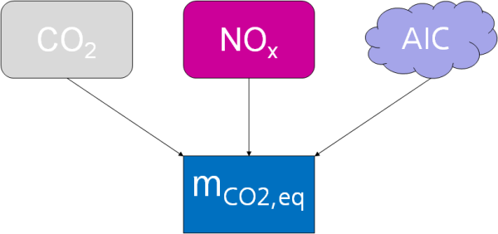
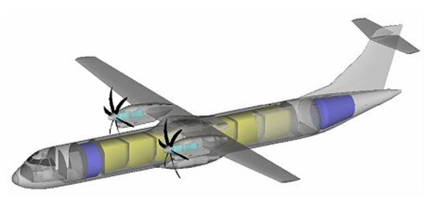
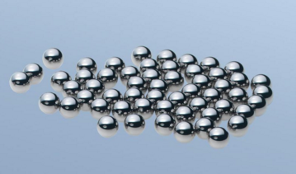
Aviation and the Climate – An Overview
CO₂
Dieter Scholz Hamburg University of Applied Sciences
Hamburg Aerospace Lecture Series (AeroLectures)
DGLR, RAeS, VDI, ZAL, HAW Hamburg
Online, 27 January 2022
https://doi.org/10.5281/zenodo.xxxxxxx

Slide 2
Abstract
Aviation and the Climate – An Overview
    Purpose –
    Methodology –
    Findings –
    Practical implications –
    Social implications –
    Originality/value –
update pending

Slide 3


Slide 4
Contents
Aviation and the Climate – An Overview
    Emissions from Aviation
    Sustainable Aviation Fuel (SAF)
    Kerosene and Hydrogen Emissions
    Mitigating Aviation Emissions
    Summary

Slide 5
This Lecture Combines Earlier Contributions and Adds to Them
Aviation and the Climate – An Overview
    Emissions from Aviation
    from: "Umweltschutz in der Luftfahrt" (Report)
    https://purl.org/aero/RR2021-07-03 (PDF, German)
    https://purl.org/aero/PR2021-07-03 (HTML, German and automatic English translation)
    from: "Passenger Aircraft Design towards Lower Emissions with SAF, LH2, and Batteries (Pros & Cons)"
    https://doi.org/10.5281/zenodo.5904292
    Sustainable Aviation Fuel (SAF) in Germany
    from: "CO2-Kompensierer Atmosfair betreibt weltweit erste Anlage zur Produktion von klimaneutralem Kerosin – Eine Analyse" (Report, unpublished)
    Kerosene and Hydrogen Emissions
    from: "Zero Emission – The New Credo in Civil Aviation", https://doi.org/10.5281/zenodo.5919013
    from: "Design of Hydrogen Passenger Aircraft", https://doi.org/10.5281/zenodo.4301103
    Mitigating Aviation Emissions
    from: "Design of Hydrogen Passenger Aircraft", https://doi.org/10.5281/zenodo.4301103 and from other sources

Slide 6
Emissions from Aviation
General Observations

Slide 7
Most Important : Clean Drinking Water (not the topic of this lecture)
Current focus: CO2 and energy, but:
It is generally not about CO2 and energy, but about clean drinking water!
It is in aviation in global warming not primarily about CO2 but it is about
Aviation Induced Cloudiness (AIC). Aviation has a water problem not a CO2 problem.
Needed: Balanced look with Life Cycle Assessment
Everything is connected:
melting ice => global warming
global warming => melting ice
fossile energy use => global warming
global warming => less energy for heating
energy use for desalination => water
water usage => energy generation (H2, ...)
1.
water
ice
}
energy
AIC/CO2
global warming
3.
2.
In modification of:
SCHOLZ, Dieter, 2012. Eco-Efficiency in Aviation – Flying Off Course? German Aerospace Congress 2012 (DLRK2012), Berlin, Germany, 10.-12.09.2012.
Available from: https://doi.org/10.5281/zenodo.4067014

Slide 8
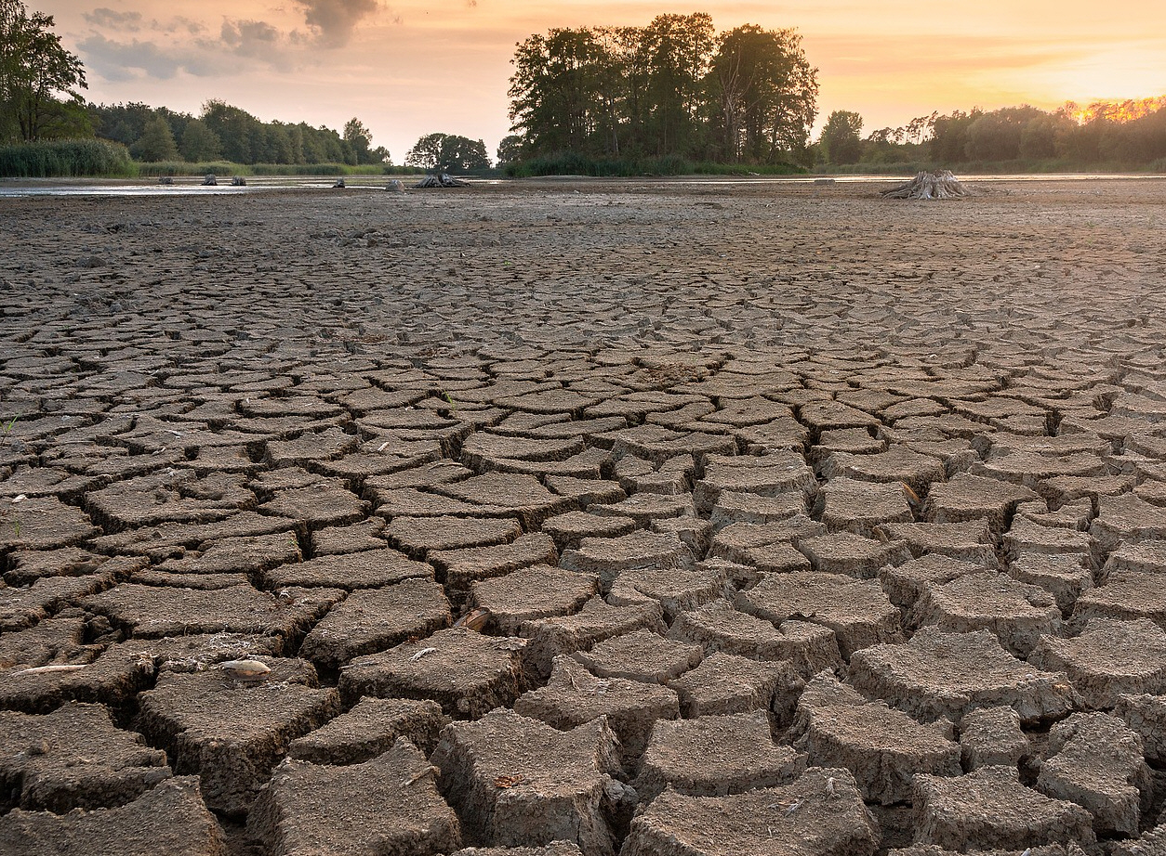
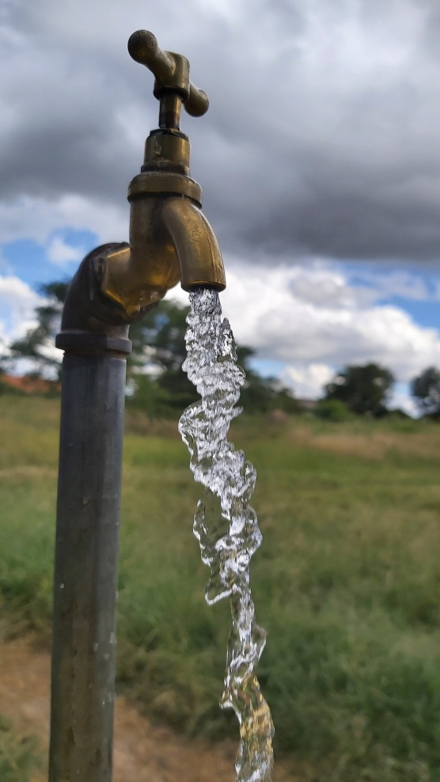
Most Important : Clean Drinking Water (not the topic of this lecture)
1.
water
ice
energy
AIC/CO2
global warming
3.
2.

Slide 9
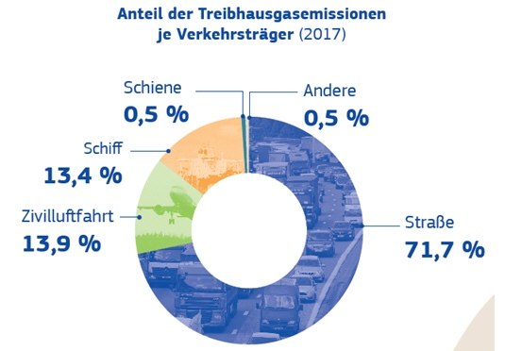
Are Emissions from Aviation Relevant?

Slide 10
What are the Climate Targets for Aviation?
Aviation Promises and Visions for 2020
The year 2020 was pivotal related to environmental goals:
  ACARE: European Aeronautics – A Vision for 2020:
  "A 50% cut in fuel consumption in the new aircraft of 2020" compared to 2000
IATA: Carbon-neutral growth from 2020
ATAG: Carbon-neutral growth from 2020
ICAO: CORSIA: "the basis for carbon neutral growth from 2020"
Goals Today: Zero Emission (https://www.destination2050.eu)

Slide 11

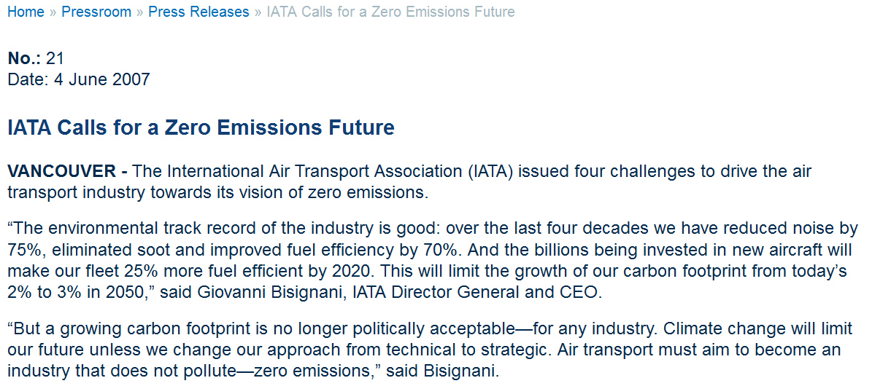
History of "Zero Emissions":
IATA 2007: First in Proclaiming "Zero Emissions" (Goals Not Active Anymore)
Archived at: https://perma.cc/JSR2-JC79

Slide 12
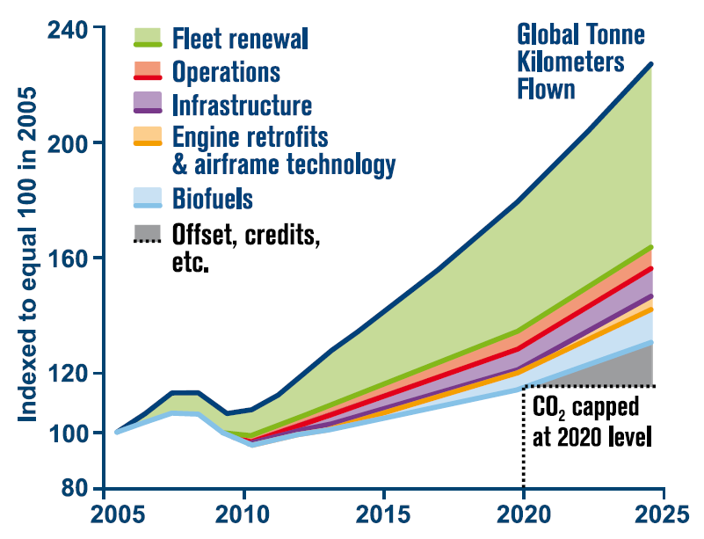
IATA: CNG from 2020
2020 is arbitrary to start with CO2 compensation.
Compensation could have started earlier.
Why not postpone longer?
Did we notice any change with the 2020 CO2 cap?
IATA Deleted this Document
IATA (and ATAG) want to achieve zero emission growth from 2020 onwards. This is
only possible with CO2 compensation (carbon offset schemes).
Archived at: https://perma.cc/42HW-ZTKF

Slide 13
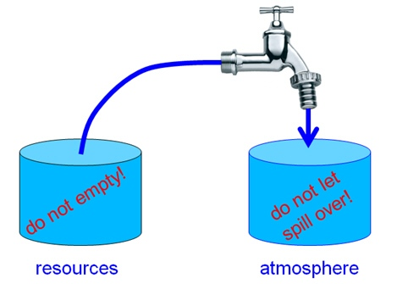
What is the Issue – Fuel Consumption or Emissions?
With carbon neutral growth (CNG) the tap is left wide open.
Maybe it is time to close the tap a least a little?
Yes, with "zero emission"!

Slide 14

ICAO: CORSIA: "the basis for carbon neutral growth from 2020"
CORSIA: Carbon Offsetting and Reduction Scheme for International Aviation
Multiple Phases
2019-2020: Monitoring for determination of the emissions baseline
2021-2023: Pilot phase (voluntary participation of the states)
2024-2026: Phase 1 (voluntary participation of the states)
2027-2035: Phase 2 (mandatory participation for all countries and their aircraft operators more than 0.5% of global air traffic in 2018, in ensuring that 90% of global air traffic is covered).
To begin the pilot phase alone took 5 years and let CORSIA start in 2021. The statement "the basis for carbon neutral growth from 2020" means in light of the regulations that carbon-neutral growth may never be achieved (its only the bases) and that it comes later than 2020 ("from") .

Slide 15
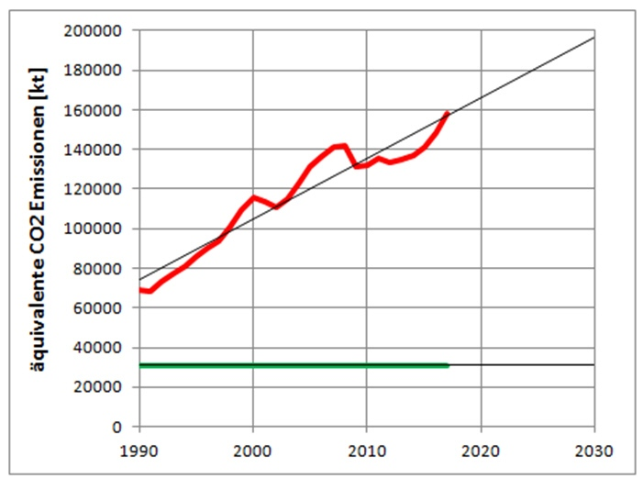
What Climate Goals Does the EU Have for Aviation?
1.) 2019: The EU's "Green Deal": "no more net greenhouse gas emissions should be released in 2050".
2.) 2020: Europe's climate target for 2030 was defined under the motto "Fit for 55". This is an interim goal for the Green Deal, greenhouse gas emissions are to be reduced by 55% compared to 1990 – i.e. only 45% of the 1990 value. This value should be reached by 2030.
"Fit for 55"

Slide 16
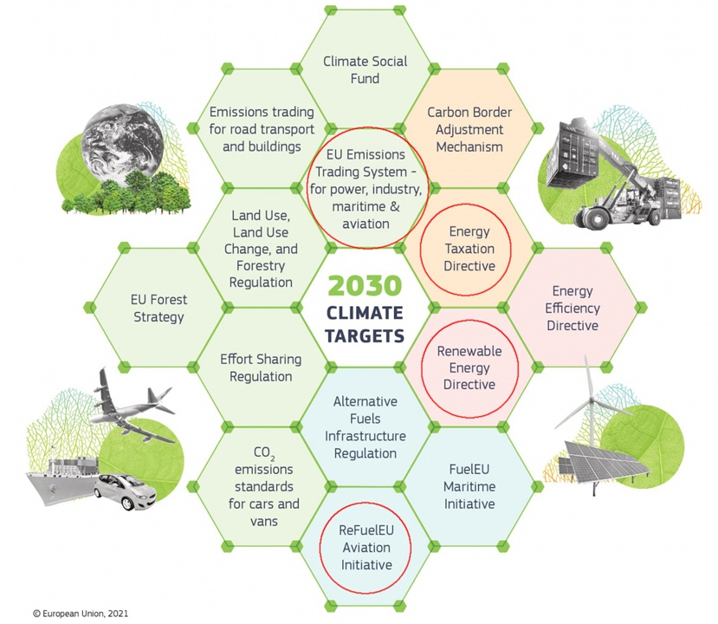
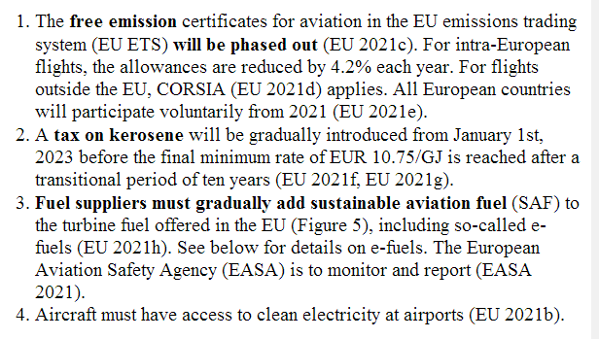
What Climate Goals Does the EU Have for Aviation?
"Fit for 55"

Slide 17
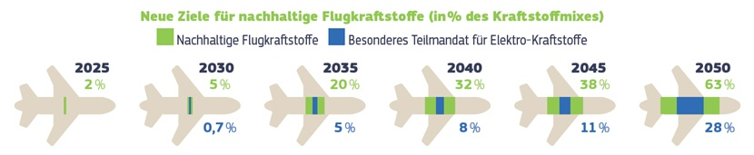
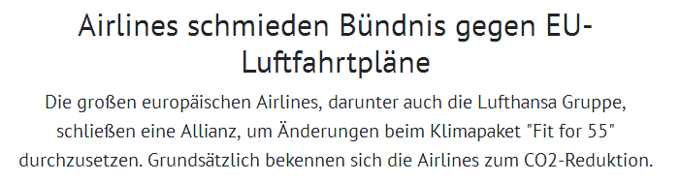

What Climate Goals Does the EU Have for Aviation?
"Fit for 55"
24.01.2022

Slide 18
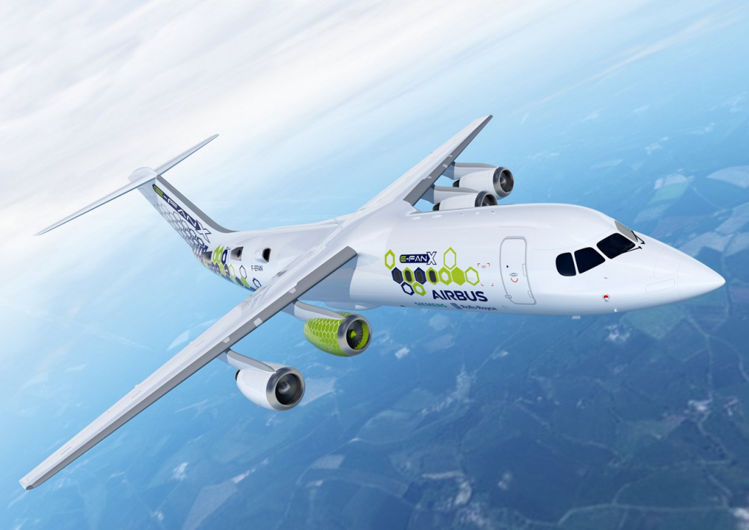

How Do We Get from Oil to the New Energy Carriers in Aviation?
1.) Aviation should be fueled by algae (Reddy 2015).
2.) Renewable electricity should be stored in batteries.
Passenger aircraft should be battery-electric operated.
3.) Hybrid-electric passenger aircraft are discussed.
Many possible combinations of conventional and electrical technology.
REDDY, Chris, O'NEIL, Greg, 2015. Jet Fuel from Algae?. Archived at: https://perma.cc/T5SG-7NFA
Airbus 2018
AIRBUS, 2018. The Future is Electric. Press Release, 2018-07-17. Archived at: https://perma.cc/V36S-7UVR
Airbus 2018

Slide 19
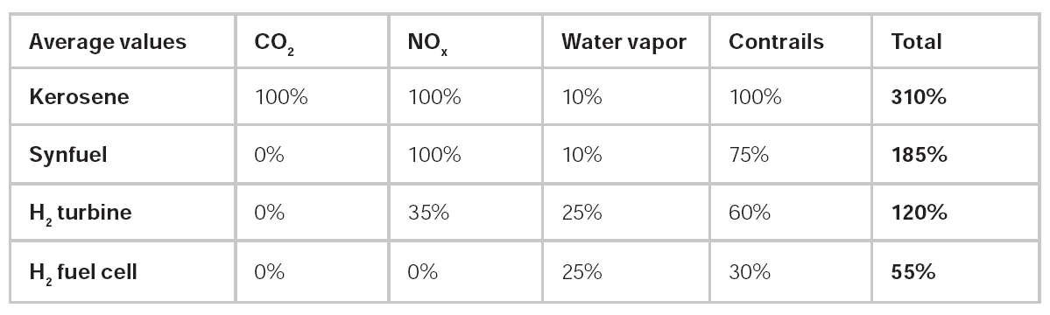
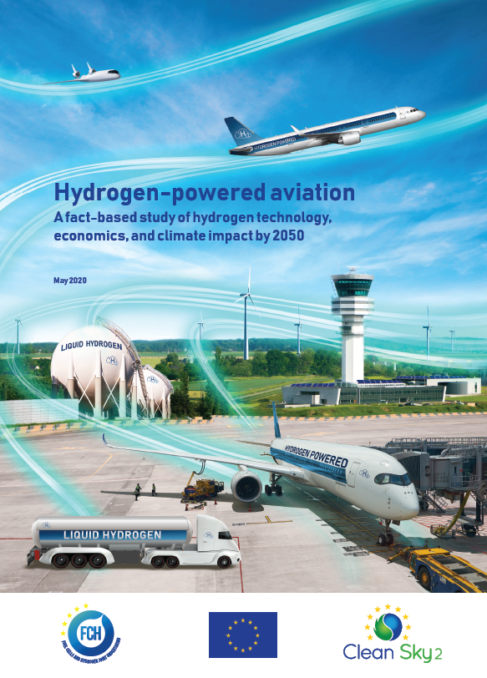
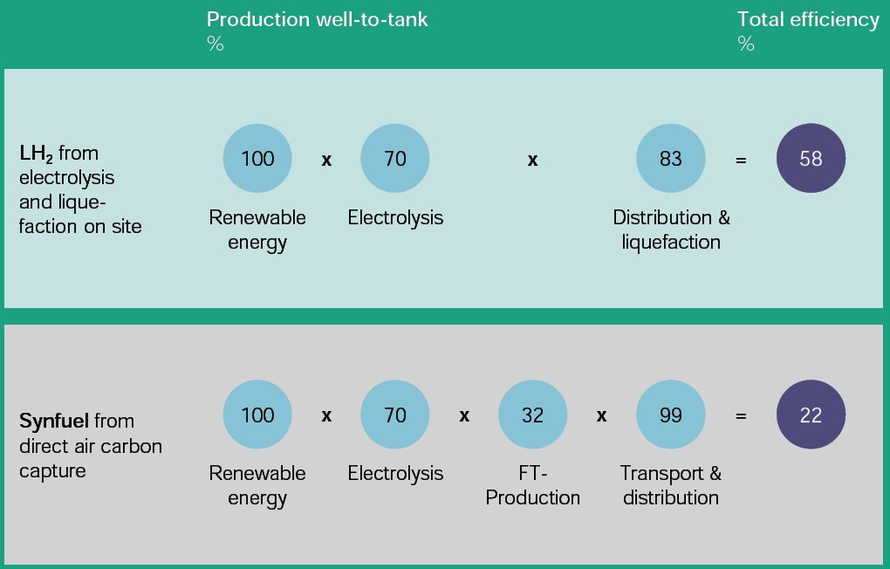

LH2 and E-Fuel
Emissions
≠ 0%
Energy / Primary Energy
energy factor
compared
to electricity
1.7
4.6
PtL:
2.7 times
more
than LH2!
https://doi.org/10.2843/471510
Archived at: https://perma.cc/BJJ6-5L74
and many others

Slide 20
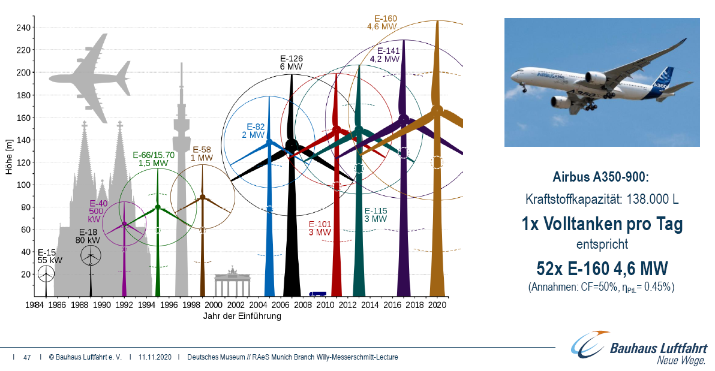
Refueling an A350 Once per Day
Can Be Done with 52 Big Wind Power Plants (4.6 MW Each)

Slide 21
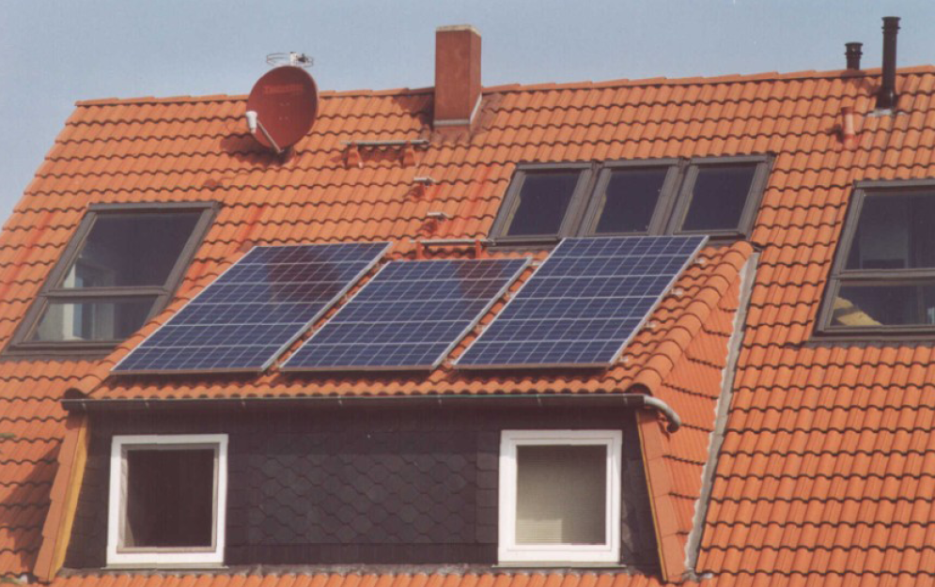
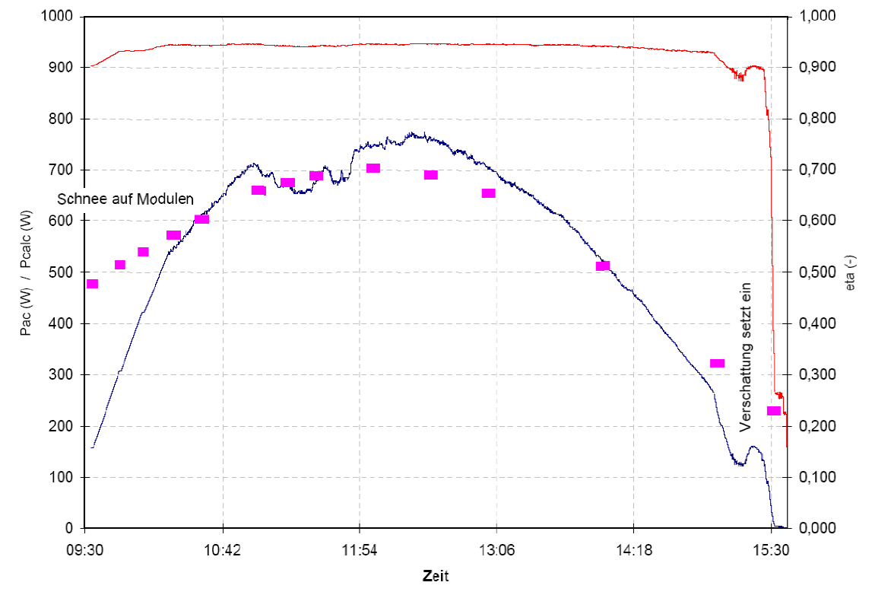
Comparison with Solar Power
update pending
1.) From the panels below not even one return flight over the Atlantic per year one person.
2.) From panels on 1 ha = 10000 m² energy equivalent to 93 t fuel per year
(fueling one A321 with e-fuel, fuel production efficiency 25%).
3.) From panels on 100 ha (a strip 300 m wide along the 3,5 km runway)
Airport 18 h open, take-off each 6 min. 65700 movements p.a., 0.15% fueled by airport.

Slide 22
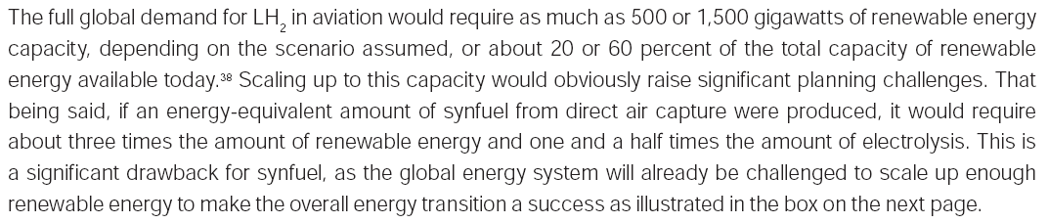
EU-Study, May 2020: Aviation's Energy Demand – Too Much
( )
Footnote 38: Total generation capacity of renewable energy: 2351 GW (2018)
Globally, total renewable energy generation capacity reached 2,351 GW at the end of last year – about a third of total installed electricity capacity. Hydropower accounts for the largest share with an installed capacity of 1,172 GW – about half of the total. Wind and solar energy account for most of the remainder, with capacities of 564 GW and 480 GW, respectively. Other renewables included 121 GW of bioenergy, 13 GW of geothermal energy and 500 MW of marine energy (tide, wave and ocean energy).
https://www.hydroreview.com/2019/04/03/irena-reports-renewable-energy-now-accounts-for-a-third-of-global-power-capacity
Archived at: https://perma.cc/YLY4-CG2R
Aviation's energy demand today is too high: Minium all wind or solar energy available today!
First we need to reduce the amount of air travel.
Then we may have a chance to power aviation with renewable energy.

Slide 23
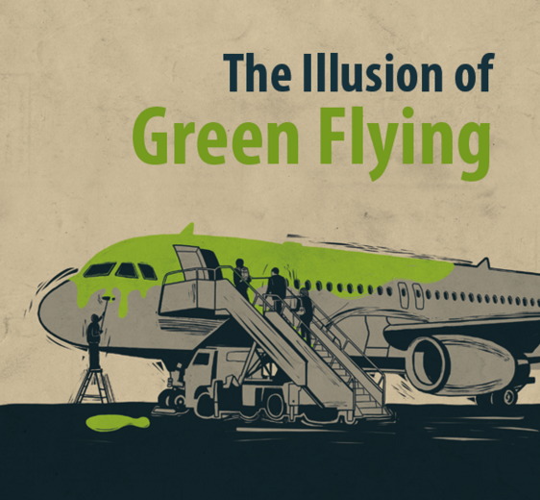
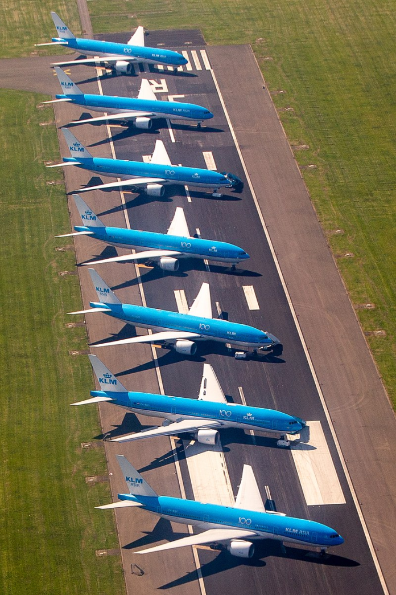

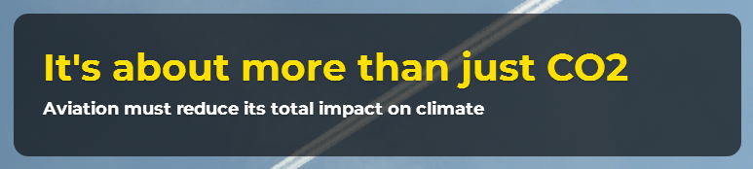
Biggest Emission Reduction in Aviation
History Thanks to the Corona Pandemic
Traffic reduction is more efficient than technology
https://stay-grounded.org
Ikreis, CC BY-SA, https://bit.ly/2Jn11T0

Slide 24
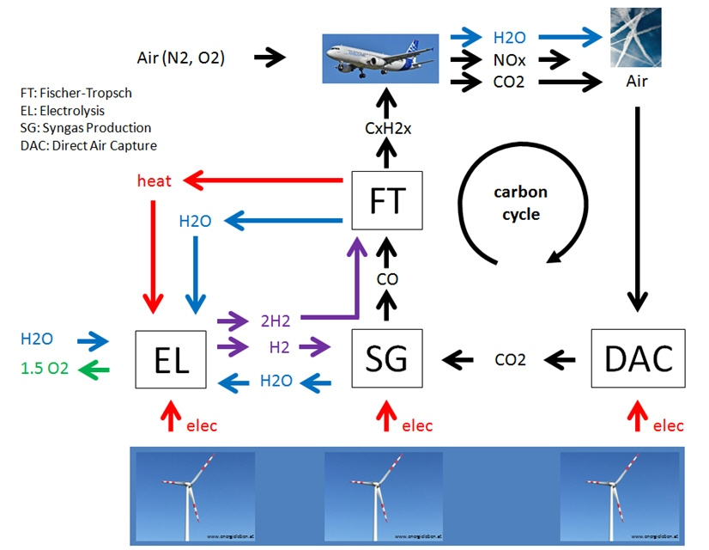
Power to Liquid (PTL), E-Fuel, Sustainable Aviation Fuel (SAF)
The Carbon Cycle

Slide 25
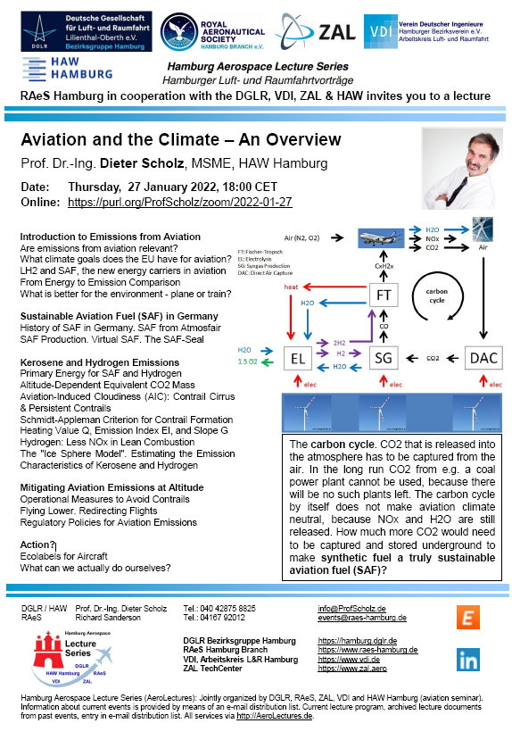
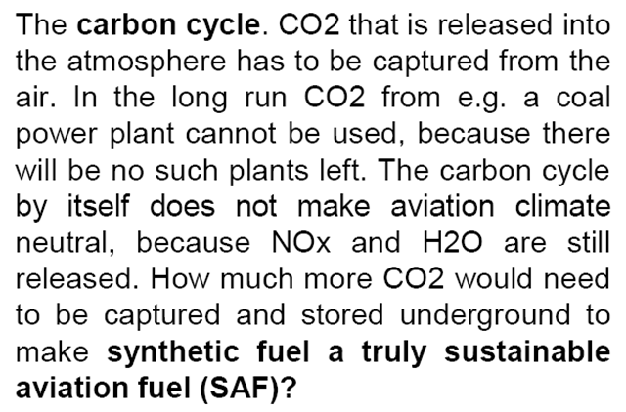
How Much More CO2 Would Need to Be Captured?

Slide 26
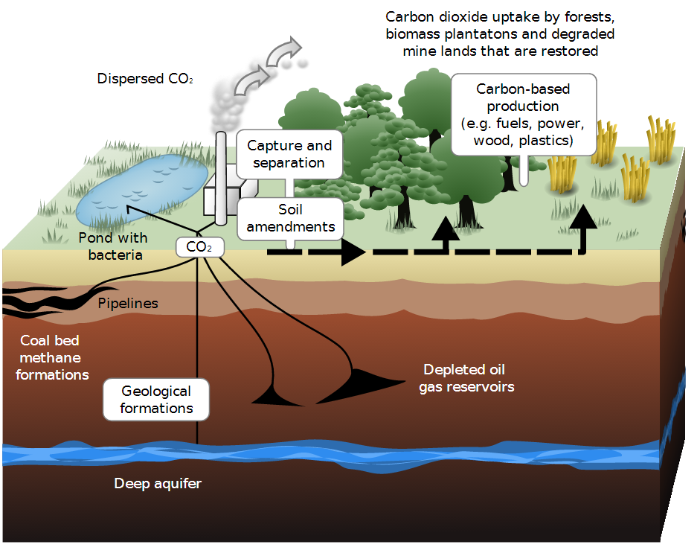
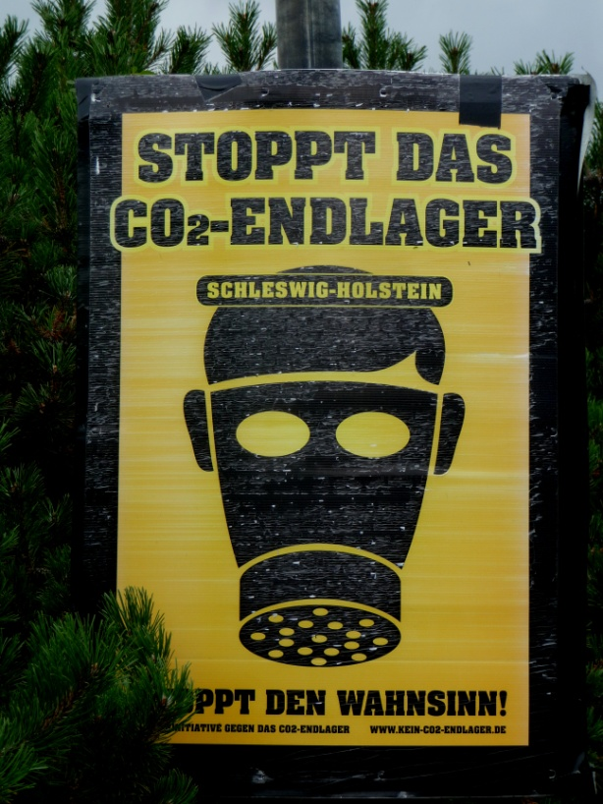
Carbon Capture and Storage (CCS)

Slide 27
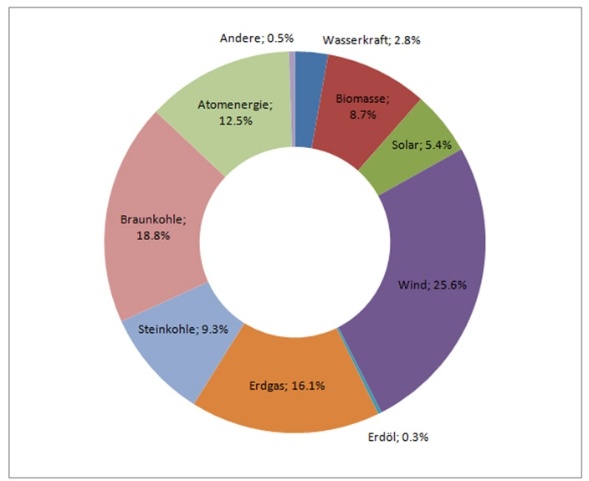
The Electricity Energy Mix

Slide 28
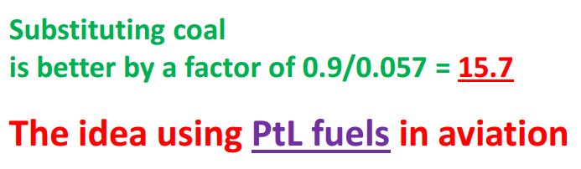
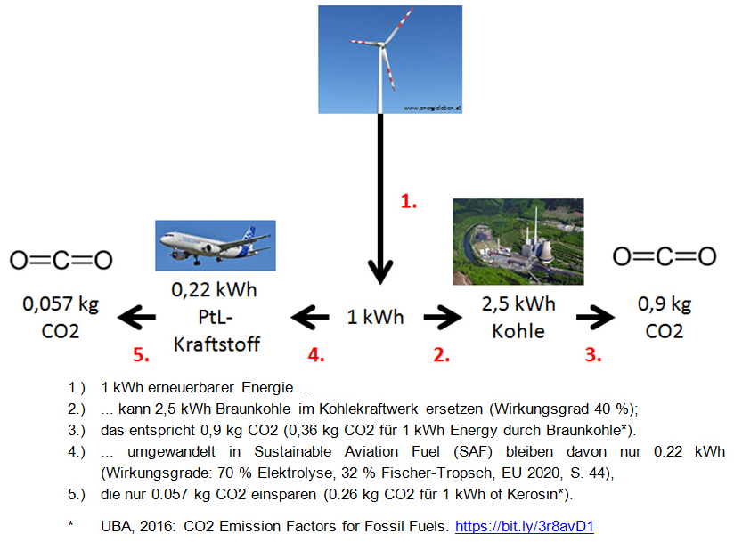
Do Not Use Electricity from the Grid to Power Aviation
http://ptl.ProfScholz.de

Slide 29
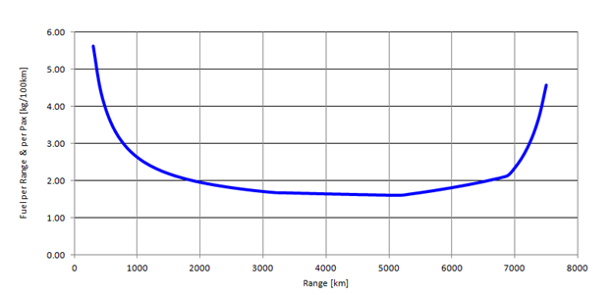
Aircraft Fuel
Consumption –
Short Range Not Efficient
Use the Train!
Airbus A320neo
Train is about 3 times more energy-efficient (certainly on short range)
Train uses 50% Eco Electricity Mix (factor 2)
Aircraft Factor 3, because in addition non-CO2 effects from:
  NOX and
  H2O (AIC)
3*2*3: aircraft is 18 times worse on global warming!
Simple Calculation of Aircraft Fuel Consumption with Public Data:
See details: https://bit.ly/3mWHo6c
Fuel Consumption = (MTOW – MZFW) / (R . Seats) . 100
R: Range at maximum payload, from payload range diagram (Document for Airport Planning).
Example calculation with Airbus A320neo:
2.2 kg per 100 km per seat =
(73500 kg – 62800 kg) / (3180 km . 150) . 100

Slide 30
Can Fuel Consumption and Emissions be Reduced?
Two "Schools" Marching towards Zero Emission
1.) The traditional school: "We have to increase efficiency."
Critique: "You will never make it to zero emission!"
2.) The new school: "We have to apply new fuels and do not care about their overall inefficiency, because all energy will be renewable energy, which is without harm."
Critique: "You will run out of energy resources!"

Slide 31
Can Fuel Consumption and Emissions be Reduced?
The Way towards Zero Emission
Zero Emission can be achieved by a combination of these principles:
apply new technologies to increase efficiency, and:
apply new fuels and with new means of propulsion/flying with no or less emissions, and:
apply the carbon (CO2) cycle with biofuels or SAF from PtL, and:
compensate remaining emissions.

Slide 32
Sustainable Aviation Fuel SAF in Germany

Slide 33
History of Using Synthetic Fuels in Germany and Beyond
Many demo flights with SAF since 2008
2011: New fuel standard: ASTM D7566
Lufthansa, 2011: Synfuel from Jatropha (oil bean) in regular flight operation for 6 month.
Only very few refineries for SAF in the world. One is Neste in Finland.
2014 start of Sunfire with a pilot plant for 160 l of crude oil per day.
Land Hessen: A pilot plant for E-fuel.
15 Million Euro, plus 2 Million Euro p.a. for pilot plant.
2019: Kopernikus- Project P2X at Karlsruher Instituts für Technologie (KIT).
2021: Government, aviation industry and others agree on "PtL-Roadmap for Aviation".
Nationalen Luftfahrtkonferenz, 18.06.2021 mentions "PtL-Development-Platform"
Government reserves 1,54 Mrd. Euro for SAF.
2021: PtX-Lab Lausitz
Norsk E-Fuel plans a plant in Herøya in the South of Norwegen

Slide 34
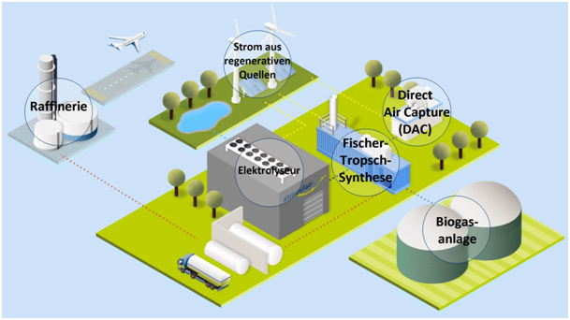
E-Fuel from Atmosfair

Slide 35
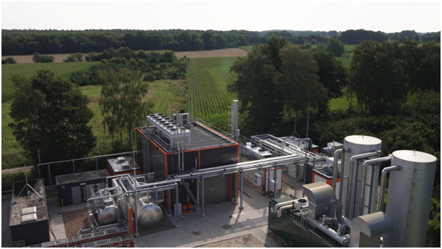
E-Fuel from Atmosfair
Erneuerbare-Energien-Gesetz (EEG)
Power Purchase Agreements, PPA
Herkunftsnachweise (HKN)

Slide 36
Seal (Gütesiegel) for Green Synthetic Kerosene
The crude oil is produced from renewable energy.
The source of renewable energy is not in competition with the energy transition.
The CO2 is obtained 95% from plants (which have captured CO2 from the air) and 5% directly from the air (through Direct Air Capture, DAC). This makes a CO2 cycle possible. CO2 is first removed from the atmosphere and then emitted back into the atmosphere in the aircraft through conventional combustion. The process is therefore CO2-neutral.
Up to crude oil production, everything is done at one location. As a result, no further energy is required for transport and no overhead lines are used to transport the electricity.
The production is not done on a laboratory scale (production of about 1 kg of fuel per day), but on a much larger scale (production of about 1000 kg of fuel per day). This is very little compared to the fuel requirements of the aircraft, but it is a first step.

Slide 37
Virtual E-Fuel – Bilanzielle Vermarktung
In this system, the customer pays for a certain amount of SynCrude that the Atmosfair/Solarbelt physically produced for him and which the refinery brings to market.
The associated CO2 reduction is certified by Atmosfair/Solarbelt with an independently tested seal of quality (TÜV) for the buyer and allocates the CO2 to the customer, although the kerosene physically co-processed with other crude oil and delivered to all airports.
The customer pays for this directly to Atmosfair/Solarbelt.
Established supply routes for crude oil and delivery routes for kerosene are unchanged.

Slide 38
Kerosene and Hydrogen Emissions from Aviation
in more Detail

Slide 39
Equivalent CO₂ Mass
CO₂
NO_{x}
AIC
m_{CO2,eq}
CAERS, Brecht, SCHOLZ, Dieter, 2020. Conditions for Passenger Aircraft Minimum Fuel Consumption, Direct Operating Costs and Environmental Impact. German Aerospace Congress 2020 (DLRK 2020), Online, 01.-03.09.2020.
Available from: https://doi.org/10.5281/zenodo.4068135
Notes:
AIC = Aircraft Induced Cloudiness
No Radiative forcing used: Only total emissions of all aircraft during a period of time

Slide 40
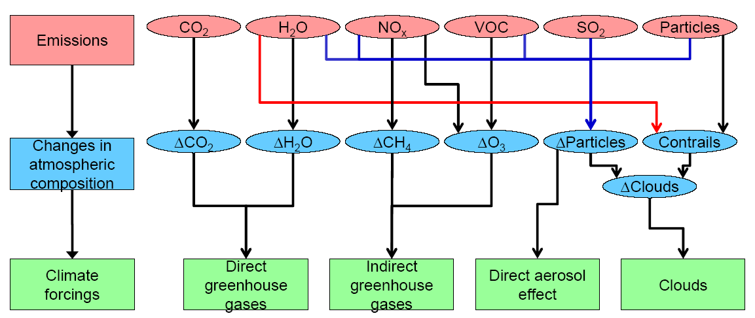
Aviation Emissions and Climate Impact
CO2: Long term influence
Non-CO2: Short term influence (immediate mitigation is possible)
RAPP, Markus, 2019. Perspektive: Wasserstoff & Hybride. Meeting: "Emissionsfreies Fliegen-wie weit ist der Weg?", Berlin, 13.11.2019

Slide 41
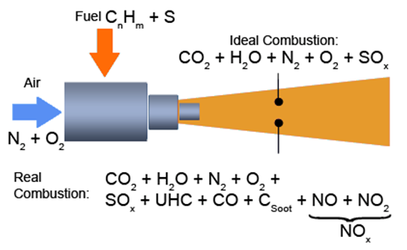
Kerosene and LH2 Combustion
EI_{NOx}
m_{F}
not included in
LH2 combustion
EMEP/EEA Guidebook
https://www.eea.europa.eu
Own Fuel Calculation

Slide 42
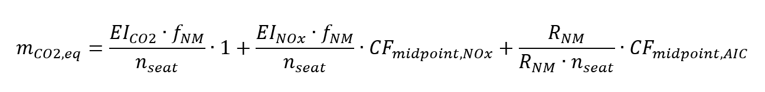
Altitude-Dependent Equivalent CO2 Mass
Sustained Global Temperature Potential, SGTP (similar to GWP):
Species | Emission Index, EI (kg/kg fuel)
CO₂ | 3,15
H₂O | 1,23
SO₂ | 2,00 ∙ 10⁻⁴
Soot | 4,00 ∙ 10⁻⁵
Species | SGTP_{i,100}
CO₂ (K/kg CO₂) | 3,58 ∙ 10⁻¹⁴
Short O₃ (K/kg NO_{x}) | 7,97 ∙ 10⁻¹²
Long O₃ (K/NO_{x}) | -9,14 ∙ 10⁻¹³
CH₄ (K/kg NO_{x}) | -3,90 ∙ 10⁻¹²
Contrails (K/NM) | 2,54 ∙ 10⁻¹³
Contrails (K/km) Cirrus (K/NM) Cirrus (K/km) | 1,37 ∙ 10⁻¹³ 7,63 ∙ 10⁻¹³ 4,12 ∙ 10⁻¹³
EI emission index
f_{NM} fuel consumption
per NM or km
R_{NM} range in NM or km
CF characterization factor
Cirrus/Contrails = 3.0
water vapor not considered
AIC aviation-induced
cloudiness

Slide 43
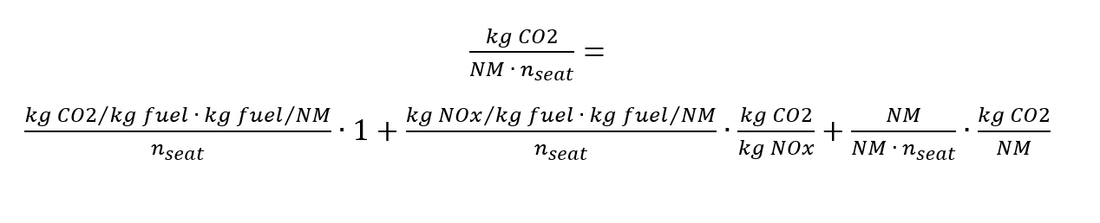
Altitude-Dependent Equivalent CO2 Mass
units only
SCHWARTZ, Emily, KROO, Ilan M., 2009. Aircraft Design: Trading Cost and Climate Impact.
47th AIAA Aerospace Sciences Meeting including The New Horizons Forum and Aerospace Exposition,
05.01.-08.01.2009, Orlando, Florida, AIAA 2009, No.1261. Available from: https://doi.org/10.2514/6.2009-1261
JOHANNING, Andreas, SCHOLZ, Dieter, 2014. Adapting Life Cycle Impact Assessment Methods for Application in Aircraft Design.
German Aerospace Congress 2014 (DLRK 2014), Augsburg, 16.-18.09.2014.
Available from: https://nbn-resolving.org/urn:nbn:de:101:1-201507202456. Download: http://Airport2030.ProfScholz.de
Notes:
Equations by Emily Dallara Schwarz
Emission indices and characterization factors
CF of CO2 is 1: no altitude dependency

Slide 44
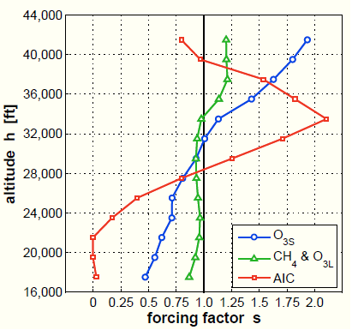
Altitude-Dependent Equivalent CO2 Mass
E.g.:
Forcing Factor s = f(h)
The curves go along with the ICAO Standard Atmosphere (ISA) applicable for average lattitudes. With a first approximation, the curves could be adapted to other lattitudes by stretching and shrinking them proportionally to the altitude of the tropopause.
The curves from SVENSSON 2004 (Fig. 1) show similar shapes. However, the importance of AIC is not yet as distinct.
SVENSSON, Fredrik, HASSELROT, Anders, MOLDANOVA, Jana, 2004. Reduced Environmental Impact by Lowered Cruise Altitude for Liquid Hydrogen-Fuelled Aircraft. In: Aerospace Science and Technology, Vol. 8 (2004), Nr. 4, pp. 307–320. Available from: https://doi.org/10.1016/j.ast.2004.02.004
Schwartz 2009 and 2011
Notes:
Sustained Global Temperature Potential. Forcing factor = altitude dependency

Slide 45
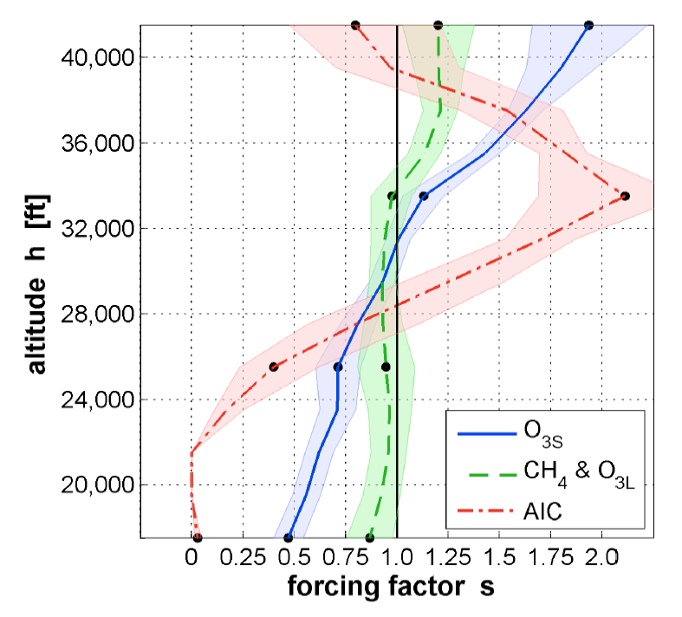
Altitude-Dependent Equivalent CO2 Mass
Forcing Factor s = f(h)
Forcing factors (lines) with 66% likelihood ranges (shaded areas). Altitudes with forcing factors based on radiative forcing data with independent probability distributions. (SCHWARTZ 2011)
Based on KÖHLER 2008 and RÄDEL 2008.
SCHWARTZ DALLARA, Emily, 2011. Aircraft Design for Reduced Climate Impact. Dissertation. Stanford University.
Available from: http://purl.stanford.edu/yf499mg3300
KÖHLER, Marcus O., RÄDEL, Gaby, DESSENS, Olivier, SHINE, Keith P., ROGERS, Helen L., WILD, Oliver, PYLE, John A., 2008. Impact of Perturbations to Nitrogen Oxide Emissions From Global Aviation. In: Journal of Geophysical Research, 113. Available from: https://doi.org/10.1029/2007JD009140
RÄDEL, Gaby, SHINE, Keith P., 2008. Radiative Forcing by Persistent Contrails and Its Dependence on Cruise Altitudes. In: Journal of Geophysical Research, 113. Available from: https://doi.org/10.1029/2007JD009117
Notes:
Sustained Global Temperature Potential. Forcing factor = altitude dependency

Slide 46
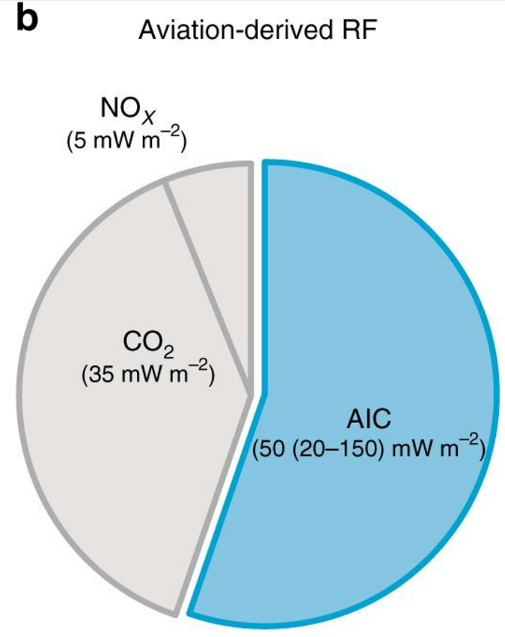
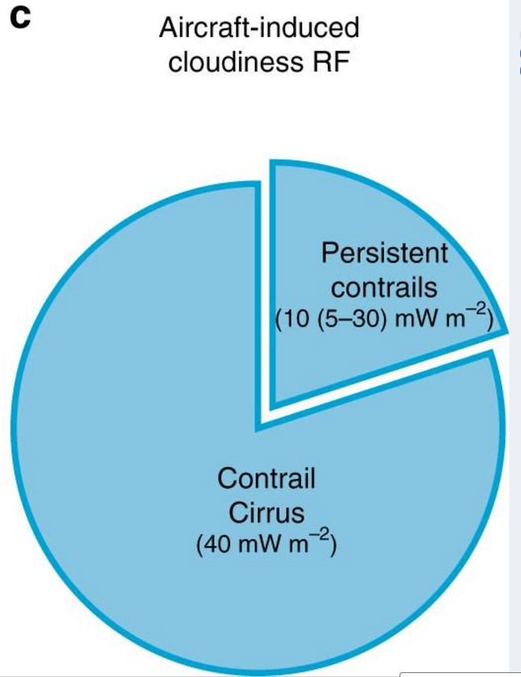
Aviation-Induced Cloudiness: Contrail Cirrus & Persistent Contrails
Cirrus/Contrails = 4.0
(b) Aviation forcing components, of which aviation-induced cloudiness (AIC) account for more than half.
(c) Breakdown of AIC radiative forcing into contrail cirrus and persistent contrails.
KÄRCHER, Bernd, 2018. Formation and Radiative Forcing of Contrail Cirrus. In: Nature Communications, Vol. 9, Article Number: 1824. Available from: https://doi.org/10.1038/s41467-018-04068-0

Slide 47
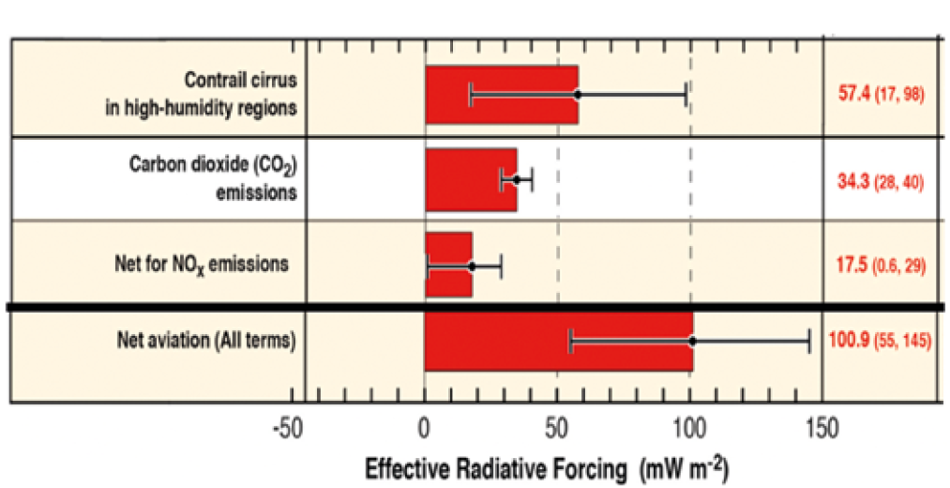
Relative Contributions to Global Warming
This can be compared to equivalent CO2 at peak AIC ("33548 ft") according to the model by SCHWARTZ 2009 due to
54.7% AIC
23.6% CO2
21.7% NOX

Slide 48
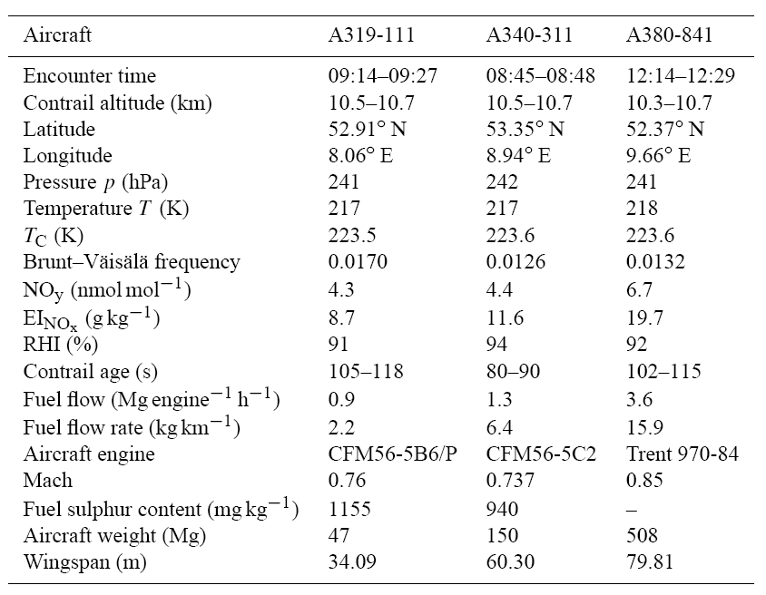
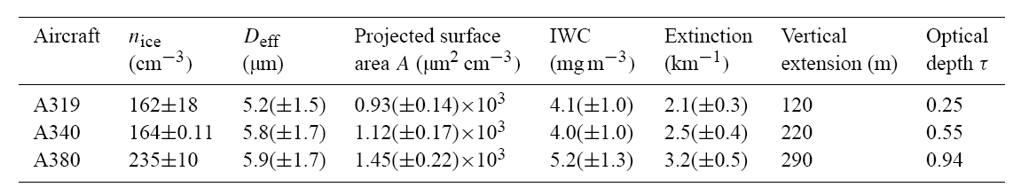
Contrail Radiative Forcing (CRF) as a Function of Fuel Flow (ff)
τ ff τ / ff [km/kg] aircraft
0.25 / 2.2 = 0.114 A319
0.55 / 6.4 = 0.0859 A340
0.94 / 15.9 = 0.059 A380
JEßBERGER, Philipp, et al. Aircraft type influence on contrail properties. Atmospheric Chemistry and Physics, 2013, 13. Jg., Nr. 23, S. 11965-11984. Available from:
https://10.5194/acp-13-11965-2013
update pending

Slide 49
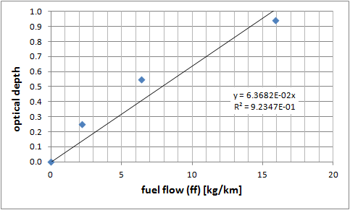
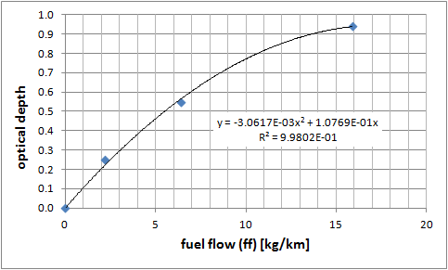
Contrail Radiative Forcing (CRF) as a Function of Fuel Flow (ff)
The quadratic regression (right) fits amazingly well. However, from the small number of aircraft tested, no such general law may be derived from it.
The climate model by SCHWARTZ 2009, which calculates AIC effects only based on contrail length
(flight distance) could be extended to include fuel burn (in kg/km) into the equation!
This remains to be done!
update pending

Slide 50
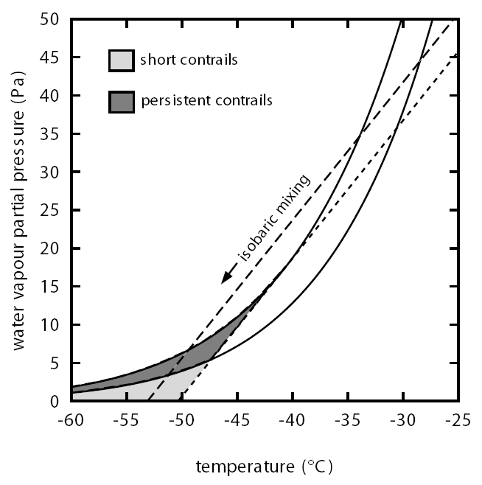

Schmidt-Appleman Criterion for Contrail Formation
water
altitude
Gierens 2008
ice
Fig. 1
altitude
G is the slope of the dotted line.
The dotted line is tangent to the water saturation line.
A steep dotted line (large G) means:
Contrails more often and also at lower altitudes.
GIERENS, Klaus, LIM, Limg, ELEFTHERATOS, Kostas, 2008. A Review of Various Strategies for Contrail Avoidance. In: The Open Atmospheric Science Journal, 2008, 2, 1-7. Available from: https://doi.org/10.2174/1874282300802010001
Notes:
Equations by Emily Dallara Schwarz
Emission indices and characterization factors
CF of CO2 is 1: no altitude dependency

Slide 51
Heating Value Q, Emission Index EI, and Slope G
fuel | Q [MJ/kg] | EI_{H2O} [kg/kg] | EI_{H2O}/Q [kg/MJ] | G_{H2}/G_{Jet-A1}
H2 | 120 | 8,94 | 0,0745 | 2,58
Jet –A1 | 43 | 1,24 | 0,0288
The slope G of the dotted line is 2,58 times steeper in case of LH2 combustion.This means: Contrails more often and also at lower altitudes.
2,58 times more water vapor is produced with LH2 combustion compared to kerosene combustion (for the same energy used).
Notes:
Equations by Emily Dallara Schwarz
Emission indices and characterization factors
CF of CO2 is 1: no altitude dependency

Slide 52
Literature Review: Hydrogen and Water Emissions
Types of water based emissions:
water vapor emissions
aviation-induced cloudiness (AIC)
  line-shaped contrails
  cirrus clouds (aged contrails)
the water vapour RF [radiative forcing] increases in the cryoplane case, but by absolute magnitude this contribution remains the smallest.
Ponater, 2006, https://doi.org/10.1016/j.atmosenv.2006.06.036
For H2 turbines and fuel cells, as they use H2 as fuel, 2.55 times more water vapor is formed compared to kerosene combustion [for the same energy content].
H2 turbines emit less soot compared to kerosene; therefore, their emission leads to optically thinner ice crystals and thus lower climate impact. [Reduction assumed down to 60% (40% reduction). See table on page 76 in report.]
EU, 2020. Hydrogen-Powered Aviation. https://doi.org/10.2843/471510. Archived at: https://perma.cc/BJJ6-5L74

Slide 53
Literature Review: Hydrogen and Water Emissions
Current state of knowledge does not allow a conclusive assessment whether the net radiative impact of cryoplane contrails will be smaller or larger than that of conventional contrails. Uncertainty with respect to radiative forcing arises mainly from insufficient knowledge regarding the mean effective ice crystal radius for both conventional and, especially, cryoplane contrails.
it would be strongly desirable to compare model results to observations, i.e., measurements taken in the wake of a prototype cryoplane, which presently does not exist.
crystal radius is about a factor of 0.3 smaller for conventional contrails than for cryoplane contrails. [Hence, the radius of cryoplane's ice crystals is 3.33 times larger and the volume is 37 times larger. That means with 2.58 the amount of water there are only 7% of the ice crystals by numbers compared to kerosene. The area of the ice crystals is 11 time larger and the coverage of the sky is only 77.4% of that for kerosene. Everything calculated from simple geometry.]
the substitution of conventional aviation by a fleet of cryoplanes would leed to ... increase in the coverage with all contrails by a factor of 1.2
However, contrails are only visible (from satellite or an Earth-bound observer) if their optical depth exceeds a certain threshold value. In our studies, we have used a visibility-threshold of 0.02 and, therefore, have distinguished between the "visible" contrail cover and the cover with "all" contrails. Though, as just explained, the coverage with all contrails increases all over the world in our cryoplane simulations, the coverage with visible contrails decreases over a substantial part of the globe
Marquart 2005, https://doi.org/10.1127/0941-2948/2005/0057

Slide 54

Literature Review: Hydrogen and Water Emissions
Change in annual mean total contrail cover for the time slice 2015 if the conventional fleet of aircraft is replaced by a fleet of cryoplanes. (d) ratio cryoplane/conventional for visible contrails.
Marquart 2005, https://doi.org/10.1127/0941-2948/2005/0057

Slide 55
Literature Review: Hydrogen and Water Emissions
the global mean radiative forcing of cryoplane contrails is simulated to be by about ... 30% [lower] in 2050 compared to the radiative forcing of conventional contrails. The global mean decrease in radiative forcing results from the decrease in contrail optical depth, which outweighs the effect of increased contrail cover due to the higher specific emission of water vapour. However, in tropical regions, where it is often too warm for contrail formation in the case of conventional aircraft, the increase in contrail cover for the cryoplane case is found to be relatively strong, leading to an increase in radiative forcing there.
Marquart 2005, https://doi.org/10.1127/0941-2948/2005/0057
Contrail cirrus, consisting of linear contrails and the cirrus cloudiness arising from them, yields the largest positive net (warming) ERF term followed by CO2 and NOx emissions.
Lee, 2020, https://doi.org/10.1016/j.atmosenv.2020.117834
Flying at lower altitudes can also lead to contrail reduction in the mid-latitudes.
Gierens, 2008, https://doi.org/10.2174/1874282300802010001
Cryoplanes should cruise at an altitude of about 2–3 km below where conventional aircraft cruise today. At this reduced flight level, the contribution to global warming from the cryoplane is slightly less than about 15% of that of the conventional aircraft cruising at the datum level. In addition to the aspects considered here, reducing the flight altitude will help to avoid the formation of contrails. Inevitably, this change in cruise altitude causes increased aircraft investments and operating costs.
Svensson, 2004, https://doi.org/10.1016/j.ast.2004.02.004

Slide 56
Hydrogen Combustion at Altitude and the "Ice Sphere Model"
Hydrogen burns without soot and therefore without condensation nuclei. The water from the combustion condenses on the few condensation nuclei in the atmosphere.
There is more water by a factor of 2.58.
The ice crystals are bigger, but there are fewer ice crystals.
Assumption: If the effective diameter of the ice crystals (imagined as a sphere) is 3.33 times as large as in the case of kerosene combustion, then the volume is 3.33*3.33*3.33 = 37 times as large and the number spheres goes down by a factor of 1/37. The cross-section of the sphere is 3,33*3.33 = 11 times as big. Taking the increased amount of water into account, the sky is covered by only 11/37*2.56 = 77.4% compared to burning kerosene (with the same amount of energy).

Slide 57

Hydrogen: Less NOx in Lean Combustion
Primary effect:
Hydrogen burns hotter and produces more NOx.
Secondary effect:
Hydrogen allows
leaner combuston
for less NOx.
NOx reduction
potential, but not zero NOX for LH2
combustion.
NOx
reduction
potential
low flame temperature means low NOX
NOx
reduction
potential
KHANDELWAL et al., 2013. Hydrogen powered aircraft: The future of air transport. In: Progress in Aerospace Sciences. Vol. 60, July 2013, pp. 45-59. Available from: https://doi.org/10.1016/j.paerosci.2012.12.002

Slide 58
Literature Review: Hydrogen and NOx Emissions
For H2 turbines (vs. kerosene), hydrogen’s wider flammability limits enable leaner combustion that results in lower flame temperatures. In addition, higher burning velocities and diffusivity allow for higher reaction rates and faster mixing respectively, resulting in lower residence time. These factors cumulatively contribute to lower thermal NOx and allow for shorter combustor designs. As the total amount of NOx reduction is promising but still uncertain, a range of 50 percent to 80 percent compared to kerosene was considered. Translating this to GWP and in reference to kerosene aircraft, we used a range of GWP for NOx from H2 turbines of 10 percent (lower limit) to 75 percent (upper limit), resulting in an average GWP value of 35 percent.
EU, 2020. Hydrogen-Powered Aviation. https://doi.org/10.2843/471510. Archived at: https://perma.cc/BJJ6-5L74
As for the NOx emissions when burning hydrogen, theoretically there is, in spite of the higher stoichiometric flame temperature of hydrogen, a potential to achieve lower emissions as compared with engines using kerosene. The main reason for this is that the hydrogen flame has a wider flammability range; particularly the lean limit is substantially lower than that encountered for kerosene flames. Therefore the entire operating range may be shifted further into the lean region, with considerably reduced NOx emissions as a consequence.
Svensson, 2004, https://doi.org/10.1016/j.ast.2004.02.004

Slide 59



Calculation of the Emission Characteristics of Aircraft Kerosene and Hydrogen Propulsion – A Comparison with Primary Effects
https://doi.org/10.7910/DVN/DLJUUK
The method from SCHWARTZ 2009 was applied and adapted. Hydrogen combustion has 2.58 times more water emissions. If this primary effect is applied to aviation-induced cloudiness (AIC) with its line-shaped contrails and cirrus clouds, the equivalent CO2 mass would be 50% higher as for kerosene. Hydrogen flame temperature is higher (without applying special technologies) and as such NOx would be higher. It is assumed here that NOx are the same as for kerosene.

Slide 60


Calculation of the Emission Characteristics of Aircraft Kerosene and Hydrogen Propulsion – A Comparison with Secondary Effects
https://doi.org/10.7910/DVN/DLJUUK
Now secondary effects are applied on top of the primary effect for contrails due to 3.333-fold larger ice crystals (factor 0.774) and for increase coverage (factor 1.2) leading all together to a reduction factor of 0.774*1.2 = 0.929. Note: This factor already includes the 2.58 for more water emissions. If the "2.58" are kept separately, the reduction factor is 0.358! The same factor is assumed for cirrus clouds. For NOx a factor of 0.35 is assumed due to lean combustion and low flame temperature. With that equivalent CO2 mass is now in the order of that for kerosene propulsion.

Slide 61


Estimated Hydrogen Emission Effect – Unknown Ice Sphere Equivalent Diameter
The "ice sphere model" gives a geometric reduction factor of f_red = 1 / (d_eff_LH2 / d_eff_kero). It is calculated from the ratios of the equivalent diameter of the ice sphere in case of hydrogen combustion with respect to kerosene combustion.
According to Marquart 2005, contrail cover is increased by a factor of 1.2. This is due to contrails forming based on the Schmidt-Appleman Criterion and a slope G steeper by a factor of 2.58. The factor of 1.2 is a global estimate.
Hydrogen combustion produces more water for the same energy. The factor is 2.58.
Hydrogen combustion produces no CO2.
The possibility exists to reduce NOX if combustion chambers are applied to optimize hydrogen combustion. A factor of 0.35 is assumed.
The overall (final) reduction effect of hydrogen combustion depends on the composition of the equivalent CO2 mass. This is a strong function of altitude. According to the model by SCHWARTZ 2009 at peak AIC ("33548 ft") it is: 54.7% AIC, 23.6% CO2, and 21.7% NOX. Hydrogen emission reductions are calculated based on this composition.

Slide 62
Mitigating Aviation Emissions

Slide 63
Literature Review: Operational Measures to Avoid Contrails
Contrails cool the surface during the day and heat the surface during the night... Whereas the longwave (terrestrial) radiative forcing varies only little over the day, the shortwave (solar) forcing displays a strong diurnal cycle due to the variation of the sun's position (zenith angle). Hence... altering the time for aircraft traffic has the potential for reducing the radiative forcing due to contrails.
that most of the RF from contrails can be attributed to night-time flights. Even though only 25% of aircraft movements occur at night, they account for 60-80% of the contrails' RF.
although 22% of annual air traffic movements are winter flights, they contribute about half of the annual mean RF from contrails.
A strategy [can be] designed to achieve environmentally optimum flight routings (avoiding ice supersaturated air masses) especially for flights in the evening and night hours... As air traffic density is lower during the night, when contrails have a large individual radiative forcing, there is a greater opportunity for redirecting flights out of ice supersaturated regions* without dramatically enhancing the work load of air traffic controllers.
Gierens, 2008, https://doi.org/10.2174/1874282300802010001
* Redirecting flights can be done either laterally or vertically.
Hence, only a small number of flights need to be redirected e.g. to lower altitudes to achieve still a significant effect.

Slide 64

https://doi.org/10.5281/zenodo.4068135
Notes:
Equations by Emily Dallara Schwarz
Emission indices and characterization factors
CF of CO2 is 1: no altitude dependency

Slide 65

Environmental Impact – Flying Lower
“Neutral” mix of 50 – 50 resource depletion and engine emissions
Clear altitude boundary from $m_{CO2,eq}$ visible
Fuel consumption shape visible
Fly low and slow
Units: normalized value between 0 and 1
Notes:
Explain normalized values and weighting factors

Slide 66
Environmental Impact – Flying Lower
Changing the regular cruise altitude of an Airbus A320-200 of about 11500 m to an altitude of 6500 m at a constant Mach 0.78 would result in:
a decrease of equivalent CO2 mass of 78 % and
an increase of fuel consumption of 5.6 %.
  The increase of fuel consumption is mostly influenced by
  an increase of TSFC of 6.0 % and
  a decrease of the aerodynamic efficiency of 5.4 %.
Combining equivalent CO2 mass and resource depletion (fuel consumption) into the environmental impact would result in a decrease of 70 % in environmental impact.
As the Mach number is kept constant, DOC are only effected by fuel consumption and increase by only 0.6%.
However, for the atmosphere this is an exchange of considerable less short term non-CO2 warming potential versus more CO2 long term warming potential. This exchange can be questioned, because it is not good for future generations.

Slide 67

Redirecting Flights
The concepts of climate-restricted airspaces (regulatory approach) and climate-charged airspaces (price-based approach) show their mitigation potential. A trajectory simulation in the North Attlantic shows that more than 90% of the maximum mitigation potential of eco-efficient flying can be achieved by these concepts. The concepts resolve the existing conflict of objectives between ecology and economy in aviation. Climate-friendly flying becomes economically attractive.
Climate Charged Airspaces, https://youtu.be/BZbOANbAG-A
NIKLAß, Malte, 2019. Ein systemanalytischer Ansatz zur Internalisierung der Klimawirkung der Luftfahrt. Dissertation. Available from: https://elib.dlr.de/126415

Slide 68
Summary

Slide 69
Summary (1 of 2)
Aviation and the Climate – An Overview
When fossil fuels come to an end, we need an efficient energy carrier to bring renewable energies (electricity) into the aircraft.
At the same time we need to make sure that flying is done with as little emissions as possible.
An aircraft flying with PtL compared with one flying on hydrogen needs 2.7/1.4 = 1.9, or roughly two times more primary energy.
Cryoplanes need lean combustion for low NOx and should fly lower to limit contrails.
Research in contrails forming behind a hydrogen aircraft is needed. This research should find the average equivalent diameter of the ice crystals in case of hydrogen combustion.
For decades to come we will have an electricity energy mix including fossil fuels and renewable energies. No one should claim the clean energy and leave the dirty energy to others.
With all measures together, cryoplanes can reduce emissions (tank to wake) down to 59%* . 1.4 = 83% compared to kerosene planes (this is a reduction of 17%). Considering however the energy mix, cryoplanes are as polluting as the kerosene planes. All the efforts do not pay off related to overall emissions!
* Strongly depending on cruise altitude (here for peak AIC).

Slide 70
Summary (2 of 2)
Aviation and the Climate – An Overview
Cryoplane emission are more short term than the CO2 long term emissions from kerosene aircraft. This means that in the long term, cryoplanes burden future generations less with global warming. If we fly cryoplanes today, less CO2 piles up. Future generations could decide to stop (or reduce) flying and will see an immediate effect when cutting the short term non-CO2 effects.
Renewable energy will by far not be sufficient to maintain flying at the level we know today (2019).
It is therefore paramount to reduce flying as it happened already during the Corona pandemic. If we do not gently start changing the aviation industry now (while change takes place), the laws of physics will tell us, with the consequence that our children will later struggle harder to make this transformation.

Slide 71

Aviation and the Climate – An Overview
Contact
info@ProfScholz.de
http://www.ProfScholz.de
Quote this document:
SCHOLZ, Dieter, 2022. Aviation and the Climate – An Overview.
Hamburg Aerospace Lecture Series, HAW Hamburg, 19.11.2020.
Available from: https://doi.org/10.5281/zenodo.xxxxxxx
© Copyright by Author, CC BY-NC-SA, https://creativecommons.org/licenses/by-nc-sa/4.0

Slide 72

Video "The Bill"
Watch "The Bill", a short video (4:21).
The video may make you think about how we live and what we really need.
https://youtu.be/EmirohM3hac (German)
https://youtu.be/rWfb0VMCQHE (English Subtitles)

