Slide 1
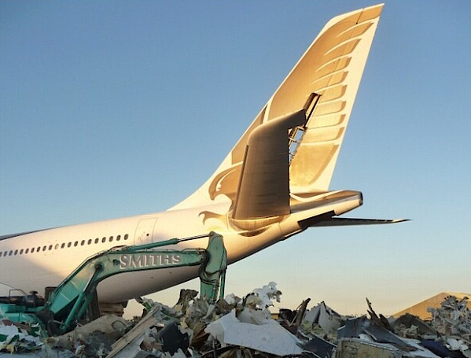
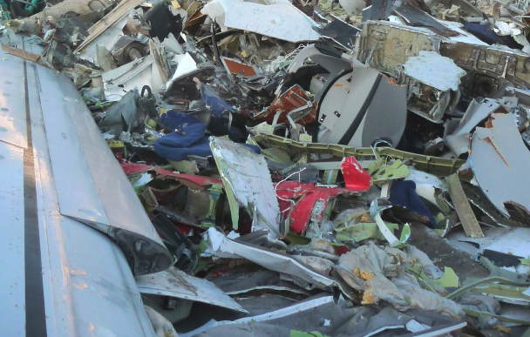
Passenger Aircraft at End-of-Life
Dieter Scholz Hamburg University of Applied Sciences
Hamburg Aerospace Lecture Series (AeroLectures)
DGLR, RAeS, VDI, ZAL, HAW Hamburg
Online, 02 June 2022
https://doi.org/10.5281/zenodo.xxxxxxx

Slide 3
Motivation
Passenger Aircraft at End-of-Life
About 1,000 commercial aircraft reach the end of their lives every year.
The safe, responsible and at the same time economical recycling of these machines is a major challenge.
This must be considered when designing new aircraft.
However, the composite materials that are increasingly being used are a recycling problem.
A new aircraft dismantling industry is emerging.
Much is developed in the recycling processes.

Slide 4
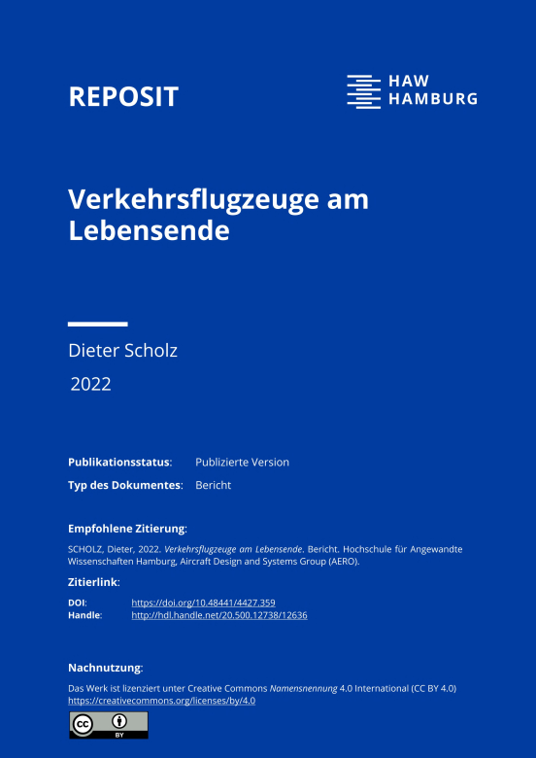
This lecture is based on:
Passenger Aircraft at End-of-Life
Project : HAW Hamburg, Aeronautical Enginerring Studies
MAASS, Svenja, 2020. Aircraft Recycling – A Literature Review. Project. Hamburg University of Applied Sciences, Aircraft Design and Systems Group (AERO). Available from: https://nbn-resolving.org/urn:nbn:de:gbv:18302-aero2020-04-05.018.
HAW-Bericht: Verkehrsflugzeuge am Lebensende
SCHOLZ, Dieter, 2022. Verkehrsflugzeuge am Lebensende. Bericht. Hochschule für Angewandte Wissenschaften Hamburg, Aircraft Design and Systems Group (AERO). Verfügbar unter: https://doi.org/10.48441/4427.359. Direkt zum PDF: https://purl.org/aero/RR2022-03-10.
Artikel in Airliners.de, die Wissensplattform für die
deutsche Luftverkehrswirtschaft
SCHOLZ, Dieter, 2022-02-25. Der Produktlebenszyklus eines Flugzeugs endet nicht mit der Ausflottung. In: airliners.de. Archiviert als: https://perma.cc/5AUE-42VN.
Online News der HAW Hamburg
SCHOLZ, Dieter, 2022-03-10. Verkehrsflugzeuge am Lebensende. Online News. Hochschule für Angewandte Wissenschaften Hamburg, Department Fahrzeugtechnik und Flugzeugbau. URL: https://www.haw-hamburg.de/detail/news/news/show/verkehrsflugzeuge-am-lebensende/.

Slide 5
Contents
Passenger Aircraft at End-of-Life
Aircraft Boneyards
Recycling
End-of-Life
Airbus and Boeing Activities
Composite Materials
Special Reuse
Summary

Slide 6
Aircraft Boneyards

Slide 7
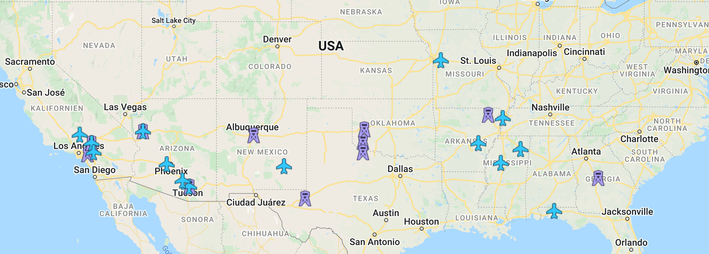
Aircraft Boneyards
Boneyards in the USA

Slide 8
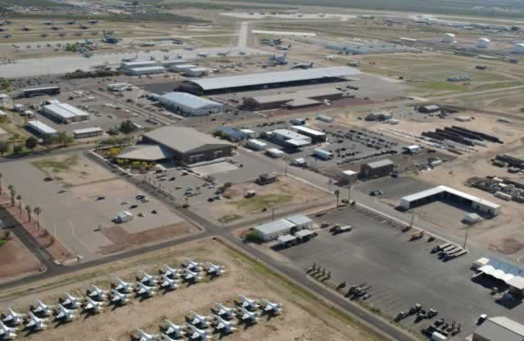
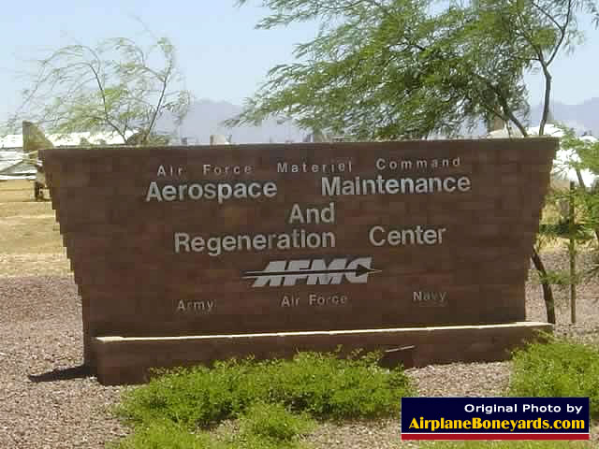
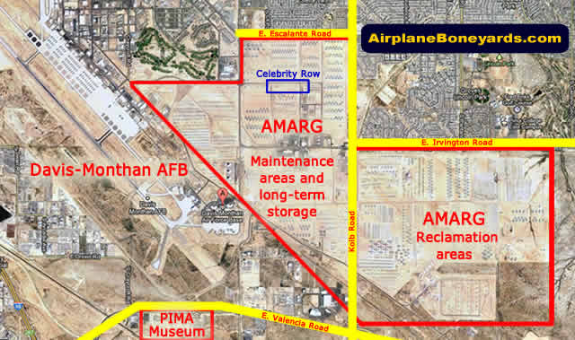
Aircraft Boneyards
309th AMARG, Tucson, Arizona, USA
https://AirplaneBoneyards.com

Slide 9
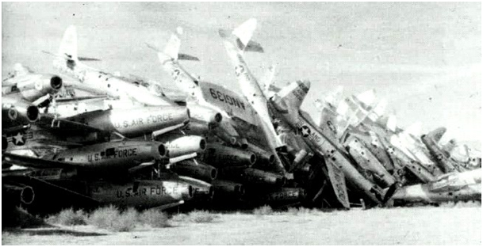
Aircraft Boneyards
By far the largest site is 309th AMARG, Tucson, Arizona, USA.
Dedicated to military aircraft.
These F-84 were decommissioned in the 1950th to AMARG. A photo from 1980.
Source: Wikipedia (in the public domain)

Slide 10
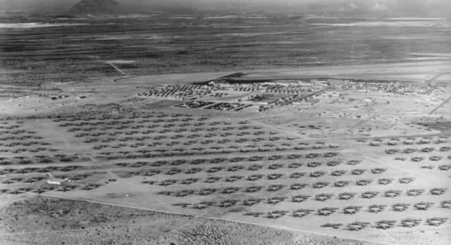
Aircraft Boneyards
309th AMARG, Tucson, Arizona, USA (1946)

Slide 11
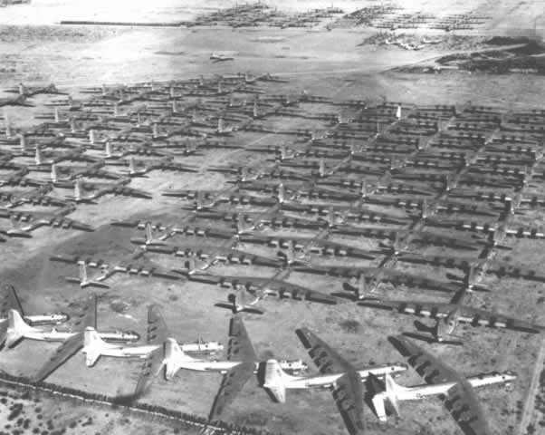
Aircraft Boneyards
309th AMARG, Tucson, Arizona, USA: B36 Peacemaker

Slide 12
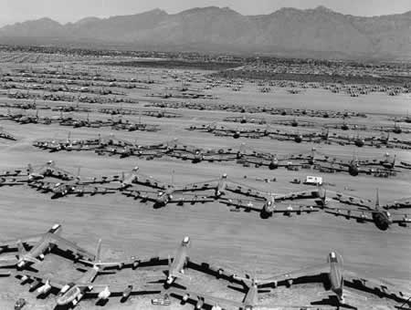
Aircraft Boneyards
309th AMARG, Tucson, Arizona, USA: B47 Stratojets

Slide 13
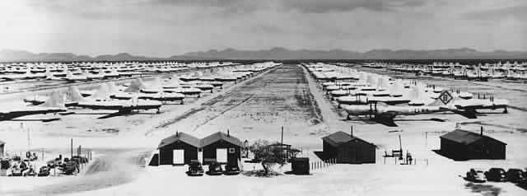
Aircraft Boneyards
309th AMARG, Tucson, Arizona, USA: Boeing B29 Superfortress

Slide 14
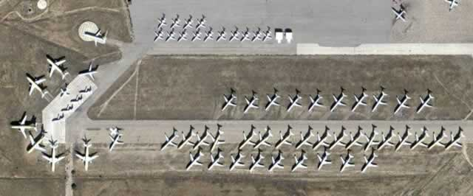
Aircraft Boneyards
Kingman Airport, Arizona, USA

Slide 15
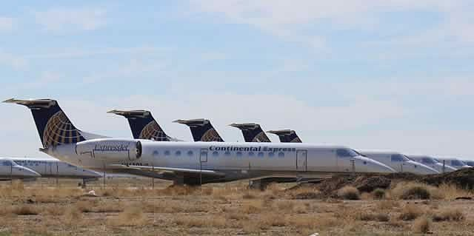
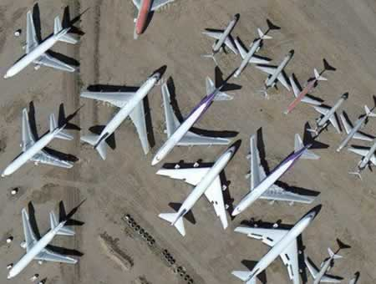
Aircraft Boneyards
Pinal Airpark, Arizona, USA
Kingman Airport, Arizona, USA

Slide 16
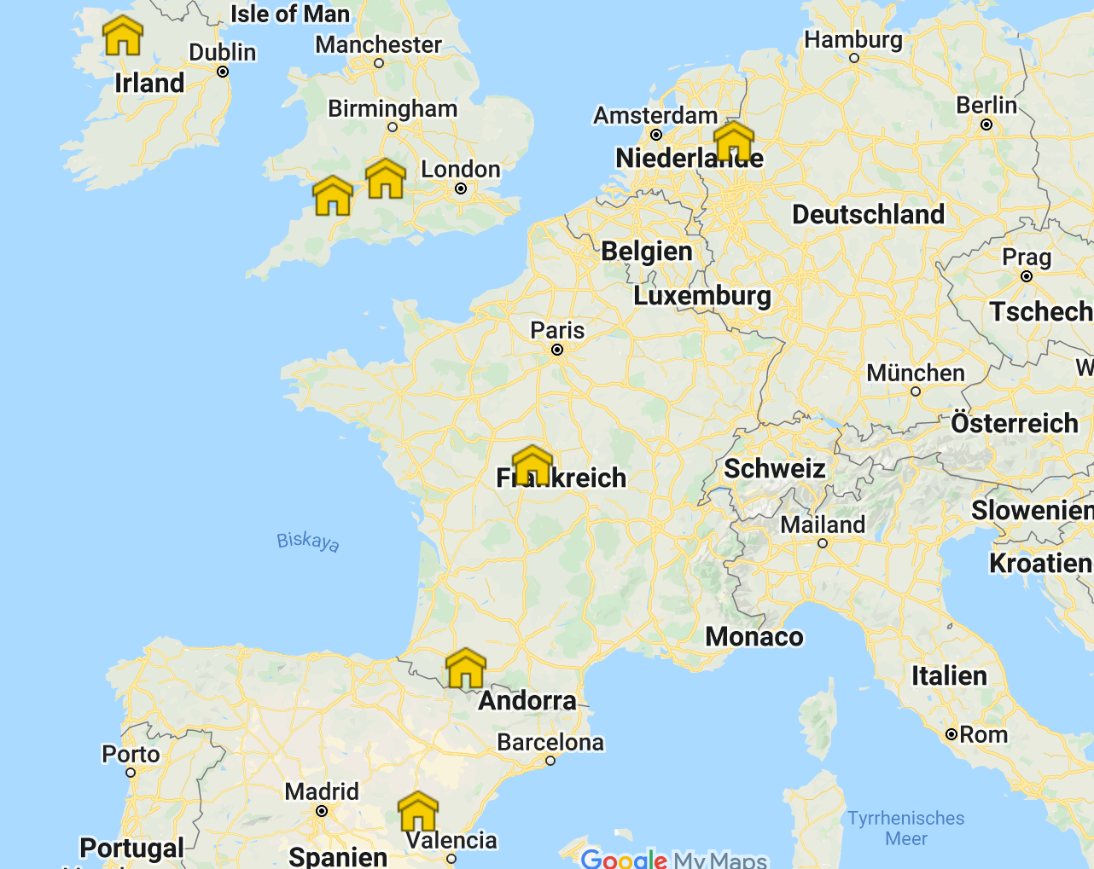
Aircraft Boneyards
Boneyards in Europe

Slide 17
Aircraft Boneyards
Chateauroux, France: British Airways, A380
Bournemouth, UK: Planes from British Airways

Slide 18
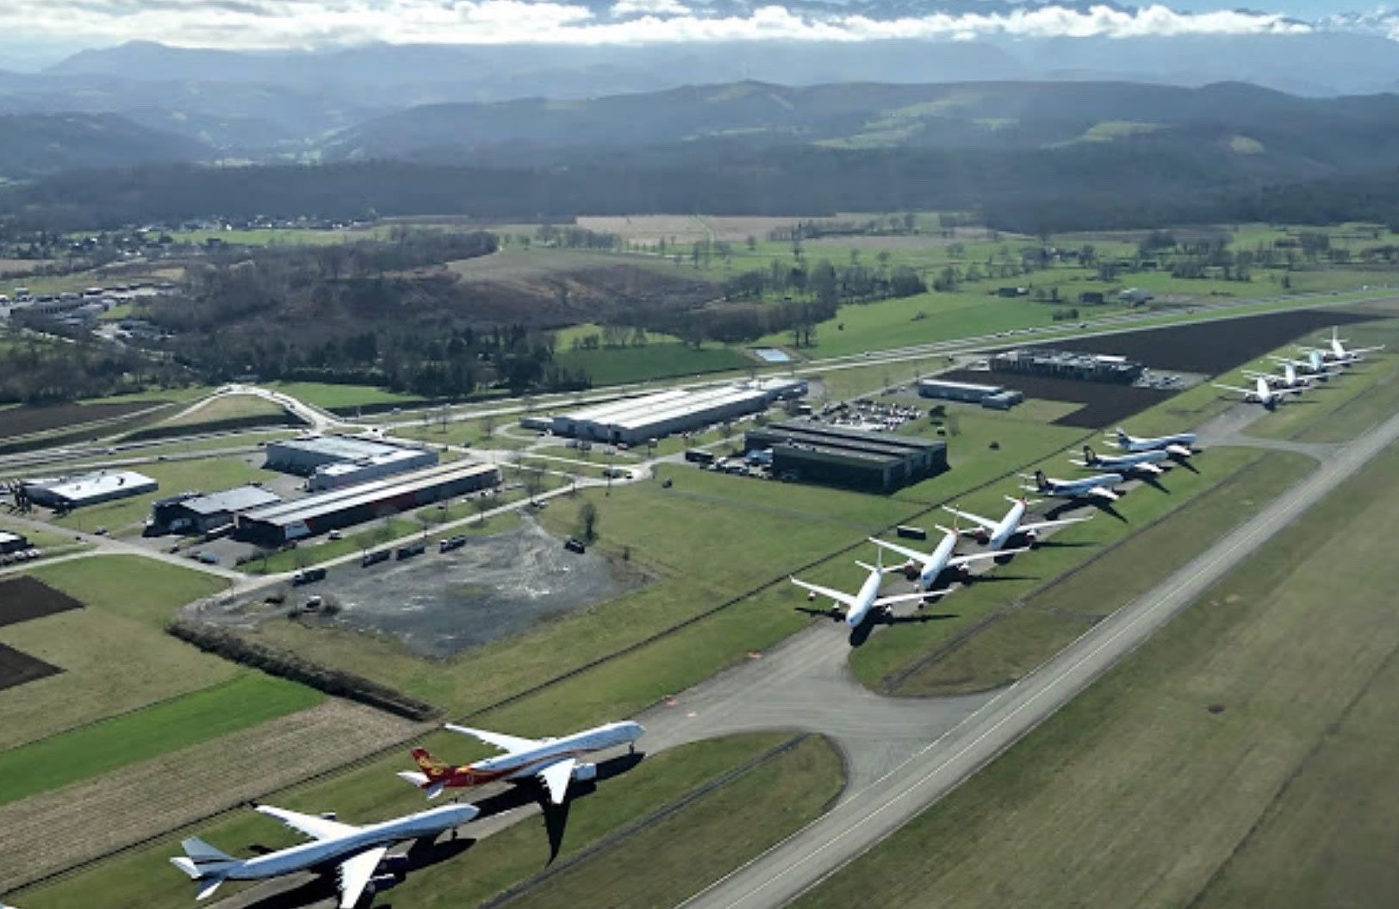
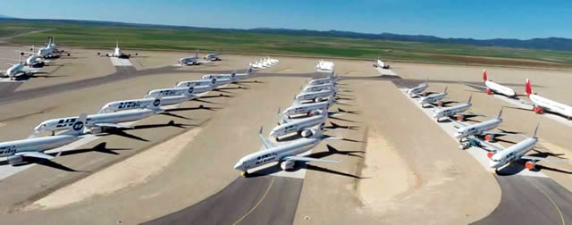
Aircraft Boneyards
Tarbes-Lourdes Pyreness Airport,
France
Tarmac Aerospace,
Teruel Airport, Spain

Slide 19
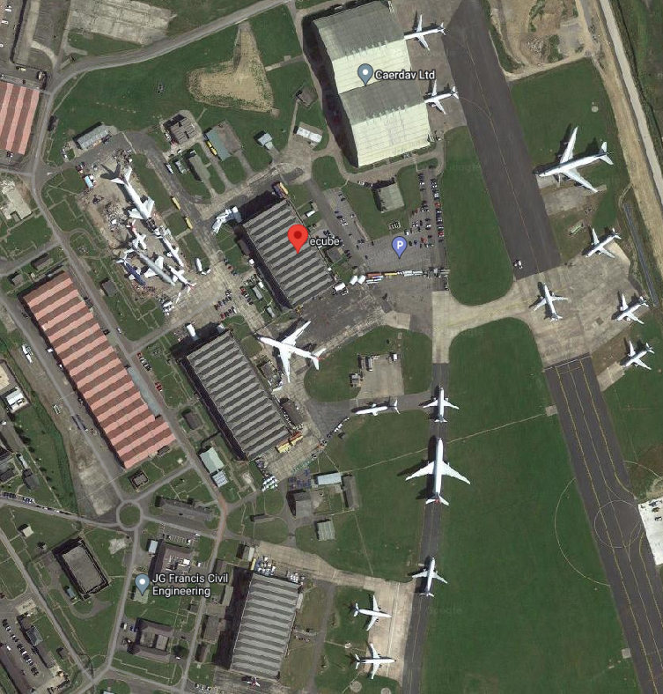
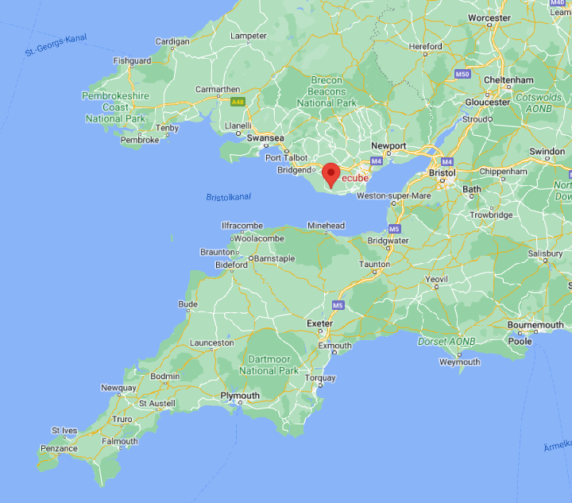
Aircraft Boneyards
eCube Solutions, St. Athan, UK

Slide 20
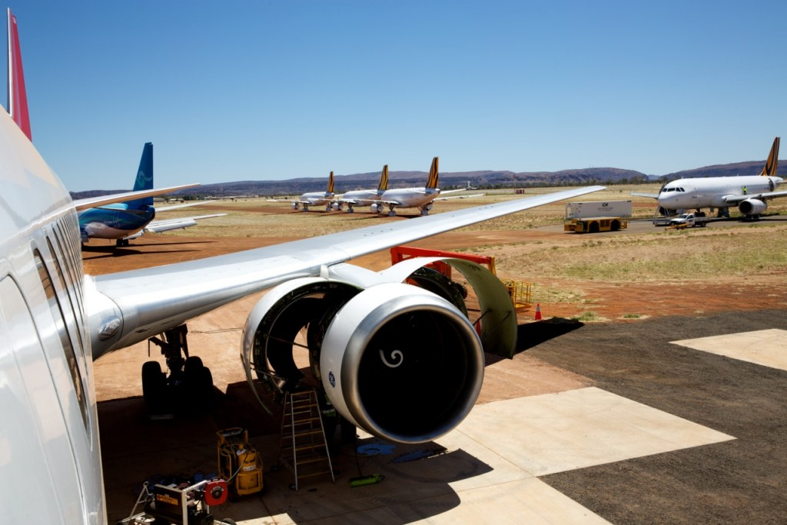
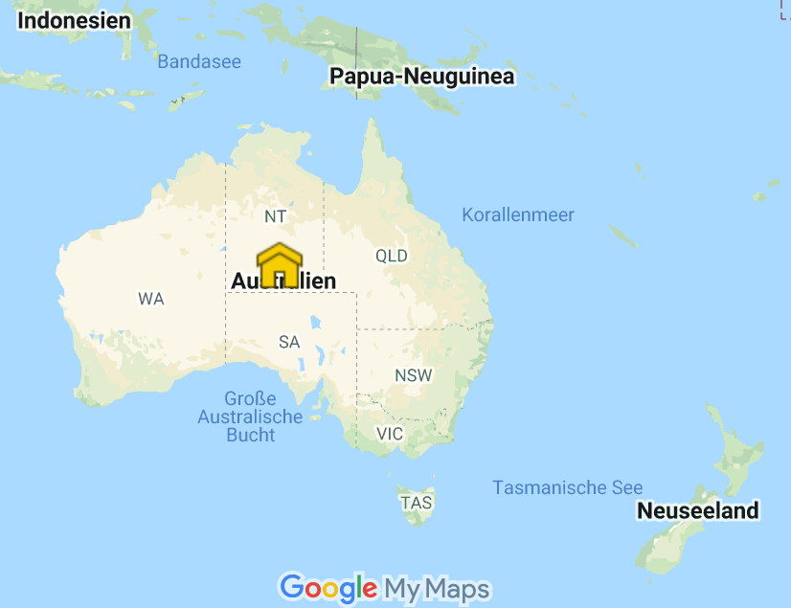
Aircraft Boneyards
Boneyard in Australia
Alice Springs Airport

Slide 21
Recycling

Slide 22
Aircraft End-of-Life: Dismantling
Aircraft end-of-life has become increasingly important over the past two decades.
It is no longer about parking the aircraft forever, but rather about
a temporary storage, followed in the best case by the restart or dismantling.
This procedure avoids the accumulation of more and more aircraft.
The largest operation in Europe is located at Teruel Airport in Spain.
140 aircraft can be accommodated at Teruel Airport.

Slide 23
The Life Cycle of an Aircraft
The life cycle of an aircraft can be divided into basic phases:
development,
production,
operations/maintenance and
end of life.
The life cycle can be analyzed with a life cycle assessment (LCA) according to ISO 14040 and ISO 14044.
The method was extended for use in aircraft (dissertation, Johanning, HAW Hamburg).
Flight operations dominate with more than 99% over the entire life cycle.
This is because flight operations take place every day, but production and end-of-life processes only occur once in an aircraft's lifetime.

Slide 24
The Life Cycle of an Aircraft
This presentation is about the end of life of aircraft – and thus actually about a tiny part of the environmental impact of aircraft.
Nonetheless, the task at hand is gigantic:
Over the next 30 years,
29,000 passenger planes will reach their end-of-life,
no matter how civil aviation continues to grow. That's about 1000 planes a year.

Slide 25
Tasks at End-of-Life
These tasks are pending at the end-of-life:
decommissioning, careful disassembly, and violent dismantling.
After the aircraft has been dismantled, a distinction is made between reuse (recycling) or disposal (disposal) depending on the component or material.
For economic and ecological reasons, we aim to achieve as high a percentage of reuse as possible (recycling rate).
But what cannot be reused must be disposed of:
landfill or incineration (burning).
When it comes to recycling, a distinction is made between
the use of secondary components and secondary raw materials.
Accordingly, a distinction can also be made between
component recycling rate and a material recycling rate.
Aircraft achieve a recycling rate (based on mass) of 60% ... 85%, with more being sought.

Slide 26
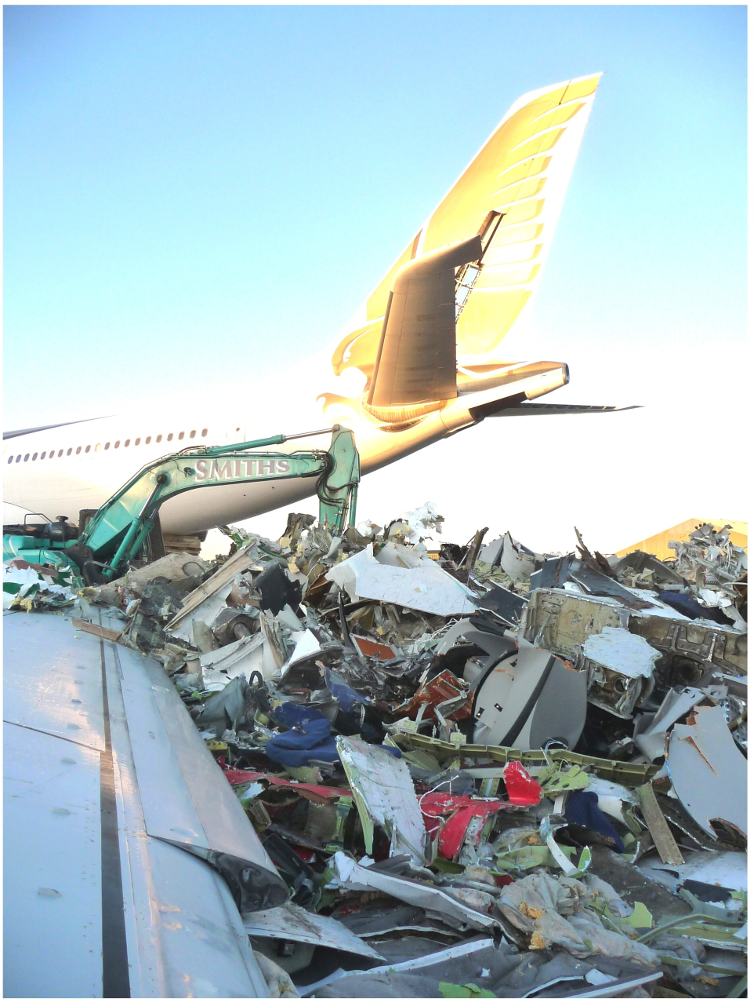
When an aircraft is dismantled by force, a voluminous heap of scrap is initially created. The parts are shredded, separated according to their density and fed into further recycling processes. What is left is disposed of in a landfill.

Slide 27
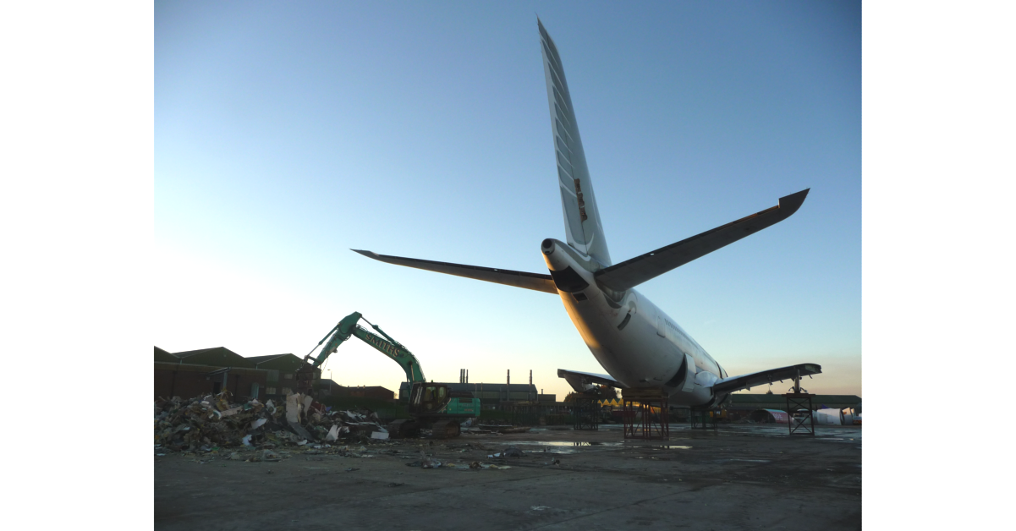
eCube Solutions, St. Athan, UK

Slide 28
Recycled Components
In the case of aircraft, the recycling of components is of great economic importance.
Aircraft components are expensive, so used parts can still fetch high prices.
Certain components on the aircraft are designated as Life-Limited Parts.
These components have a lifespan described in flight hours, cycles, or calendar time.
Proper technical documentation is part of airworthiness and must allow back-to-birth traceability.
The documentation must always show the life status in flight hours, cycles or calendar time.
For used parts from recycling, the functionality results from the fact that they were operated correctly on the last flight or from a quality check.
Recycled components can be
sold with their current life status, or
sold as new after appropriate maintenance.

Slide 29
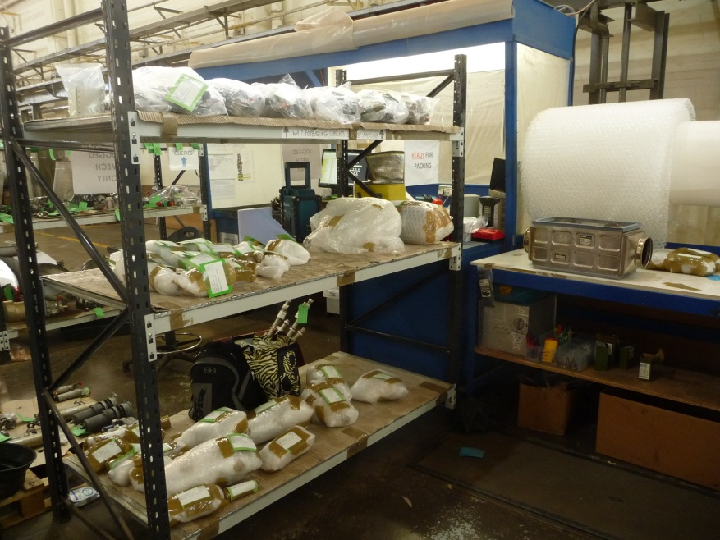
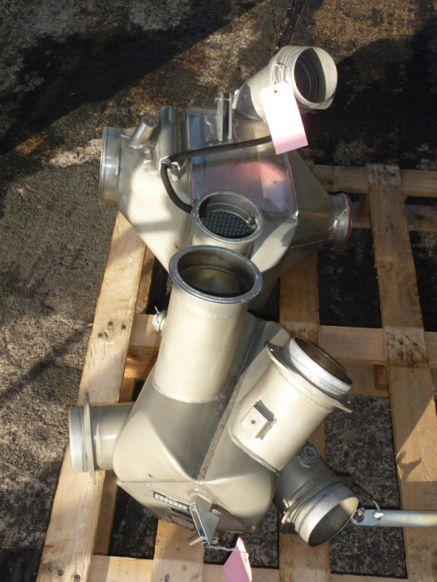
Recycled Components
Aircraft parts are
removed, labeled,
checked for quality,
serviced if necessary
and packaged for sale.

Slide 30
End-of-Life

Slide 31
End-of-Life Does Not Necessarily Have Anything to Do with Age
End-of-life does not necessarily have anything to do with age or overall use of the aircraft.
Irrespective of flight hours and flight cycles, an aircraft becomes obsolete if its operating costs are too high compared to other aircraft, or if there is simply no demand for flights.
Under favorable circumstances, passenger aircraft can be operated economically for around 30 years.
However, the end of an aircraft's life is always determined by an economic consideration.
End-of-life can occur after as little as 13 years, as was recently the case for some Airbus A380 aircraft.
If there is no buyer for the used aircraft, then the only choice left is between further operation or scrapping.
You try to sell the aircraft in individual parts. The engines are the most valuable.
Cargo aircraft have lower usage than passenger aircraft and do not require regular expensive cabin renewal and can therefore be kept in service longer.

Slide 32
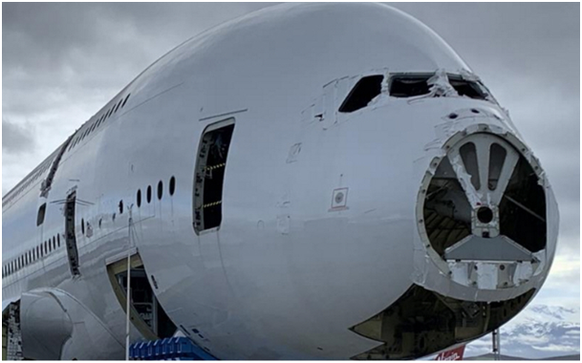
Among the early A380s due to be dismantled is this ex-Singapore Airlines aircraft. It only lived to be 13 years old. Source: Flight Global (2021-11-09)

Slide 33
The End-of-Life often Begins Slowly
An aircraft that has no place on the market today can possibly be used again later.
This is due to fluctuations in supply and demand and changing opportunities to make profits.
An operator will therefore be willing to leave the aircraft idle at low running costs for the ability to reactivate the aircraft if necessary.
A distinction can be made between parking and storage.

Slide 34
Airbus and Boeing Activities

Slide 35
Airbus and Boeing Started Research and Recycling Facilities
The two major civil aircraft manufacturers, Airbus and Boeing, both independently started research projects and recycling test facilities.
Both manufacturers are benefiting from the results of their efforts by being able to incorporate the learnings into the development of their next-generation aircraft.

Slide 36
Airbus started the PAMELA Project
Airbus started the PAMELA (Process for Advanced Management of End-of-Life of Aircraft) project in 2005 in collaboration with
Suez-Sita - a French recycling company - and
the LIFE working group (l'Instrument Financier pours l'Environnement).
In early 2006, an Airbus A300-B2 was completely dismantled and dismantled at Tarbes Airport.
in 2006, it was the world's first demonstration of a complete dismantling of a passenger aircraft.

Slide 37
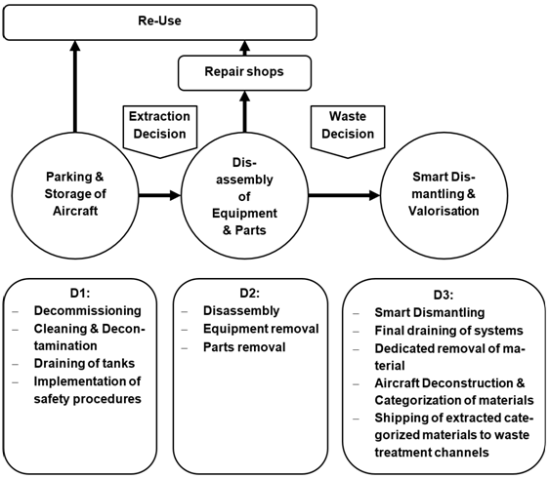
The so-called 3D approach to aircraft dismantling from the PAMELA project

Slide 38
Airbus Founded Tarmac Aerosave
After the PAMELA project, Airbus, together with other companies, founded the Tarbes Advanced Recycling and Maintenance Aircraft Company (Tarmac Aerosave).
A new plant opened in Teruel, Spain in 2013, followed by Toulouse Francazal, France in 2017.
In 2020, Tarmac Aerosave has recycled a total of 170 aircraft since inception.
In addition to Airbus, the two shareholders of Tarmac Aerosave are today
the Safran Group and
Suez.
Around the same time, many other similar companies emerged in Europe.

Slide 39
Boeing Founded the Aircraft Fleet Recycling Association (AFRA)
In April 2006, Boeing founded the Aircraft Fleet Recycling Association (AFRA) in partnership with ten European and American companies.
The founding members come from sectors such as waste management, raw material production, aircraft maintenance and manufacture, parts suppliers and service providers.
They are committed to using their combined know-how, including aircraft scrapping, at the highest technical level.
AFRA is a self-financing non-profit organization whose members work under a certificate with defined processes.
With the collective experience of AFRA members, a guide to "Best Management Practice for Management of Used Aircraft Parts and Assemblies and for Recycling of Aircraft Materials" (BMP) was developed.
For members or companies applying for membership, the BMP document sets out the verifiable standards.

Slide 40
Composite Materials

Slide 41
Challenge: The Increasing use of Composite Materials
A particular challenge is the increasing use of composite materials for which there are still no mature recycling processes.
In 1970, the Boeing 747 still managed almost entirely without composite materials.
Since then, the proportion of composites has increased with each new aircraft type, reaching 50% with the Boeing 787 and Airbus A350.

Slide 42
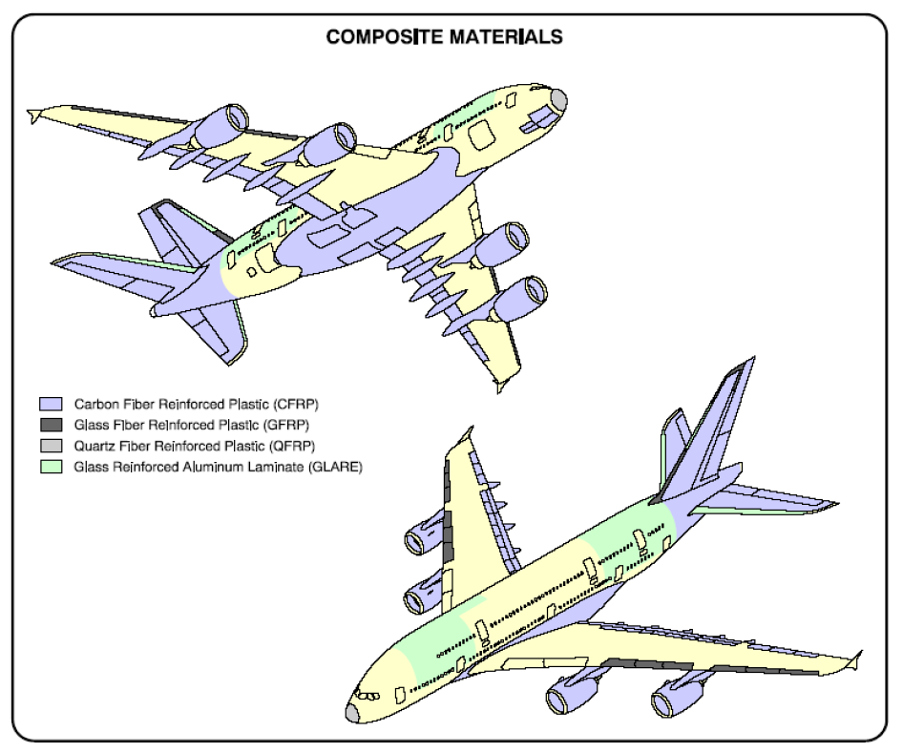

Slide 43
Compound Waste Can Be Processed in Three Ways
Carbon fiber and epoxy are most commonly used in large commercial aircraft.
The composite parts from the aircraft will only be produced in large quantities in 25 years.
This means the problem is still ahead of us.
The compound waste can be processed
mechanically,
thermally or
chemically.

Slide 44
Processing Composite: Thermally
Thermal processes use high temperatures.
First, the parts are mechanically broken down into manageable pieces, which are then fed into a fluidized bed reactor.
The hot air flow decomposes the matrix.
The clean fibers are then separated from the air by a cyclone:
Heavier components such as metallic components are not carried up with the airflow and are therefore separated.
The resin from the matrix is completely oxidized in an afterburner that produces energy.
The resulting fibers have a fluffy shape and a length of up to 10 mm.
So far, it has not been possible to prevent a reduction in tensile strength, but the modulus of elasticity and the surface quality of the recycled fibers are comparable to fresh fibres.
The recycled fibers can only be used in non-oriented fabrics.

Slide 45
Special Reuse

Slide 46
Special Reuse Approaches
In contrast to these common disposal strategies, there are special reuse approaches.
The general idea is to give an aircraft component a second life outside of aviation.
Aircraft fuselages with intact cabin interiors have been used as
apartments,
cafés or
registry offices in the past.
Airbus engineers are pursuing a project to set up an A380 as a luxury hotel in Toulouse. (https://www.projet-envergure.com).

Slide 47
Projet Envergure

Slide 48
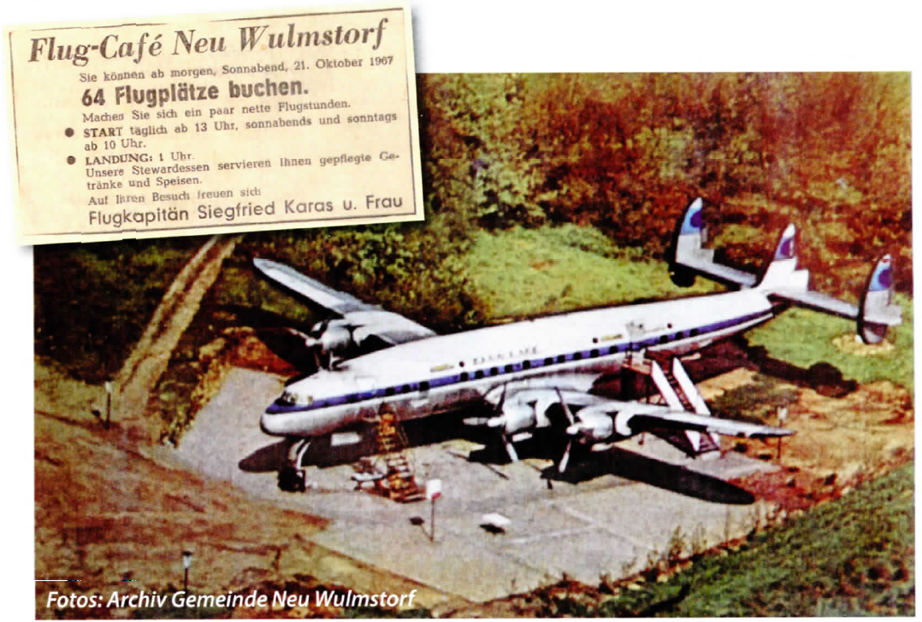
Lufthansa Superconstellation, D-ALOP, 12 years old, 26715 Flight Hours

Slide 49
Summary

Slide 50
Summary (1 of 2)
Passenger Aircraft at End-of-Life
Aircraft Boneyards
USA
Europe
Australia
Recycling
Aircraft End-of-Life: Dismantling
The Life Cycle of an Aircraft
Tasks at End-of-Life
Recycled Components
End-of-Life
End-of-Life Does Not Necessarily Have Anything to Do with Age
The End-of-Life often Begins Slowly

Slide 51
Summary (2 of 2)
Passenger Aircraft at End-of-Life
Airbus and Boeing Activities
Airbus and Boeing Started Research and Recycling Facilities
Airbus started the PAMELA Project
Airbus Founded Tarmac Aerosave
Boeing Founded the Aircraft Fleet Recycling Association (AFRA)
Composite Materials
Challenge: The Increasing use of Composite Materials
Compound Waste Can Be Processed in Three Ways
Processing Composite: Thermally
Special Reuse
Projet Envergure
Café Superconstellation

Slide 52
Passenger Aircraft at End-of-Life
Contact
info@ProfScholz.de
http://www.ProfScholz.de
Quote this document:
SCHOLZ, Dieter, 2022. Passenger Aircraft at End-of-Life.
Hamburg Aerospace Lecture Series, Online, 02.06.2022.
Available from: https://doi.org/10.5281/zenodo.xxxxxxx
© Copyright by Author, CC BY-NC-SA, https://creativecommons.org/licenses/by-nc-sa/4.0

